Slide 1
Mathematics Standards and
Model Curriculum
Targeted Professional Development Webinar
Brian Roget
Ann Carlson
2/24/2012
Notes:
(Prior to the presentation, personalize this screen by entering your name and the date)
(Welcome - Introduce yourself and guests)
(Participants’ introductions: name, district, grade)

Slide 2
Targeted Professional Development Meetings
Goal:
To provide opportunities for Ohio educators to develop an understanding of the revised standards and model curricula in all four content areas: English language arts, mathematics, science and social studies
Notes:
(Read slide aloud)

Slide 3

Overview
A Look Inside the CCSSM
  K- 8
  High School
Digging Deeper
Model Curriculum
Progressions
Resources
Making the Transition
Notes:
Take a quick look at an overview of this Targeted Professional Development Meeting.

Slide 4
Change always comes bearing gifts.
  ~Price Pritchett
  Continuity gives us roots;
    Change gives us branches,
    letting us stretch and grow and reach new heights.
    ~ Pauline R. Kezer
Notes:
(Say) Think about change. (Give time for them to read them.)
(Say) Change is difficult, but the results are worth the effort.

Slide 5
Shifts in Mathematics
Greater Focus
  Identifies key ideas, understandings and skills for each grade or course
  Stresses deep learning, which means applying concepts and skills within the same grade or course
More coherence
  Progressions of learning within and across grades
  Concepts and skills that are developed over a defined period of time
Notes:
The Common Core State Standards for Mathematics were developed to accomplish focus and coherence.
Focus refers to identifying the key mathematical ideas, understandings and skills for each grade. Deep learning of fewer ideas begins to address the US problem of a mathematics curriculum that is historically a mile wide and an inch deep. Students are expected to apply their current learnings in mathematical and/pr contextual situations, not wait to find the relevance in another grade.
Coherence refers to the progression of learning across the grades and the connections within mathematics and to other content areas.

Slide 6

A Look Inside the CCSS for Mathematics
Notes:
(Say)
The CCSSM is a response to the need for improved mathematical achievement, a competitive workforce in a global economy, and a desire to have common mathematical standards across the United States. The nation’s governors sanctioned the writing of the CCSSM. Three central writers were charged with the responsibility: William McCallum, Jason Zimba, and Phil Daro. In Ohio, Brad Findell formerly with ODE, participated on the writing team. Through his leadership, Ohio educators were accessed for input throughout the writing process. Ohio continues to be out front creating support documents and participating on national committees, leading the way in the transition to the CCSSM.

Slide 7
CCSS Mathematical Practices
Make sense of problems and persevere in solving them
Reason abstractly and quantitatively
Construct viable arguments and critique the reasoning of others
Model with mathematics
Use appropriate tools strategically
Attend to precision
Look for and make use of structure
Look for and express regularity in repeated reasoning
Notes:
(Say)
The Standards for Mathematical Practice are standards describing what students should be doing. Instruction should be organized and presented in such a manner that students are developing these practices. All Mathematical Practices are not of equal importance at all grades, nor valid for every standard.
The ‘mathematical practices’ embrace the goals of 21st Century skills and literacy. It is through orchestrated, intentional, experiences reading, writing, talking, listening and reasoning mathematically that students will develop the mathematical habits of mind allowing them to connect mathematics to daily life and career situations.

Slide 8
Reading Literacy Standards
Grades 6-8
Notes:
(Say)
Contained within the Common Core State Standards for ELA is a section on Literacy for Science, Social Studies, and other Technical subjects. Mathematics is considered a technical subject. Therefore, Mathematics teachers of grades 6-12 are responsible for the 10 reading and 10 writing literacy standards. Once again, these standards are found on pages 62-66 of the Common Core State Standards for ELA.

Slide 9
What does literacy look like in the mathematics classroom?
Learning to read mathematical text
Communicating using correct mathematical terminology
Reading, discussing and applying the mathematics found in literature
Researching mathematics topics or related problems
Reading appropriate text providing explanations for mathematical concepts, reasoning or procedures
Applying readings as citing for mathematical reasoning
Listening and critiquing peer explanations
Justifying orally and in writing mathematical reasoning
Representing and interpreting data
Notes:
(Say)
A few of the examples of what students should be seen doing that represent literacy skills being employed in the mathematics classroom are:
Learning to read mathematical text including textbooks, articles, problems, problem explanations
Communicating using correct mathematical terminology appropriate to the student’s mathematical development
Reading, discussing and applying the mathematics found in literature, including looking at the author’s purpose
Researching mathematics topics or related problems
Reading appropriate text providing explanations for mathematical concepts, reasoning or procedures
Applying readings as citing for mathematical reasoning – using information found in texts to support their reasoning; developing works cited documents for research done to solve a problem
Listening and critiquing peer explanations of their reasoning
Justifying orally and in writing reasoning
Representing and interpreting data with and without technology
Using the Literacy standards as an adjunct to the Standards for Mathematical Practice will further students’ mathematical proficiency.

Slide 10
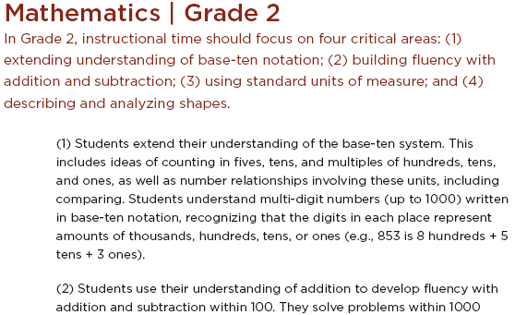
Grade Level Introduction
Cross-cutting themes
Critical Area of Focus
Notes:
(This slide is animated. Say)
Each grade in K-8 begins with an Introduction.
These introductions identify the critical areas, which cut across topics, in the grade
The numbered description of each critical area illustrates the focus for the learning.

Slide 11
Grade Level Overview
Grade 4 Overview
Operations and Algebraic Thinking
  Use the four operations with whole numbers to solve problems.
  Gain familiarity with factors and multiples.
  Generate and analyze patterns.
Number and Operations in Base Ten
  Generalize place value understanding for multi-digit whole numbers.
  Use place value understanding and properties of operations to perform multi-digit arithmetic.
Number and Operations—Fractions
  Extend understanding of fraction equivalence and ordering.
  Build fractions from unit fractions by applying and extending previous understandings of operations on whole numbers.
  Understand decimal notation for fractions, and compare decimal fractions.
Measurement and Data
  Solve problems involving measurement and conversion of measurements from a larger unit to a smaller unit.
  Represent and interpret data.
  Geometric measurement: understand concepts of angle and measure angles.
Geometry
  Draw and identify lines and angles, and classify shapes by properties of their lines and angles.
Mathematical Practices
Make sense of problems and persevere in solving them
Reason abstractly and quantitatively
Construct viable arguments and critique the reasoning of others
Model with mathematics
Use appropriate tools strategically
Attend to precision
Look for and make use of structure
Look for and express regularity in repeated reasoning
Notes:
(Say)
The second page of each grade is an Overview. It identifies the domains and clusters in that grade also reminding readers of the mathematical practices.

Slide 12
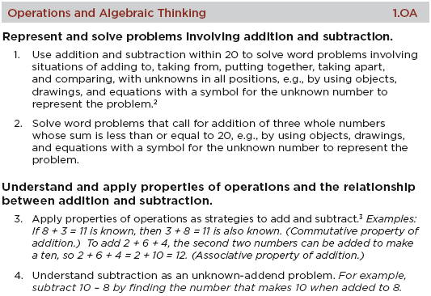
Format of K-8 Standards
Grade Level
Domain
Standard
Cluster
Notes:
(This slide is animated. Say)
Each K-8 grade is made up of domains, clusters and standards.
Domain names are in the shaded band; overarching ideas that continue across multiple grades; illustrates a progression of increasing complexity
Clusters are underneath in bold with the standards numbered under each of the clusters; describes the big idea of a group of related standards
Standards are numbered and describe what students should know and be able to do at each grade level

Slide 13
Change of Emphasis K- Grade 5
K-2
Greater development of how numbers work
Data analysis is just a tool for working with numbers and shapes
Grades 3-5
Fractions then decimals
Multiplication with inverse division
Operation strategies and relationships developed BEFORE algorithm procedures
Notes:
(Say)
The CCSSM changes the emphasis of the learning from what we have been used to.
(Read the slide)

Slide 14
Change of Emphasis Grades 6-8
Beginning of Data Analysis and Probability
Introduction of Integers,
Coordinate Graphing
Focus on Linear Algebra: numerically, graphically and symbolically
Completion of Operations with fractions and decimals
Notes:
(Read the slide)

Slide 15

CCSS for High School Mathematics
Organized in “Conceptual Categories”
  Number and Quantity
  Algebra
  Functions
  Modeling
  Geometry
  Statistics and Probability
Conceptual categories are not courses
Additional mathematics for advanced courses indicated by (+)
Standards with connections to modeling indicated by (★)
Notes:
(Say)
High school has an added level in the hierarchy – the Conceptual Category. These Conceptual Categories are: Number and Quantity, Algebra, Functions, Geometry, Statistics and Probability and Modeling. Modeling actually does not have Standards; it is embedded within the other Conceptual Categories. Standards connected to Modeling are indicated by asterisks. Conceptual Categories are not courses. Standards marked with a plus sign are standards that are necessary for advanced mathematics. This means that any student who intends to pursue advanced mathematics needs these experiences.

Slide 16
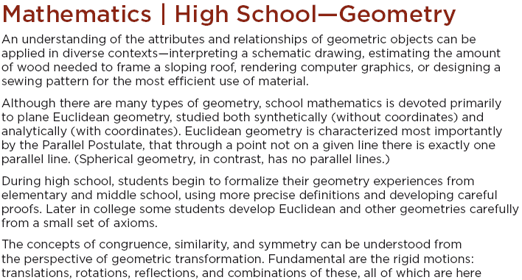
Conceptual Category Introduction
Notes:
(Say)
Like the K-8 grade level introduction, the Conceptual Category Introduction describes the mathematics within the Conceptual Category and places that mathematics within the K-16 perspective.

Slide 17
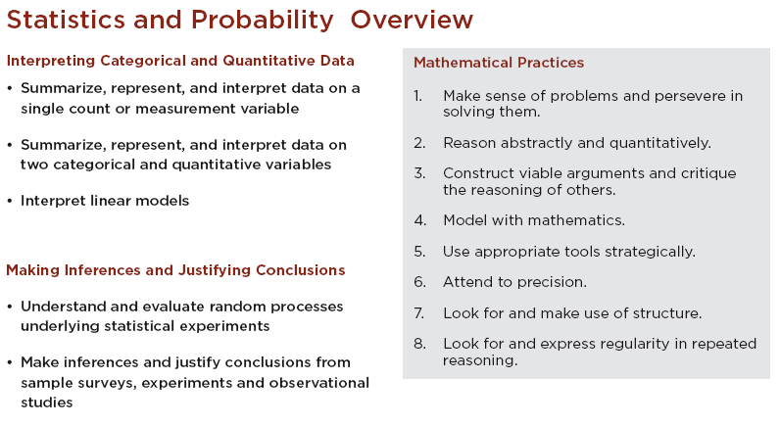
Conceptual Category Overview
Domain
Cluster
Notes:
(This slide is animated. Say)
The Conceptual Category Overview serves as an outline of the conceptual category, (click) listing the domains with their clusters, (click) and reminding readers of the mathematical practices.

Slide 18
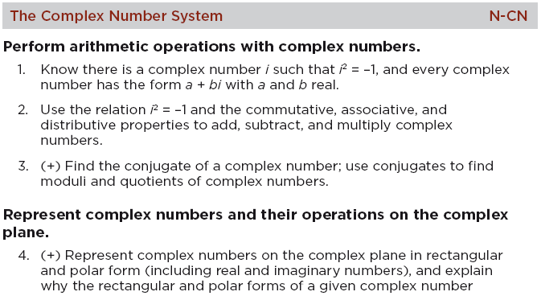
Format of High School Standards
Domain
Cluster
Standard
Advanced
Notes:
(This slide is animated. Say)
Within each Conceptual Category the structure parallels K-8. (Click) there are Domains or big ideas. (Click) The bolded statements are the Clusters. (Click) The Standards are numbered and further describe the Cluster. (Click) An added element is the (+) standards which identify standards that are needed for advanced study. They are not intended to be required for all students.

Slide 19
HS CCSS: Changing Content
Emphases
Number and Quantity
  Number systems, attention to units
Modeling
  Threaded throughout the standards
Geometry
  Proof for all, based on transformations
Algebra and Functions
  Organized by mathematical practices
Statistics and Probability
  Inference for all, based on simulation
Notes:
(Read the slide)

Slide 20

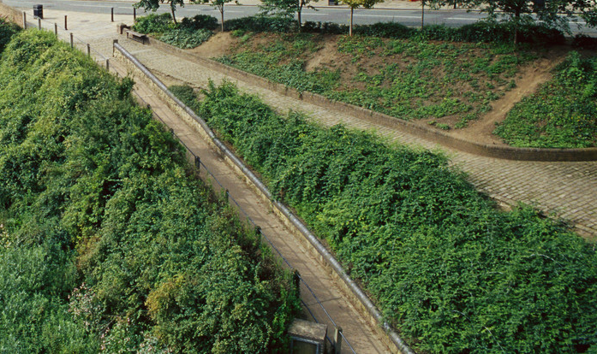
A Look Inside the Model Pathways
Notes:
(Say)
A separate group of writers through Achieve took on the challenge of modeling ways that the Common Core could be formatted into courses. Two examples were created called The Model Pathways.

Slide 21
High School Mathematical Pathways
Typical in U.S.
Two main pathways:
  Traditional: Two algebra courses and a geometry course, with statistics and probability in each
  Integrated: Three courses, each of which includes algebra, geometry, statistics, and probability
Both pathways:
  Complete the Common Core in the third year
  Include the same “critical areas”
  Require rethinking high school mathematics
  Prepare students for a menu of fourth-year courses
Typical outside U.S.
Notes:
(This slide is animated. Say)
An Achieve committee organized the high school standards into course sequences.
(Allow time for all to read the slide)

Slide 22
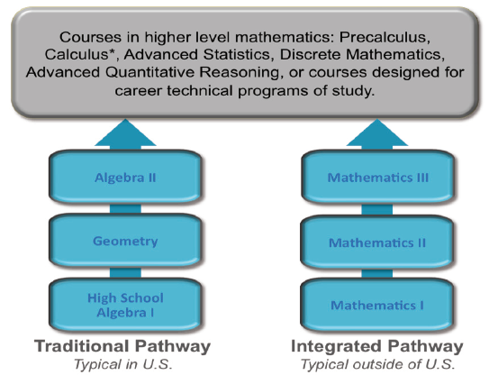
Two Main Pathways
Notes:
(Say) [This is a picture limiting the editing of the slide colors.]
Each Pathway prepares students for a menu of fourth-year courses such as:
Pre-calculus (or AP Calculus)
AP Statistics
Discrete Mathematics
Advanced Quantitative Reasoning
And courses designed for particular career technical pathways

Slide 23
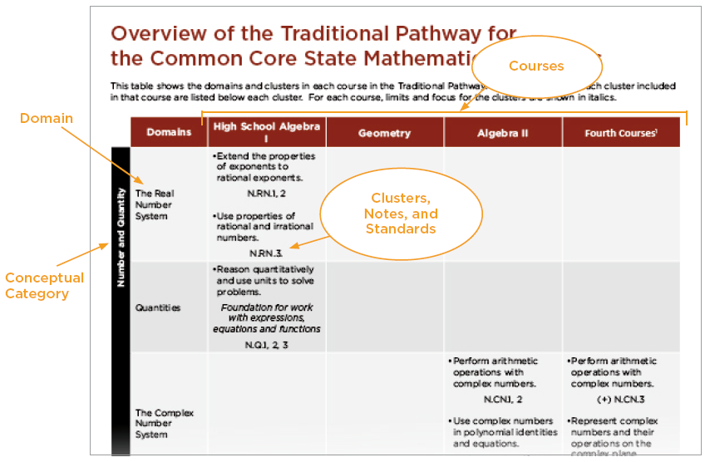
Pathway Overview
Notes:
(Say)
Each of the Pathways has an overview that details the content addressed in each course. The columns represent each course with the related domains, clusters and standards.

Slide 24
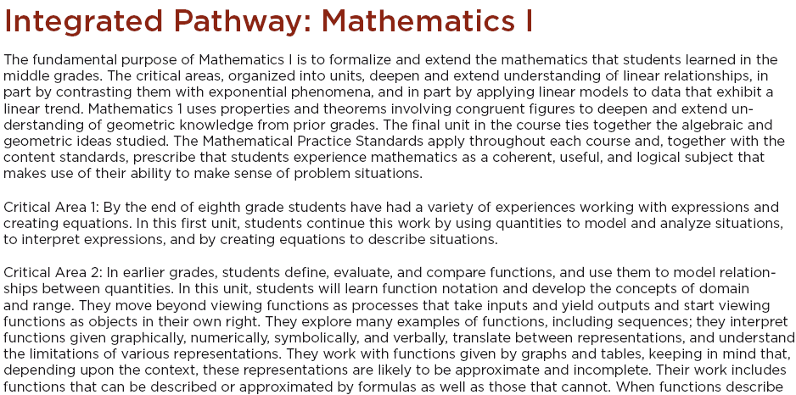
Course Overview: Critical Areas (units)
Notes:
(Say)
The critical areas are fleshed out as the units within each course. The overview By the end of the third course in each pathway, all of the critical areas have been addressed.

Slide 25
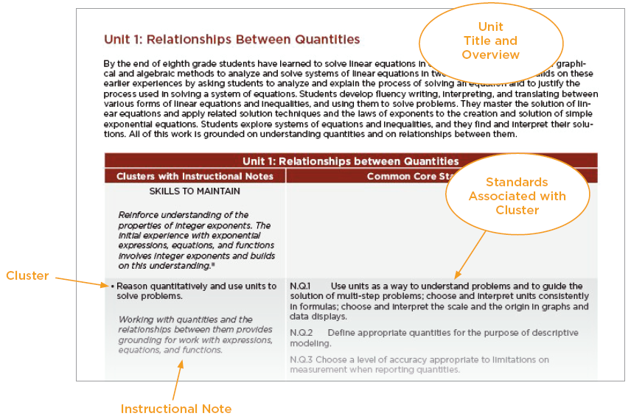
Course Detail by Unit (critical area)
Notes:
(Say)
Unit details are elaborated with the addition of unit overviews containing instructional notes. These notes are seen in italics and further clarify the related clusters and standards.

Slide 26

Digging Deeper into the CCSS
Notes:
(Say)
Time to dig deeper into the Standards!
In this next section of our time together, we have activities planned to assist in getting to know the standards better. Time only allows us the opportunity to model ways in which to delve into the standards. Concentrated time either individually or with colleagues following this meeting will be needed to really get a grasp on the meaning and impact of the Common Core.

Slide 27
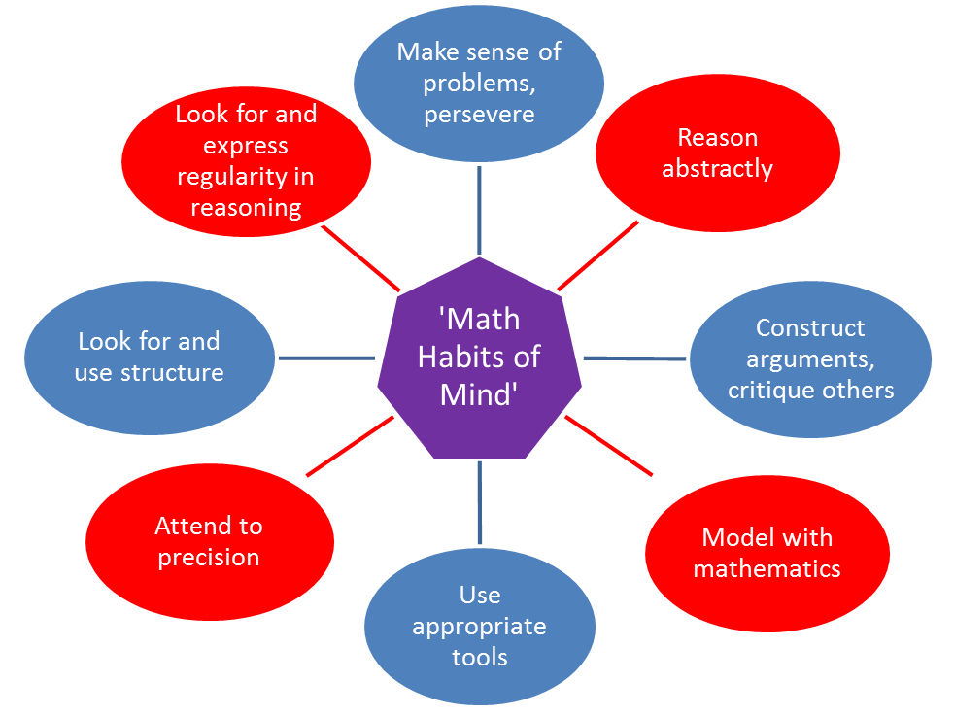
Standards for Mathematical Practice
Mathematical ‘Habits of Mind’
Notes:
(Say) What should a mathematically proficient student be able to do?
With a rich understanding of the mathematical content, students will be able to: “consider analogous problems, represent problems coherently, justify conclusions, apply the mathematics to practical situations, use technology mindfully to work with the mathematics, explain the mathematics accurately to other students, step back for an overview, or deviate from a known procedure to find a shortcut”.
In essence, engage in important processes and proficiencies that have been identified in the CCSS as the Standards of Mathematical Practice.
The ‘mathematical practices’ embrace the goals of 21st Century skills and literacy. It is through orchestrated, intentional, experiences reading, writing, talking, listening and reasoning mathematically that students will develop the mathematical habits of mind allowing them to connect mathematics to daily life and career situations.
It is our responsibility as educators to present these opportunities for students.
Our first activity will utilize the Standards for Mathematical Practice. A reminder that the Standards for Mathematical Practice are descriptors for what students should be doing. They include the mathematical processes: representation, reasoning and proof, communication, problem solving, and connections, along with adaptive reasoning, strategic competence, conceptual understanding, procedural fluency and productive disposition from Adding It Up.

Slide 28

Activity 1a:
Standards for Mathematical Practice
Read the assigned Standard for Mathematical Practice
Think – Write – Pair – Share
  What is the meaning of the practice?
  How will the practice look at my grade level?
Group Sharing
Notes:
(Have participants sit in groups by grade levels)(Say)
The mathematical practices are on pages 6 – 8 of the CCSS Mathematics document. (Read the bolded statements of each of the eight Standards for Mathematical Practice.)
(Assign each group a Mathematical Practice to analyze.)
(Say) Read your assigned mathematical practice. In pairs and then in your grade level group answer the questions: What is the meaning of the practice? How will the practice look at my grade level?
(Note: other ways to state this question for clarification. How might the mathematical practices be integrated into the content at your grade? Or What clusters and standards lend themselves to the mathematical practices? – According to the CCSS, the clusters and standards that contain the word understand are often especially good opportunities to connect the practices to the content.)
(Give time to work)
(After 10-15 minutes, call the group back together to share their thoughts on each question. Be sure each group gets to report out.)
(Say) A final thought. What professional development will be required for teachers to effectively integrate the Standards for Mathematical Practices within the content standards?

Slide 29
Activity 1b:
Standards for Mathematical Practice
Read the assigned Standards for Mathematical Practice
Discuss practice meaning:
  What would students do?
  What would students say?
  What would teachers do?
  What would teachers say?
Group Sharing
Notes:
Getting to Know the Mathematical Practices (Have participants sit in groups by grade levels)(Say)
The mathematical practices are on pages 6 – 8 of the CCSS Mathematics document. (A 2-page document of the Standards for Mathematical Practice can be found on the ODE webpage.) (Read the bolded statements of each of the eight Standards for Mathematical Practice. )
(Assign each group two Mathematical Practices to analyze. Materials: chart paper and markers for each group)
(Say) Read your assigned mathematical practice. In pairs and then in your grade level group answer the questions: What is the meaning of the practice? How will the practice look at my grade level?
(Note: other ways to state this question for clarification. How might the mathematical practices be integrated into the content at your grade? Or What clusters and standards lend themselves to the mathematical practices? – According to the CCSS, the clusters and standards that contain the word understand are often especially good opportunities to connect the practices to the content.)
(Give time to work)
(After 10-15 minutes, call the group back together to share their thoughts on each question. Be sure each group gets to report out.)
(Say) A final thought. What professional development will be required for teachers to effectively integrate the Standards for Mathematical Practices within the content standards?

Slide 30
MP + CAF + Standards = Instruction
In order to design instruction that meets the rigor and expectations of the CCSSM, understanding the Mathematical Practices and Critical Areas (of Focus) are essential.
Notes:
(Read the equation) The addition of the Mathematical Practices and the Critical Areas of Focus to the content standards leads to higher instruction – in other words, having a strong working understanding of the mathematical practices and the critical areas of focus will lead to more rigorous instruction.

Slide 31

Critical Areas of Focus
Critical Areas of Focus inform instruction by describing the mathematical connections and relationships students develop in the progression at this point.
Notes:
(Say) Once again, critical areas of focus inform instruction by describing the mathematical connections and relationships students develop in the progression at this point.
Where are the Critical Areas of Focus found? (on the Introduction page of each grade level or course)
Understanding of the Critical Areas of Focus is essential in developing the context of the big picture of what students should know and be able to do. They more fully describe the breadth and depth of the learning at this point.

Slide 32
Concepts, Skills and Procedures
Concepts
    Big ideas
    Understandings or meanings
    Strategies
    Relationships
    Understanding concepts underlies the development and usage of skills and procedures and leads to connections and transfer.
Skills and Procedures
Rules
Routines
Algorithms
Skills and procedures evolve from the understanding and usage of concepts.
Notes:
(This is an animated slide. Say)
What are concepts? (Wait for responses.)
(Click to show the bullets.)
A concept represents a big idea, understandings, or strategies in which relationships of key elements are developed. When these understandings are developed they evolve into efficient and effective procedures.
What are skill and procedures? (Wait for responses.)
(Click to show the bullets.)
Skills and procedures are rules, routines or processes.
The Common Core treats concepts, and skills and procedures equally. The expectation is that students develop understanding of concepts first. Over time and through usage, fluency with skills and procedures will develop.
The CCSSM content standards follow a pattern of one year developing understanding and in a subsequent year expecting the use of the skills and procedures. The first year students solve problems by employing strategies and the next year they utilize the efficient procedures or algorithms.

Slide 33
Concepts, Skills and Procedures
Understand ratio concepts and use ratio reasoning to solve problems.
Understand the concept of a ratio and use ratio language to describe a ratio relationship between two quantities.
Understand the concept of a unit rate a/b associated with a ratio a:b with b ≠ 0, and use rate language in the context of a ratio relationship.
Use ratio and rate reasoning to solve real-world and mathematical problems, e.g., by reasoning about tables of equivalent ratios, tape diagrams, double number line diagrams, or equations.
  Make tables of equivalent ratios relating quantities with whole-number measurements, find missing values in the tables, and plot the pairs of values on the coordinate plane. Use tables to compare ratios.
  Solve unit rate problems including those involving unit pricing and constant speed.
  Find a percent of a quantity as a rate per 100 (e.g., 30% of a quantity means 30/100 times the quantity); solve problems involving finding the whole, given a part and the percent.
  Use ratio reasoning to convert measurement units; manipulate and transform units appropriately when multiplying or dividing quantities.
Notes:
(Say) Take a look at this slide from the Common Core State Standards. What would you classify as concepts, (in red) skills and procedures (in blue) ?
(wait long enough for them to read and decide, then say)
Check your thoughts with this slide. (click)
Replicating these slides for particular grades/grade bands will help illustrate the distinction in concepts and skills/procedures.

Slide 34
Concepts, Skills and Procedures
Understand ratio concepts and use ratio reasoning to solve problems.
Understand the concept of a ratio and use ratio language to describe a ratio relationship between two quantities.
Understand the concept of a unit rate a/b associated with a ratio a:b with b ≠ 0, and use rate language in the context of a ratio relationship.
Use ratio and rate reasoning to solve real-world and mathematical problems, e.g., by reasoning about tables of equivalent ratios, tape diagrams, double number line diagrams, or equations.
  Make tables of equivalent ratios relating quantities with whole-number measurements, find missing values in the tables, and plot the pairs of values on the coordinate plane. Use tables to compare ratios.
  Solve unit rate problems including those involving unit pricing and constant speed.
  Find a percent of a quantity as a rate per 100 (e.g., 30% of a quantity means 30/100 times the quantity); solve problems involving finding the whole, given a part and the percent.
  Use ratio reasoning to convert measurement units; manipulate and transform units appropriately when multiplying or dividing quantities.
Notes:
(Say) Comments? (Handle any questions or comments.)
#1, 2, 3 and d are concepts (red ). They require foundational understanding or reasoning
A, b, c are blue and describe specific skill or procedures to be followed

Slide 35

Activity 2:
K-8 Critical Areas of Focus
HS Critical Areas
Read a K-8 grade level’s Critical Areas of Focus or HS Critical Area
  What are the concepts?
  What are the skills and procedures?
  What relationships are students to make?
Notes:
(this slide is for introduction of the activity)
(Say)
Our second activity involves getting to know the HS Critical Areas or the K-8 Critical Areas of Focus.
Choose a grade in K-8 or High School Algebra 1 or Math 1. (You may tailor the grade selections to match your audience.)
The Critical Areas of Focus are on the Introduction page of each grade in K-8, or on the introduction page of the HS course in the Pathways. Locate your selected grade or course.
You will be looking for the concepts, skills and procedures, and the relationships that students are to make.
Before we move on. Let’s clarify the difference between a concept and a skill/procedure.

Slide 36
Activity 2
Critical Areas
Read the grade level Critical Areas of Focus or HS Critical Areas
  What are the concepts?
  What are the procedures and skills?
  What relationships are students to make?
Look at the domains, clusters and standards for the same grade(s) or High School Course
How do the Critical Areas inform their instruction?
Notes:
(This animated slide repeats the directions so that you do not have to go back to the previous slide to have the task displayed during work time. The second bullet will show on a second mouse click. Say)
After your group finishes analyzing the critical area, look at the domains, clusters and standards that address that critical area, answer the question “How does the Critical Area of Focus inform their instruction?
(If time permits, you may have groups report out. You may have them do more than one Critical Area, also.)

Slide 37

Model
Curriculum
Notes:
(Say)
The Model Curriculum has been written in Ohio by Ohio educators to support the use of the Common Core State Standards for Mathematics. Right now the Model Curriculum is posted on the Mathematics web page. In time, this will be an interactive document. It is also a document that will grow and change over time. Once “live” there will be opportunities for educators to submit requests for modifications or to make comments.

Slide 38
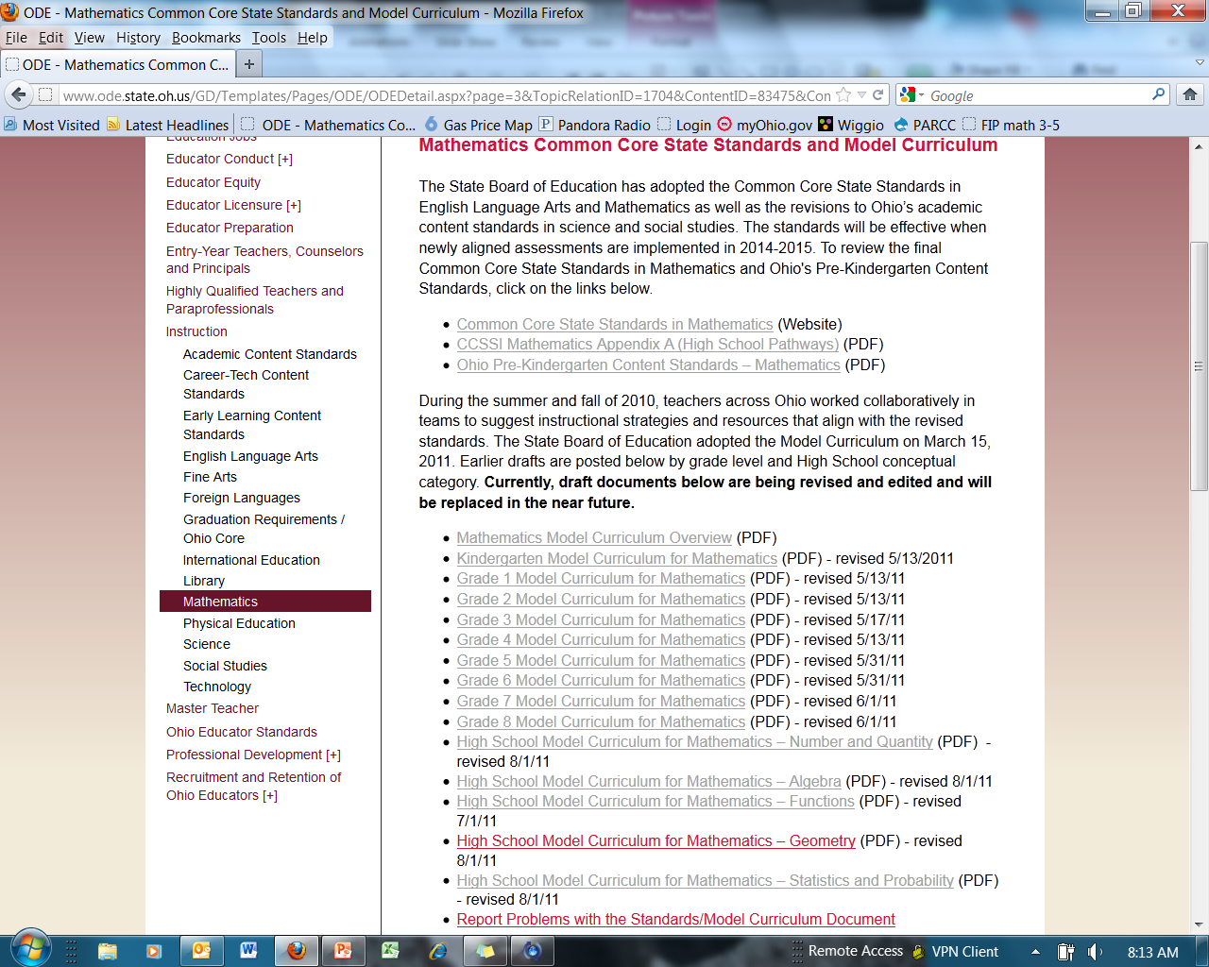
Notes:
(Say)
This is how the ODE webpage looks for the Common Core and Model Curriculum

Slide 39
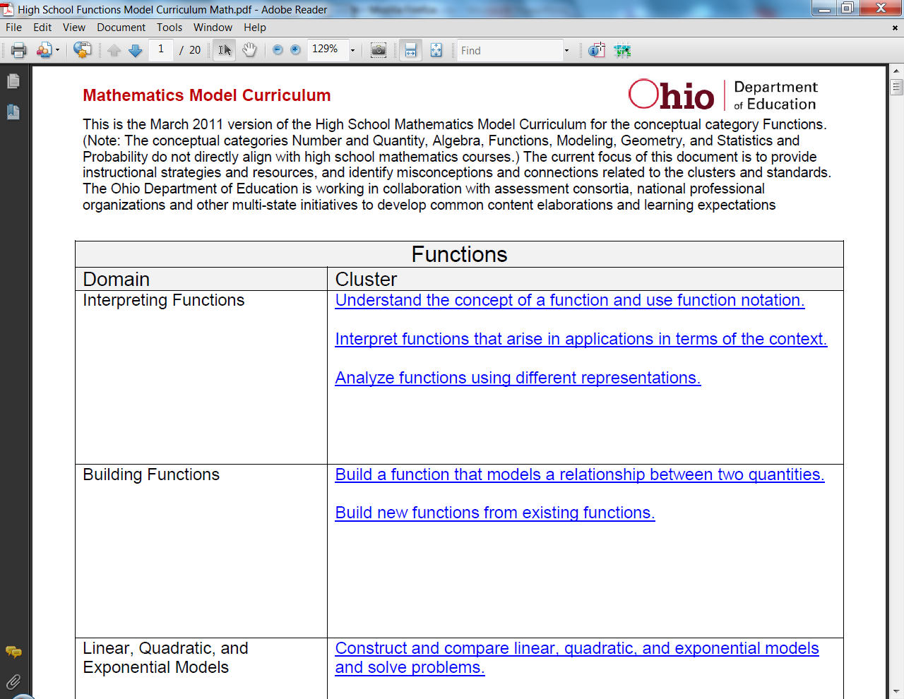
Model Curriculum
Notes:
(Say)
Each grade and high school conceptual category has its own Model Curriculum document. The format is the same for all documents. The Clusters for each Domain are listed as links on the first page. Clicking on the link will take you to that part of the document. If you were to click on the first cluster under Building functions, the page would look like this: (click to next slide)

Slide 40
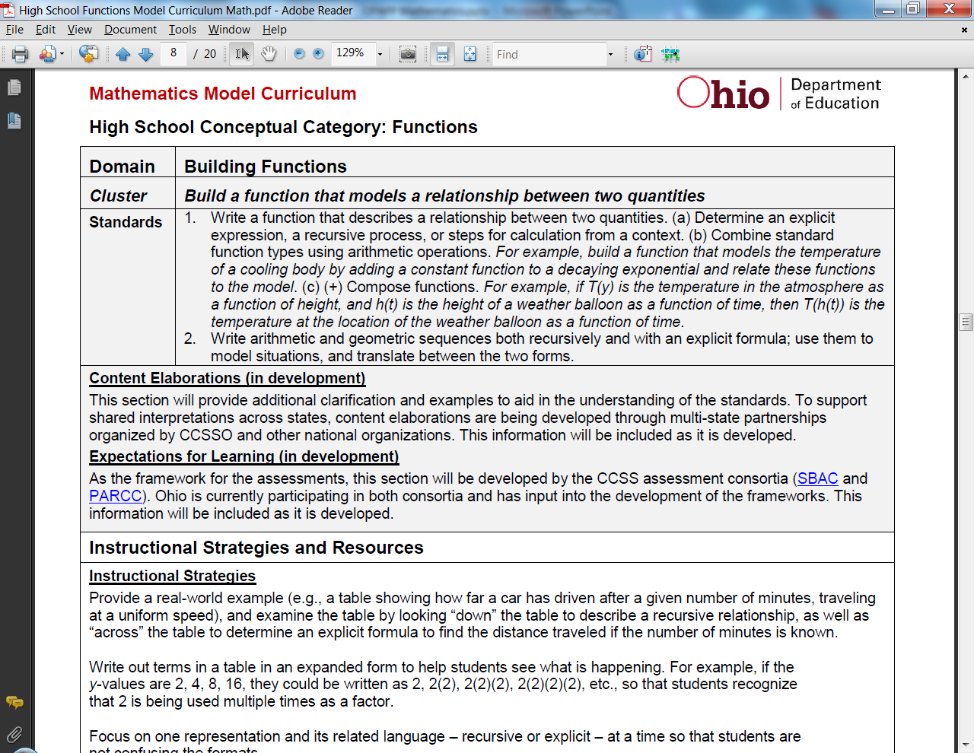
Model Curriculum
Updates to this section coming this spring.
Notes:
(Say)
Each cluster’s section shows the domain, and the related standards. The next two sections: Content Elaborations and the Expectations for Learning are in development on the national level. They will provide further explanation of the meaning of the standards and clarity on the impact in assessment.

Slide 41
Model Curriculum
Content Elaborations (in development) To maintain a common understanding of the Common Core State Standards for Mathematics (CCSSM), The Ohio Department of Education will link to collaborative CCSSM projects whenever possible. One of these projects is the Progressions Documents for the Common Core Math Standards. These Learning Progression documents, informed both by research on children's cognitive development and by the logical structure of mathematics, describe the progression of a topic across a number of grade levels. A second project is series of video vignettes, commissioned by the Council of Chief State School Officers and the Hunt Institute, designed to provide additional explanation of the CCSS. These projects and other work are ongoing: therefore, periodic updates to this section with new information and links to the most current information is necessary.
Notes:
(Say)
Each cluster’s section shows the domain, and the related standards. The next two sections: Content Elaborations and the Expectations for Learning are in development on the national level. They will provide further explanation of the meaning of the standards and clarity on the impact in assessment.

Slide 42
Model Curriculum
Expectations for Learning (in development) The Ohio Department of Education has selected to be a governing member of the PARCC assessment consortium. This consortium will be developing the new assessments that include: Questions aligned to the Common Core State Standards for Mathematics, A computer based delivery system, Online scoring to provide rapid results to students, parents, teachers and districts, and Multiple types of questions (multiple choice, constructed response, technology enhanced, and performance task). The development of the assessments will be informed by the PARCC Model Content Framework. This document is currently in draft form and will be revised in the spring/summer of 2012.
Notes:
(Say)
Each cluster’s section shows the domain, and the related standards. The next two sections: Content Elaborations and the Expectations for Learning are in development on the national level. They will provide further explanation of the meaning of the standards and clarity on the impact in assessment.

Slide 43
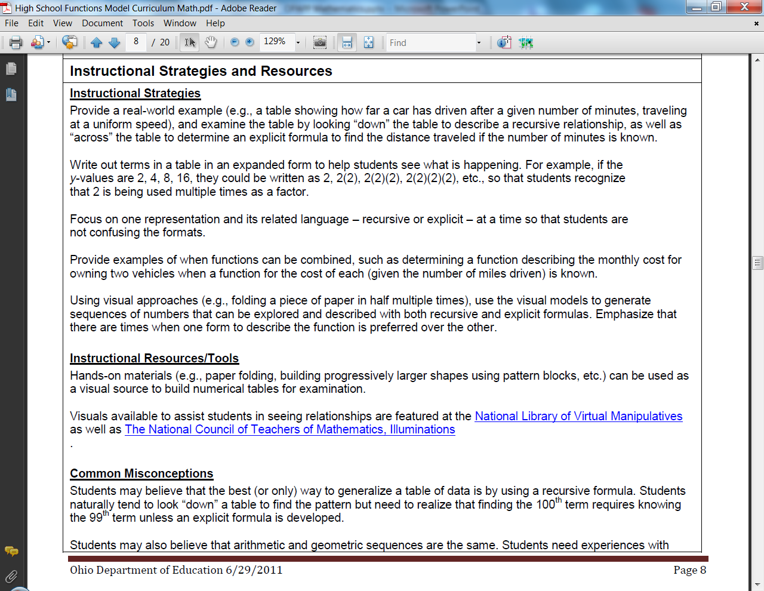
Model Curriculum
Instructional Strategies
Instructional Resources and Tools
Common Misconceptions
Notes:
(This slide is animated! Say)
The next section is the Instructional Strategies and Resources. The most detailed part of this section is the Instructional Strategies section. (click and Instructional Strategies will appear) It contains guidance for developing concepts based upon how students learn, examples of a progression of learning, explanations for terminology, and often a connection to students’ previous learning. (click and Instructional Resources and Tools will appear) Notable instructional resources or tools are listed. (click and Common Misconceptions will appear) The Common Misconceptions part is included to point out significant understandings that may confuse students. It does not include common errors. Not all clusters have Common Misconceptions listed.

Slide 44
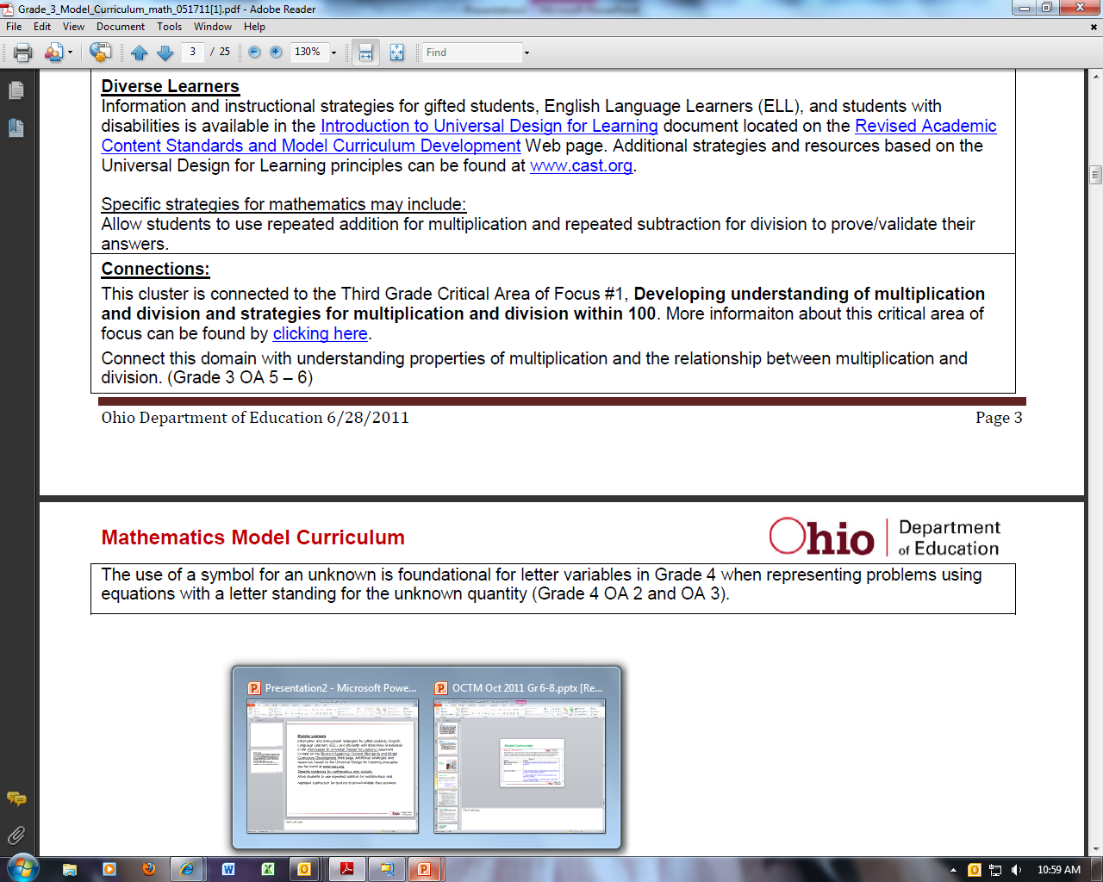

Slide 45

Progressions
Notes:
The Common Core, like mathematics is built on Progressions.

Slide 46
Progressions
Progressions
  Describe a sequence of increasing sophistication in understanding and skill within an area of study
Three types of progressions
  Learning progressions
  Standards progressions
  Task progressions
Notes:
(Read this slide.)
(The next slides will describe these three types of progressions.)

Slide 47
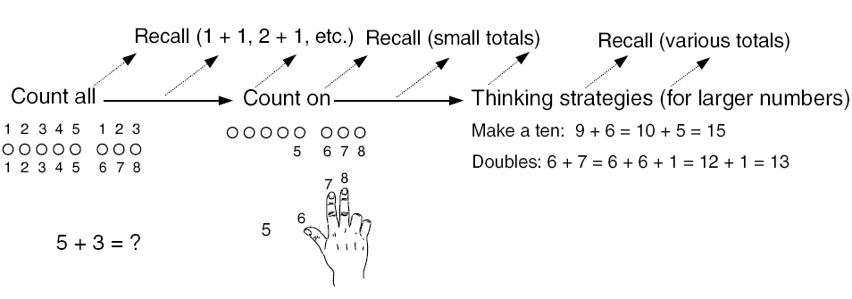
Learning Progression for
Single-Digit Addition
From Adding It Up: Helping Children Learn Mathematics, NRC, 2001.
Notes:
(Say)
This slide is taken from Adding It Up: Helping Children Learn Mathematics, NRC, 2001. It shows the typical learning progression from learning how to find a sum by first counting all, then starting from the last number said representing a set and counting on to using strategies such as making ten, using doubles, etc.

Slide 48
Learning Progressions Document for CCSSM
http://ime.math.arizona.edu/progressions/
Narratives
Typical learning progression of a topic
Children's cognitive development
The logical structure of mathematics
Math Common Core Writing Team with
Bill McCallum as Creator/Lead Author
Notes:
(Say) Bill McCallum is responsible for narratives describing the typical learning progression of a topic, informed both by research on children's cognitive development and by the logical structure of mathematics.
In other words, they describe how ideas connect and grow across grades. A technical appendix, authored by Jason Zimba, highlights structural features that are not highly visible in the document.

Slide 49

Standards Progressions
Notes:
(Say)
Standards Progressions are the actual standards represented in a time progression.

Slide 50
CCSS Domain Progression
K |  | 1 | 2 | 3 | 4 | 5 | 6 | 7 | 8 | HS
Counting & Cardinality
Number and Operations in Base Ten |  |  |  |  |  |  | Ratios and Proportional Relationships |  |  | Number & Quantity
 |  |  |  | Number and Operations – Fractions |  |  | The Number System
Operations and Algebraic Thinking |  |  |  |  |  |  | Expressions and Equations |  |  | Algebra
 |  |  |  |  |  |  |  |  | Functions | Functions
Geometry |  |  |  |  |  |  |  |  |  | Geometry
Measurement and Data |  |  |  |  |  |  | Statistics and Probability |  |  | Statistics & Probability
Notes:
(Say)
This diagram illustrates how the domains are distributed across the Common Core State Standards.
What is not easily seen is how a domain may impact multiple domains in future grades.
An example is K-5 Measurement and Data, which splits into Statistics and Probability and Geometry in grade 6.
Likewise, Operations and Algebraic Thinking in K-5 provides foundation Ratios and Proportional Relationships, The Number System, Expressions and Equations, and Functions in grades 6-8.

Slide 51
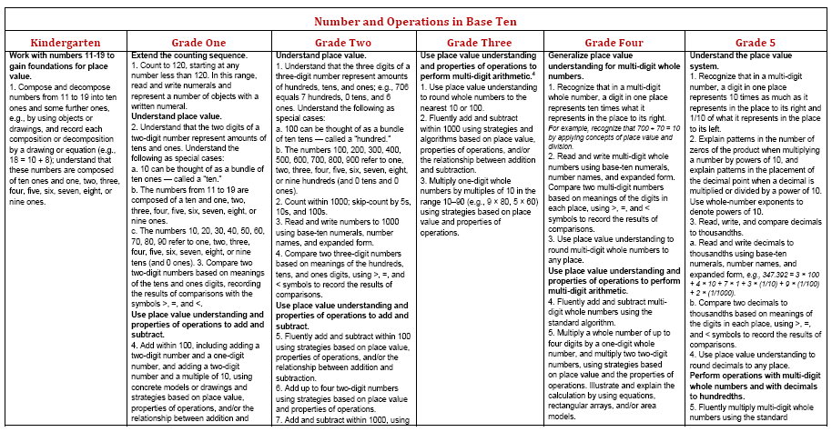
Standards Progression:
Number and Operations in Base Ten
Notes:
(Say)
Nonetheless, to support some analysis of the progressions of standards across grades, we can place the text of the standards, for each domain, in a table as shown. Sometimes the clusters of standards support more fine-grained analysis.

Slide 52
Use Place Value Understanding
Grade 1 | Grade 2 | Grade 3
Use place value understanding and properties of operations to add and subtract. 4. Add within 100, including adding a two-digit number and a one-digit number, and adding a two-digit number and a multiple of 10, using concrete models or drawings and strategies based on place value, properties of operations, and/or the relationship between addition and subtraction; relate the strategy to a written method and explain the reasoning used. Understand that in adding two-digit numbers, one adds tens and tens, ones and ones; and sometimes it is necessary to compose a ten. 5. Given a two-digit number, mentally find 10 more or 10 less than the number, without having to count; explain the reasoning used. 6. Subtract multiples of 10 in the range 10-90 from multiples of 10 in the range 10-90 (positive or zero differences), using concrete models or drawings and strategies based on place value, properties of operations, and/or the relationship between addition and subtraction; relate the strategy to a written method and explain the reasoning used. | Use place value understanding and properties of operations to add and subtract. 5. Fluently add and subtract within 100 using strategies based on place value, properties of operations, and/or the relationship between addition and subtraction. 6. Add up to four two-digit numbers using strategies based on place value and properties of operations. 7. Add and subtract within 1000, using concrete models or drawings and strategies based on place value, properties of operations, and/or the relationship between addition and subtraction; relate the strategy to a written method. Understand that in adding or subtracting three digit numbers, one adds or subtracts hundreds and hundreds, tens and tens, ones and ones; and sometimes it is necessary to compose or decompose tens or hundreds. 8. Mentally add 10 or 100 to a given number 100–900, and mentally subtract 10 or 100 from a given number 100–900. 9. Explain why addition and subtraction strategies work, using place value and the properties of operations. | Use place value understanding and properties of operations to perform multi-digit arithmetic. 1. Use place value understanding to round whole numbers to the nearest 10 or 100. 2. Fluently add and subtract within 1000 using strategies and algorithms based on place value, properties of operations, and/or the relationship between addition and subtraction. 3. Multiply one-digit whole numbers by multiples of 10 in the range 10–90 (e.g., 9 × 80, 5 × 60) using strategies based on place value and properties of operations.
Notes:
(Say)
This slide show the highlighted sections on place value from the previous slide. By reviewing standards progressions, one can see how one year builds upon another.

Slide 53
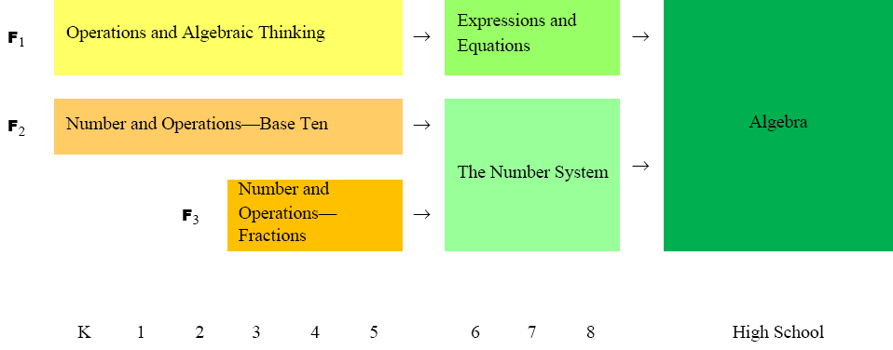
Flows Leading to Algebra
Notes:
(Say)
Because of structural differences between the disciplines of mathematics and English Language Arts, the mathematics standards do not support such easy analysis of the progression of standards across grades.
This diagram depicts some of the structural features of the mathematics standards, where several different domains from grades K-8 converge toward algebra in high school. This diagram does not include other “flows,” such as from Number and Operations—Fractions in grades 3-5, to Ratios and Proportional Relationships in grades 6 and 7, to Functions in grade 8 and high school, with connections to geometry and probability.
An Algebra Idea Across K-12
Compare and contrast: patterns, functions, and sequences
In grades K-8, students study patterns
In grades 9-11, students study functions
In grade 12, students might study sequences
A sequence is a pattern
A pattern suggests a function
A sequence is a function with a domain consisting of whole numbers

Slide 54

Resources for Implementation
Notes:
(Read)

Slide 55
CCSS Support Materials
Mathematics Common Core State Standards and Model Curriculum
K-8 Standards Progressions 2/14/2012 (PDF)
Mathematics Resource Filter NEW (PDF)
Mathematics K-8 Comparative Analysis (PDF)
CCSS: Standards for Mathematical Practice (PDF)
Mathematics – K-8 Critical Areas of Focus (PDF) – Revised 2/10/11
Mathematics – K-8 Critical Areas Progressions (PDF)
What should districts be doing? (PDF) – Revised 2/28/11
Focus One: TPD Meeting (PPT)
Notes:
(Say)
The Ohio Department of Education has created a number of documents to assist in the understanding and transition to the Common Core.
The K-8 Comparative Analysis is an analysis of each grade to determine what topics are still there or modified, what topics have moved and what topics are new. This document is in the process of being posted.
Standards Progressions View provides all the Standards Progressions for K-8
K-8 Critical Areas of Focus is a document that aligns a grade level’s Domains, Clusters and Standards to each of its Critical Areas of Focus. A second document titled the Critical Areas of Focus Progressions, provides a progression view of the Critical Areas of Focus across grade bands of K-2, 3-5, and 6-8.
An original document called Crosswalks: Cluster to Benchmark Comparison gives a very general alignment of the OACS benchmarks to the Common Core Clusters
What should districts be doing? Suggestions for planning, understanding and transitioning to the Common Core
FAQ a constantly changing document reflecting the most commonly asked questions about Mathematics
These documents are all posted on the Mathematics web page (Click to see it on the next slide)

Slide 56
Grade Level Comparative Analysis
Content that is new to Grade 8 | Content that is still included at Grade 8, but may be modified or at a greater depth | Content that is no longer a focus at Grade 8
The Number System Know that there are numbers that are not rational, and approximate them by rational numbers. (8.NS.1-2) Functions Define, evaluate, and compare functions. (8.F.1-3) Functions Use functions to model relationships between quantities. (8.F.4-5) Geometry Understand congruence and similarity using physical models, transparencies, or geometry software.[initial introduction] (8.G.1-2) Geometry Understand and apply the Pythagorean Theorem. [initial introduction] (8.G.6-8) Statistics and Probability Investigate patterns of association in bivariate data. (8.SP.4) | Expressions and Equations Work with radicals and integer exponents. (8.EE.1-4) Expressions and Equations Understand the connections between proportional relationships, lines, and linear equations. [derive y=mx] (8.EE.5-6) Expressions and Equations Analyze and solve linear equations and pairs of simultaneous linear equations. (8.EE.7-8) Geometry Understand congruence and similarity using physical models, transparencies, or geometry software. (8.G.3-5) Geometry Solve real-world and mathematical problems involving volume of cylinders, cones, and spheres. (8.G.9) Statistics and Probability Draw informal comparative inferences about two populations. (7.SP.3-4) Statistics and Probability Investigate patterns of association in bivariate data. (8.SP.1-3) | Number, Number Sense and Operations Ratio, proportion percent problems (See Grade 7.RP) Measurement Order and conversion of units of measure (See Grade 6.G) Measurement Rates (See Grade 7.RP) Geometry Geometric figures on coordinate plane (See Grades 6-7.G) Geometry Nets (See 6.G.4) Patterns, Functions and Algebra Algebraic expressions (See Grades 6-7.EE) Patterns, Functions and Algebra Grade 8 learning is limited to linear equations Patterns, Functions and Algebra Quadratic equations (See HS) Data Analysis Graphical representation analysis (See Grade 6.SP) Data Analysis Measures of center and spread; sampling (See Grade 7.SP) Probability (See Grade 7.SP)
Notes:
(Say)
ODE consultants have completed K-8 grade level documents that describe: content that is missing, new, and exists but is modified when comparing the Common Core to the OACS. As districts transition to the Common Core, instruction needs to focus on the second and third columns: modified and no longer a focus to ensure that students are still prepared for the OAAs. In 2014, assessment will move to the Common Core and thus instruction will move to the first two columns.
The first two columns are correlated to the Common Core, first listing the Domain in italics, then the cluster and finally the coding for the specific standards. Example: (8.NS.1-2) stands for (Grade Eight. The Number System.Standards one and two). Information in the brackets comments on what specifically is new or different. The third column references the OACS with the Strand, the topic and if relevant the new location in the Common Core.

Slide 57

External Resources for CCSSM
PARCC
  www.parcconline.org
CCSSO
  www.ccsso.org/
Achieve
  www.achieve.org
NCTM
  www.Nctm.org
Center for K-12 Assessment & Performance Management at ETS
  www.k12center.org
YouTube Video Vignettes explaining the CCSS
  http://www.Youtube.com/user/TheHuntInstitute#P/a
Notes:
(Say)
A few of the websites posting resources created for CCSS are listed. Explanatory PowerPoints are posted on nctm.org along with the digital document
Making it Happen: A Guide to Implementing and Interpreting the Common Core Standards
See http://www.nctm.org/mih

Slide 58
Resources for H.S. Improvement
NCTM’s high school reports
  Focus on Reasoning and Sense Making
Use the Common Core State Standards
  Identify A2E content for all students
Use Pathways and Standards Progressions
  Reduce redundancy and incoherence
  Use previous mathematics in service of new ideas
Ohio’s Model Curriculum
  Adopted in March 2011
Notes:
(Say)
To assist High School in transitioning to the Common Core, the National Council of Teachers of Mathematics has created reports and inservices, one of which is Focus on Reasoning and Sense Making.
(Read the remaining slide)

Slide 59
Transition
Common Core State Standards for Mathematics
2001
Academic
content
standards

Slide 60
Transition
2011-2012 Academic Year Transition Year 1 | 2012-2013 Academic Year Transition Year 2 | 2013-2014 Academic Year Transition Year 3 | 2014-2015 Academic Year Full Implementation
Develop Plan Gap Analysis Redesign Curriculum Professional development opportunities | Implement plan Pilot and refine curriculum Phase out old curriculum Professional development opportunities | Fully Implement new curriculum – refine as needed Professional development opportunities | Full implementation Professional development opportunities
Notes:
This slides highlights the district role in the transition to the CCSSM.

Slide 61
Transition
2011-2012 Academic Year Transition Year 1 | 2012-2013 Academic Year Transition Year 2 | 2013-2014 Academic Year Transition Year 3 | 2014-2015 Academic Year Full Implementation
Targeted Professional Development Webinars and webcasts Resources – Links to national resources Comparative Analysis Guidance Documents | Targeted Professional Development Webinars and webcasts Curriculum resources Guidance Document | Targeted Professional Development Webinars and webcasts Curriculum Resources and materials | Targeted Professional Development Webinars and webcasts Curriculum Resources and materials
Notes:
This highlights ODE’s role in assisting districts in this transition process

Slide 62
Transition
2011-2012 Academic Year Transition Year 1 | 2012-2013 Academic Year Transition Year 2 | 2013-2014 Academic Year Transition Year 3 | 2014-2015 Academic Year Full Implementation
State assessments remain aligned to the 2001-2002 Academic Content Standards. Align item banks to the CCSSM Work with PARCC on the development of new assessments | State assessments remain aligned to the 2001-2002 Academic Content Standards. Work with PARCC on the development of new assessments Pilot testing of online assessments | As much as possible Assessments will focus on content shared by 2001 ACS and CCSSM Continues work with PARCC Field testing of the PARCC assessments | Full implementation of the new assessment system – PARCC
Notes:
This slide highlights the assessment transition plan at this time.

Slide 63
Supporting the Transition:
Integrating Technology in Mathematics
How can technology be integrated into instruction to support the learning of mathematics?
How can technology enhance instructional strategies?
How can the use of technology support mathematical understanding for particular students?
Notes:
As you think about the transition to the Common Core State Standards and the technology-based assessments, you should actively be working on ways to use technology to support instruction and advance student understanding.
Consider your particular learning targets/goals for your students -
How can technology be integrated to support the learning of mathematics?
Consider the concepts and skills to be learned in terms of instructional strategies and the characteristics of your students-
How can technology enhance instructional strategies?
How can the use of technology support mathematical understanding for particular students?

Slide 64
Ohio’s Decision
Ohio had been a participating member of two consortia.
On November 15, the Ohio State Board of Education voted for Ohio to join PARCC as a governing member.
Notes:
Summative Performance Tasks – reading writing and mathematics
PARCC what it stands for and online source.

Slide 65
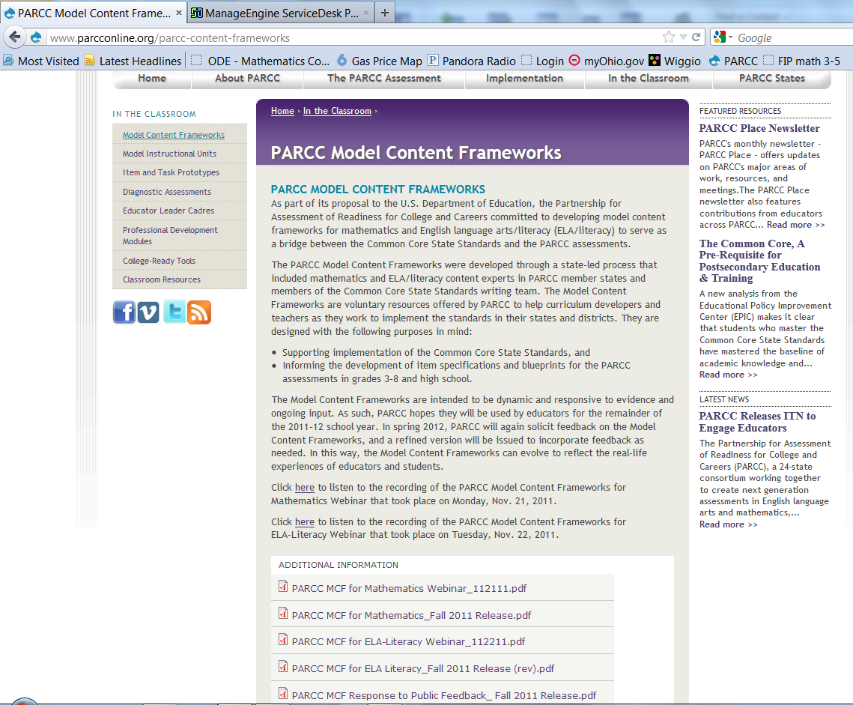
PARCC

Slide 66




PARCC Assessment Design
English Language Arts/Literacy and Mathematics, Grades 3-11
Optional Assessments/Flexible Administration
Diagnostic Assessment
Early indicator of student knowledge and skills to inform instruction, supports, and PD
Mid-Year Assessment
Performance-based
Emphasis on hard-to-measure standards
Potentially summative
Performance-Based
Assessment (PBA)
Extended tasks
Applications of concepts and skills
End-of-Year
Assessment
Innovative, computer-based items
ELA - Speaking And Listening
Assessment
Locally scored
Non-summative, required
Summative,
Required assessment
Interim, optional assessment
Notes:
TALKING POINTS
Graphic depiction of the assessment system. The system includes a suite of assessments and tools that, taken together, provide a more complete picture of student mastery of standards and progress throughout the year than is currently available on state assessments.
Considerations Leading to 2 optional assessments:
The cost of the assessments
Flexibility on when to administer the optional assessments
The amount of testing time needed to administer the assessments
Possible disruption to school schedules caused by through-course assessment preparation and administration
Constraints the distributed design might have on the flexibility of state and local educators to sequence instruction of the CCSS and to implement their own benchmark and formative assessment initiatives
The PARCC assessment system will:
Reflect the sophisticated knowledge and skills found in the English and math Common Core State Standards
Include a mix of item types (e.g., short answer, richer multiple choice, longer open response, performance-based)
Make significant use of technology
Include testing at key points throughout the year to give teachers, parents and students better information about whether students are on track or need additional support in particular areas
Taken together, the PARCC assessment components comprise a comprehensive system of assessments that will provide timely information to teachers throughout the year, and provide students with meaningful information about their progress toward college and career readiness

Slide 67
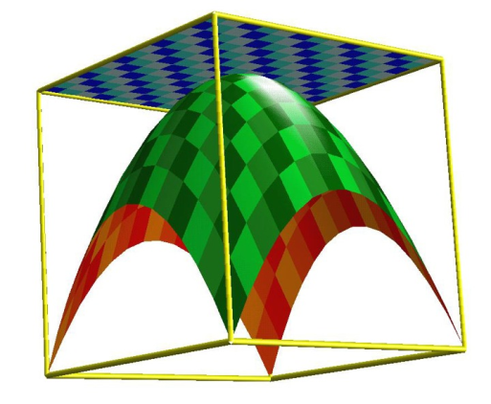

It is time to recognize that standards are not just promises to our children, but promises we intend to keep.”¹
Students need to meet the standards, and in order to do that, what they must learn is not standards but mathematics.²
1 CCSS, 2010, p. 5
2 PARCC – Draft Content Framework - 2011
Notes:
(Say) In closing, (read the quotes, PAUSE and then read the following:)
Thank you for attending this session. Please ask questions now or email them to ODE. Please return in the spring for our next Targeted Professional Development Sessions.

Slide 68
ODE Mathematics Consultants
Brian Roget brian.roget@education.ohio.gov
Ann Carlson ann.carlson@education.ohio.gov
Yelena Palayeva yelena.palayeva@education.ohio.gov

