Slide 1
Literacy Across the Hall
“I teach Math, why should I teach the literacy standards?”
Innovative Learning Environments
August 2-3, 2012
Ann Carlson
Mathematics Consultant
Ohio Department of Education

Slide 2
The literacy standards will enhance mathematical learning!
Through the use of text dependent questions, graphic organizers, summarizing strategies, and vocabulary development, we will start the journey of addressing the literacy standards and the shifts in the CCSSM.
Notes:
Implementing the Literacy Standards will enhance mathematical learning.

Slide 3
21st Century Skills
Creativity and innovation
Critical thinking and problem solving
Communication and collaboration
Personal management
Productivity and accountability
Leadership and responsibility
Information, media and technology literacy
Interdisciplinary and project-based learning
Notes:
In the writing of the CCSSM, consideration was given to addressing the 21st Century Skills.
The red skills reflect the Mathematical Practices
The blue skills directly relate to personal characteristics of students taking responsibility for their own learning
The black items connect to modes of presenting instruction or demonstrating learning.

Slide 4
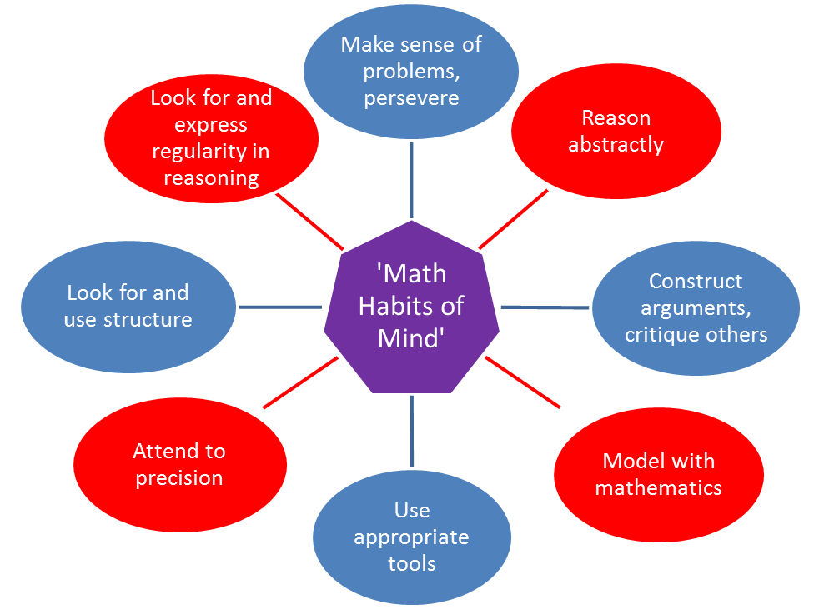
Standards for Mathematical Practice
Mathematical ‘Habits of Mind’
Notes:
Let’s explore the Mathematical Practices in relation to the Literacy Standards
The ‘mathematical practices’ embrace the goals of 21st Century skills and literacy. It is through orchestrated, intentional, experiences reading, writing, talking, listening and reasoning mathematically that students will develop the mathematical habits of mind allowing them to connect mathematics to daily life and career situations.

Slide 5
CCSS Mathematical Practices
Make sense of problems and persevere in solving them
Reason abstractly and quantitatively
Construct viable arguments and critique the reasoning of others
Model with mathematics
Use appropriate tools strategically
Attend to precision
Look for and make use of structure
Look for and express regularity in repeated reasoning

Slide 6
Partner Work
Highlight the phrases that refer to
citing evidence or
communication (writing, talking)
Be prepared to justify your choices
  Why
  Literacy Standards links
Notes:
Using the bulleted list of the Mathematical Practices, highlight those phrases that require citing evidence, writing or talking.
Group Share: what is highlighted, why, clarify the Practices

Slide 7
What does literacy look like in the mathematics classroom?
Learning to read mathematical text
Communicating using correct mathematical terminology
Reading, discussing and applying the mathematics found in literature
Researching mathematics topics or related problems
Reading appropriate text providing explanations for mathematical concepts, reasoning or procedures
Applying readings as citing for mathematical reasoning
Listening and critiquing peer explanations
Justifying orally and in writing mathematical reasoning
Representing and interpreting data
Notes:
A few of the examples of what students should be seen doing that represent literacy skills being employed in the mathematics classroom are:
Learning to read mathematical text including textbooks, articles, problems, problem explanations
Communicating using correct mathematical terminology appropriate to the student’s mathematical development
Reading, discussing and applying the mathematics found in literature
Researching mathematics topics or related problems
Reading appropriate text providing explanations for mathematical concepts, reasoning or procedures
Applying readings as citing for mathematical reasoning – using information found in texts to support their reasoning; developing works cited documents for research done to solve a problem
Listening and critiquing peer explanations
Justifying orally and in writing reasoning
Representing and interpreting data with and without technology
Using the Literacy standards as an adjunct to the Mathematical Standards of Practice will further students’ mathematical proficiency.

Slide 8
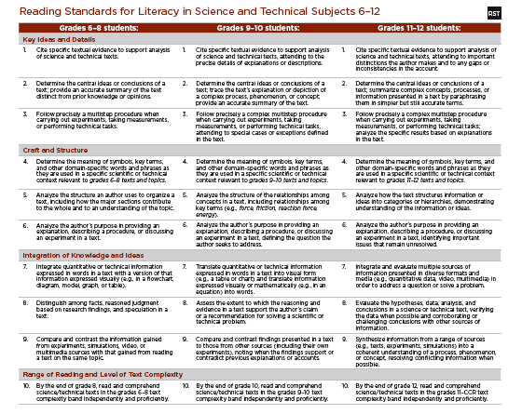
Notes:
In Ohio, mathematics teachers in grades 6-12 have the responsibility of developing literacy through mathematics. The assessment of these standards will be within the ELA end-of-course exams; however, Mathematics teachers have the content knowledge to make this learning meaningful. The Literacy standards will also assist in making mathematical understanding transferrable from one idea to another and from one year or course to the next. The Literacy Standards appear on pages 62-66 of the CCSS-ELA document. They pertain to grades 6-12. These are the Reading Standards. There are also 10 Writing Standards.

Slide 9
Reading Standards
Read grade level texts
Determine central ideas; provide accurate summary
Determine meaning of key terms, symbols
Follow multi-step procedures
Compare and contrast information from reading with that found in experiments, media sources
Notes:
Today we will work with these Reading Standards. Generally across grades 6-12 the standards parallel each other. This is the simplified gist of most of those standards.

Slide 10
Informational Text
Text Dependent Questions
Sources
Textbooks
Internet
Reference books
Notes:
What is informational text? Discuss. Informational text provides details about key concepts, facts or procedures of a topic. It is dense – many ideas within short passages and vocabulary rich. In mathematics, students will often skip over major ideas when the language becomes technical or involved.
Students who can read their mathematics assignments, problems, and assessments will be more successful. It is our responsibility to teach students how to read mathematical information. Initially, experiences should focus on reading text that is needed on a day-to-day basis. These sources can be found in textbooks, study guides, teacher content explanations, reference books and the Internet. The review sections of higher level textbooks often provide a better set of text.

Slide 11
The Rocket Problem
Notes:
Our informational text is the “The Rocket Problem” taken from a Seventh Grade Japanese Textbook translation.
Quickly read this over.

Slide 12
Notes:
Let’s look at the structure of this text.
Topic?
How is it laid out?
What components of this text would assist students in understanding?
Where is the text dense?
Our goal in looking at the structure is to help students quickly preview how that structure might provide them keys in understanding the meaning. We do not want to front load all the work so there is no need to read the text.
By writing text dependent questions, guidance is given to students to keep them actively engaged in the reading, personalizing the learning and thereby increasing the chances that students benefit from reading the text.

Slide 13
Notes:
Look at the questions on the right hand side. These questions took about 10 minutes to create. They can only be answered by actually reading the selection, not by previously learned information. The beginning questions are very concrete yet lead to a discussion of what variables are which is often misunderstood. The questions progressively get harder, pointing out key words or symbols and highlighting the desired concepts to be understood. The questions conclude by assessing whether or not the student has understood the text.
This type of activity invites discussion. Students can work together to read and answer the questions. The first few times informational text is used, the teacher should facilitate the discussion.
Informational text is a significant part of flipped classrooms. Having students find their own sources of information, say on the topic of slope, prior to the initial lessons on slope will help them connect to the learning.

Slide 14
Notes:
These are the final questions that provide a chance for students to try out their learning.

Slide 15
Creating
Text-Dependent Questions
Step One: Identify the Core Understandings and Key Ideas of the Text
Step Two: Start Small to Build Confidence
Step Three: Target Vocabulary and Text Structure
Step Four: Tackle Tough Sections Head-on
Step Five: Create Coherent Sequences of Text Dependent Questions
Step Six: Identify the Standards That Are Being Addressed
Step Seven: Create the Culminating Assessment
Notes:
An effective set of text dependent questions delves systematically into a text to guide students in extracting the key meanings or ideas found there. They typically begin by exploring specific words, details, and arguments and then moves on to examine the impact of those specifics on the text as a whole. Along the way they target academic vocabulary and specific sentence structures as critical focus points for gaining comprehension.
Step One: Identify the Core Understandings and Key Ideas of the Text
As in any good reverse engineering or “backwards design” process, teachers should start by identifying the key insights they want students to understand from the text—keeping one eye on the major points being made is crucial for fashioning an overarching set of successful questions and critical for creating an appropriate culminating assignment.
Step Two: Start Small to Build Confidence
The opening questions should be ones that help orientate students to the text and be sufficiently specific enough for them to answer so that they gain confidence to tackle more difficult questions later on.
Step Three: Target Vocabulary and Text Structure
Locate key text structures and the most powerful academic words in the text that are connected to the key ideas and understandings, and craft questions that illuminate these connections.
Step Four: Tackle Tough Sections Head-on
Find the sections of the text that will present the greatest difficulty and craft questions that support students in mastering these sections (these could be sections with difficult syntax, particularly dense information, and tricky transitions or places that offer a variety of possible inferences).
Step Five: Create Coherent Sequences of Text Dependent Questions
The sequence of questions should build toward coherent understanding and analysis so students learn to stay focused on the text to bring them to a gradual understanding of its meaning.
Step Six: Identify the Standards That Are Being Addressed
Take stock of what standards are being addressed in the series of questions and decide if any other standards are suited to being a focus for this text (forming additional questions that exercise those standards).
Step Seven: Create the Culminating Assessment
Develop a culminating activity around the key ideas or understandings identified earlier that reflects (a) mastery of one or more of the standards, (b) involves writing, and (c) is structured to be completed by students independently.

Slide 16
Math ≠ ELA
Mathematics
ELA
Right to Left
Decimals
Symbols Change
Key Idea at End (problems)
Left to Right
Periods
Symbols are Static
Key Idea in Beginning
Beginning Middle End
Notes:
There are significant differences between reading math and reading in ELA. Students need guidance in learning how to read, write and interpret mathematical text.
Reading consistently moves from left to right. Mathematics changes according to the skill or concept. Decimals and periods look alike, yet they have very different roles and placement. The symbols of reading are letters and numbers, which once learned remain static. We are constantly learning new or enhanced symbols in mathematics. When students read problems or tasks in mathematics, the key idea or question is at the end. Whereas, most writing introduces the topic in the beginning, develops the topic throughout the middle and then restates it in the end. Students benefit from experiencing these differences. They need instruction and support in making these transitions from the typical text to the mathematical text.
Taking notes in math is not the same as other content areas. Just writing down the problem and its solution does not elicit understanding, connections and recall. Students benefit from prompts that actively engage thinking. They also benefit from assistance in using shortcuts and symbols to make note-taking easier.

Slide 17
Note Taking
Abbreviate
  Use the first few letters of the word
  vocabulary – vocab
  Leave out the vowels
  book= bk;
  Use the first letter of each syllable
  notebook = nb; without = w/o
Use symbols: #, %, $, &, =, +,??, ☺, ⌂,↑, ↓, ∆
traditional or your own
Notes:
Provide model notes.
Providing copies of good notes with an open side column lets students pay attention to the discussion adding their own comments along the side. Encouraging students to mark parts they agree with using !! Or don’t agree with XX, creates the emotional connection to the learning. ?? Can be used to mark areas of interest or concern.
Model note taking during class discussions
Using abbreviations saves time, no memorizing, if done right
Develop a system so you know what the abbreviation stands for the next time you see it

Slide 18
Note Taking
Notes are for the user
Paraphrase
Single words
Pictures
Choose a format that works for the topic and YOU
  Bulleted list
  T-chart
  Web
  4 square
Notes:
Note taking is a difficult task when the student is also trying to follow a reasoning. Providing your notes for students to follow with key questions to answer about the notes helps model how to take notes. Learning how to use summarizing skills and organizers aids in the creation of notes that lead to learning and recall.

Slide 19
Summarizing
“Restating the essence of text or an experience in as few words as possible or in a new, yet efficient, manner.”
Rick Wormeli
Notes:
Most underused teaching technique
Research shows it yields some of the greatest leaps in comprehension and long term retention of information
Rick Wormeli’s book Summarization in any Subject is filled with summarizing techniques and their directions.

Slide 20
Summaries
Take many forms:
Orally
Visually
Physically
Musically
Writing
In groups or
Individually
Notes:
Summarization can take many forms. Interject some form of summarizing periodically during a lesson, not just at the end in an exit slip.

Slide 21
Graphic Organizers
Provide visual representation of facts and concepts and their relationships helping students to:
Organize ideas
Represent abstract ideas more concretely
Illustrate the relationships among facts and concepts
Store and recall information
Notes:
Graphic Organizers can be used for note taking, summarizing or as an assessment

Slide 22
Graphic Organizers
Explain the purpose and benefits
  Importance of organization
  Assists in comprehension and recall
For each organizer :
  Explain purpose and form
  Model with familiar information
  Model with new information
  Let students apply to familiar information
  Let students apply to new information
Notes:
Students should understand that the purpose of organizers is to organize information so that it can be understood, stored in the brain and recalled easily.
Whenever a new organizer is introduced, it should be done so by pointing out its purpose, and its form. Modeling should start with familiar information followed by new information. Students should then try out the organizer with familiar information before attempting new information.

Slide 23
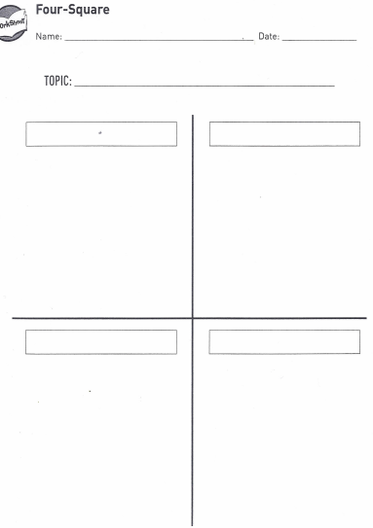
Summarize Note Taking
Notes:
Four Square is an organizer that can be used individually, in small groups or whole class. The page is divided into 4 squares with each one representing a topic or key concept. It can be used to take notes about each concept. If a line is drawn across the bottom then an overall summary can be written. Likewise, Four Square can be adapted to three topics or concepts.

Slide 24
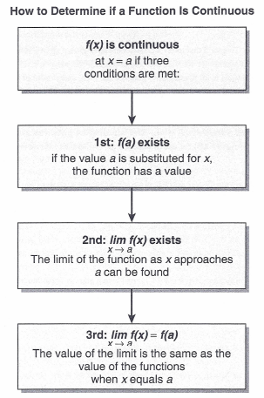
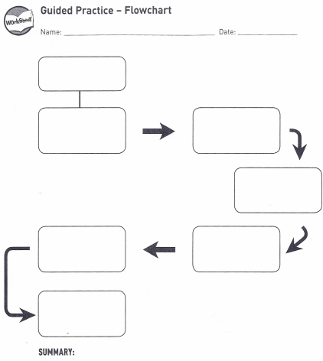
Flow Charts - Create one for the integer rules
Notes:
Flow charts are great tools for summarizing a process or procedure. If students create the flow chart based upon their learning they organize their thinking, leading to more likely recall and also create a tool that can be used to reinforce that learning in the application of those concepts or procedures.

Slide 25
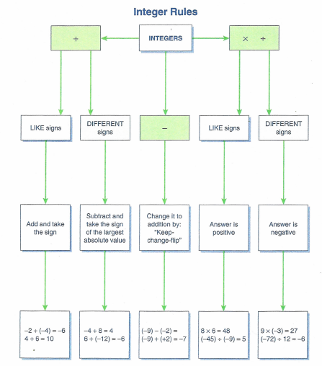
Model, Assessment
Notes:
Here is an example of a flow chart on how to combine signed numbers. Students would benefit most from experiencing “operating” on signed numbers with a variety of tools: chips, number lines then creating a flow chart that would synthesize what they have observed.

Slide 26
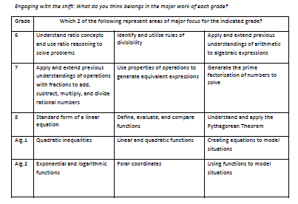
Exclusion Brainstorming
Notes:
Exclusion Brainstorming requires three phrases or statements about a topic or concept. Two are true and one is a misrepresentation. The task is to determine which one is not appropriate. This is an example around standards in the Common Core.

Slide 27
P M I
Plus | Minus | Interesting
What part of what we just covered is positive for you? | Are there topics or concepts that you don’t like or understand? | What parts are interesting?
Notes:
PMI serves well as both a note taking tool and as a summarizing tool. Words or phrases are recorded under the appropriate section. It is a great organizer for keeping students actively engaged in the reading.

Slide 28
Vocabulary
________ ultimately _____ whether _______ _____ _____ or _____ of_____. If _____ have already _____ a _____ _____yet we _____ to _____ them more of the same_____, they _____ no _____ in _____ _____ _____. They _____ _____, they _____ _____as boring and hum-drum_____, their _____ _____ , and their _____ _____. The _____ here _____ for the _____ to _____ _____ and _____ _____ of the _____ _____ or _____to _____ _____and_____, key _____ or_____. And even more so, the _____ _____ to _____ how much _____ each ______ _____ to show_____, and no more.
Notes:
This is a paragraph missing adjectives, nouns and verbs. Take a look. The subject and purpose are hard to determine.

Slide 29
________ ultimately decide whether _______ is full or devoid of_____. If _____ have already mastered a mathematical _____yet we continue to give them more of the same_____, they see no purpose in completing repetitive_____. They lose_____, they see _____as boring and hum-drum_____, their _____drops, and their _____ slump. The _____here is for the _____ to find different and meaningful _____ of the mathematical _____ or _____to maintain _____and_____, key _____ or_____. And even more so, the _____ needs to recognize how much _____ each ______ needs to show_____, and no more.
Notes:
The same paragraph with adjectives and verbs back! Still unable to really determine what it is about.

Slide 30
Teachers ultimately decide whether mathematics is full or devoid of novelty. If adolescents have already mastered a mathematical operation yet we continue to give them more of the same assignments, they see no purpose in completing repetitive practice. They lose interest, they see mathematics as boring and hum-drum work, their motivation drops, and their grades slump. The key here is for the teacher to find different and meaningful applications of the mathematical operation or concept to maintain interest and attention, key components or motivation. And even more so, the teacher needs to recognize how much practice each student needs to show mastery, and no more.
From: How the Brain Learns Mathematics Novelty and Mathematics © 2008 David A. Sousa
Notes:
Without the nouns, meaning is difficult to ascertain. Students need a firm handle on key vocabulary in order to read and understand and write text.
An adolescent’s focus time is equal to the age of the student in minutes. To maintain or re-energize focus, topics need to change or something needs to trigger an emotional connection back to the topic.
Wait time – gives time to answer and question their own thinking about the task. Using longer wait time allows long term memory to be searched while holding onto new information resulting in:
Response lengths increase
“I don’t knows” decrease
Student to student interaction increases
Student achievement increases

Slide 31
Vocabulary Concept Map
Notes:
Since nouns play such a significant role in understanding text, students need a mechanism that allows them to visualize and internalize word meanings. A vocabulary concept map does this. There are several forms with the key characteristics that students list examples and non-examples, many times including a picture along with characteristics or elements. If a definition is included, it is in the student’s own words. Looking up and writing down a dictionary definition has little to no long term benefit. As students learn more about a term, concept or topic, they can modify the concept map.

Slide 32
Notes:
This is a second vocabulary concept map. It is often referred to as the Frayer Model. I like to have students draw a picture or a model as one of the examples.

Slide 33
Word Splash
A three to five minute writing
Specific Focus
Required words are written at the top of the page (limit)
Required words are familiar key vocabulary words or concepts
Words splash words are spelled correctly
Word splash words are used correctly
Graded
Notes:
Writing is a great means of helping students integrate vocabulary into their language. Through writing, students become aware of what they understand and what they are unsure. A Word Splash is a mechanism for writing about vocabulary.

Slide 34
Reflection is not a luxury; it is a necessity!
Thinking and talking about experiences not only helps to make sense of the past, but also changes the likelihood of subsequent remembering.
Daniel Schacter
The Seven Sins of Memory
Notes:
Reflection – learned habit
Brain literally lights up during reflection
Promotes social experience
Evaluation is a part of the reflective process; valuing something worth reflection involves emotion
As students write about thinking, they learn what they know and do not know. When they explain their thinking to others and listen to others’ thinking they confirm ideas and pick up new ones. Students learn more from other students. Encourage active thinking from your students at all times.

