Slide 1
Pre-apprenticeships
Linda O’Connor

Slide 2
Return On Investment
Susan Helper, Carlton Professor of Economics at Case Western Reserve University in Cleveland, and economists from the U.S. Department of Commerce have written the report The Benefits and Costs of Apprenticeships: A Business Perspective, an overview of apprenticeship programs nationwide and 13 case studies that illustrate substantial ROI for the approach.

Slide 3
ROI
For every $1 an industry invests in an apprentice, the company receives over $4 back in production after the first year.
Individuals enjoy an 8% to 22% ROI in their apprenticeship programs based on the time and occupational path.
“Review of Apprenticeship Research: A Summary of Research Published Since 2010
Institute for Employment, Research University of Warwick, U.K., July 2012”

Slide 4
Registered Apprentices
500,000 registered apprentices in the USA (US Department of Labor)
ApprenticeOhio has over 19,000 apprentices (second in the nation to California)
Fields as diverse as aerospace, construction, energy, healthcare, manufacturing, information tech, and utilities

Slide 5

Ohio State Apprenticeship Council

Slide 6
Pre-apprenticeship Certificate
Industry-recognized Credential List across career fields
12 Points to High School Graduation
Eligible for ApprenticeOhio scholarships
Articulates to post-secondary/journeyperson status

Slide 7
ApprenticeOhio
Ohio State Apprenticeship Council - Registers Apprenticeship programs (Ohio 2nd to California) and apprentices
Ohio has more than 19,000 registered apprentices in fields as diverse as: aerospace, construction, energy, health care, manufacturing, and utilities

Slide 8
Difference
Registered - Industry Aligned Standards (nationally and internationally recognized) through ApprenticeOhio
Unregistered (formalized training program) – no validation of standards and apprentices are not registered in the USDOL database
Recognized by – meets state standards and utilizing some registered programs (certificates) and scholarships

Slide 9
14 Secondary Schools/Programs
Miami Valley Career Center CTEC
Upper Valley Career Center Stebbins High School
Southwestern City Schools Penta
Grant Career Center Magnet
Northwestern Local Schools YouthBuild
Wayne County Career Center
Cleveland Metropolitan School District
Trumbull County Career Center
Vanguard-Sentinel Career & Technology Centers (Secondary and Adult)

Slide 10
Post-Secondary Sponsors
Columbus State Community College – J.D. White jwhite02@cscc.edu
Cuyahoga Community College – Rini Grover rini.grover@tri-c.edu
Edison State Community College – Brandi Olberding bolberding@edisonohio.edu
Lorain County Community College – Anthony Schweppe aschweppe@lorainccc.edu

Slide 11
Marion Technical College – Bob Haas
haasr@mtc.edu
North Central State College – Linda Hess lhess2@ncstatecollege.edu
Rhodes State College – Tammy Eilerman eilerman.t@rhodesstate.edu
Sinclair Community College – Dawn Warner dawn.warner@sinclair.edu
Stark State College – Marisa Rohn mrohn@starkstate.edu
Washington State Community College – Brenda Kornmiller bkornmiller@wscc.edu

Slide 12
ApprenticeOhio Concentration
Information Technology
Business Services
Healthcare
Advanced Manufacturing
Approved Programs
http://omj.ohio.gov/program/index.stm

Slide 13
Sponsors
Adult Training
Ohio Technical Centers (OTCs), secondary schools, post-secondary, trade associations, community organizations.

Slide 14
Sponsor Responsibilities
Applicant Qualifications and Selection Criteria
EEO Fair Recruitment Process
Mentor (Journeyperson-to-apprentice ratio)
Progressive wage schedules (completion of competency levels)
Record documentation and retention

Slide 15
Pre-Apprenticeship Program
basic technical and job-readiness skills for a designated apprentice occupation – 144 hrs. classroom
classroom and on-the-job (paid experience) – 120 to 900 hours
to prepare participants for Registered Apprenticeship training.

Slide 16
Ohio Revised Code 4109.07
Restrictions on hours of employment
No person under 16 may be employed more than 40 hours in any one week nor during school hours unless employment tis incidental to a bona fide programs of vocational cooperation training, work-study, or other work-oriented programs with the purpose of educating students, and the program meets standards established by the state board of education. (ORC 4109 Hazardous tasks for minors)

Slide 17
Pre-apprenticeship Model
Sophomore Year – Shadow Experience
Begins Junior/Senior Year in High School (technical skills) – work full time during summer
Senior Year (20-40 hours week) ORC 4109.07, half-day, one-week, two-week (on-off)

Slide 18
Multi-tiered Status
Pre-apprentice (secondary level)
Apprentice (at the company level)
Employed
Enrolled in an Apprenticeship Training Program with post-secondary (earning an associate degree)
Simultaneously (no duplication of training)
Little to no cost to the student

Slide 19
Apprenticeship
An apprenticeship is a formalized training program of on-the-job training and related classroom instruction under the supervision of a journey-level or trade professional craft person aligned to a highly skilled occupational industry standards.
Apprenticeships can be union or merit shops.

Slide 20
Standard Apprenticeships
Classroom and OJT or OJL (on-the-job training/learning)
Average 2,000 hours per year up to 8,000 (depends upon occupation)
Average 4-5 years program (high school and/or adult training may articulate credit toward their journeyperson status, determined by the sponsor)

Slide 21
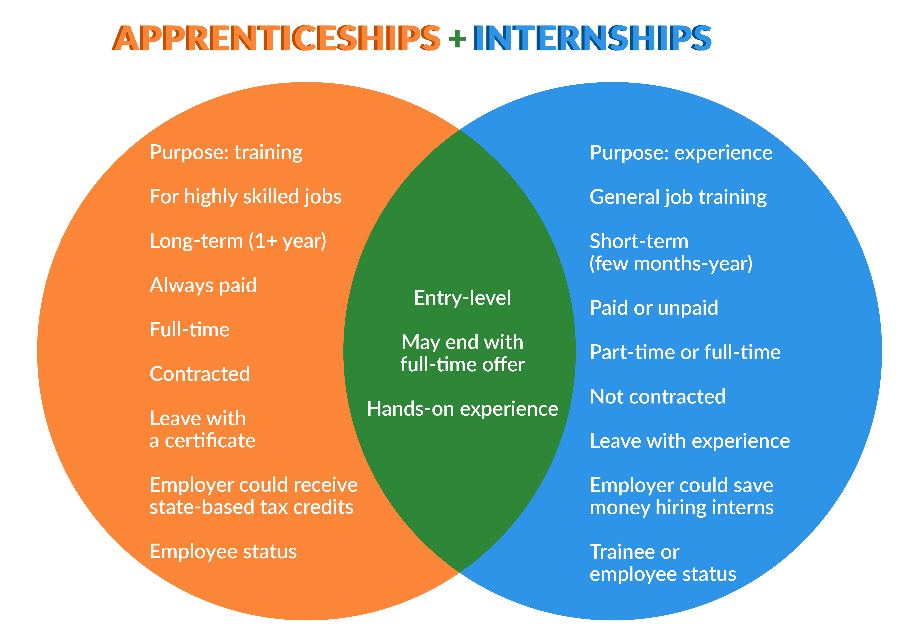
Difference

Slide 22
Co-ops
Co-operative Education (Co-op) is a type of internship program that enables college students to receive career training with pay as they work with professionals in their major fields of study. Some high school students (e.g. Agriculture) participate in co-ops. Co-ops last longer than a semester and usually up to a year.

Slide 23
Recognition Application
EEO Recruitment
Enrollment
Operating Plan = Instructional Content/Design (aligned with industry standards by occupation)
More than one industry
Reporting to the Council
Safety
Program Administration
Linkage (Registered Apprenticeship Sponsors)

Slide 24
Student-Parent Agreement
List requirements and expectations:
Attendance must be maintained at 95%
Grade point average
Transportation
Absence
Records that must be maintained
Problems/Issues
Safety/Employer Rules

Slide 25
Apprenticeship Agreement Employer-Student
State all parties responsibilities: parent, student, teacher, coordinator, employer
Wage
Evaluation of Performance
Training Plan Progress
Related Instruction

Slide 26
Training Plan
List job tasks/competencies that student will be performing/learning, aligned to class room competencies.
Attach B.A.T. (Bureau of Apprenticeship and Training) standards for that occupation

Slide 27
New Subject Code
990365 – Pre-apprenticeships/CTE-26 funding application (not tied to recognition)
May be used as the 4th course (no test) for concentrators (enrolled in third course)
OJT Hours
Program still requires 450 hours

Slide 28
Who Receives CTE State Funding
Whoever serves the Student in approved CTE Program as reported in EMIS
District that sends students to a JVSD retains 20% of the Opportunity Grant

Slide 29
CTE Supplemental Funding
FY18 & FY19
Category | Career Fields | Amount
1 | Agricultural & environmental systems, construction technologies, engineering & science technologies, finance, health science, information technology, manufacturing technologies | $5,192
2 | Business & administration, hospitality & tourism, human services, law & public safety, transportation systems, arts &communications | $4,921

Slide 30
CTE Supplemental Funding
Category | Career Fields | Amount
3 | Career based intervention | $1,795
4 | Education & training, marketing, workforce development academics, public administration, career development | $1,525
5 | Family and consumer sciences (which includes students enrolled in GRADs) | $1,308

Slide 31
Use of 75% of CTE Supplemental Funds
Section 3317.022(E)
curriculum development, purchase, and implementation;
instructional resources and supplies
industry-based program certification
student assessment, credentialing and placement

Slide 32
ORC 3317.022 (E) Cont’d
curriculum specific equipment purchases and leases
career-technical student organization fees and expenses
home and agency linkages
work-based learning experiences
professional development
and other costs directly associated with career-technical

Slide 33
Use of Associated Services Funds
ORC Section 3317.022 (A)(9)(D)
apprenticeship coordination
career technical program development
career assessment and or evaluation
career development
school improvement
post-secondary articulation or placement coordination

Slide 34
ODJFS Income Exclusion
Effective August 1, 2010
All income excluded under the food assistance program regulations, as set forth described in rule 5101:4-4-13 of the Administrative Code.
(2)The gross earnings of a minor child in the assistance group who is a full-time student as defined by the school, unless the minor is a parent. Minor child is defined in section 5107.02 of the Revised Code.
http://emanuals.jfs.ohio.gov/CashFoodAssist/CAM/Chapter2000/5101-1-23-20-1.stm

Slide 35
Income Exclusion
Cash Assistance policy defines a minor as someone who is under 19 and is attending high school full time and the status does not change until they graduate or leave high school.
There’s a similar exclusion of income for food assistance in 5101:4-4-13

Slide 36
Allowable and Unallowable Expenditures
http://education.ohio.gov/Topics/Finance-and-Funding/School-Payment-Reports/State-Funding-For-Schools/Career-Technical-Funding/Weighted-Funds-Certification-Letter-Calculations

Slide 37
Forms/Models
http://education.ohio.gov/Topics/Career-
Tech/Apprenticeships-and-Internships
How-to-Implement a Pre-Apprenticeship Program Guide
Example under Pre-Apprenticeship:
Vanguard-Sentinel Approved Application

Slide 38
Resources
NAPE Construction Workbooks and Lesson Plans (Equity Outreach) – Manufacturing end of October I (CTE Apprenticeships)
Adecco – CTE/Miscellaneous
Career Connections – Credit Flex/WBL
Education.Ohio.Gov and
OhioMeansJobs Readiness Seal
Drug Free Clubs of America – www.drugfeeclubs.com

Slide 39
Credit Flex Note
Credit may be issued by enhancing current courses with work-based learning experiences or by utilizing the local district’s policy on credit flexibility to award credit.
Work experience must be documented and conducted at the work site (during or after school) with training plans and evaluation forms.

Slide 40
Ohio Department of Public Safety
Driver’s Training Schools
Laws and Rules relating to Driver Training in Ohio may found in Ohio Revised Code (ORC) 4508.01, www.drivertraining.ohio.gov
Driver Training Program:
Valerie Wald (614) 466-3524
vwald@dps.ohio.gov

Slide 41
Ohio Department of Education and Apprenticeship Contacts
Linda O’Connor, Assistant Director CTE linda.OConnor@education.ohio.gov
614-644-6095
Patrick Reardon, Executive Administrator
Patrick.reardon@jfs.ohio.gov
614-644-0863
http://apprentice.ohio.gov/index.stm

