Slide 1
Perkins Local Needs Assessment
Closing out the Perkins Local Needs Assessment process
&
Preparing for the Perkins Local Application workshop
Tawanna Fields-Mphande ∙ Rhedeshia Young-Willingham
April 18, 2022

Slide 2
Agenda
Where are you in the process?
Closing Out Perkins Local Needs Assessment
Pre-Planning Tab/ED STEPS
Approvable Application/Timelines
Questions

Slide 3
Where are you in the process?
1

Slide 4
Where are you in the process?
Status-Have not started or in progress with the Perkins Local Needs Assessment
Next Steps:
Review previous Perkins Needs Assessment.
From the Comprehensive Continuous Improvement Plan system, download the excel document.
Review data (Secured Data Center/Equity Lab Report)
Copy and paste information from the excel document to the Perkins Local Needs Assessment.
Begin discussion with the Question Group Leaders.
Review feedback and conduct root cause analysis
Copy and paste information into the platform.
Notes:
How to fast track…
Many of you are in various process stages, so hopefully, the information I share today will address where everyone is with the Perkins Local Needs Assessment.
Collect necessary documentation to begin the work.
Documentation-Review Perkins Comprehensive Local Needs Assessment website for relevant resources
Model Process Guidance document
Five Part CLNA training video
CLNA workbook
I encourage you to download the previous document located in CCIP submitted in spring of 2020.
Copy and paste the questions into the Perkins Needs Assessment portal.
You can always go back and revise this information.
Utilize the Question Group teams to minimize the work. Remember this is not a redo of the previous document, but an opportunity to update the information. Also, remember this is your needs assessment that is design to inform the local application. There are not right or wrong answers.
Contact your assigned consultant for question or support.

Slide 5
Where are you in the process?
Status-Completed the Perkins Local Needs Assessment
Next steps:
Revisit root cause(s) identified as priority.
Review the pre-planning tab and begin thinking about goals, strategies, actions steps and allocated amounts.
Notes:
Completed
If you have already completed your needs assessment, as a suggestion, revisit the pre-planning tool root cause(s) to ensure the statement addresses outcomes that will translate to the results of the needs assessment.
Begin to think about potential strategies, action steps and the budgeted dollar amounts.

Slide 6
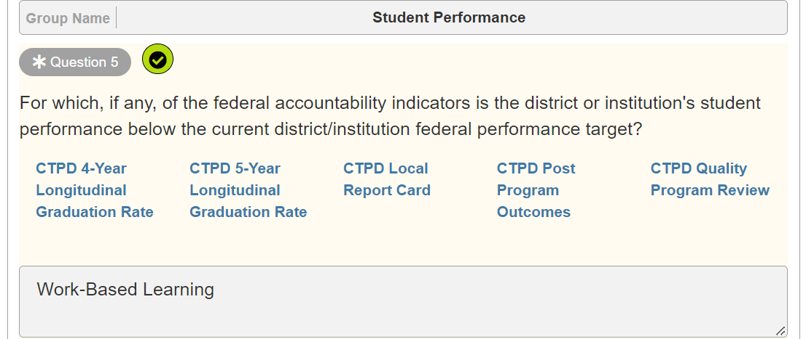
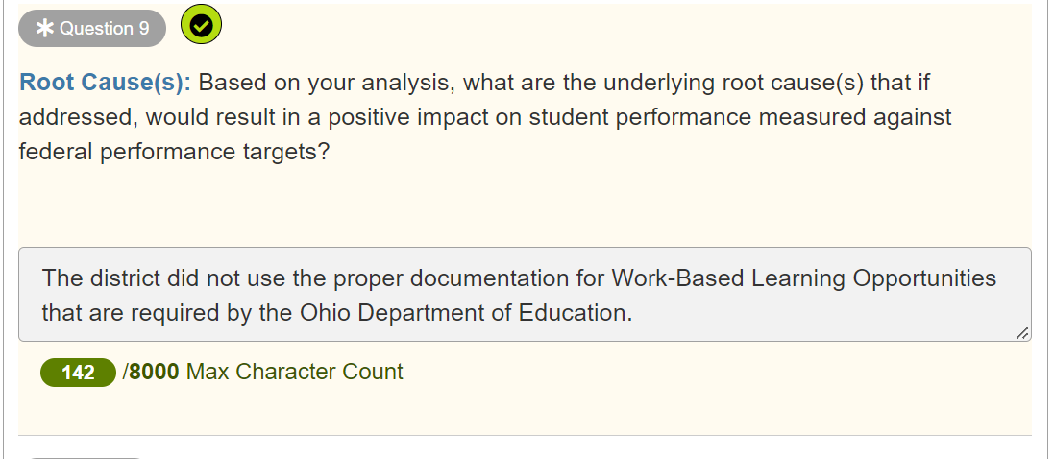
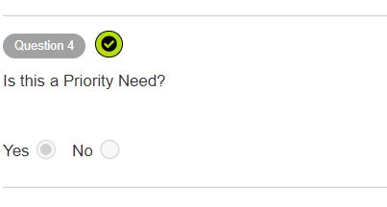
Completing the Question Groups
Include any Program Improvement Plans Root Cause information with question #9.
Notes:
As I stated earlier, many of you have submitted your needs assessment or are close to completion. However, to better prepare for the workshop, I thought it would be best to review the Perkins Local Needs Assessment's critical components relevant to the Pre-Planning Tab and the ED STEPS process. I will use the Evaluation of Student Performance question group as an example to serve as guidance for the remaining sections. After reviewing this section, you should clearly understand what is required of you for the workshop.
After receiving feedback from the leadership team on the various questions groups, it is now time to dive into the Root Cause(s).
Any root cause identified as a priority will be pulled into the Pre-Planning tab. This information will be utilized in the Perkins Local Application/ED STEPS process.
Also, as you continue to complete the CLNA questions, please include the Root Cause(s) analysis statement from your PIPs with question #9 response.
Review slide.

Slide 7
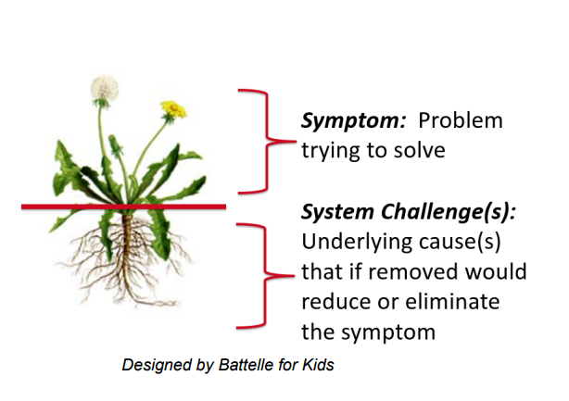
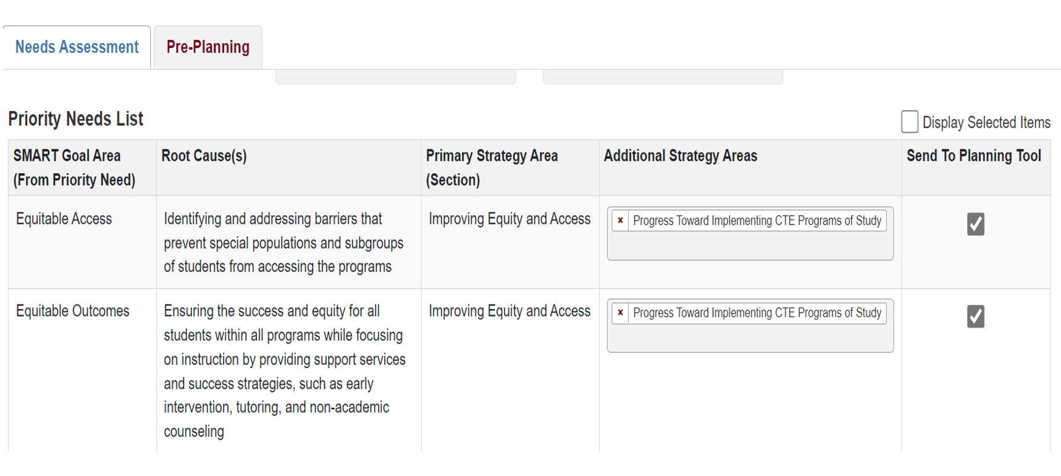
Root Cause(s)
Notes:
Now, lets review the Root Cause a little closer.
When writing the Root Cause(s), please be mindful understanding the importance of a root-cause analysis.
Once districts or institution complete the data analysis, identifying the most concerning equity gap, districts and institutions then conduct a root cause analysis to understand why there are any potential equitable gaps. Again, a root-cause analysis is a systematic strategy to determine the cause of equity gaps. It is important to differentiate between a symptom – for example, high teacher turnover – and a system challenge, or root cause, of that symptom – for example, a specific weakness in the building leadership.
Conducting-a-Root-Cause-Analysis-with-Stakeholders.pdf.aspx (ohio.gov)

Slide 8
Closing Out Perkins Local Needs Assessment
2

Slide 9
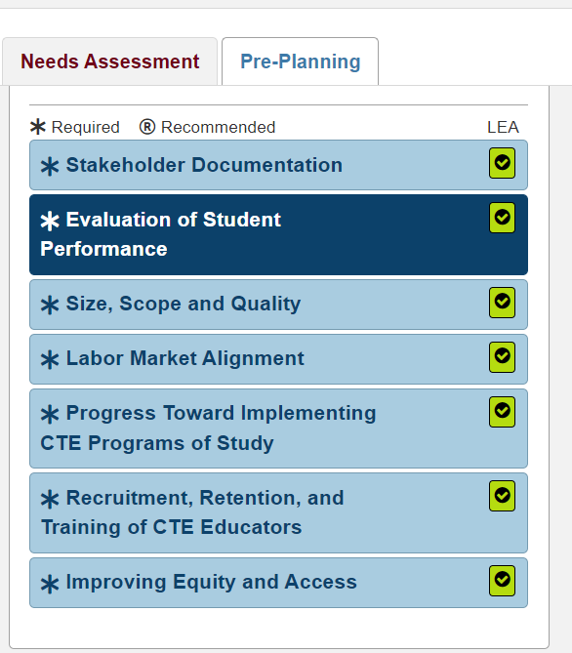
Closing out the Perkins Local Needs Assessment
Be sure to answer every question in each section.
Review the root cause analysis statement to ensure it the most concerning gap from the data analysis.
Notes:
Remember that it is essential to answer all questions, and all sections have a green checkmark. Also, again make sure to review your root cause statement, as this information is essential for the Perkins One Plan process in the ED STEPS system.

Slide 10
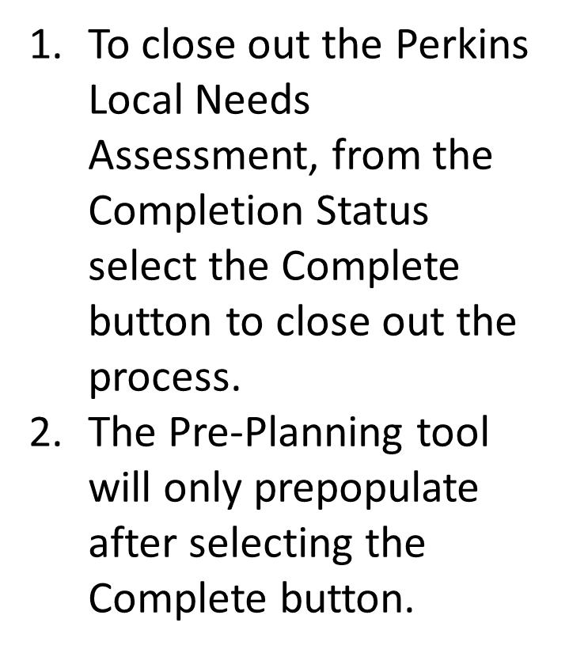
Closing out the Perkins Local Needs Assessment
Notes:
Now, how do you close out the CLNA and begin working in the Pre-Planning tab and preparing for the ED STEPS workshop? To close out the Perkins Local Needs Assessment, from the Completion Status, select the Complete button as shown here on the slide. The pre-planning tab will not transfer any information chosen as a priority until this step is completed.
Please note, you can make changes in the CLNA as needed moving from “In Progress” to “Completed” status. This flexibility will allow for you to make any changes in the Pre-Planning tab and later the Perkins One Plan.

Slide 11
Pre-Planning Tab/ED STEPS
3

Slide 12
Pre-Planning Tab
Notes:
On the Pre-Planning Tab you will see the Priority Needs List: Root Cause(s) selected as priority are pre-populated to the Pre-Planning Tab. From the Priority Needs List, select which SMART Goal Area and Root Cause(s) to send to the Planning Tool. It is very important that this step is completed prior to attending the workshop.
SMART Goal will serve as a header for the Perkins One Plan in ED STEPS
The Root Cause is pre-populated from the Perkins Local Needs Assessment. The entire narrative is transferred over. Please note, a need must be identified before an action step can be funded. (prep for Rhedeshia..)
The Strategies Area- will serve as a header for the ED STEPS planning tool.
If you recall, the information listed here can be edit at anytime it is a fluid process.

Slide 13
ED STEPS Application
Notes:
You will need this tile to access ED STEPS. Please contact your OEDS administrator to gain access. Also, it is important to have the correct OEDS role to access the system. Please make sure to have the application prior to attending the workshop.

Slide 14
ED STEPS OEDS Roles
Career Technical Planning Districts | Ohio Technical Centers | Colleges
Superintendent | Superintendent | CCIP Authorized Representative
Superintendent Designee | Superintendent Designee | CCIP Fiscal Representative Treasurer
Treasurer | Data Entry Planning-CCIP | Data Entry Funding/Planning-CCIP
CCIP Fiscal Representative | CCIP Fiscal Representative | Data Entry Funding/Planning View-CCIP
 | Treasurer
Notes:
Review and confirm if roles are accurate. The role for the correct organization type. (Review this information Tawanna)

Slide 15
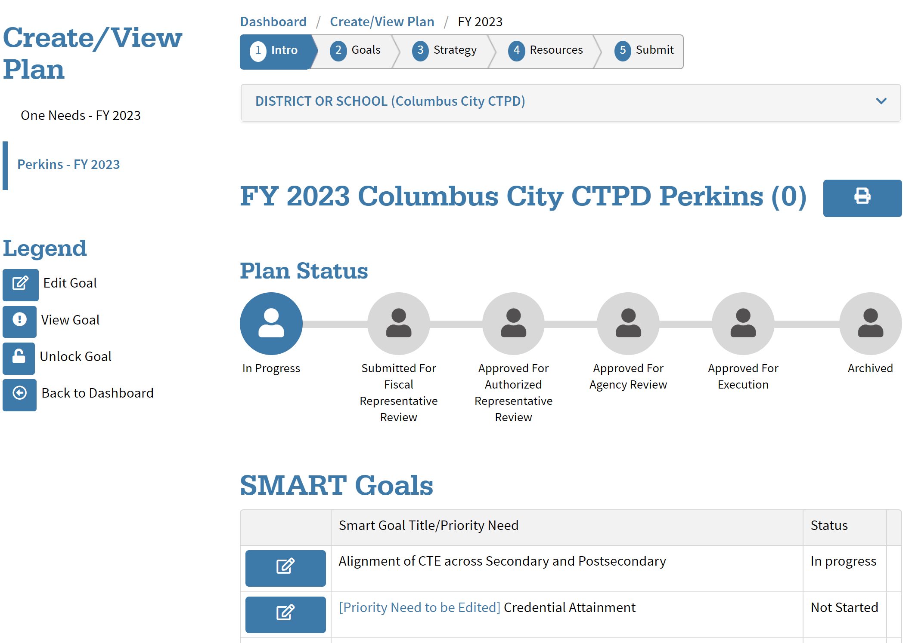
ED STEPS Dashboard
Guided step-by step process.
Access to:
Perkins One Plan
CCIP
Perkins Local Needs Assessment
Goal headers are prepopulated from the pre-planning tool.
Notes:
Now, after reviewing the Pre-Planning tab, I would like to show you the ED STEPS Perkins One Plan. Hopefully, this will help you understand how everything connects from the Perkins Needs Assessment Root Cause analysis process, to the Pre-Planning Tab items selected as priority and finally the Perkins One Plan.
What is ED STEPS?
ED STEPS is the Education Department’s System of Tiered E-Plans and Supports (ED STEPS). It is a process for improving the way the Department coordinates, collaborates and communicates to support districts and schools in addressing their needs. ED STEPS standardizes timelines and streamlines the process for assessing needs, developing plans and applying for funds. The ED STEPS process will be supported by improvements to the Department’s technology systems and tools, most notably the Comprehensive Continuous Improvement Plan (CCIP), over the next several years.
Goals were populated from the pre-planning page in the Perkins Local Needs Assessment. Goals can be changed by editing your Perkins Local Needs Assessment. So, If you want to change a goal or add a goal, you will need to go back into the needs assessment.
This is where you will begin to write your SMART goal statement.
The Perkins One Plan Dashboard provides navigational and other important information for you to implement your plan

Slide 16
ED STEPS
The SMART Goal statement is created by a list of responses selected from the drop-down menu.
Notes:
The SMART Goal Statement is completed by adding the responses to the statement that are BLUE 3 The SMART Goal statement can be completed by clicking on the item in the sentence or the row in the chart below.
As you make your selection it is populated into the SMART Goal statement.
See very easy to navigate. The workshop will go into more detail and we will walk you through the process.

Slide 17
Making the Connections
Perkins Local Needs Assessment
Root cause analysis process and identifying district needs.
Pre-Planning process
ED STEPS
Perkins Local Application
Building goals, strategies and action steps.
Comprehensive Continuous Improvement Plan Process
Budget process
Eight required questions
Approval
Perkins Local Application Rubric

Slide 18
Approvable Application/Timelines
4

Slide 19
Criteria for an Approvable Application
Comprehensive Local Needs Assessment
Goals, Strategies and Action Steps
Budget
Required Elements Document
Notes:
Element of substantial approval.

Slide 20
Completed CLNA
Diverse Group of Stakeholders
Root Cause
Notes:
Stakeholders
Root cause analysis should identify factors that contribute to the identified gap.

Slide 21
Goals
Goal Alignment
S.M.A.R.T.
Notes:
The EdSTEPS system will only allow you to set goals for priority needs identified in the assessment system. Those goals must be supported by the documented root cause. EdSTeps provides dropdown menus to build out your SMART goals.
SPECIFIC will answer the five “W” questions:
Who is involved?
What do I want to accomplish?
Identify a location.
Establish a time frame.
Specific reasons, purpose or benefits of accomplishing the goal. The Why is addressing the documented ROOT CAUSE
MEASURABLE
How much? How many?
Attainable - Achievable
Realistic – Results Focused
TIMELY
In what time will you see tangible results

Slide 22
Strategies and Action Steps
Goals
Strategies
Action Steps
Notes:
The Strategies must align to the goal. The EdSteps system ties the permissible use of funds category to your strategy.
Remember the Action Steps fully describe the steps to implement each strategy and address who, what, when, where, and how the action step will occur. Each action step connects to a corresponding goal AND each action step has identified allowable funding resource.

Slide 23
Checklist
Notes:
The above document will be available at the regional workshops and posted to the website. This document shows what we are looking for in a quality submission of your local application.

Slide 24
Preparing for Local Application
Perkins Local Application (ED STEPS)
CCIP
Goals Strategies
Funded Action Steps
Budget Perkins Required Elements
Notes:
The Local Application components will lie in two systems. The EdSTEPS system houses the implementation planning for this year’s application. The goals, strategies and action steps of your plan are compiled and will be submitted through the EdSTEPs system. The budget will be completed in CCIP. Along with the budget, Perkins local application will require the ‘Required Elements- FY23’ document to be uploaded in the CCIP system. As you may recall from last year’s application, section 3 of the local application required local recipients to answer 8 questions. The questions are identical to last year. This required document must be answered and uploaded as part of the submission process.
As you consider what action steps will be funded, you are building your budget.

Slide 25
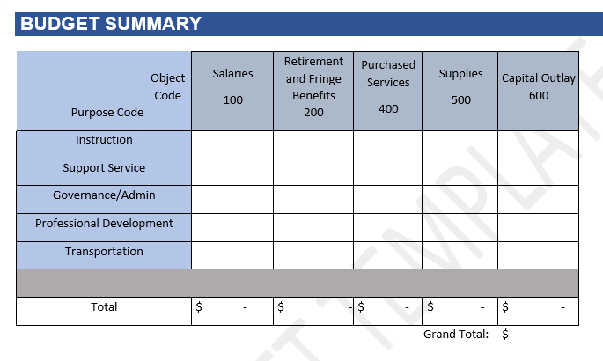
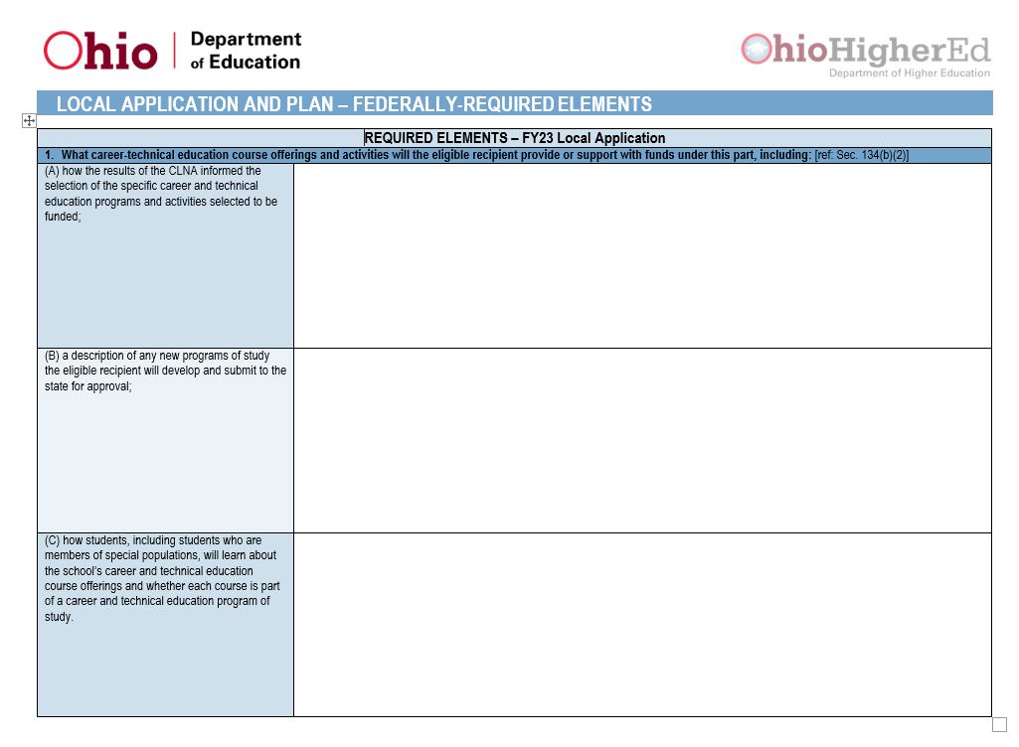
CCIP Entry and Upload for Submission
Budget Entry
Document Upload
Notes:
The budget entry will be completed in the CCIP and all funds must total the current year allocation. At the time of submission, the Federal Required Element document must have all 8 questions answered with the submission. (CCIP document upload on the Sections page)

Slide 26
Deadlines
Substantial Approval Date July,1, 2022
Local Application
By June 15, 2022
Completed CLNA
FY2023-2024
Notes:
Arriving at the regional workshop, the CLNA must be in completed status to get a full-experience of the new system. The CLNA can be edited for completion prior to submission of your local application. The CLNA has a flexible completion date; HOWEVER, the is required to be submitted prior to the Perkins local application. The deadline for the local application is June 15, 2022. Application submitted by June 15th, will have a substantial approval date allowing the district to spend funds for this award year.

Slide 27
Homework
Complete CLNA
Goals, Strategies and Action Steps
Budget Plan
Notes:
Every question answered
Correct elements of root cause.

Slide 28
Questions
5

Slide 29
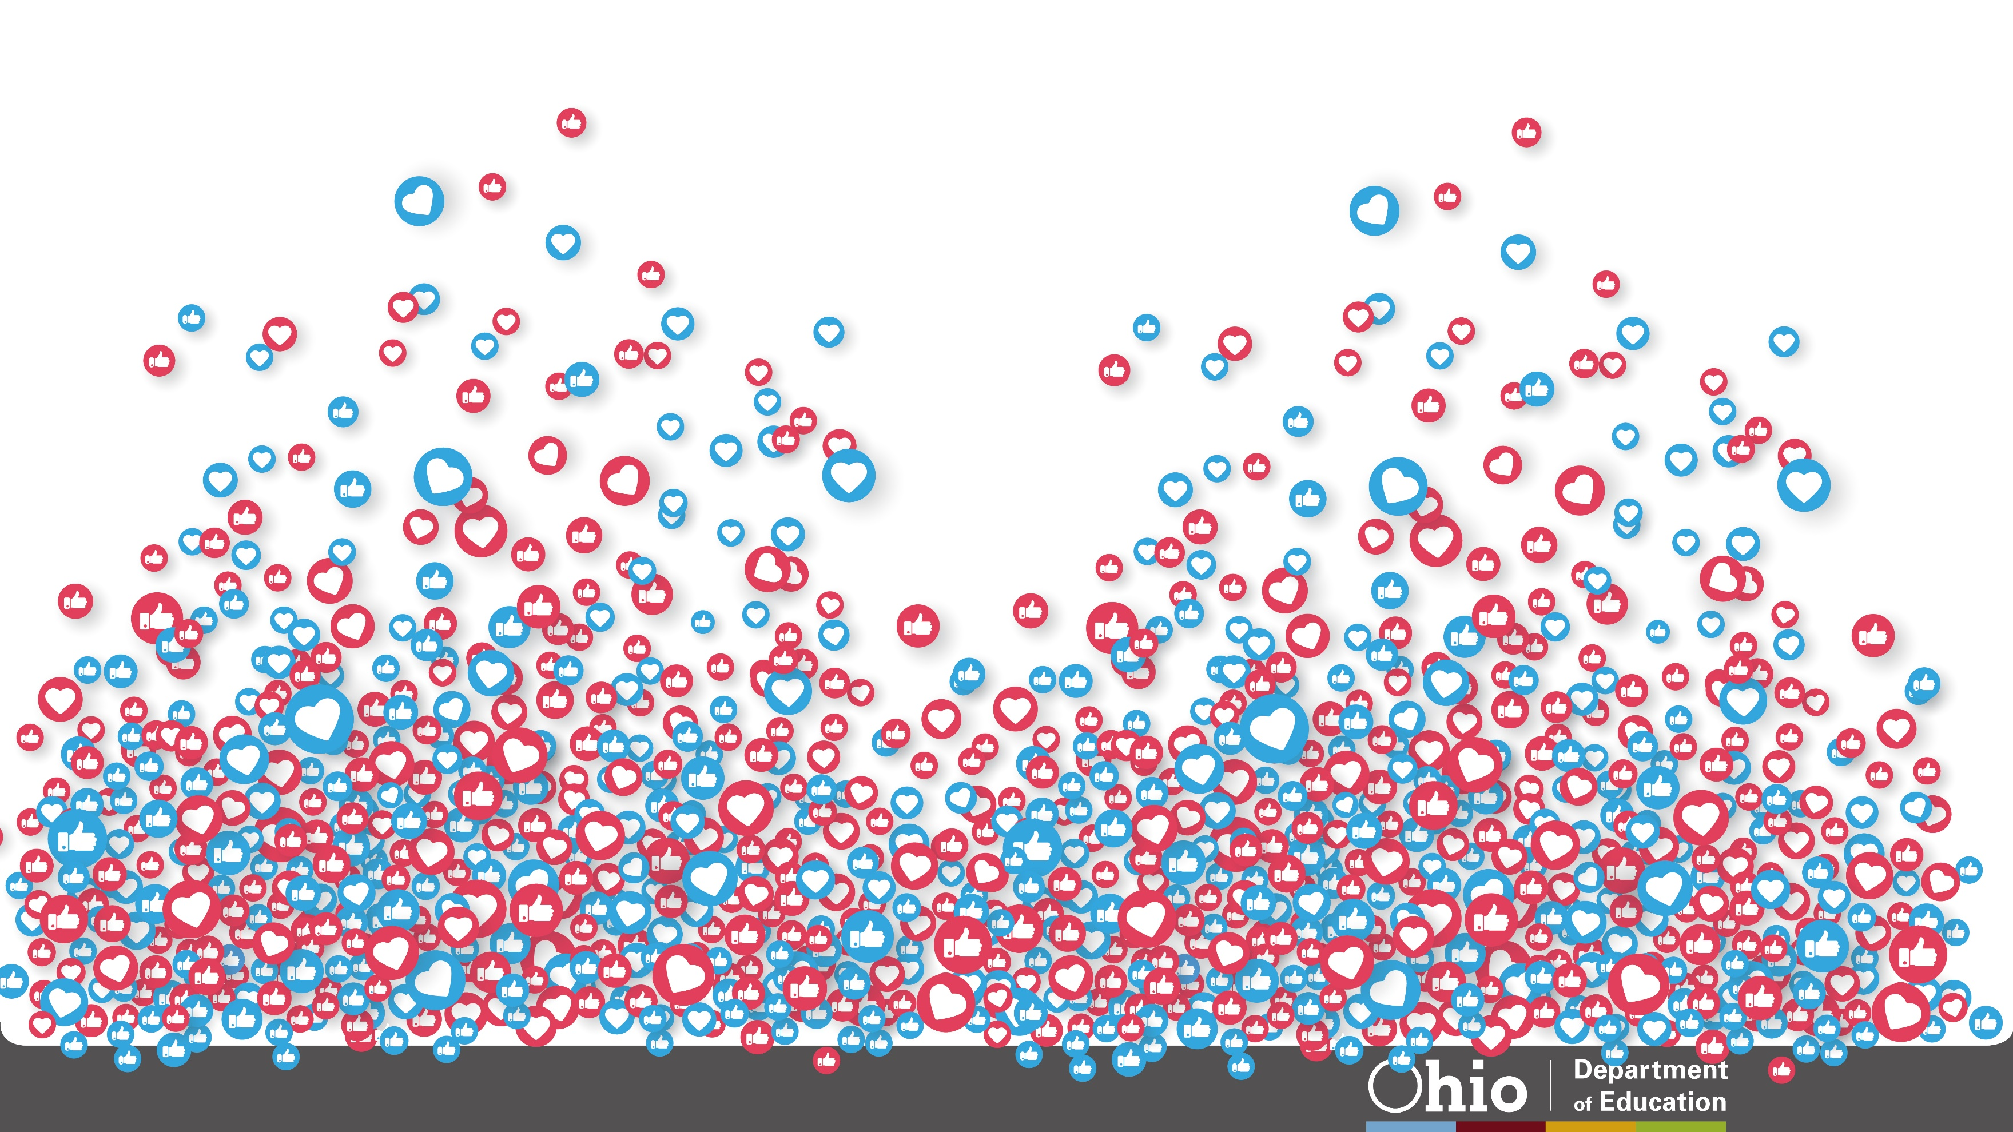
@OHEducation

Slide 30
Share your learning community with us!
#MyOhioClassroom
Celebrate educators!
#OhioLovesTeachers

