Slide 1
Quality Program Review – Year 4

Slide 2
Discussion Topics
Continuous Improvement Cycle
Evaluation of FY18 Action Plans
Celebrate & Share Successes
Modify Action Plans

Slide 3



Preparing Each Student for Success
Notes:
In Ohio, each child is challenged to discover and learn, prepared to pursue a fulfilling post-high school path and empowered to become a resilient, lifelong learner who contributes to society.
>>>TO ACHIEVE THIS GOAL
Ohio developed Quality Program Standards that offer an opportunity to drive local program improvement with a common vision. The instrument employs standards, indicators, and criteria for an understanding of what is specifically needed for a program to reach exemplary level. Students will be better prepared for connections to post-secondary education and careers upon exiting Career-Technical Education.

Slide 4
Year 4 Workshop Objectives
Receive direct support and technical assistance from the Office of Career-Technical Education staff.
Evaluate successes and challenges from implementation of the FY18 Action Plans.
Identify promising practices from FY18, share, and discover new ideas from your colleagues.
Adjust and modify FY18 Action Plans to reflect new and ongoing needs, opportunities, and lessons learned.
Notes:
Todays workshop is designed to provide:
Support through out the Quality Program Review by the Office of Career Technical Education.
Time for Districts to examine their FY18 Action Plans, reflect on implementation of the FY18 Action Plans, and celebrate and share success from their FY18 Action Plans.
A decision framework for Districts to adjust FY18 action plans by identifying needs, researching best practices, and planning action steps to implement.

Slide 5
Progress Monitoring
CYCLE FOR CONTINIOUS IMPROVEMENT
Notes:
>>> Office Facilitator shares Continues model and provides overview
Action Plan Development:
As a part of the Year 3 Quality Program Review workshop your District Identified, Researched, Planed, and Implemented steps to improve program quality for all students as measured in the Quality Program Standards. Last year your District submitted three reasonable action plans for the pathway with measurable outcomes, defined strategies, and attainable goals.
Progress Monitoring:
Is the ongoing review of adult implementation and student performance that inform your District of impact your Action Plan is having on the improvement of program quality as measured in the Quality Program Standards.
>>> Let’s Review the Cycle
Identify: Identifying critical needs begins with collecting and analyzing data, which encourages impartial, nonjudgmental decision-making when completing the Career-Technical Education Quality Program Standards survey. With analysis of reliable data, districts can pinpoint the areas of greatest concern related to the quality program review.
Research:
After identifying needs and root causes, teams research and select an evidence-based strategy that addresses the critical needs in the quality program review. Benefits of selecting an evidence-based strategy include:
Greater likelihood of positive student outcomes if the strategy is implemented as outlined in the research; and
Assurance that time and resources will go toward strategies that show evidence of achieving positive student outcomes.
Plan:
Teams planning for implementation should focus on the critical need identified during Step 1, Identify Critical Needs.
An effective plan includes:
An aligned SMART goal to the quality program review measure that is non-compliant;
Using Evidence-based strategies;
Using a progress-monitoring process for both:
Adult implementation indicators; and
Student performance indicators; and
Assign action steps to all responsible parties.
Implement:
Implementation is the focus of the district on completing each action step assigned in the Districts Action Plan.
Monitoring is collaborative learning through observing implementation of adult practices and their impact on student outcomes
Collecting ongoing adult and student data and analyzing it gives districts immediate feedback for course corrections and informs implementation and monitoring efforts.
DATA COLLECTION
on adult implementation and student performance indicators to monitor progress of selected evidence-based strategies. Teams and/or individuals collect implementation evidence that shows the level of impact.
COURSE CORRECTIONS
Implementers should base course corrections on all evidence and whether the strategy is having the intended impact.
If the strategy is not having the intended impact, corrections could include additional training, coaching or resources based on the identified need.
Examine:

Slide 6
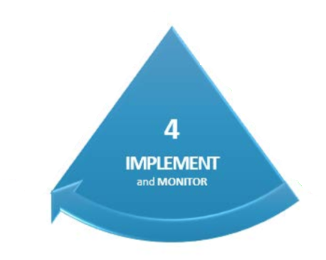
Implement &
Monitor
Page 6 of your workbook.
Notes:
In order to examine our action plan we need to retrieve that information from the CTE-26 Compliance Web Application. Once you retrieve your year 3 action plan, we will examine implementation and monitoring by taking an inventory of each action plan. Each inventory question will be an opportunity for your District discuss key information that may guide the action plan modification process this afternoon.

Slide 7
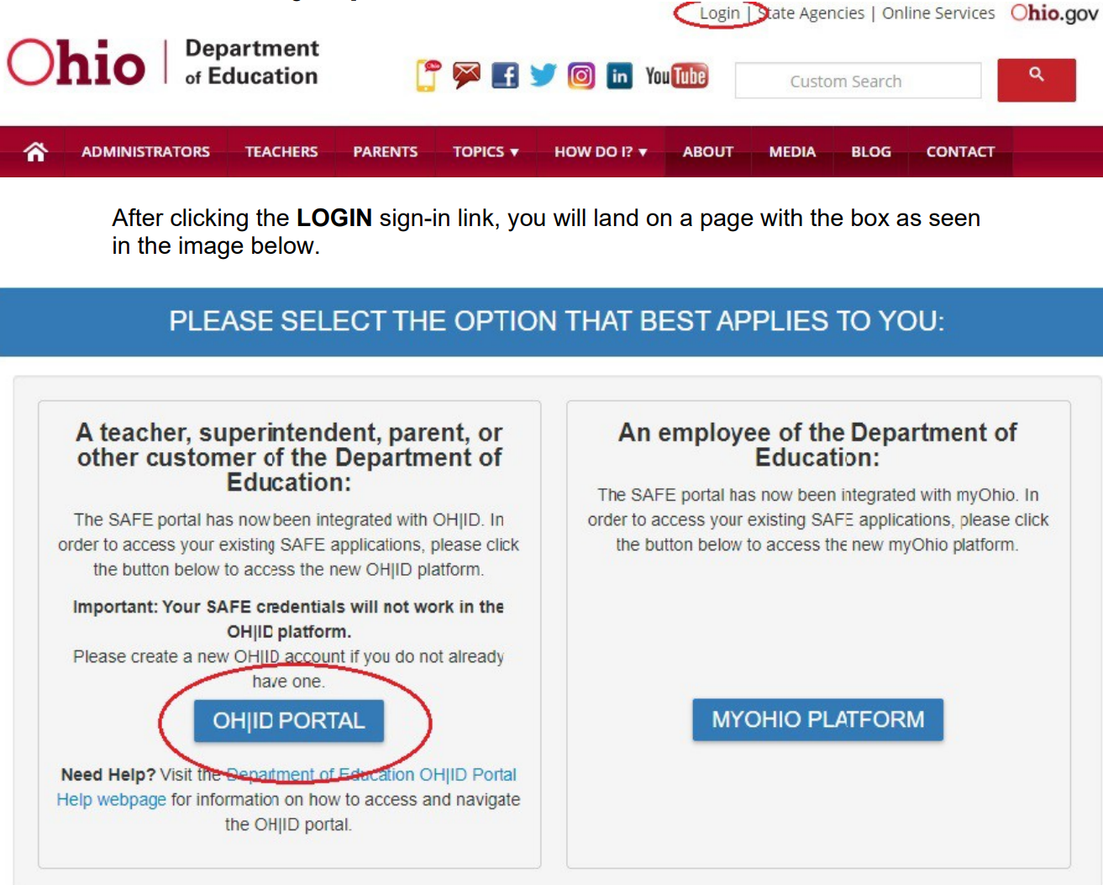
Retrieving FY18 Action Plan
CTE Quality Program Review Resources
http://education.ohio.gov/Topics/Career-Tech/CTE-Program-Review
s and workbook
Notes:
Login to your OHID Portal or SAFE Account

Slide 8
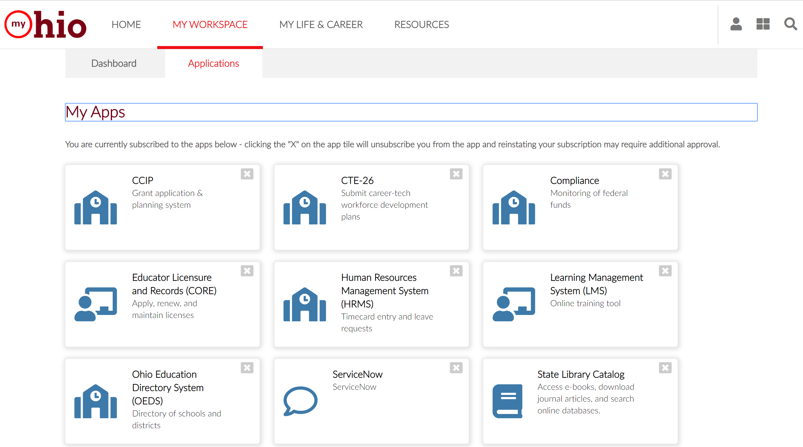
Retrieving FY18 Action Plan
SCREEN SHOT STEP BY STEP ACCESS for slides and workbook
Notes:
Select the CTE-26 web application. If you do not see this application in your My Apps screen, please ensure you have been correctly assigned an eligible role in OEDS.

Slide 9
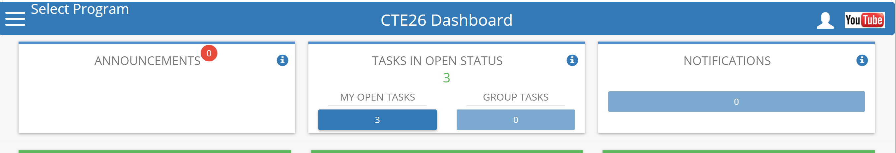
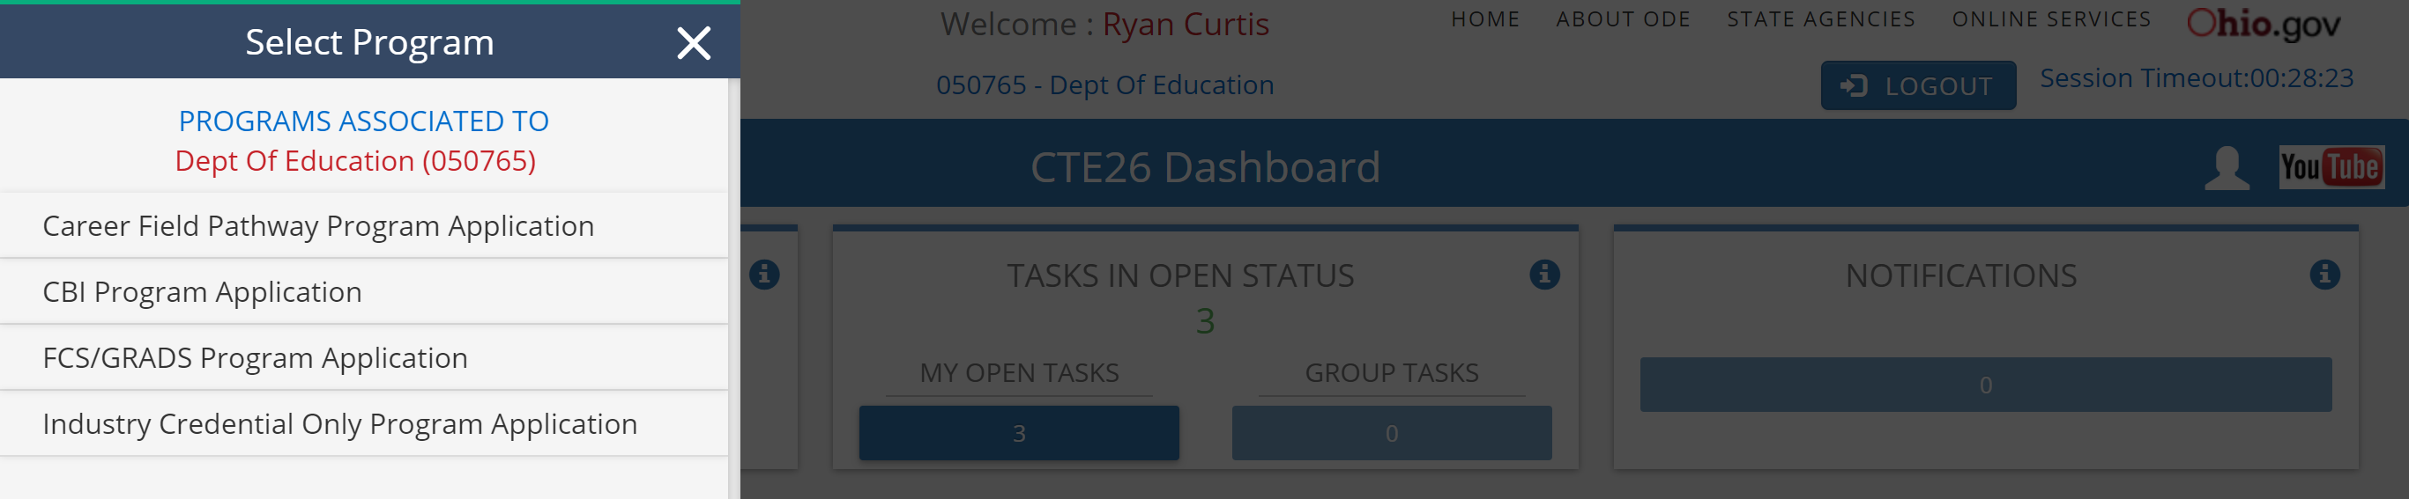
Retrieving FY18 Action Plan
SCREEN SHOT STEP BY STEP ACCESS for slides and workbook
Notes:
From you Dashboard Select program and then select Career Field Pathway Program Application from the program list.

Slide 10
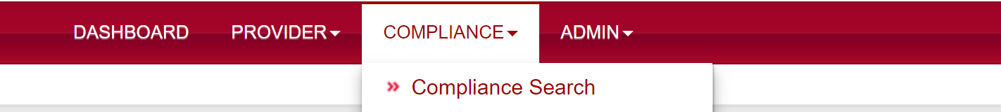
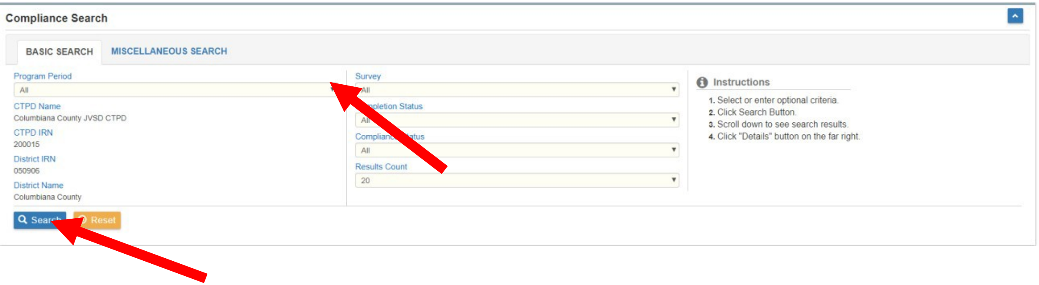
Retrieving FY18 Action Plan
Notes:
At the top of the page in the red tool bar select COMPLIANCE and Compliance Search
To access your FY18 action plans select the 2018 Compliance Program Period and select Search

Slide 11
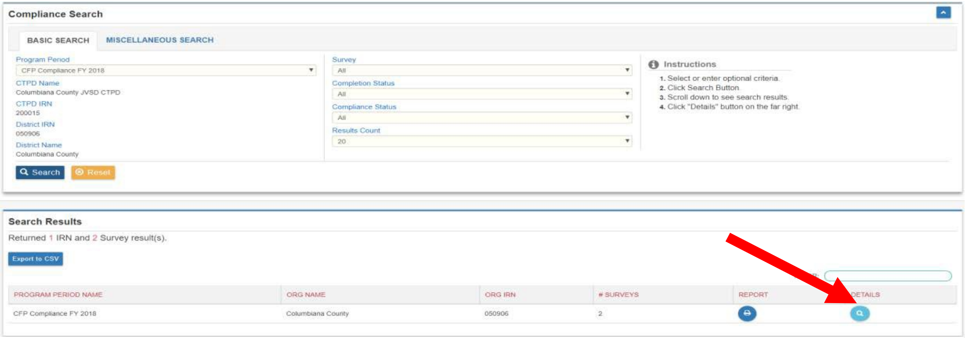
Retrieving FY18 Action Plan
Notes:
In your search results select the details icon for CFP Compliance FY 2018

Slide 12
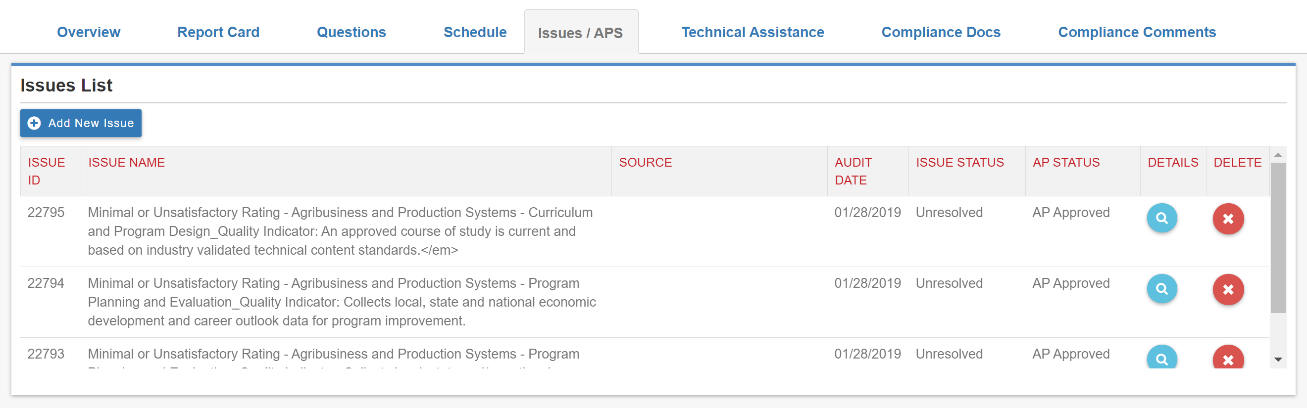
Retrieving FY18 Action Plan
Notes:
The FY18 Compliance Details select the Issues/APS TAB
Select the Details ICON of each Action Plan submitted

Slide 13
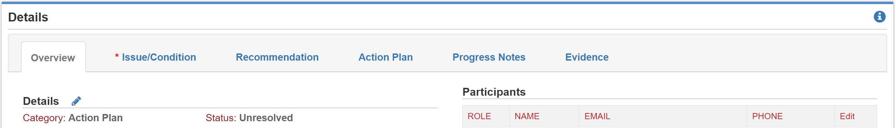
Retrieving FY18 Action Plan
Notes:
Scrolling down the screen select the Evidence tab.
Each action plan document will be examined by your team.

Slide 14
Progress Monitoring Inventory
Open workbook to Appendix I; “Progress Monitoring Inventory Worksheet Year 3”.
OR
Download the worksheet by visiting
education.ohio.gov/Topics/Career-Tech/CTE-Program-Review
Click “Action Plan Goal Template - Year 4” at the bottom of the page.
Notes:
Now that you have retrieved your year 3 action plans to examine. You are ready to take an inventory.
Appendix I in your workbook may be downloaded from the CTE Program Review Resources page. Appendix 1 is the Action Plan Goal Template PDF – Year 4
These documents will become your new action plans to be uploaded at the end of this workshop.

Slide 15
Progress Monitoring Inventory
Each pathway will complete 3 Progress Monitoring Inventory worksheets for each of the 3 submitted FY18 Action Plans.
Step 1
Identify the Action Plan pathway, standard and indicator from FY18.
Step 2
Review the Action Plan goal and strategy.
Notes:
These worksheets will become your modified action plan for FY19 and may be uploaded at the end of this workshop.
Your District will complete a set of 3 progress monitoring inventory worksheets for each pathway in 4-year non-compliance.
Step 1 Identify the action plan pathway, standard and indicator from FY18. Copy this information over to the action plan worksheet
Step 2. Review the action plan goal and strategy. Copy this information over to the action plan worksheet

Slide 16
Progress Monitoring Inventory
Step 3
Answer each question on the Progress Monitoring Inventory worksheet as a team.
Step 4
If the answer to Question 11 is “no”, participate in additional root cause analysis to determine ongoing needs.
Discuss what went well and what needs improvement.
Take notes for adjustment and modification purposes.
Notes:
Step 3. Discuss and answer questions 1-11.
During your discussion be listing for success or best practices that you can share with other Districts.

Slide 17
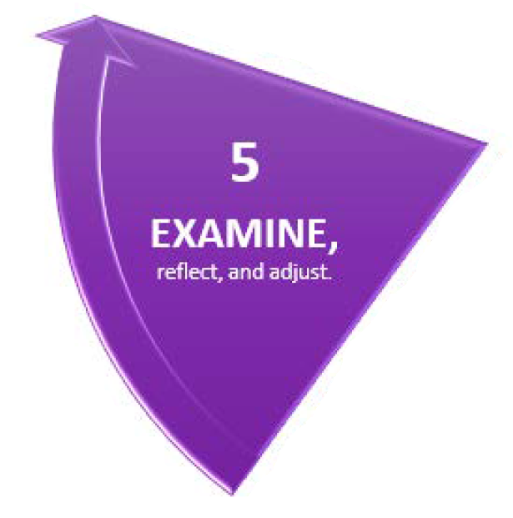
Examine, Reflect, and Adjust
Page 8 of the workbook.
Notes:
In order to examine our action plan we need to retrieve that information from the CTE-26 Compliance Web Application. Once you retrieve your year 3 action plan, we will examine implementation and monitoring by taking an inventory of each action plan. Each inventory question will be an opportunity for your District discuss key information that may guide the action plan modification process this afternoon.

Slide 18

Celebrating Success – Case Study
In order to celebrate our successes and identify promising practices for replication, each district team will complete a case study of their most successful strategy.
Utilize Appendix II; Successful Strategy Case Study in the back of your workbook.

Slide 19
Celebrating Success – Case Study
The strategy and the Quality Program Standard to which it is aligned.
The most essential action steps and the timeline in which they were achieved.
The team involved, their roles and contributions.
Notable outcomes and the data that confirms them.

Slide 20
Celebrating Success – Case Study
The most essential and impactful resources.
Other recommendations for replication!
Any favorable conditions.

Slide 21

Break for Lunch!

Slide 22
Celebrating Success
Gallery Walk
Having completed the Successful Strategy Case Study worksheet, transfer the most valuable information on to a large post-it note.
1-2 Team Members will stay with the poster to “present” their strategy.
Other Team Members should participate in a Gallery Walk to observe and learn about successful strategies from other districts.
Seek out strategies that are aligned to standards that are most relevant to your own district & pathway!

Slide 23
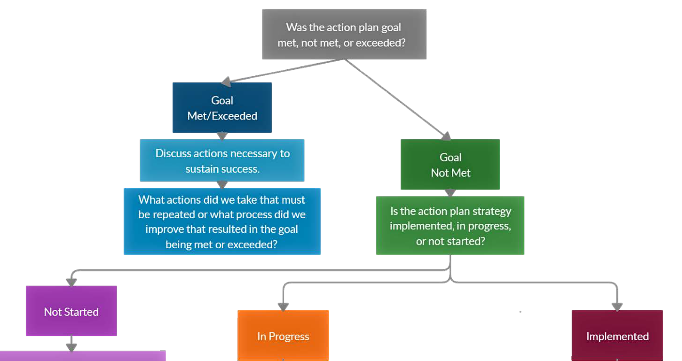
Modifying Action Plans
Action Plan Modification Decision Framework on Page 10 of the workbook.
Notes:
Now that we have examined and reflected on our FY18 Action Plans it is time for us to adjust. In your workbook on page 12 you will find a decision framework to lead your District team through the continues improvement cycle. The decision framework is a tool to assist you in identifying, researching, and planning for action to drive program quality improvement.

Slide 24
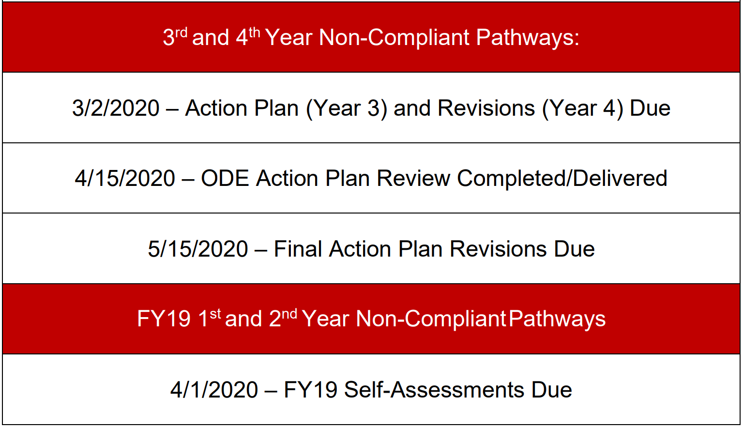
Submission Timeline
FYXX.PATHWAY CODE.STANDARD.INDICATOR
For example, you might write a goal sheet for the B0 Media Arts pathway to
Standard 7, Indicator 8, which should be saved as:
FY19.B0.7.8
Notes:
Quality Program Review Submission Timeline Overview

Slide 25
Questions?

Slide 26
Thank You!

Slide 27






@OHEducation

Slide 28

Share your learning community with us!
#MyOhioClassroom
Celebrate educators!
#OhioLovesTeachers

