Slide 1
Policy on Career Advising
Carolyn George, January 2015
Notes:
Welcome to the overview for the policy on career advising. My name is Carolyn George, Career Connections Administrator at the Ohio Dept of Ed.

Slide 2
Career Connections
Links Learning to Careers
Notes:
As part of the growing effort to prepare all students for successful futures, Ohio’s new policy on career advising establishes an outline of key supports. Through the Career Connections initiative, the department is working to expand opportunities for students to link their learning to future career options.
This new effort allows districts to formalize those strategies and build upon work already taking place in schools.

Slide 3
Model career advising policies
Districts can customize based on local needs
Flexibility and Implementation
Notes:
To get the ball rolling, the department developed model career advising policies that districts can customize based on local resources and needs.
These models recognize the need for flexibility and reflect degrees of implementation – where a district may be more established in particular areas but needs to further develop others.

Slide 4
Essentials
Adopt a policy on career advising
Post on district website
Schedule local review once every two years
Notes:
Here are the essentials on the new Career Advising policy:
By the start of the 2015-2016 school year, each city, local, exempted village and joint vocational school district must adopt a policy on career advising.
The policy must be reviewed at least once every two year, available to students, families and the community – and posted in a prominent location on the district’s website.

Slide 5
Email policies by Sept. 30
CareerConnections@education.ohio.gov
Notes:
Districts need to email their policies to the department no later than September 30, 2015 to CareerConnections@education.ohio.gov.

Slide 6
components to the policy
Notes:
The policy consists of eight components with noticeable commonalities among three topics – pathways, individualized planning, and student learning.

Slide 7
pathways
planning
learning
Notes:
The policy consists of eight components with noticeable commonalities among three topics – pathways, individualized planning, and student learning.
The policy must address how the district will provide the following eight components.

Slide 8
1
Career Connections Learning Strategies
Notes:
The first component of the policy on career advising is providing grade-level strategies that link student coursework to career fields. Schools may use the career connections learning strategies provided by the department in the model curricula … or develop their own strategies that help students see and understand the relevance of their learning to future career options.

Slide 9
Aligns with Two Systems
Ohio Teacher Evaluation System Rubric
Ohio School Counselor Association’s Evaluation System
Notes:
Note that this component aligns with two evaluation systems that the district may have adopted:
- Ohio Teacher Evaluation System – Teacher Performance Evaluation Rubric
- and Ohio School Counselor Association’s Ohio School Counselor Evaluation System.

Slide 10
2
Career Advising
for Students in
Grades 6-12
Notes:
The second component of the policy on career advising is providing career advising to students in grades 6 through 12. Schools will determine the frequency of student interaction and the type of career advising activities provided based upon student need.

Slide 11
o
l
s
S
e
t
g
a
Each student should
plan academic and career goals.
meet with a counselor.
Notes:
Research recommends that each student meet with an advisor or school counselor at least once each semester to monitor and plan academic and career goals. The model student success plan provided by the department offers suggested activities for each grade level.

Slide 12
Career
Interest
and Education
Options
Inventory
Notes:
Examples include career interest inventories, researching career and education options, and developing a draft resume. Activities may vary by school and student readiness levels. Career advising tools and documentation are covered in subsequent components of the policy.

Slide 13
3
Interventions for Students At-Risk of Dropping Out
Notes:
The third component of the policy on career advising is providing additional interventions and career advising to students who are identified as at-risk of dropping out of school.

Slide 14
Process for identifying students
Notes:
First, districts will use a local, research-based method that includes input from teachers, school counselors and other appropriate school staff.

Slide 15
Early Warning System
Includes data indicators
Notes:
The department will develop an Early Warning System, which includes a set of data indicators, that districts may use.

Slide 16
Student Success Plan
Notes:
Next, districts will develop a student success plan with each student identified as at-risk of dropping out. A student success plan addresses the student’s academic and career pathway to a successful high school graduation and the role of career-technical education, competency-based education and experiential learning as appropriate.

Slide 17
Model plan for schools to customize
Invite parent to assist
Provide copy and statement to non-participating parents
Parent signature recommended
Notes:
The department has provided a model student success plan with suggested activities for each grade level. Schools may customize the activities based upon student readiness, need and aspiration.
Before starting the plan, district staff must invite the student’s parent, guardian or custodian to assist in developing the plan.
If that adult does not participate, the district will provide them with a copy of the plan and a listing of the pathways to graduation available to the student. That notice should also include a statement of the importance of a high school diploma.
Note that research shows requiring a parent signature on the plan is more likely to engage them and increase the effectiveness of the process.

Slide 18
4
Career Pathways
Notes:
The fourth component of the policy on career advising is providing training for staff on how to advise students on pathways and training on advising students using online tools, such as OhioMeansJobs K-12.

Slide 19
Tools to cover career interests and education options
Notes:
This may also include other tools provided by the district that offer resources to students for discovering career interests, exploring and researching career and education options, and supporting the development of their student success plan.

Slide 20
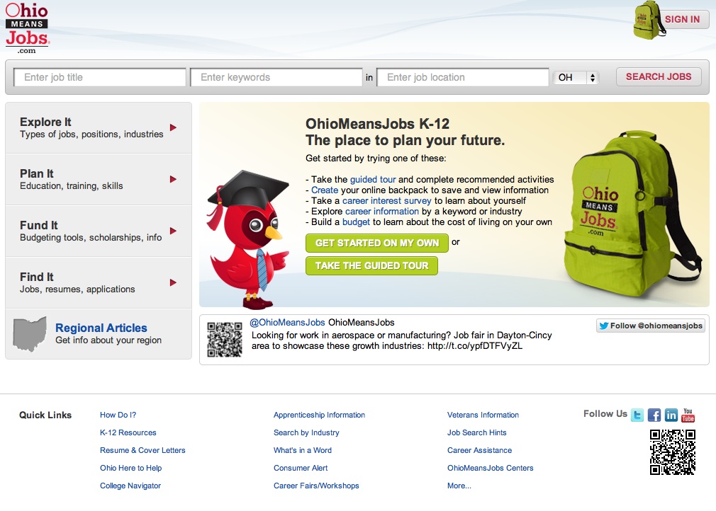
Notes:
While using OhioMeansJobs K-12 is not required, it is encouraged as a quality no-cost tool available to all districts. Online training and support materials are available on the dept’s website.
The dept has also development sample pathway documents that help align education and training to related careers. These pathways can be customized according to school course offerings as well as individual student plans for high school and beyond.

Slide 21
5
Pathways to Earn a High School Diploma
Notes:
The fifth component of the policy on career advising is providing multiple pathways through high school that students may choose to earn a high school diploma.

Slide 22
Class of 2018
Notes:
Beginning with the class of 2018, Ohio students have multiple pathways to earn a high school diploma.

Slide 23
Start learning about these options in the middle grades
Inform goals and planning
Notes:
Students will begin learning about these options in the middle grades so they may use them to inform their goals and planning.

Slide 24
Notes:
Districts may use the pathways provided by the department to offer students examples of the pathways available to earn a high school diploma.

Slide 25
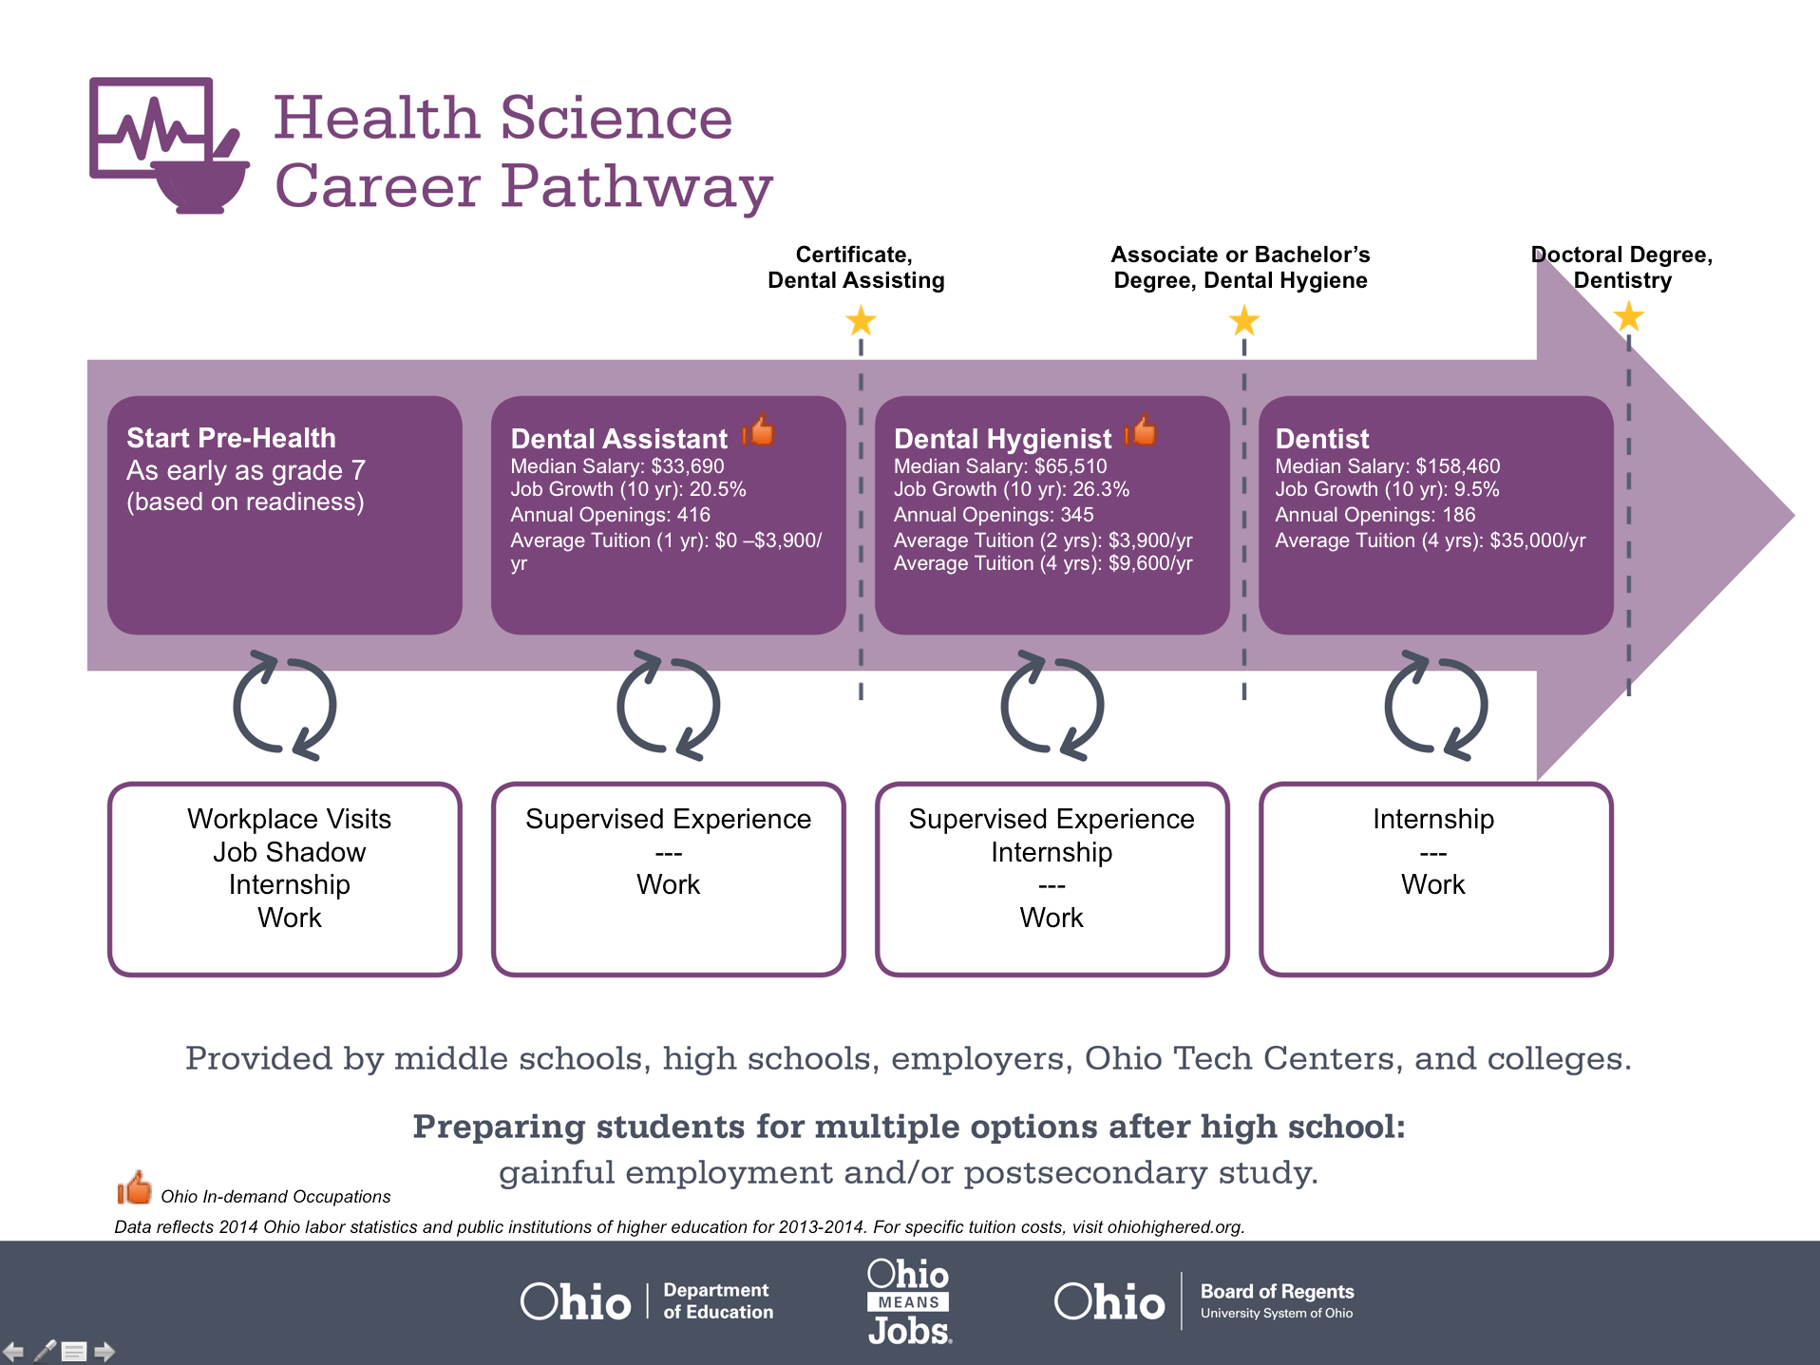
Notes:
Options highlighted in the pathway may include opportunities for students to earn credentials and college credit.

Slide 26
6
Credit Flexibility – Academic and Career Tech
Notes:
The sixth component of the policy on career advising is providing information to students on courses that can award both traditional academic and career-technical credit.

Slide 27
Academic Credit
Credit Flex
Integrated credit
Notes:
One option for accomplishing this is through credit flex, where academic credit may be earned in flexible ways through options described in existing school policy.
The second option is for the district to allow students to meet a graduation requirement through a course that integrates both career-tech and academic content.

Slide 28
Integrated Courses
More time in schedule
Relevancy
Experiential opportunities
Notes:
Research supports that students who participate in integrated courses, (1) have more time in their schedule to earn college credit and industry credentials, (2) learn academic content in a relevant context and, (3) can participate in experiential learning.

Slide 29
7
Documentation
Notes:
The seventh component of the policy on career advising is providing documentation on career advising for review by the student, student’s parent, guardian, or custodian, and schools the student may attend in the future.

Slide 30
OhioMeansJobs K-12 Backpack
Notes:
Documentation may be satisfied through the OhioMeansJobs K-12 Backpack, as students complete and save activities to their individual account.

Slide 31
Support academic, career and social/emotional development.
Notes:
Otherwise, the district will need to maintain evidence of activities completed by students that support their academic, career and social/emotional development. Suggested activities by grade level are demonstrated in the model student success plan provided by the department.

Slide 32
8
Successful Postsecondary Transitions
Notes:
The eighth component of the policy on career advising is providing the supports necessary for students to have successful transitions from high school to their postsecondary destinations, including interventions and services for students in need of remediation in mathematics and English language arts.

Slide 33
Interventions for students in need of remediation
Mathematics and English language arts
Notes:
The eighth component of the policy on career advising is providing the supports necessary for students to have successful transitions from high school to their postsecondary destinations, including interventions and services for students in need of remediation in mathematics and English language arts.

Slide 34
Obligations
Enhance existing supports
Expand resources and options
Notes:
The approach to this component will vary depending on student need. Districts may recognize that there is a need to enhance existing supports with targeted interventions; this approach will ensure that the resources for students to prepare for college and career are available.
Districts may also need to expand resources and options to meet the needs of advanced learners. Examples may include: increasing course offerings and enhancing wrap-around services to support the most critical transition points for students such as entering and exiting high school.

Slide 35
Connect with Us
education.ohio.gov/CareerConnections
CareerConnections@education.ohio.gov
Notes:
This concludes the overview on the career advising policy. As we work together to prepare all students for successful futures, additional resources and supports will be available from the department.
Local boards of education should begin developing a policy on career advising to adopt by the start of the 2015-2016 school year. Once your policies have been adopted, send an electronic copy to CareerConnections@education.ohio.gov.
The department will review policies and include exemplars in an online clearinghouse for career advising strategies.
In addition, the department will continue to add tools and resources to the Career Connections webpage, available at http://education.ohio.gov/CareerConnections. In the meantime, be sure to review the existing Career Connections Framework, Career Connections Learning Strategies, and OhioMeansJobs K-12.
And look for a series of regional professional development sessions beginning Summer 2015.

