Slide 1
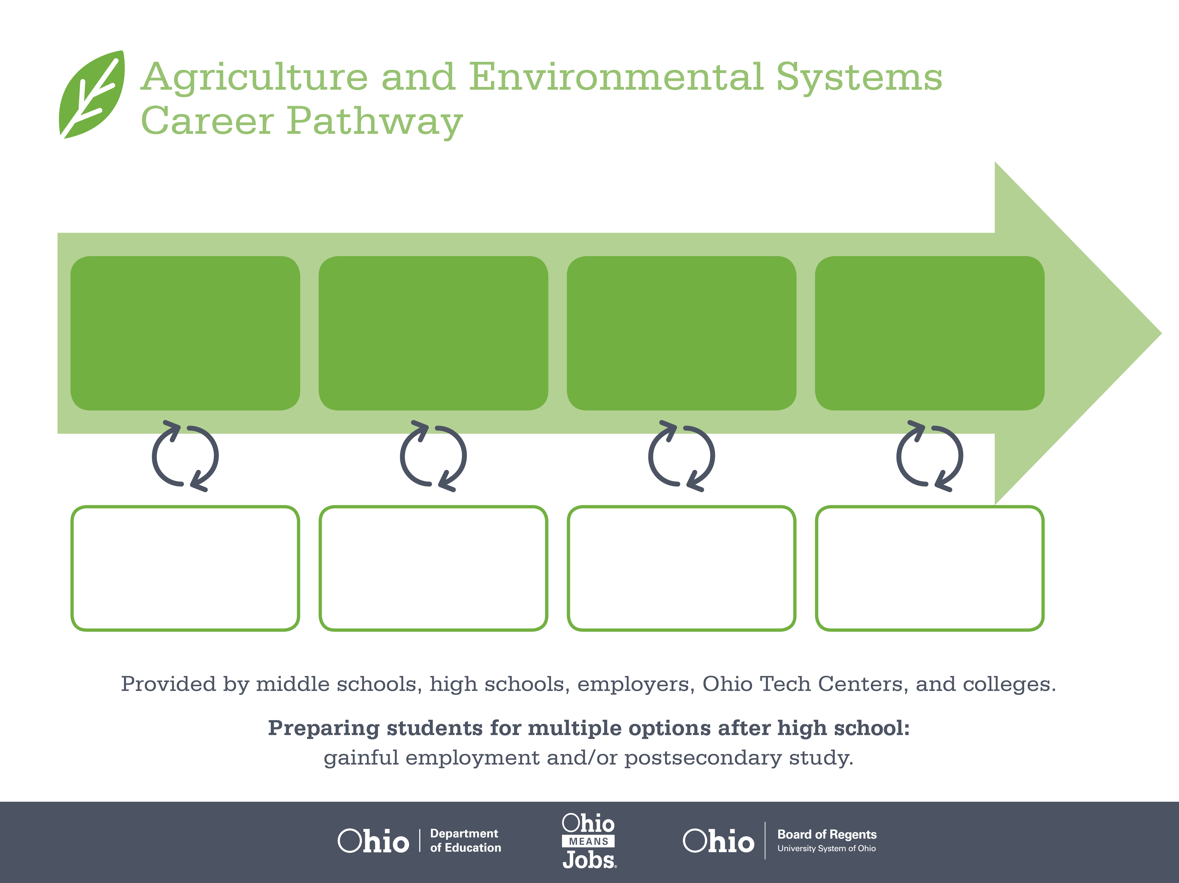
Certificate
Associate Degree,
Agricultural Business
Bachelor’s Degree,
Agricultural Systems
Management
Start Pre-Agriculture
As early as grade 7
(based on readiness)
Livestock Laborer
Median Salary: $24,210
Job Growth (10 yr): -3.3%
Annual Openings: 84
Average Tuition (1 yr): $0 – $3,900/yr
Livestock Manager
Median Salary: $48,400
Job Growth (10 yr): -4%
Annual Openings: 20
Average Tuition (2 yr): $3,900/yr
Livestock Producer
Median Salary: $61,190
Job Growth (10 yr): -3.5%
Annual Openings: 1,462
Average Tuition (4 yr): $9,600/yr
Workplace Visits
Job Shadow
Internship
Work
Supervised Experience
---
Work
Supervised Experience
Internship
---
Work
Internship
---
Work
Ohio In-demand Occupations
Data reflects 2014 Ohio labor statistics and public institutions of higher education for 2013-2014. For specific tuition costs, visit ohiohighered.org.

Slide 2

Secondary Pathway: Animal Science and Management |  |  |  |  | Postsecondary Program: Livestock Management
An Example of Courses with Secondary and Postsecondary Credits
Secondary | 7 8 | English I | Algebra I | Physical Science |  | Social Studies | Fine Arts | Animal & Plant Science | Ag, Food, & Natural Resources
 | 9 10 | English II | Geometry | Biology |  | World History | Health (.5) PE (.5) | Livestock Selection, Nutrition, & Mgt | World Languages
 | 11 | English III | Algebra II | Chemistry |  | U.S. History | Animal Health | World Languages
 | 12 | English IV | Trigonometry/ Calculus | Animal Anatomy & Physiology |  | U.S. Government | Business Management | A&E Capstone
Postsecondary | Year 1 1st Semester | Technical Writing | Technical Math | Biology |  | Computer Applications | Introduction to Animal Production | Livestock Operations Management
 | Year 1 2nd Semester | Economics | Humanities Elective | Animal Anatomy & Physiology |  | Reproductive Management | Livestock Health | Livestock Selection & Evaluation | Agri-Business Co-Op Experience
 | Year 2 1st Semester | Business Communication | Social Science Elective | Records & Analysis |  | Operations Leadership | Animal Nutrition | Manure Management | Elective
 | Year 2 2nd Semester | Reproduction & Marketing Leadership | Livestock Genetics | Small Animal Production |  | Ruminant Nutrition | Farm Business Management | Elective
 |  | High School Career-Technical Education Program Courses
 |  | High School Courses for Postsecondary Credit (Including Apprenticeship Hours) and the Corresponding Postsecondary Courses
 |  | Required Courses
 |  | Recommended Electives
Visit education.ohio.gov/CareerConnections for reference information.
Course titles and sequences will vary between schools.
11/2014

