Slide 1
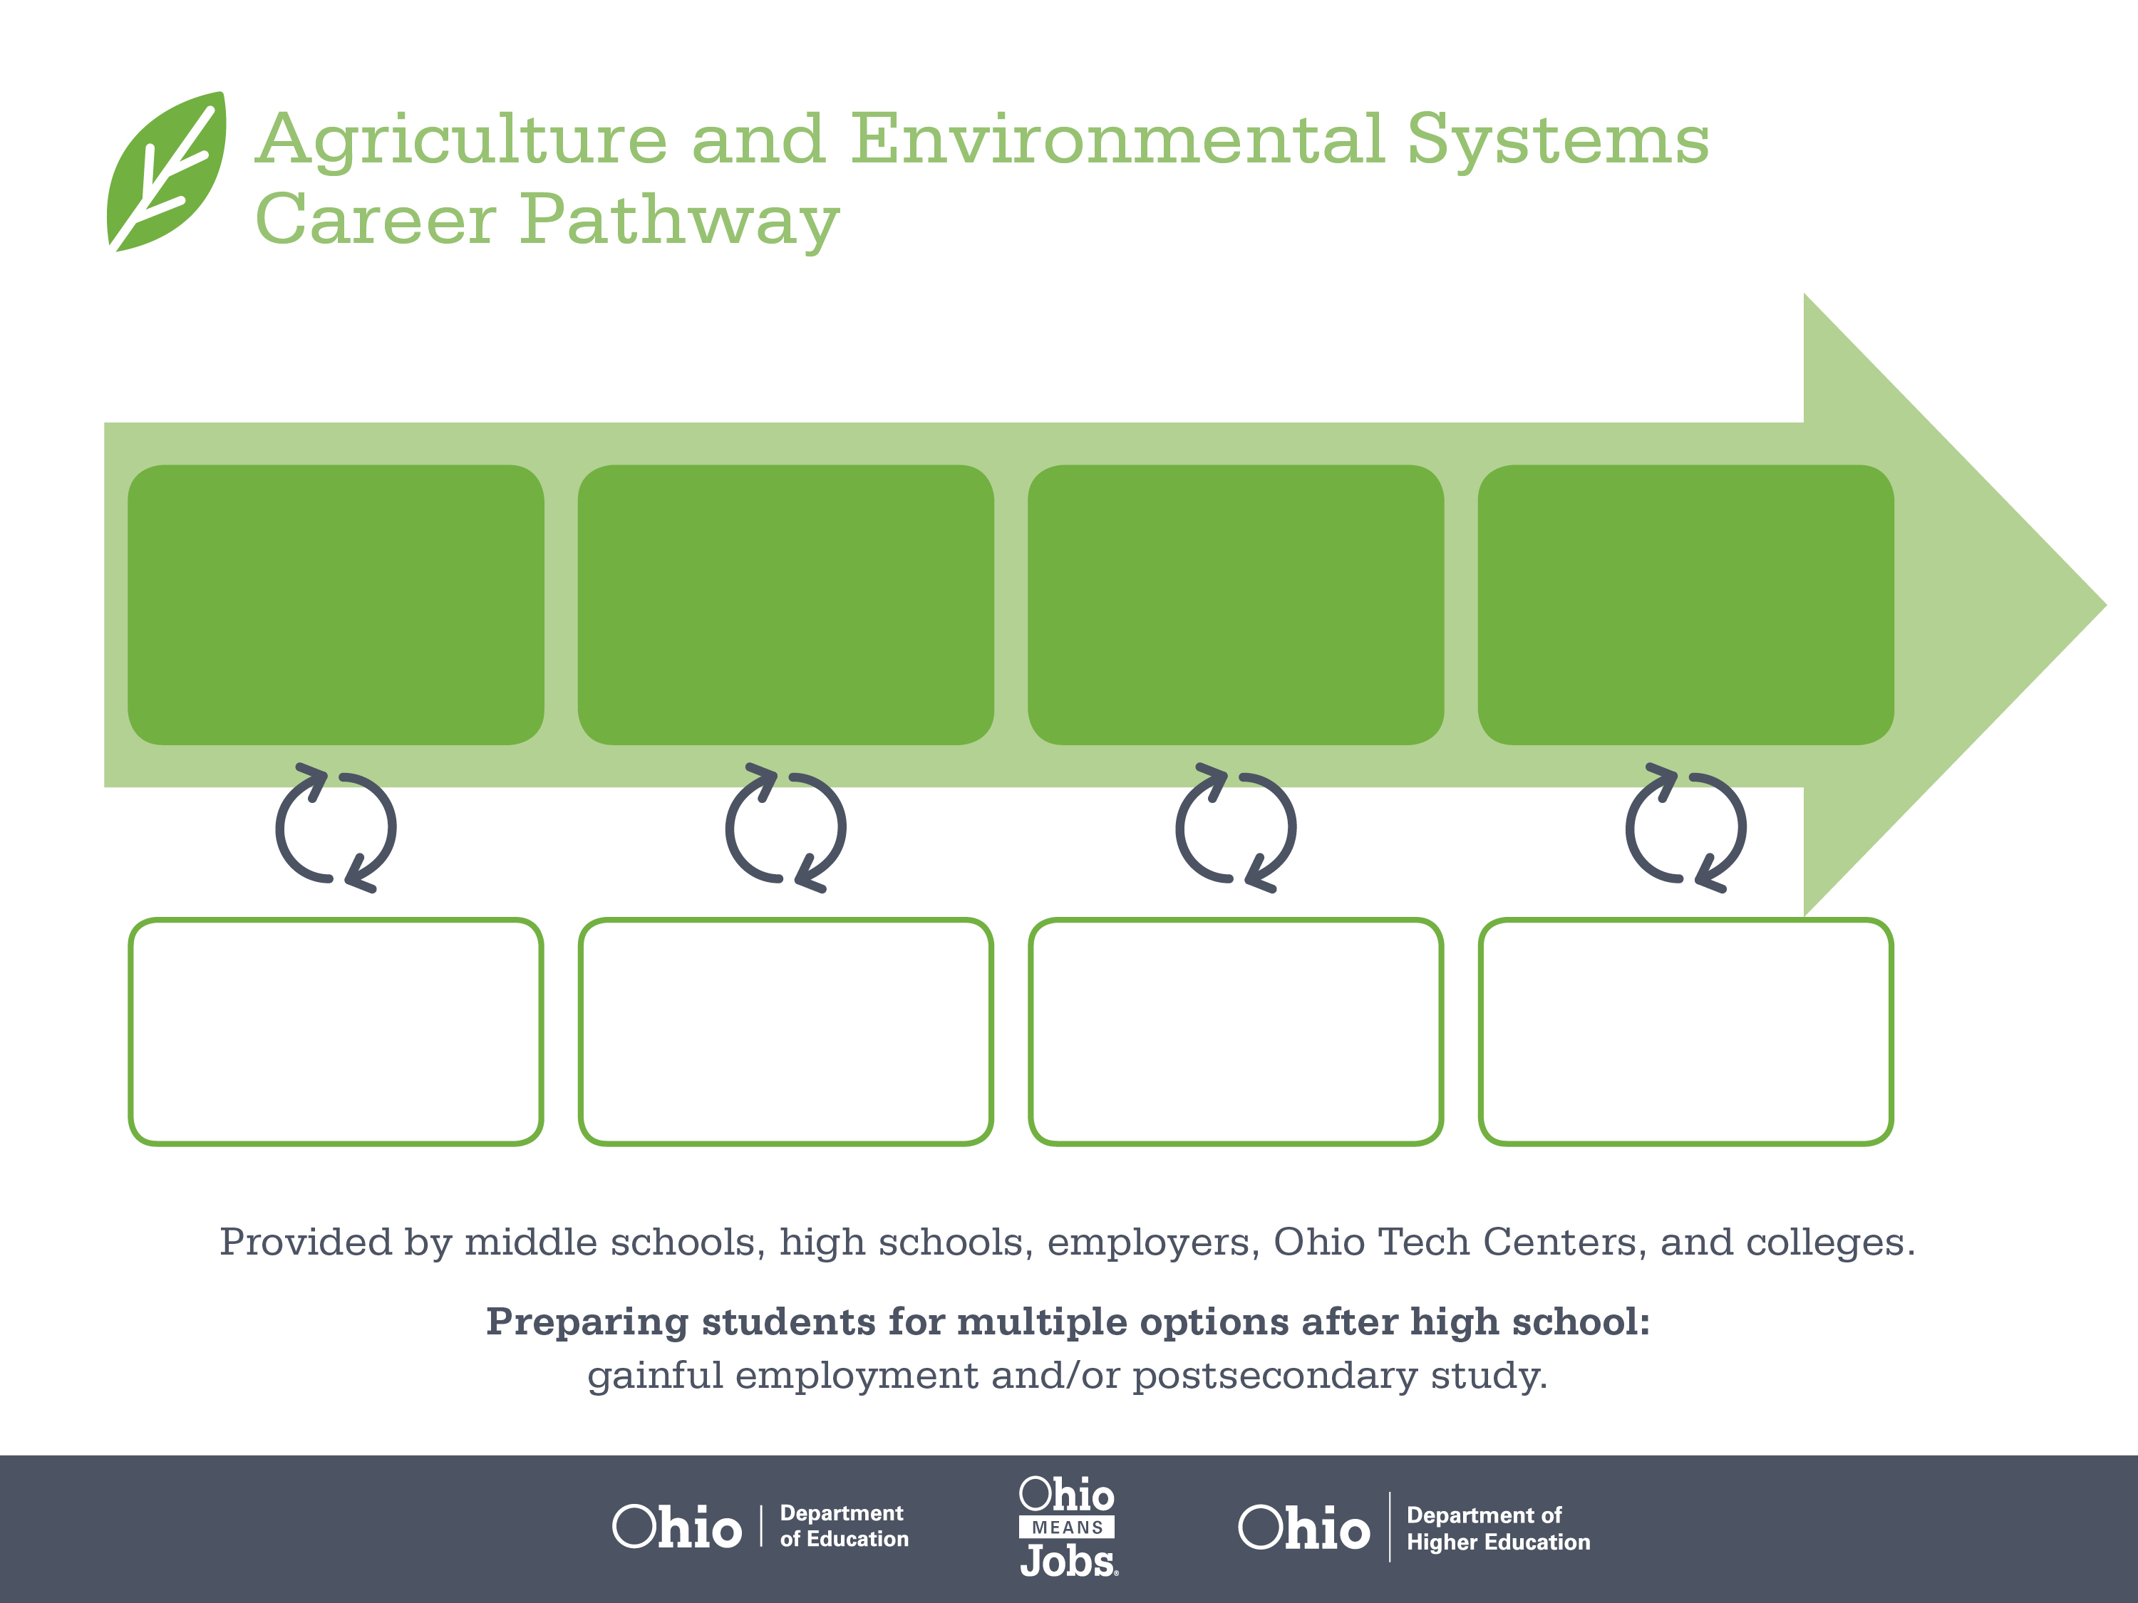
Certificate
Associate Degree,
Urban Forestry
Bachelor’s Degree,
Natural Resource
Management
Start Pre-Agriculture
As early as grade 7
(based on readiness)
Arborist
Median Salary: $32,400
Job Growth (10 yr): 13.4%
Annual Openings: 53
Average Tuition (1 yr): $0 – $3,900/yr
Forestry Specialist
Median Salary: $50,790
Job Growth (10 yr): 0%
Annual Openings: 2
Average Tuition (2 yr): $3,900/yr
Forestry Manager
Median Salary: $61,900
Job Growth (10 yr): 0%
Annual Openings: 2
Average Tuition (4 yr): $9,600/yr
Workplace Visits
Job Shadow
Internship
Work
Supervised Experience
---
Work
Supervised Experience
Internship
---
Work
Internship
---
Work
Ohio In-demand Occupations
Data reflects 2014 Ohio labor statistics and public institutions of higher education for 2013-2014. For specific tuition costs, visit ohiohighered.org.

Slide 2

Secondary Pathway: Natural Resource Management |  |  |  |  | Postsecondary Program: Urban Forestry
An Example of Courses with Secondary and Postsecondary Credits
Secondary | 7 8 | English I | Algebra I | Science |  | Social Studies | Fine Arts | Ag, Food, & Natural Resources
 | 9 10 | English II | Geometry | Biology |  | World History | Health (.5) PE (.5) | Environmental Science | Natural Resources | World Languages
 | 11 | English III | Algebra II | Chemistry |  | U.S. History | Forestry & Woodland Ecosystems | World Languages
 | 12 | English IV | Trigonometry/ Calculus | Physics |  | U.S. Government | Urban Forestry | Environmental Systems Management
Postsecondary | Year 1 1st Semester | English Composition | College Algebra | Computer Systems |  | Intro to Horticulture | Horticultural Botany | Humanities Elective
 | Year 1 2nd Semester | Chemistry | Algebra II | Arboriculture |  | Plant Identification & Selection I | Landscape Construction | Tree Care Co-Op I
 | Year 2 1st Semester | Communication | Intro to Business | Soil & Horticulture Management |  | Plant Identification& Selection II | Occupational Regulations & Safety | Irrigation Design & Maintenance
 | Year 2 2nd Semester | Professional Selling Techniques | Environmental Earth Science | Urban Forestry |  | Principles of Pest Management | Social Sciences Elective | Tree Care Co-Op II
 |  | High School Career-Technical Education Program Courses
 |  | High School Courses for Postsecondary Credit (Including Apprenticeship Hours) and the Corresponding Postsecondary Courses
 |  | Required Courses
 |  | Recommended Electives
Visit education.ohio.gov/CareerConnections for reference information.
Course titles and sequences will vary between schools.
5/2016

