Slide 1
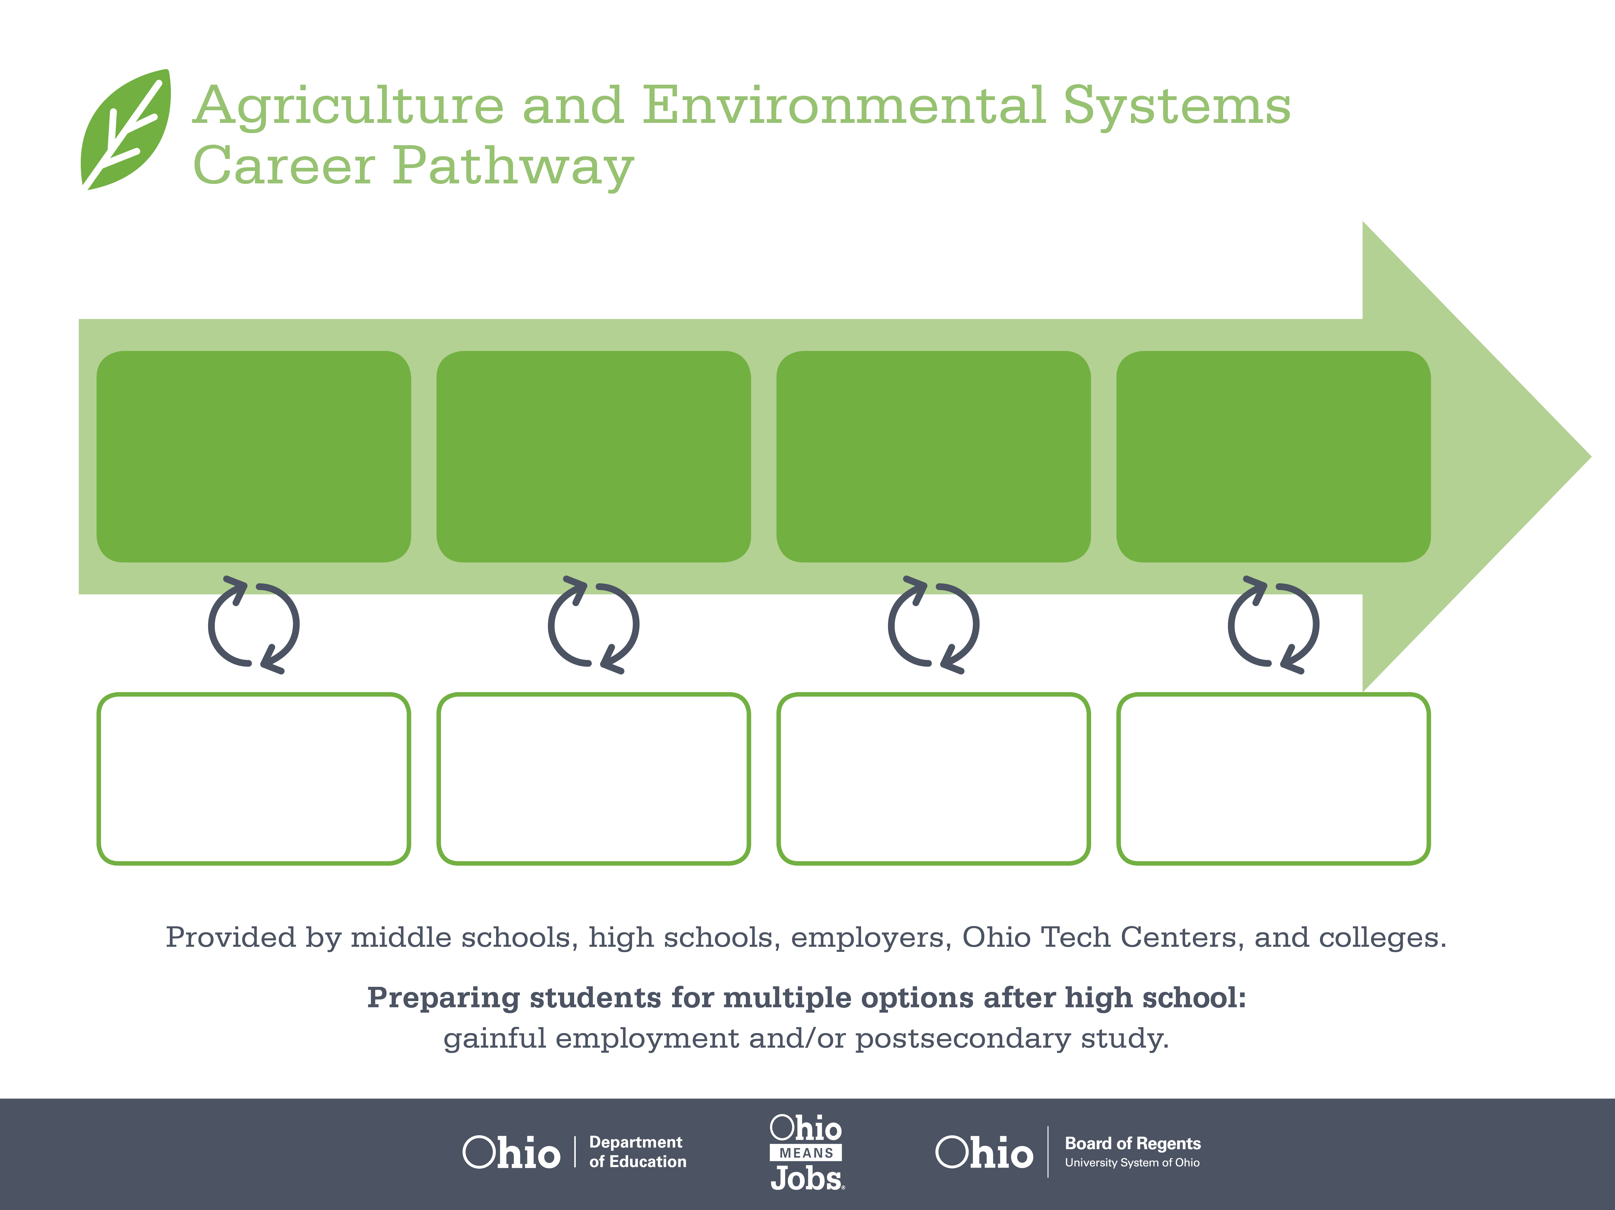
Certificate
Associate Degree,
Agricultural Business
Bachelor’s Degree,
Food Business
Management
Start Pre-Agriculture
As early as grade 7
(based on readiness)
Production Packager
Median Salary: $27,940
Job Growth (10 yr): 1.4%
Annual Openings: 275
Average Tuition (1 yr): $0 – $3,900/yr
Produce Buyer
Median Salary: $50,020
Job Growth (10 yr): 0%
Annual Openings: 8
Average Tuition (2 yrs): $3,900/yr
Purchasing Manager
Median Salary: $96,550
Job Growth (10 yr): 5.1%
Annual Openings: 90
Average Tuition (4 yrs): $9,600/yr
Workplace Visits
Job Shadow
Internship
Work
Supervised Experience
---
Work
Supervised Experience
Internship
---
Work
Internship
---
Work
Ohio In-demand Occupations
Data reflects 2014 Ohio labor statistics and public institutions of higher education for 2013-2014. For specific tuition costs, visit ohiohighered.org.

Slide 2

Secondary Pathway: Agribusiness and Production Systems |  |  |  |  | Postsecondary Program: Agricultural Business
An Example of Courses with Secondary and Postsecondary Credits
Secondary | 7 8 | English I | Algebra I | Physical Science |  | Social Studies | Fine Arts | Ag, Food, & Natural Resources | Animal & Plant Science
 | 9 10 | English II | Geometry | Biology |  | World History | Health (.5) PE (.5) | Animal & Plant Biotechnology | World Languages
 | 11 | English III | Algebra II | Chemistry |  | U.S. History | Livestock Selection, Nutrition & Mgt | Science & Technology of Food | World Languages
 | 12 | English IV | Trigonometry/ Calculus | Anatomy & Physiology |  | U.S. Government | Business Management for A & E | Agronomic Systems | Global Economics & Food Markets
Postsecondary | Year 1 1st Semester | English Composition | Exploring Business | Personal Selling |  | U.S. History | College Orientation | Food & Resource Economics
 | Year 1 2nd Semester | Agricultural Communication | College Algebra | Chemistry |  | Management Records & Analysis | Human Resources Management
 | Year 2 1st Semester | World Literature | Business Calculus | Bioscience |  | Rural Sociology | Humanities Elective
 | Year 2 2nd Semester | Marketing | Small Business Management | Business Finance |  | Microbiology | Agricultural Issues in Society
 |  | High School Career-Technical Education Program Courses
 |  | High School Courses for Postsecondary Credit (Including Apprenticeship Hours) and the Corresponding Postsecondary Courses
 |  | Required Courses
 |  | Recommended Electives
Visit education.ohio.gov/CareerConnections for reference information.
Course titles and sequences will vary between schools.
9/2015

