Slide 1
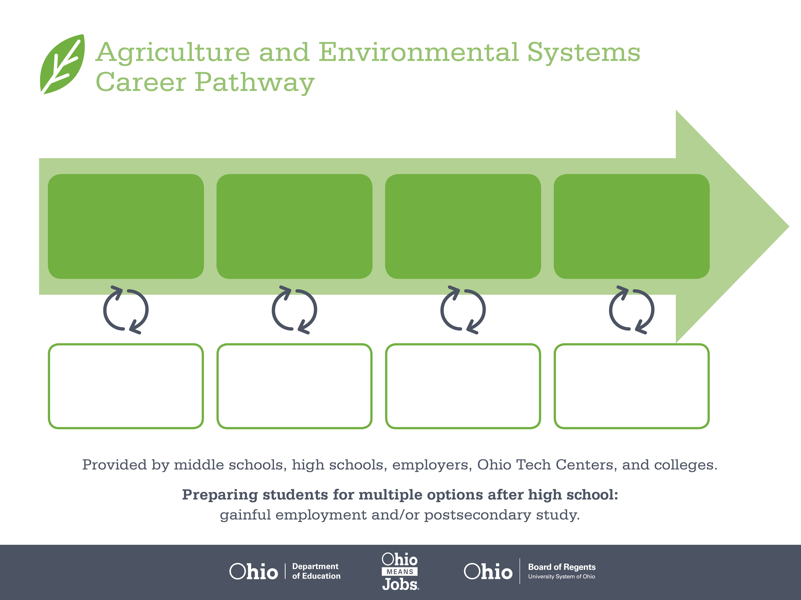
Associate Degree,
Environmental Studies
Bachelor’s Degree,
Environmental Science
Master’s Degree,
Environmental Engineering
Start Pre-Agriculture
As early as grade 7
(based on readiness)
Environmental Technician
Median Salary: $51,500
Job Growth (10 yr): 12%
Annual Openings: 17
Average Tuition (2 yrs): 3,900/yr
Environmental Specialist
Median Salary: $67,770
Job Growth (10 yr): 12%
Annual Openings: 108
Average Tuition (4 yrs): $9,600/yr
Natural Sciences Manager
Median Salary: $108,540
Job Growth (10 yr): 6.4%
Annual Openings: 72
Average Tuition (2 yrs): $11,300/yr
Workplace Visits
Job Shadow
Internship
Work
Supervised Experience
---
Work
Supervised Experience
Internship
---
Work
Internship
---
Work
Ohio In-demand Occupations
Data reflects 2014 Ohio labor statistics and public institutions of higher education for 2013-2014. For specific tuition costs, visit ohiohighered.org.

Slide 2

Secondary Pathway: Natural Resource Management |  |  |  |  | Postsecondary Program: Environmental Science
An Example of Courses with Secondary and Postsecondary Credits
Secondary | 7 8 | English I | Algebra I | Physical Science |  | Social Studies | Fine Arts | Ag, Food, & Natural Resources | Natural Resources
 | 9 10 | English II | Geometry | Biology |  | World History | Health (.5) PE (.5) | Environmental Science | World Languages
 | 11 | English III | Algebra II | Chemistry |  | U.S. History | Environmental Systems Management | Forestry & Woodland Ecosystems | World Languages
 | 12 | English IV | Trigonometry/ Calculus | Physics |  | U.S. Government | Park & Recreational Management | Urban Forestry
Postsecondary | Year 1 1st Semester | English Composition I | Biology I | College Algebra |  | Intro to Environmental Science | Environmental Laws & Regulations | Health & Safety for Water Operation
 | Year 1 2nd Semester | Technical Writing | Chemistry I | Physical Geology |  | Environmental Aspects of Soils | Environmental Site Assessment | Pollution Control | Drinking Water Treatment
 | Year 2 1st Semester | Introduction to Psychology | Hazardous Materials Management | Environmental Hydrology |  | Environmental Sampling | Safety & Loss Prevention | OSHA General Industrial Safety & Health
 | Year 2 2nd Semester | Cultural Anthropology | Environmental Analytical Methods | Applied Environmental Engineering |  | Air Pollution & Monitoring | Environmental Restoration
 |  | High School Career-Technical Education Program Courses
 |  | High School Courses for Postsecondary Credit (Including Apprenticeship Hours) and the Corresponding Postsecondary Courses
 |  | Required Courses
 |  | Recommended Electives
Visit education.ohio.gov/CareerConnections for reference information.
Course titles and sequences will vary between schools.
6/2015

