Slide 1
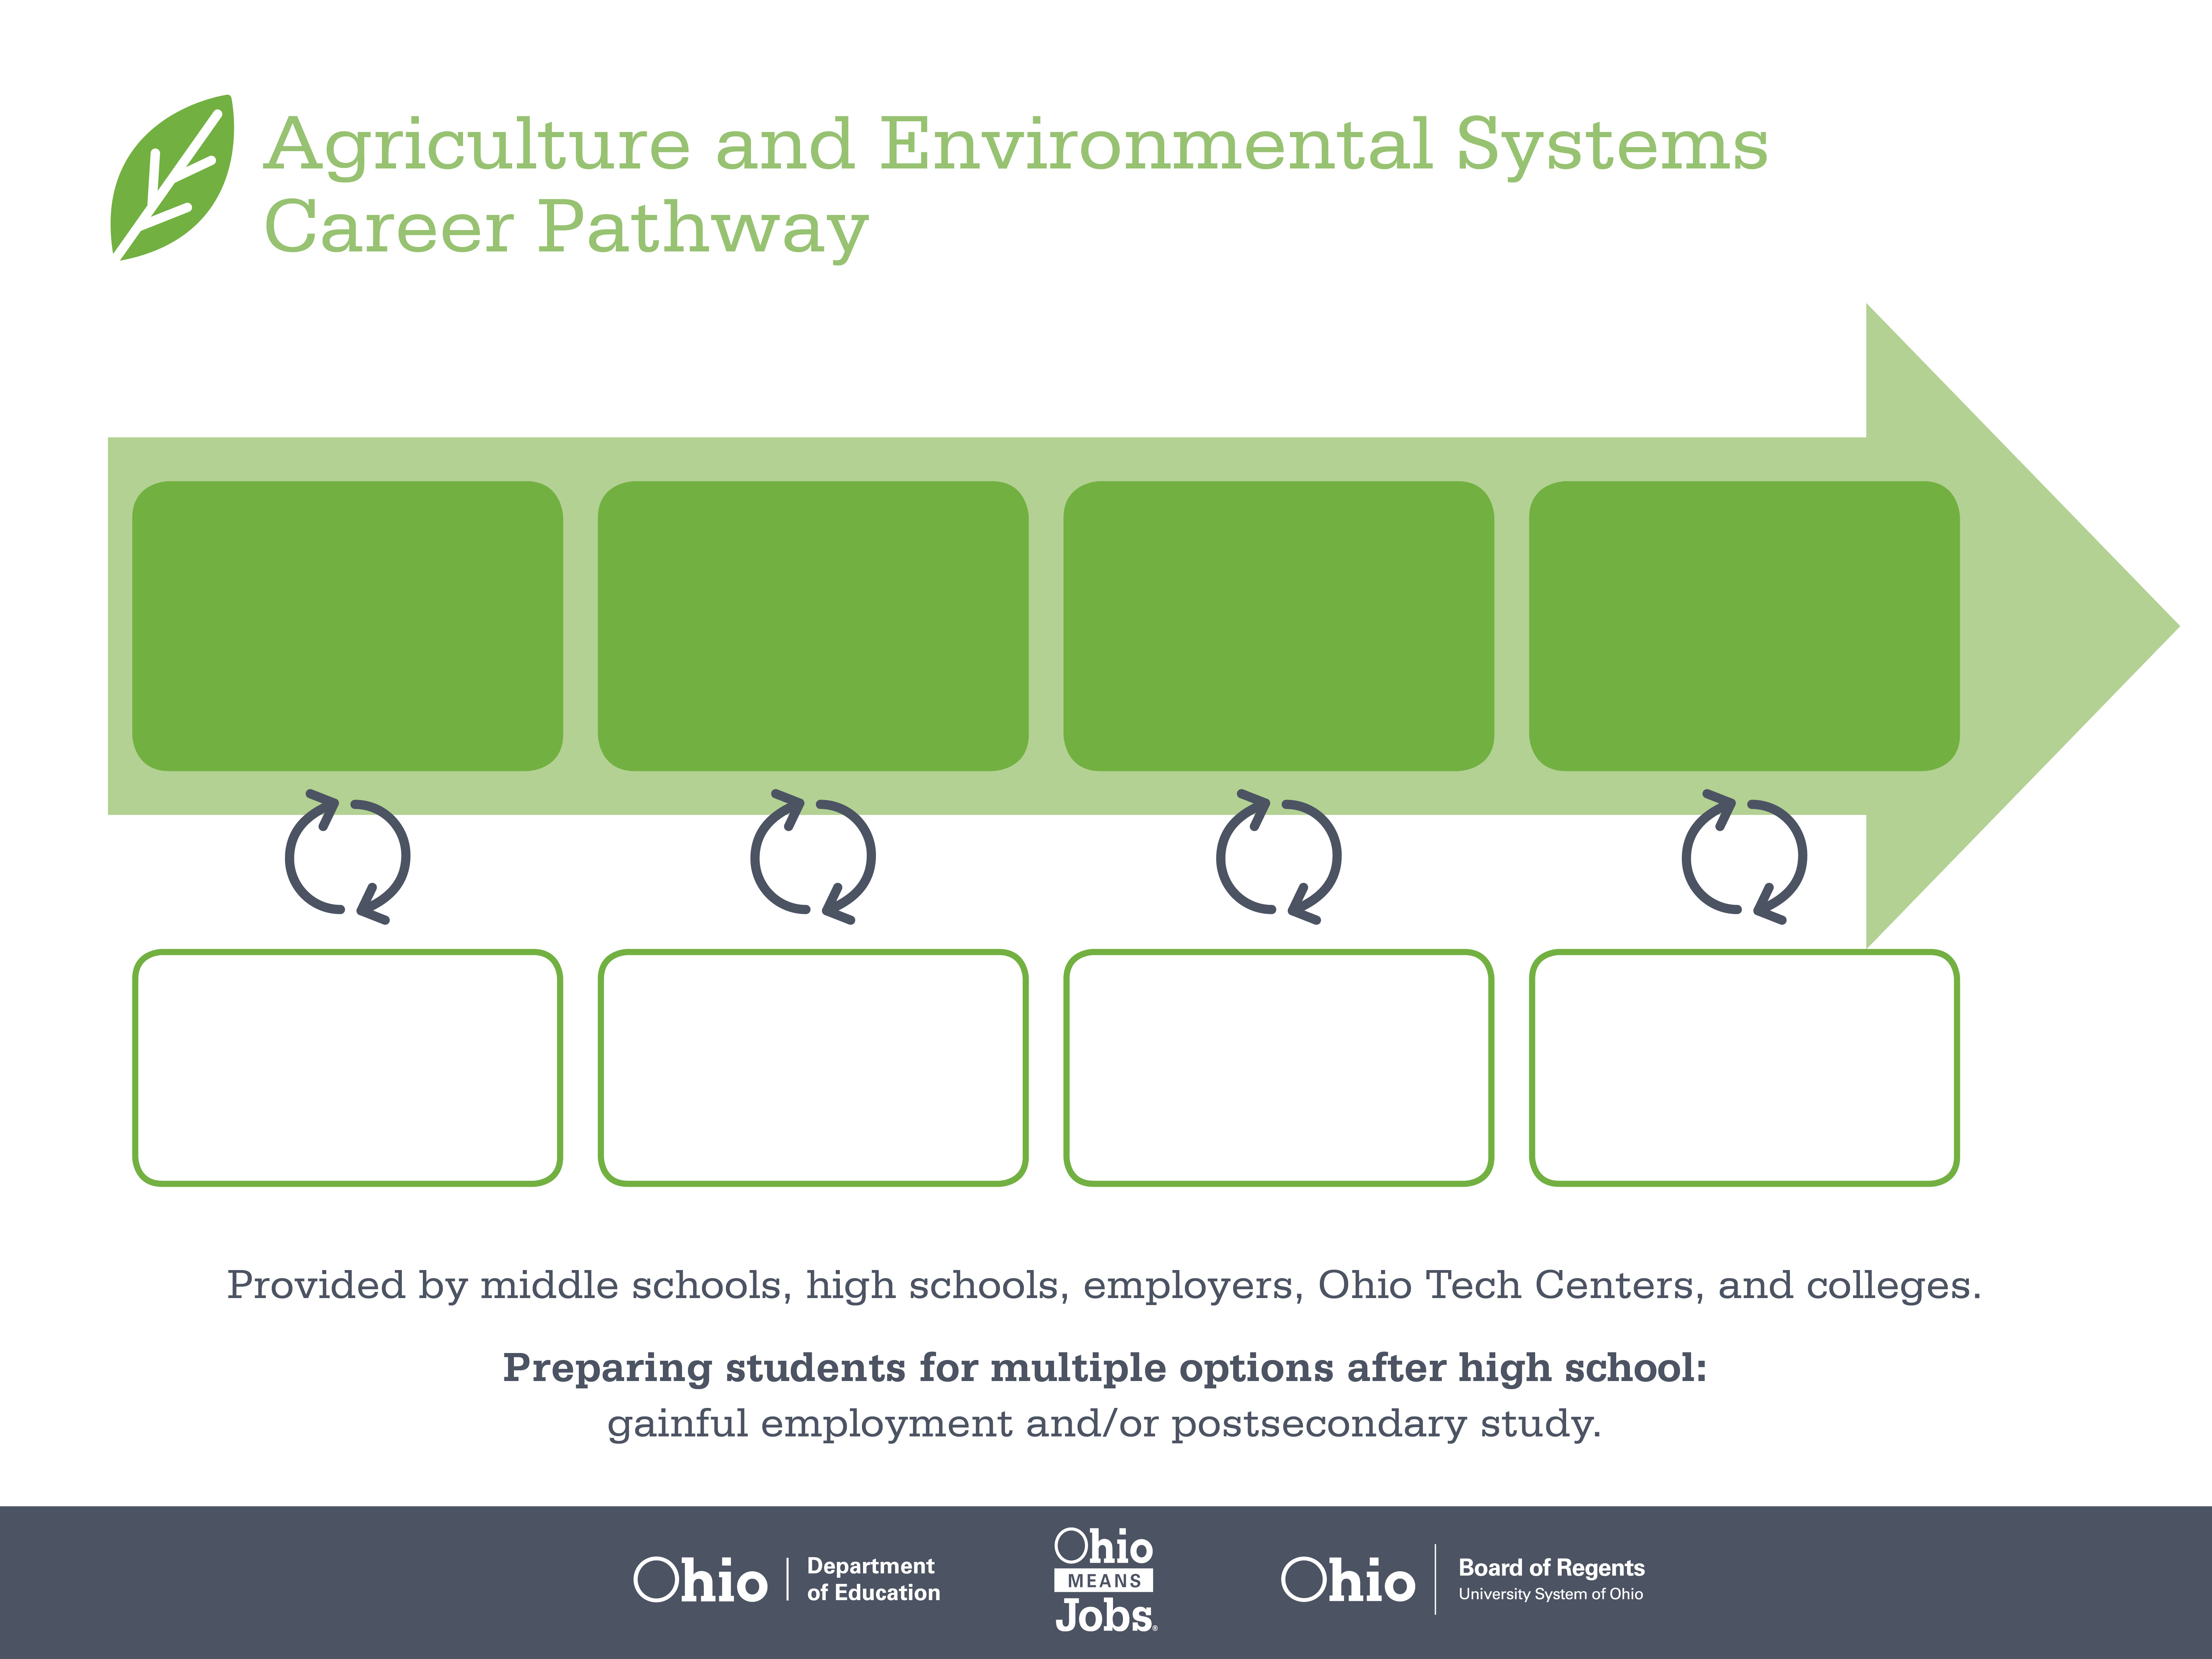
Certificate,
ServSafe
Associate Degree,
Food Technology
Bachelor’s Degree,
Food Science
Start Pre-Agriculture
As early as grade 7
(based on readiness)
Food Service Supervisor
Median Salary: $28,290
Job Growth (10 yr): 6.5%
Annual Openings: 1,332
Average Tuition (1 yr): $0 – $3,900/yr
Food Science Technician
Median Salary: $40,290
Job Growth (10 yr): -0.9%
Annual Openings: 40
Average Tuition (2 yr): $3,900/yr
Food Scientist
Median Salary: $67,180
Job Growth (10 yr): 3.5%
Annual Openings: 25
Average Tuition (4 yr): $9,600/yr
Workplace Visits
Job Shadow
Internship
Work
Supervised Experience
---
Work
Supervised Experience
Internship
---
Work
Internship
---
Work
Ohio In-demand Occupations
Data reflects 2014 Ohio labor statistics and public institutions of higher education for 2013-2014. For specific tuition costs, visit ohiohighered.org.

Slide 2

Secondary Pathway: Food Science and Technology |  |  |  |  | Postsecondary Program: Food Science and Technology
An Example of Courses with Secondary and Postsecondary Credits
Secondary | 7 8 | English I | Algebra I | Physical Science |  | Social Studies | Fine Arts | Science and Technology of Food | Ag, Food, & Natural Resources
 | 9 10 | English II | Geometry | Biology |  | World History | Health (.5) PE (.5) | Applications of Food Science & Safety | Principles & Practices of Bioscience | World Languages
 | 11 | English III | Algebra II | Chemistry |  | U.S. History | Meat Science/ Genetics | World Languages
 | 12 | English IV | Trigonometry/ Calculus | Anatomy & Physiology |  | U.S. Government | Food Marketing & Research | A&E Capstone | Agriculture Communication & Leadership
Postsecondary | Year 1 1st Semester | English Composition | Intro to Food Science | Chemistry I |  | Human Nutrition
 | Year 1 2nd Semester | Public Speaking | Food Safety | Chemistry II |  | Biology I | Food Regulations
 | Year 2 1st Semester | Ethics | Technical Math | Advanced Food Science |  | Microbiology | Sensory Evaluation | Seminar
 | Year 2 2nd Semester | Product Development | HACCP Safety Training | Food Chemistry |  | Product Processing | Food Production
 |  | High School Career-Technical Education Program Courses
 |  | High School Courses for Postsecondary Credit (Including Apprenticeship Hours) and the Corresponding Postsecondary Courses
 |  | Required Courses
 |  | Recommended Electives
Visit education.ohio.gov/CareerConnections for reference information.
Course titles and sequences will vary between schools.
11/2014

