Slide 1
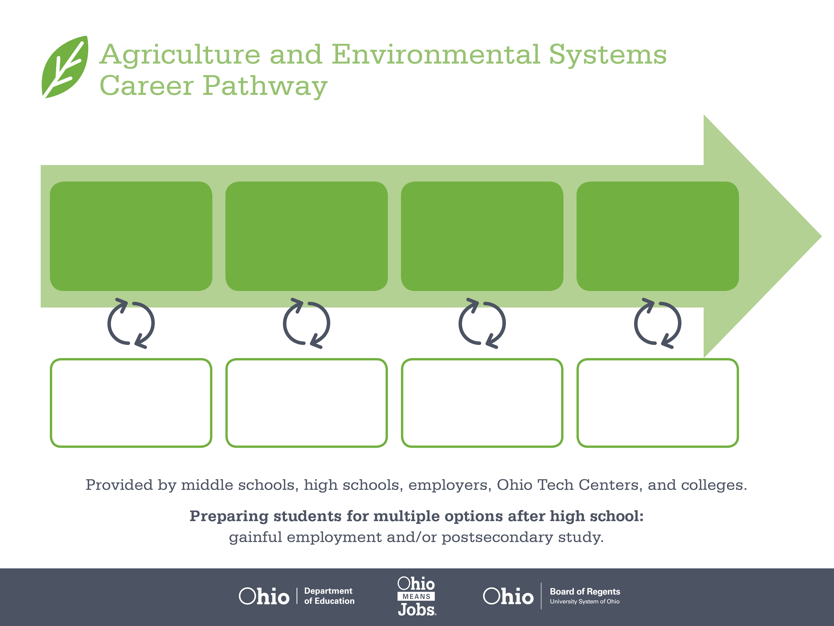
Certificate
Associate Degree,
Natural Resources
Bachelor’s Degree,
Geology/Earth Science
Start Pre-Agriculture
As early as grade 7
(based on readiness)
Wellhead Pumper
Median Salary: $33,020
Job Growth (10 yr): 28%
Annual Openings: 15
Average Tuition (1 yr): $0 – $3,900/yr
Petroleum Process Operator
Median Salary: $55,840
Job Growth (10 yr): -11.6%
Annual Openings: 39
Average Tuition (2 yr): $3,900/yr
Geoscientist
Median Salary: $71,950
Job Growth (10 yr): 29%
Annual Openings: 40
Average Tuition (4 yr): $9,600/yr
Workplace Visits
Job Shadow
Internship
Work
Supervised Experience
---
Work
Supervised Experience
Internship
---
Work
Internship
---
Work
Ohio In-demand Occupations
Data reflects 2014 Ohio labor statistics and public institutions of higher education for 2013-2014. For specific tuition costs, visit ohiohighered.org.

Slide 2

Secondary Pathway: Natural Resource Management |  |  |  |  | Postsecondary Program: Natural Resources
An Example of Courses with Secondary and Postsecondary Credits
Secondary | 7 8 | English I | Algebra I | Physical Science |  | Social Studies | Fine Arts | Ag, Food, & Natural Resources | Natural Resources
 | 9 10 | English II | Geometry | Biology |  | World History | Health (.5) PE (.5) | Energy Systems Management | World Languages
 | 11 | English III | Algebra II | Chemistry |  | U.S. History | Environmental Science for Agriculture | Environmental Systems Management | World Languages
 | 12 | English IV | Trigonometry/ Calculus | Physics |  | U.S. Government | Oil & Gas Operations | A & E Systems Capstone
Postsecondary | Year 1 1st Semester | English Composition | Algebra | Environmental Science |  | College Orientation | Humanities Elective
 | Year 1 2nd Semester | American History | Chemistry I | Soil Science |  | Society & Natural Resources | Communicating Environmental Information
 | Year 2 1st Semester | World Literature | Bio Science | Rural Sociology |  | Data Analysis in Sciences | Food& Resource Economics
 | Year 2 2nd Semester | Ecology | Chemistry II | Geographic Information Systems |  | Environmental Policy | Elective
 |  | High School Career-Technical Education Program Courses
 |  | High School Courses for Postsecondary Credit (Including Apprenticeship Hours) and the Corresponding Postsecondary Courses
 |  | Required Courses
 |  | Recommended Electives
Visit education.ohio.gov/CareerConnections for reference information.
Course titles and sequences will vary between schools.
1/2016

