Slide 1
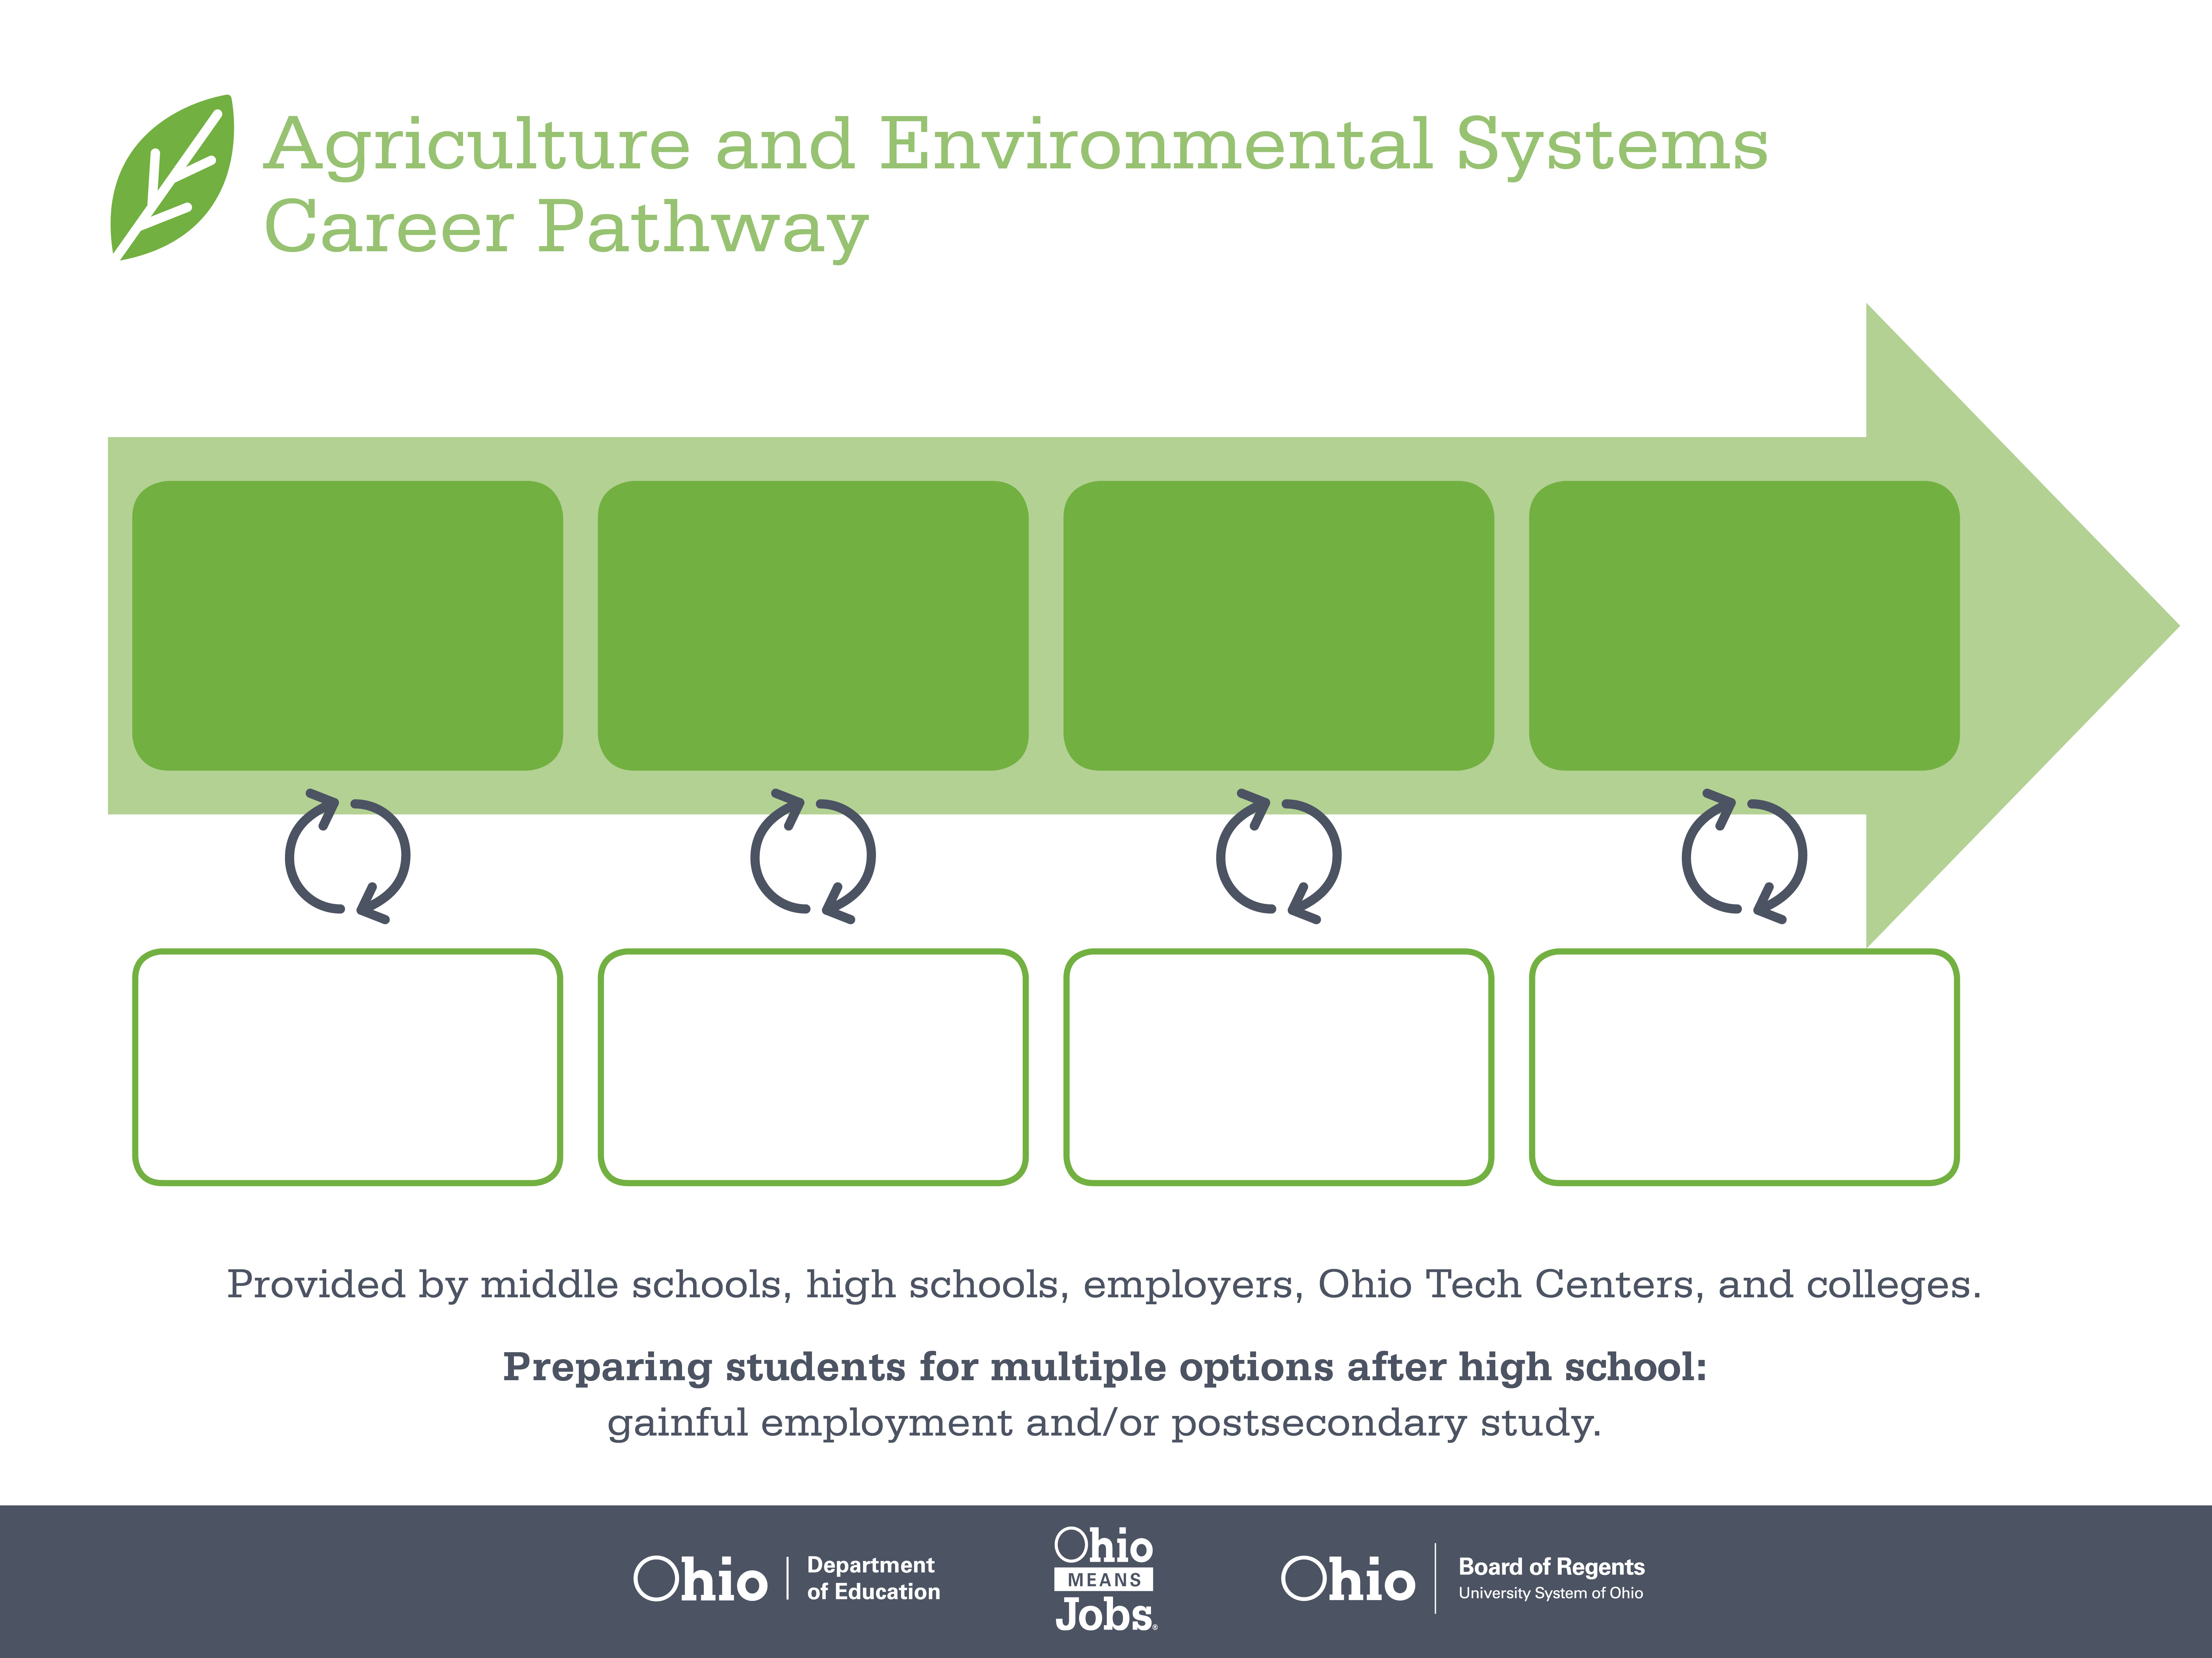
Certificate
Associate Degree,
Crop Management
Bachelor’s Degree,
Agronomy
Start Pre-Agriculture
As early as grade 7
(based on readiness)
Greenhouse Laborer
Median Salary: $24,080
Job Growth (10 yr): 1.3% Annual Openings: 149
Average Tuition (1 yr): $0 – $3,900/yr
Greenhouse Manager
Median Salary: $48,400
Job Growth (10 yr): -4%
Annual Openings: 20
Average Tuition (2 yr): $3,900/yr
Crop Producer
Median Salary: $61,190
Job Growth (10 yr): -3.5%
Annual Openings: 1,462
Average Tuition (4 yr): $9,600/yr
Workplace Visits
Job Shadow
Internship
Work
Supervised Experience
---
Work
Supervised Experience
Internship
---
Work
Internship
---
Work
Ohio In-demand Occupations
Data reflects 2014 Ohio labor statistics and public institutions of higher education for 2013-2014. For specific tuition costs, visit ohiohighered.org.

Slide 2

Secondary Pathway: Horticulture |  |  |  |  | Postsecondary Program: Horticultural Science
An Example of Courses with Secondary and Postsecondary Credits
Secondary | 7 8 | English I | Algebra I | Physical Science |  | Social Studies | Fine Arts | Ag, Food, & Natural Resources | Animal & Plant Science
 | 9 10 | English II | Geometry | Biology |  | World History | Health (.5) PE (.5) | Greenhouse & Nursery Management | Agronomic Systems | World Languages
 | 11 | English III | Algebra II | Chemistry |  | U.S. History | Business Management | World Languages
 | 12 | English IV | Trigonometry/ Calculus | Anatomy & Physiology |  | U.S. Government | Ag Econ, International/ Commodities | A&E Capstone
Postsecondary | Year 1 1st Semester | English I | Soil Science | Agriculture Survey |  | Animal Agriculture
 | Year 1 2nd Semester | English II | Technical Math | Biology |  | Soil Fertility | Ag Elective | Agri-Business Co-Op
 | Year 2 1st Semester | Public Speaking | Sales Management | Business Management |  | Plant Pests | Crop Production
 | Year 2 2nd Semester | Agriculture Seminar | Ag Marketing & Trade | Pest Management |  | Equipment Management | Humanities/ Social Science Elective
 |  | High School Career-Technical Education Program Courses
 |  | High School Courses for Postsecondary Credit (Including Apprenticeship Hours) and the Corresponding Postsecondary Courses
 |  | Required Courses
 |  | Recommended Electives
Visit education.ohio.gov/CareerConnections for reference information.
Course titles and sequences will vary between schools.
11/2014

