Slide 1
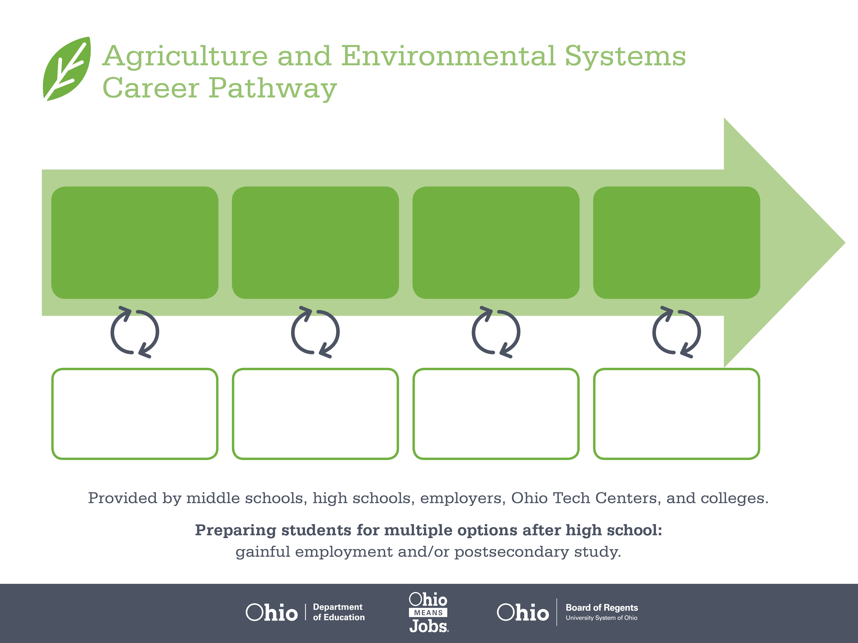
Certificate
Associate Degree,
Food Science
Bachelor’s Degree,
Agricultural and Food
Products Processing
Start Pre-Agriculture
As early as grade 7
(based on readiness)
Food Batch Mixer
Median Salary: $28,000
Job Growth (10 yr): 0.8%
Annual Openings: 107
Average Tuition (1 yr): $0 – $3,900/yr
Quality Control Specialist
Median Salary: $45,780
Job Growth (10 yr): 9%
Annual Openings: 91
Average Tuition (2 yrs): $3,900/yr
Agricultural Inspector
Median Salary: $50,620
Job Growth (10 yr): 0%
Annual Openings: 13
Average Tuition (4 yrs): $9,600/yr
Workplace Visits
Job Shadow
Internship
Work
Supervised Experience
---
Work
Supervised Experience
Internship
---
Work
Internship
---
Work
Ohio In-demand Occupations
Data reflects 2014 Ohio labor statistics and public institutions of higher education for 2013-2014. For specific tuition costs, visit ohiohighered.org.

Slide 2

Secondary Pathway: Food Science and Technology |  |  |  |  | Postsecondary Program: Food Science and Technology
An Example of Courses with Secondary and Postsecondary Credits
Secondary | 7 8 | English I | Algebra I | Physical Science |  | Social Studies | Fine Arts | Science and Technology of Food | Ag, Food, & Natural Resources
 | 9 10 | English II | Geometry | Biology |  | World History | Health (.5) PE (.5) | Applications of Food Science & Safety | World Languages
 | 11 | English III | Algebra II | Chemistry |  | U.S. History | Meat Science/ Genetics | Principles & Practices of Bioscience | World Languages
 | 12 | English IV | Trigonometry/ Calculus | Anatomy & Physiology |  | U.S. Government | Food Marketing & Research | A&E Capstone | Agriculture Communication & Leadership
Postsecondary | Year 1 1st Semester | English Composition | Food Science | Chemistry I |  | Human Nutrition | Anatomy & Physiology
 | Year 1 2nd Semester | Public Speaking | Food Safety | Chemistry II |  | Biology I | Food Regulations | Psychology
 | Year 2 1st Semester | Ethics | College Algebra | Advanced Food Science |  | Microbiology | Sensory Evaluation | Seminar
 | Year 2 2nd Semester | Product Development | HACCP Safety Training | Food Chemistry |  | Product Processing | Food Production
 |  | High School Career-Technical Education Program Courses
 |  | High School Courses for Postsecondary Credit (Including Apprenticeship Hours) and the Corresponding Postsecondary Courses
 |  | Required Courses
 |  | Recommended Electives
Visit education.ohio.gov/CareerConnections for reference information.
Course titles and sequences will vary between schools.
1/2016

