Slide 1
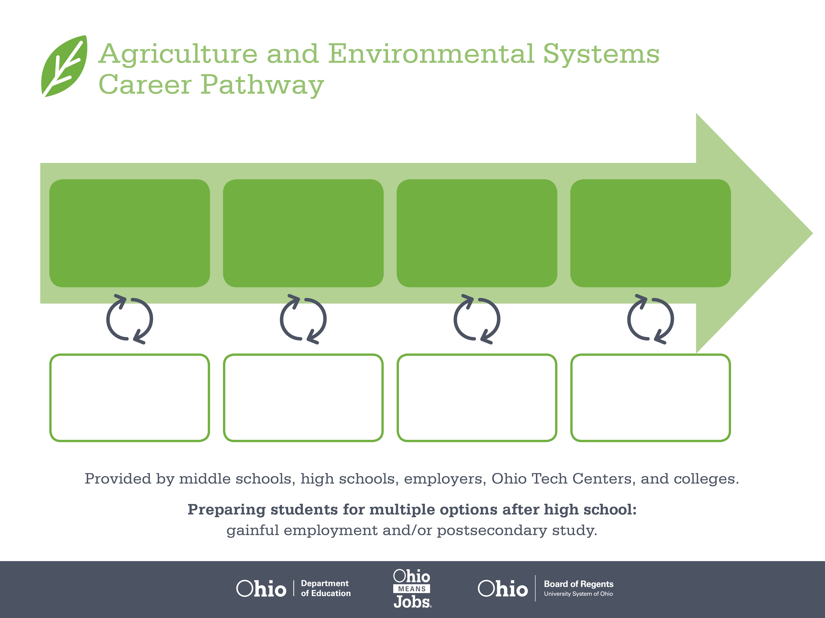
Certificate
Associate Degree,
Pipeline Technician
Bachelor’s Degree,
Petroleum Engineering
Start Pre-Agriculture
As early as grade 7
(based on readiness)
Pipeline Operator
Median Salary: $42,530
Job Growth (10 yr): 21.9%
Annual Openings: 15
Average Tuition (1 yr): $0 – $3,900/yr
Petroleum Technician
Median Salary: $51,520
Job Growth (10 yr): 14.8%
Annual Openings: 13
Average Tuition (2 yr): $3,900/yr
Petroleum Engineer
Median Salary: $109,130
Job Growth (10 yr): 42.6%
Annual Openings: 39
Average Tuition (4 yr): $9,600/yr
Workplace Visits
Job Shadow
Internship
Work
Supervised Experience
---
Work
Supervised Experience
Internship
---
Work
Internship
---
Work
Ohio In-demand Occupations
Data reflects 2014 Ohio labor statistics and public institutions of higher education for 2013-2014. For specific tuition costs, visit ohiohighered.org.

Slide 2

Secondary Pathway: Natural Resource Management |  |  |  |  | Postsecondary Program: Petroleum Technology
An Example of Courses with Secondary and Postsecondary Credits
Secondary | 7 8 | English I | Algebra I | Science |  | Social Studies | Fine Arts | Ag, Food, & Natural Resources
 | 9 10 | English II | Geometry | Biology |  | World History | Health (.5) PE (.5) | Environmental Science | Natural Resources | World Languages
 | 11 | English III | Algebra II | Chemistry |  | U.S. History | Oil & Gas Operations | World Languages
 | 12 | English IV | Trigonometry/ Calculus | Physics |  | U.S. Government | Hydraulics & Pneumatics | Electronic & Electrical Systems
Postsecondary | Year 1 1st Semester | Interpersonal Communication | Regulations & Compliance | Introduction to Petroleum Industry |  | Electrical Circuits & Devices | Mechanical Drive Components | Supervisory Control & Data Acquisition
 | Year 1 2nd Semester | Corrosion Basics | Petroleum Instrumentation | Gas Compression & Flow Dynamics |  | Pipeline Operations | Basic Pumps | Engineering Co-Op
 | Year 2 1st Semester | Physical Geology | College Algebra | College Composition |  | Chemistry
 | Year 2 2nd Semester | Computer Applications | Physics | Arts & Humanities Elective
 |  | High School Career-Technical Education Program Courses
 |  | High School Courses for Postsecondary Credit (Including Apprenticeship Hours) and the Corresponding Postsecondary Courses
 |  | Required Courses
 |  | Recommended Electives
Visit education.ohio.gov/CareerConnections for reference information.
Course titles and sequences will vary between schools.
1/2016

