Slide 1
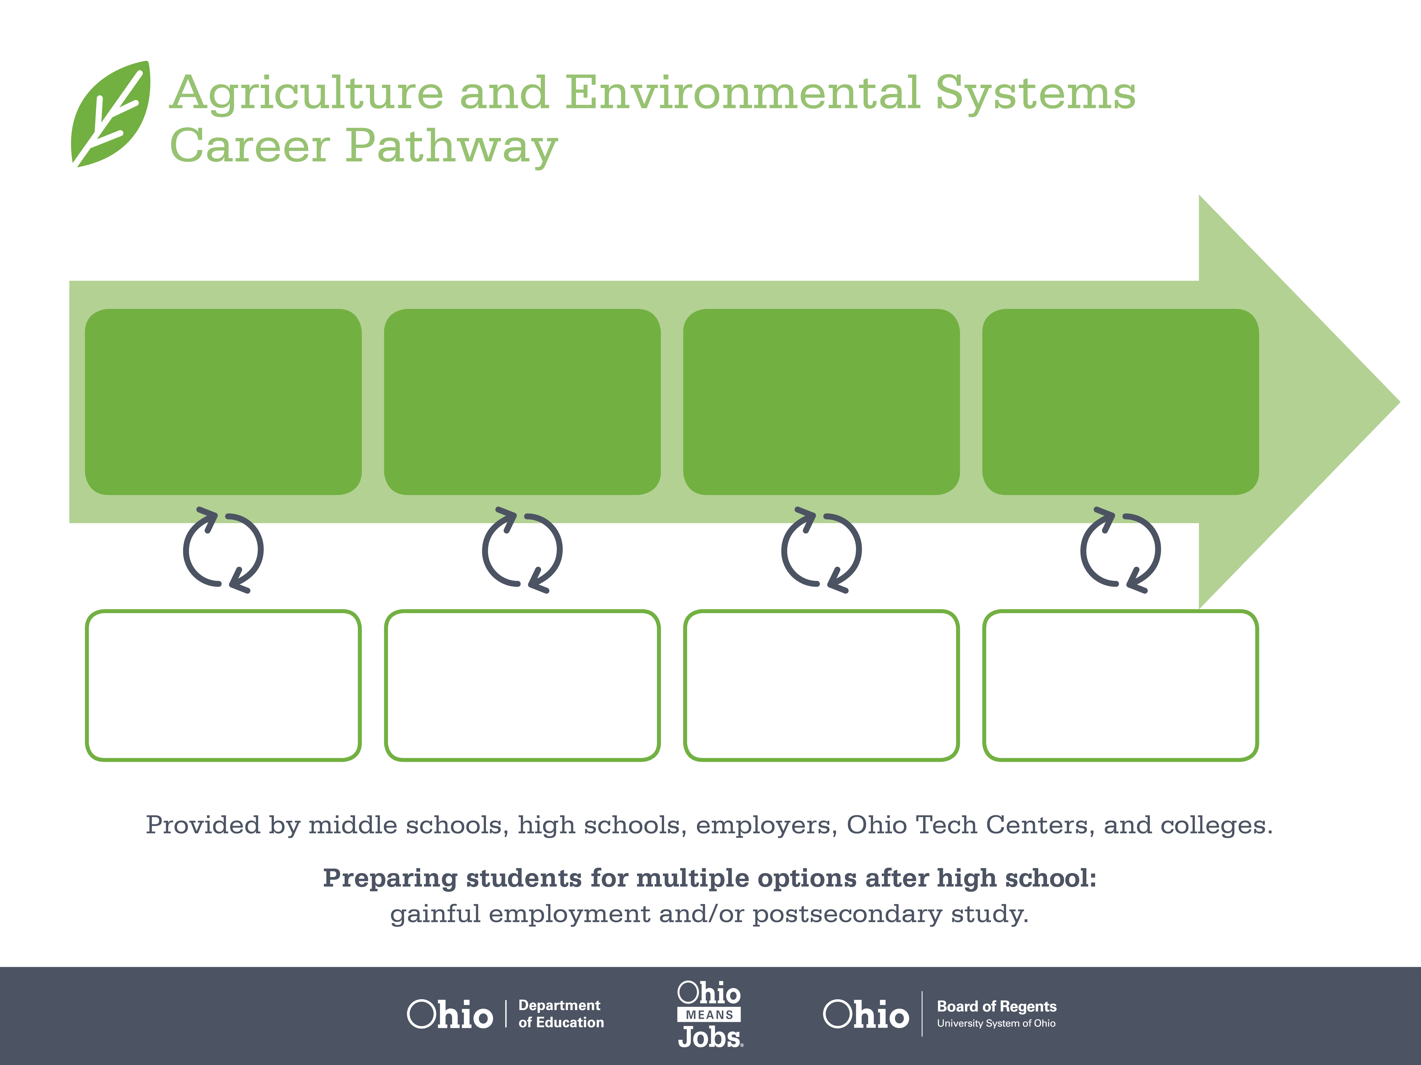
Certificate,
Animal Care
Associate Degree,
Veterinary Technology
Doctoral Degree,
Veterinary Medicine
Start Pre-Agriculture
As early as grade 7
(based on readiness)
Veterinary Assistant
Median Salary: $21,860
Job Growth (10 yr): 6.8%
Annual Openings: 82
Average Tuition (1 yr): $0 – $3,900/yr
Veterinary Technician
Median Salary: $30,430
Job Growth (10 yr): 42.8%
Annual Openings: 138
Average Tuition (2 yr): $3,900/yr
Average Tuition (4 yr): $9,600/yr
Veterinarian
Median Salary: $87,610
Job Growth (10 yr): 28.8%
Annual Openings: 117
Average Tuition (4 yr): $30,000/yr
Workplace Visits
Job Shadow
Internship
Work
Supervised Experience
---
Work
Supervised Experience
Internship
---
Work
Internship
---
Work
Ohio In-demand Occupations
Data reflects 2014 Ohio labor statistics and public institutions of higher education for 2013-2014. For specific tuition costs, visit ohiohighered.org.

Slide 2

Secondary Pathway: Animal Science and Management |  |  |  |  | Postsecondary Program: Veterinary Technology
An Example of Courses with Secondary and Postsecondary Credits
Secondary | 7 8 | English I | Algebra I | Physical Science |  | Social Studies | Fine Arts | Animal Science & Technology | Ag, Food, & Natural Resources
 | 9 10 | English II | Geometry | Biology |  | World History | Health (.5) PE (.5) | Animal Selection, Nutrition, & Mgt | World Languages
 | 11 | English III | Algebra II | Chemistry |  | U.S. History | Animal Health | World Languages
 | 12 | English IV | Trigonometry/ Calculus | Animal Anatomy & Physiology |  | U.S. Government | Veterinary Science | A&E Capstone
Postsecondary | Year 1 1st Semester | College Seminar | Algebra II | Anatomy & Physiology I |  | Anatomy & Physiology II | Small Animal Medicine | Veterinary Parasitology | Social Science Elective
 | Year 1 2nd Semester | Interpersonal Skills | Clinical Pathology I | Veterinary Anatomy & Physiology |  | Advanced Medical Terminology | Veterinary Radiography | Veterinary Anesthesia | Veterinary Surgical Techniques
 | Year 2 1st Semester | English Composition I | Ethics | Biochemistry |  | Veterinary Nutrition | Animal Medicine | Small Animal Health & Disease | Clinical Applications I
 | Year 2 2nd Semester | Clinical Pathology II | Veterinary Pharmacology | Large Animal Health & Disease |  | Veterinary Seminar I & II | Veterinary Practicum I & II | Humanities Elective | Clinical Applications II & III
 |  | High School Career-Technical Education Program Courses
 |  | High School Courses for Postsecondary Credit (Including Apprenticeship Hours) and the Corresponding Postsecondary Courses
 |  | Required Courses
 |  | Recommended Electives
Visit education.ohio.gov/CareerConnections for reference information.
Course titles and sequences will vary between schools.
10/2015

