Slide 1
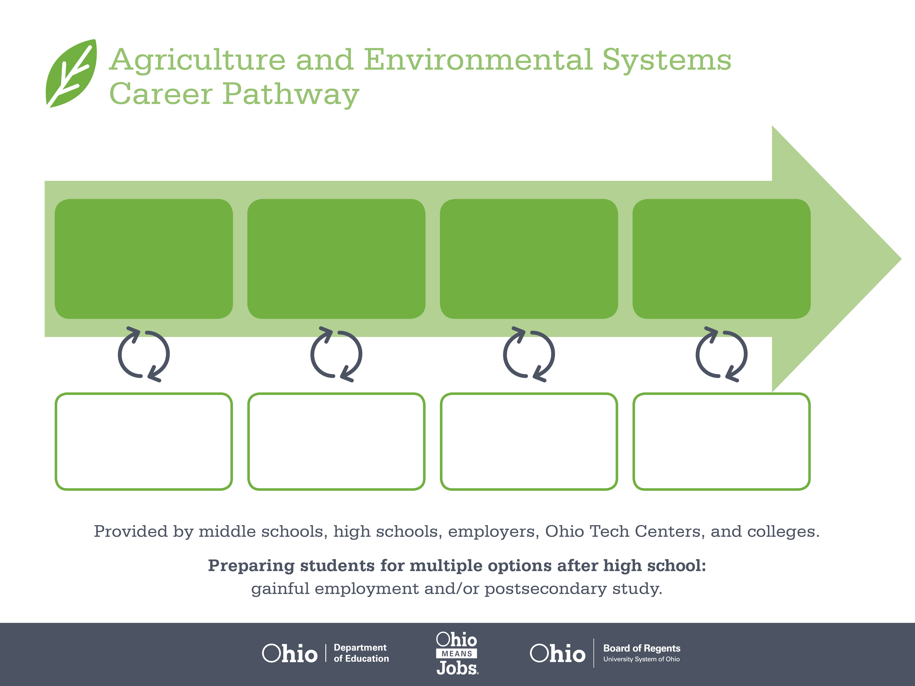
Certificate,
Water Technician
Associate Degree,
Environmental Science
Bachelor’s Degree,
Environmental Engineering
Start Pre-Agriculture
As early as grade 7
(based on readiness)
Water Plant Operator
Median Salary: $43,400
Job Growth (10 yr): 4.4%
Annual Openings: 138
Average Tuition (1 yr): $0 – $3,900/yr
Water Plant Manager
Median Salary: $52,940
Job Growth (10 yr): -0.2%
Annual Openings: 400
Average Tuition (2 yr): $3,900/yr
Utilities Director
Median Salary: $81,100
Job Growth (10 yr): 14%
Annual Openings: 39
Average Tuition (4 yr): $9,600/yr
Workplace Visits
Job Shadow
Internship
Work
Supervised Experience
---
Work
Supervised Experience
Internship
---
Work
Internship
---
Work
Ohio In-demand Occupations
Data reflects 2014 Ohio labor statistics and public institutions of higher education for 2013-2014. For specific tuition costs, visit ohiohighered.org.

Slide 2

Secondary Pathway: Natural Resource Management |  |  |  |  | Postsecondary Program: Environmental Science
An Example of Courses with Secondary and Postsecondary Credits
Secondary | 7 8 | English I | Algebra I | Physical Science |  | Social Studies | Fine Arts | Ag, Food, & Natural Resources | Natural Resources
 | 9 10 | English II | Geometry | Biology |  | World History | Health (.5) PE (.5) | Environmental Science | World Languages
 | 11 | English III | Algebra II | Chemistry |  | U.S. History | Environmental Systems Management | World Languages
 | 12 | English IV | Trigonometry/ Calculus | Physics |  | U.S. Government | Bio Energy | Hydraulics & Pneumatics
Postsecondary | Year 1 1st Semester | English Composition I | Biology I | College Algebra |  | Public Speaking | Wastewater Treatment
 | Year 1 2nd Semester | English Composition II | Biology II | Environmental Sustainability |  | Water Resources | Environmental Field Biology
 | Year 2 1st Semester | Introduction to Psychology | Chemistry I | Trigonometry |  | Water Collection | Water Distribution
 | Year 2 2nd Semester | Technical Writing | Utility Management | Statistics |  | Environmental Policy, Law & Ethics
 |  | High School Career-Technical Education Program Courses
 |  | High School Courses for Postsecondary Credit (Including Apprenticeship Hours) and the Corresponding Postsecondary Courses
 |  | Required Courses
 |  | Recommended Electives
Visit education.ohio.gov/CareerConnections for reference information.
Course titles and sequences will vary between schools.
1/2016

