Slide 1
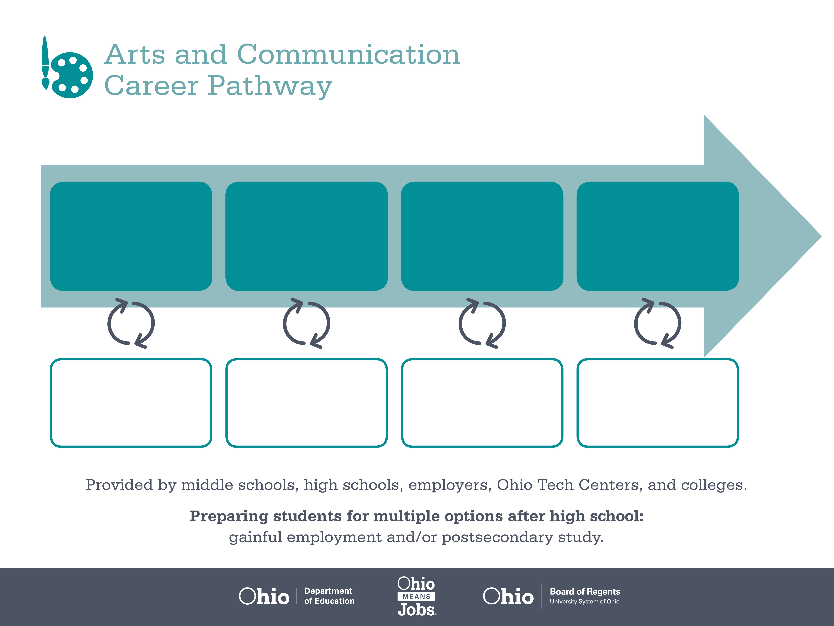
Certificate
Associate Degree,
Graphic Design
Bachelor’s Degree,
Commercial Design
Start Pre-Arts and Communication
As early as Grade 7
(based on readiness)
Prepress Technician
Median Salary: $36,790
Job Growth (10 yr): -18.5%
Annual Openings: 50
Average Tuition (1 yr): $0 –$3,900/yr
Graphic Designer
Median Salary: $41,460
Job Growth (10 yr): 10%
Annual Openings: 414
Average Tuition (2 yrs): $3,900/yr
Commercial Designer
Median Salary: $63,210
Job Growth (10 yr): 3.4%
Annual Openings: 60
Average Tuition (4 yrs): $9,600/yr
Workplace Visits
Job Shadow
Internship
Work
Supervised Experience
---
Work
Supervised Experience
Internship
---
Work
Internship
---
Work
Ohio In-demand Occupations
Data reflects 2014 Ohio labor statistics and public institutions of higher education for 2013-2014. For specific tuition costs, visit ohiohighered.org.

Slide 2

Secondary Pathway: Visual Design and Imaging |  |  |  |  | Postsecondary Program: Graphic Design
An Example of Courses with Secondary and Postsecondary Credits
Secondary | 7 8 | English I | Algebra I | Science |  | Social Studies | Fine Arts | Arts & Communication Primer
 | 9 10 | English II | Geometry | Biology |  | World History | Health (.5) PE (.5) | Intro to Visual Design | Business of Arts and Communication | World Languages
 | 11 | English III | Algebra II | Chemistry |  | U.S. History | Visual Creation | Digital Print Design | World Languages
 | 12 | English IV | Trigonometry/ Calculus | Physics |  | U.S. Government | Multi-Media Web Production | Photographic Composition
Postsecondary | Year 1 1st Semester | English Composition I | College Algebra | Computer Applications for Mac |  | Digital Imaging | Drawing I | Vector Graphic Design
 | Year 1 2nd Semester | English Composition II | Multicultural Diversity | Digital Design |  | Graphic Fundamentals | 2D Design | Electronic Page Layout
 | Year 2 1st Semester | Public Speaking | Accounting | Digital Video |  | Digital Photography | Interactive Media | Web Design
 | Year 2 2nd Semester | Advanced Graphic Design | History of Western Art | Advanced Graphic Design & History |  | Technical Communication | Physical Science for Technology | 3D Graphics
 |  | High School Career-Technical Education Program Courses
 |  | High School Courses for Postsecondary Credit (Including Apprenticeship Hours) and the Corresponding Postsecondary Courses
 |  | Required Courses
 |  | Recommended Electives
Visit education.ohio.gov/CareerConnections for reference information.
Course titles and sequences will vary between schools.
6/2015

