Slide 1
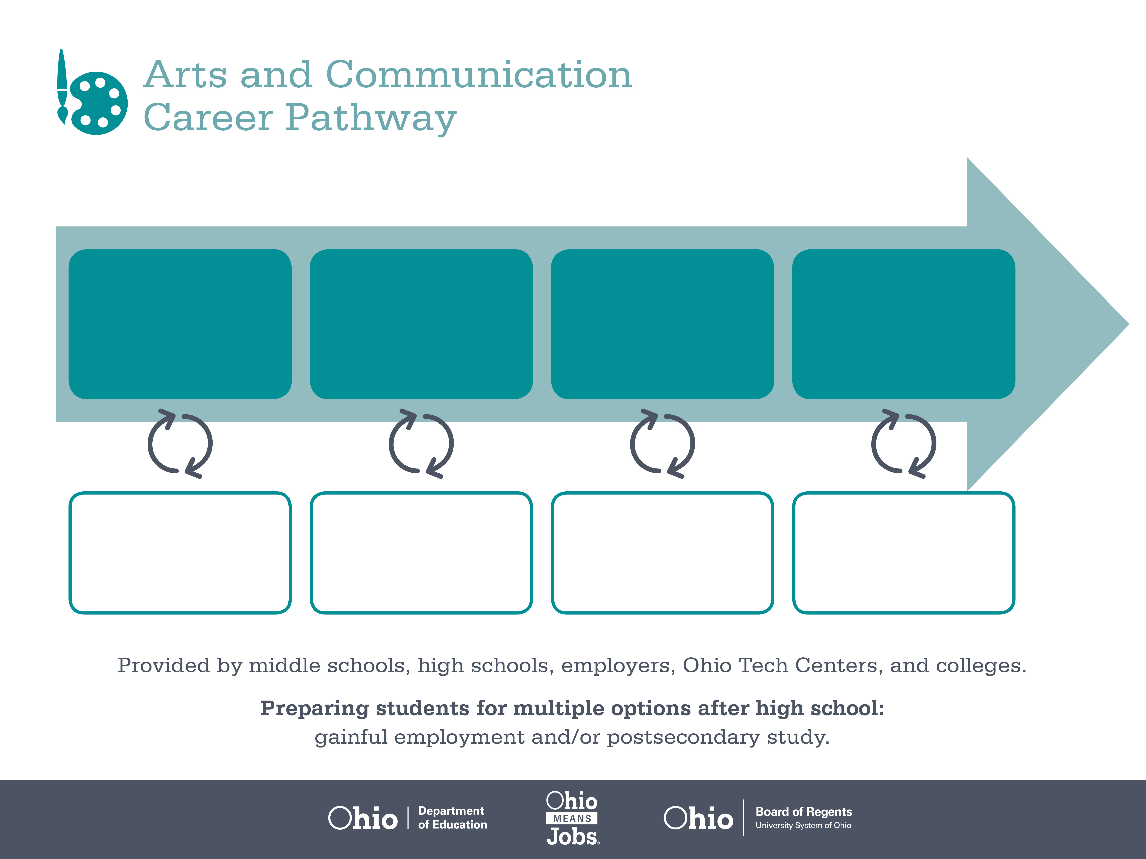
Certificate
Associate Degree,
Interactive Media
Bachelor’s Degree,
Cinematography
Start Pre-Arts and Communication
As early as Grade 7
(based on readiness)
Audio/Video Technician
Median Salary: $36,200
Job Growth (10 yr): 11%
Annual Openings: 40
Average Tuition (1 yr): $0 –$3,900/yr
Videographer
Median Salary: $42,420
Job Growth (10 yr): -3%
Annual Openings: 10
Average Tuition (2 yrs): $3,900/yr
Technical Director
Median Salary: $50,900
Job Growth (10 yr): 7%
Annual Openings: 70
Average Tuition (4 yrs): $9,600/yr
Workplace Visits
Job Shadow
Internship
Work
Supervised Experience
---
Work
Supervised Experience
Internship
---
Work
Internship
---
Work
Ohio In-demand Occupations
Data reflects 2014 Ohio labor statistics and public institutions of higher education for 2013-2014. For specific tuition costs, visit ohiohighered.org.

Slide 2

Secondary Pathway: Media Arts |  |  |  |  | Postsecondary Program: Interactive Media
An Example of Courses with Secondary and Postsecondary Credits
Secondary | 7 8 | English I | Algebra I | Physical Science |  | Social Studies | Fine Arts | Arts & Communication Primer
 | 9 10 | English II | Geometry | Biology |  | World History | Health (.5) PE (.5) | Media Arts Introduction | Video Production | World Languages
 | 11 | English III | Algebra II | Chemistry |  | U.S. History | Digital Cinema | World Languages
 | 12 | English IV | Trigonometry/ Calculus | Environmental Science |  | U.S. Government | Multi-Media Web Production | Arts & Communication Capstone
Postsecondary | Year 1 1st Semester | English | Interactive Design Principles | Basics of Video & Sound |  | Intro to Computer Design | HTML | Biology
 | Year 1 2nd Semester | Storyboarding | Visual Communication | Intro to Humanities |  | CSS | Branding | Media & Graphics Optimization | Audio Production
 | Year 2 1st Semester | Statistics | Flash I & II | Sociology |  | Java-script Fundamentals | Content Management & Integration | Video Production
 | Year 2 2nd Semester | Web Design | Advanced Flash III | Interactive Portfolio |  | Interactive Media Practicum | Interactive Media Seminar | DVD Creation
 |  | High School Career-Technical Education Program Courses
 |  | High School Courses for Postsecondary Credit (Including Apprenticeship Hours) and the Corresponding Postsecondary Courses
 |  | Required Courses
 |  | Recommended Electives
Visit education.ohio.gov/CareerConnections for reference information.
Course titles and sequences will vary between schools.
11/2014

