Slide 1
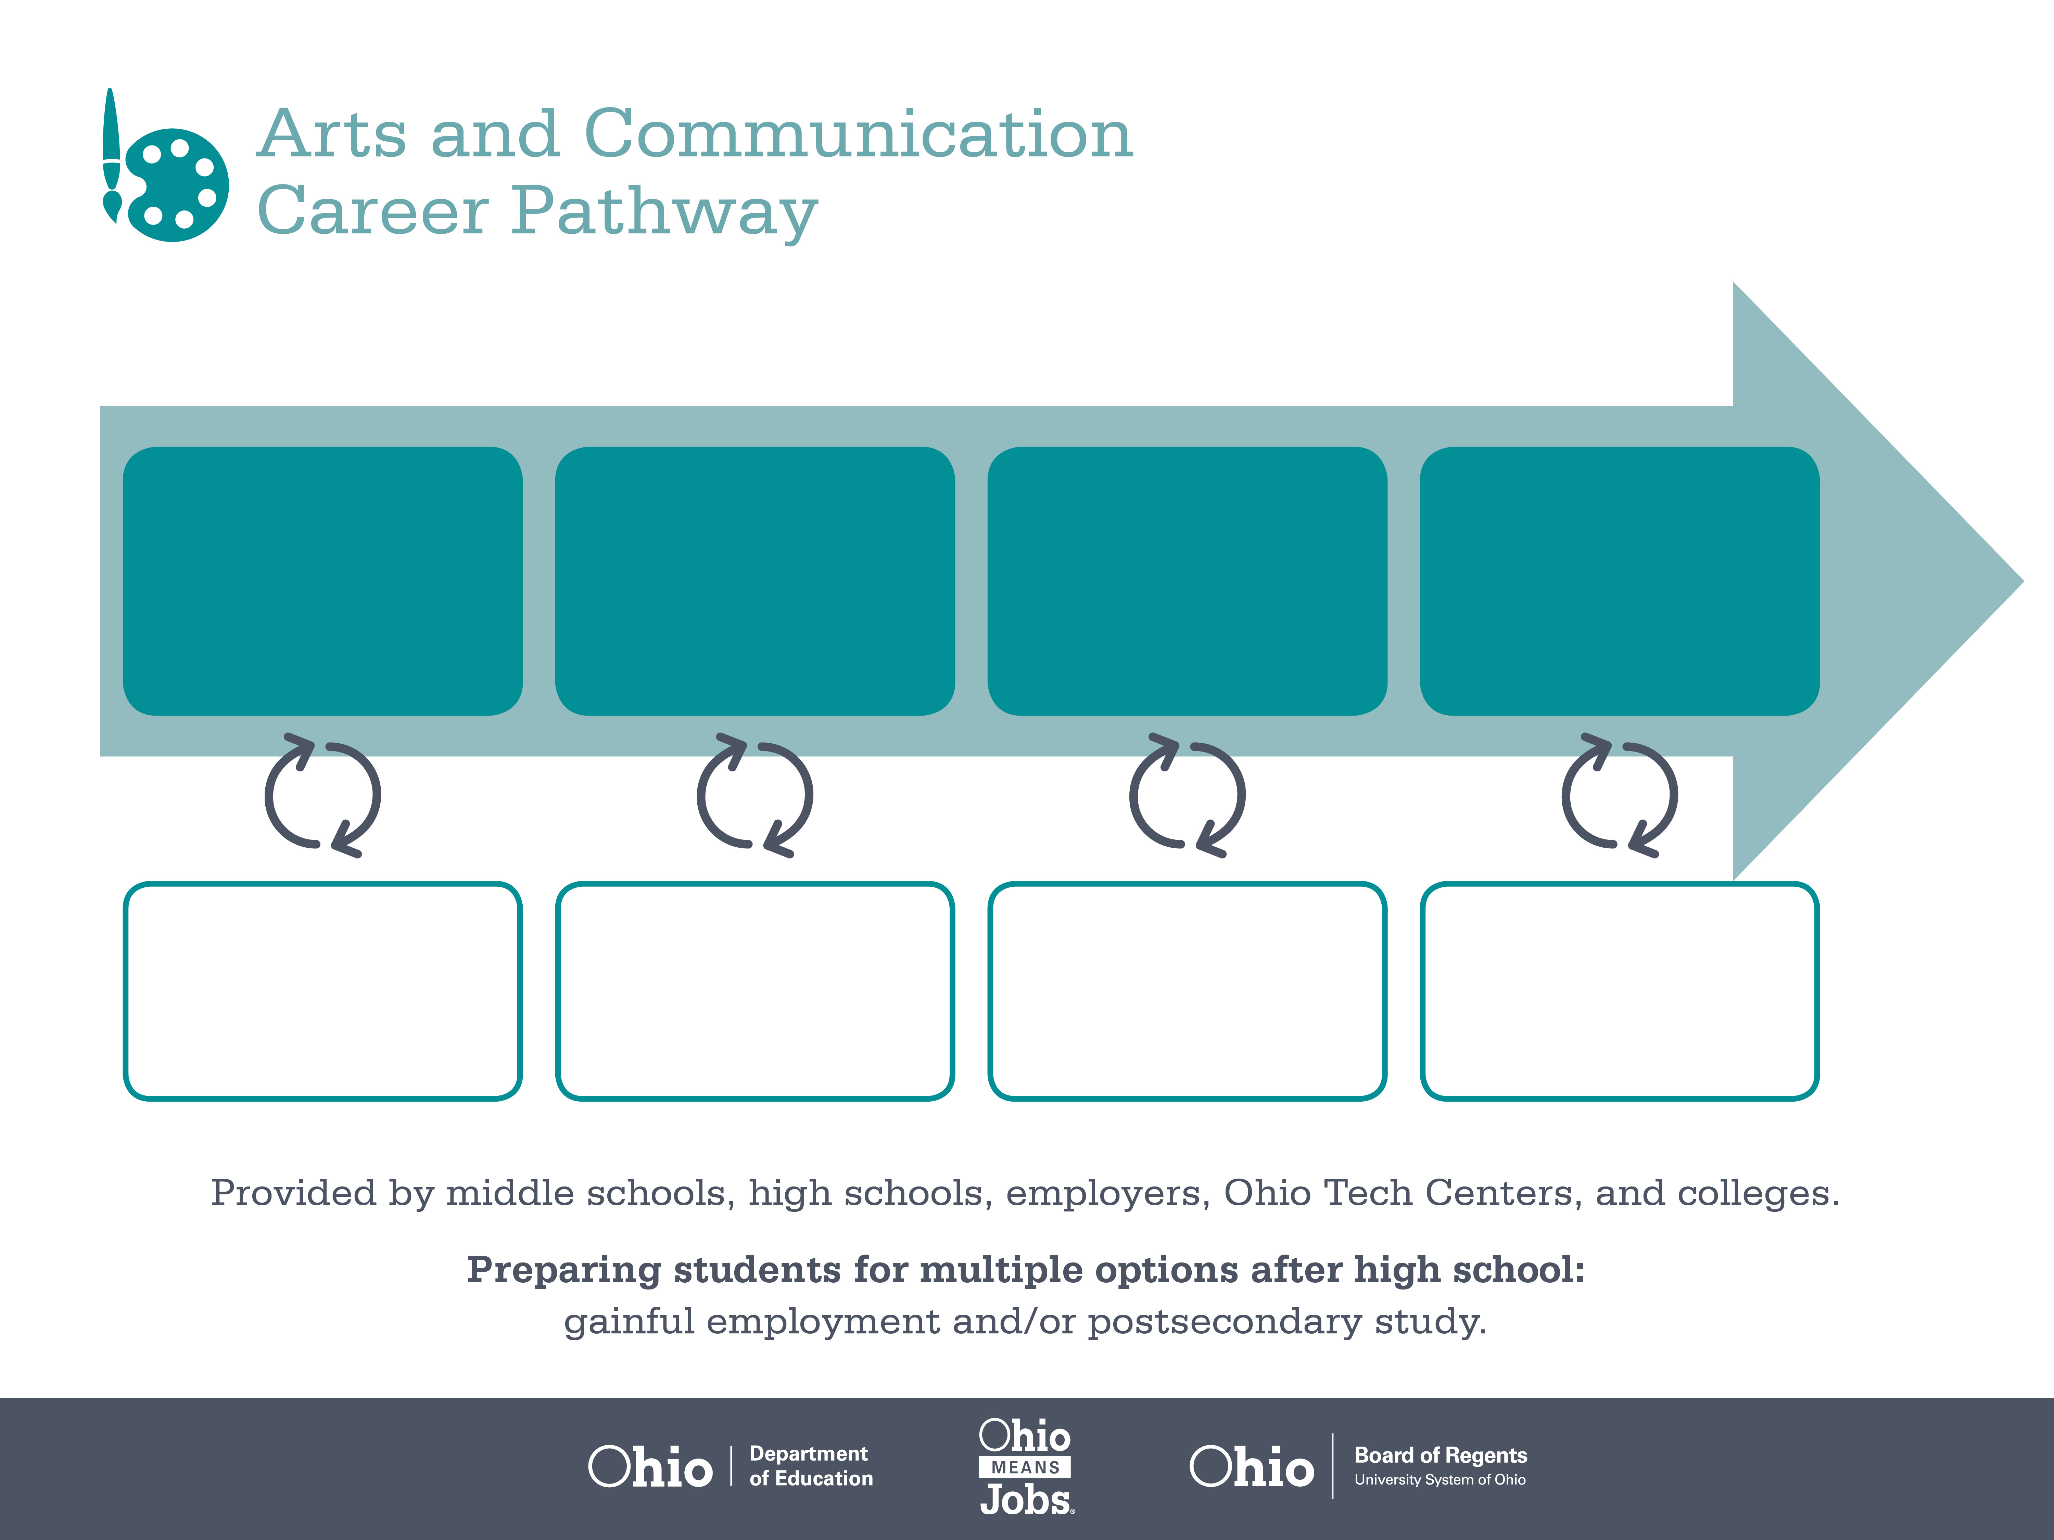
Certificate
Associate Degree,
Film/Video Production
Bachelor’s Degree,
Journalism
Start Pre-Arts and Communication
As early as Grade 7
(based on readiness)
Reporter
Median Salary: $29,580
Job Growth (10 yr): -12%
Annual Openings: 90
Average Tuition (1 yr): $0 –$3,900/yr
News Director
Median Salary: $50,900
Job Growth (10 yr): 7%
Annual Openings: 70
Average Tuition (2 yrs): $3,900/yr
Broadcast News Analyst
Median Salary: $77,250
Job Growth (10 yr): 4%
Annual Openings: 10
Average Tuition (4 yrs): $9,600/yr
Workplace Visits
Job Shadow
Internship
Work
Supervised Experience
---
Work
Supervised Experience
Internship
---
Work
Internship
---
Work
Ohio In-demand Occupations
Data reflects 2014 Ohio labor statistics and public institutions of higher education for 2013-2014. For specific tuition costs, visit ohiohighered.org.

Slide 2

Secondary Pathway: Media Arts |  |  |  |  | Postsecondary Program: Film/Video Production
An Example of Courses with Secondary and Postsecondary Credits
Secondary | 7 8 | English I | Algebra I | Physical Science |  | Social Studies | Fine Arts | Arts & Communication Primer
 | 9 10 | English II | Geometry | Biology |  | World History | Health (.5) PE (.5) | Introduction to Media Arts | Video Broadcast | World Languages
 | 11 | English III | Algebra II | Chemistry |  | U.S. History | Media Arts Writing | World Languages
 | 12 | English IV | Trigonometry/ Calculus | Environmental Science |  | U.S. Government | Business of Arts & Communication | Video Production
Postsecondary | Year 1 1st Semester | English | Digital Media Concepts | Intro to Audio/Visual Production |  | Market Research for Multimedia | Multimedia Information Design
 | Year 1 2nd Semester | Public Speaking | Videography | 2D Graphics |  | English Composition | Technical Communication | Math for Technology
 | Year 2 1st Semester | Multimedia Information Design | Digital Video Editing | Applied 2D Graphics |  | Graphic Imaging Tech. Co-op | Audio Production & Sound Design | Video Editing & Compositing
 | Year 2 2nd Semester | Internship | Humanities Elective | Multi Camera Production & Lighting |  | Motion Graphics- After Effects | Audio/Video Capstone | Social Science Elective | Audio/Visual Elective
 |  | High School Career-Technical Education Program Courses
 |  | High School Courses for Postsecondary Credit (Including Apprenticeship Hours) and the Corresponding Postsecondary Courses
 |  | Required Courses
 |  | Recommended Electives
Visit education.ohio.gov/CareerConnections for reference information.
Course titles and sequences will vary between schools.
11/2014

