Slide 1
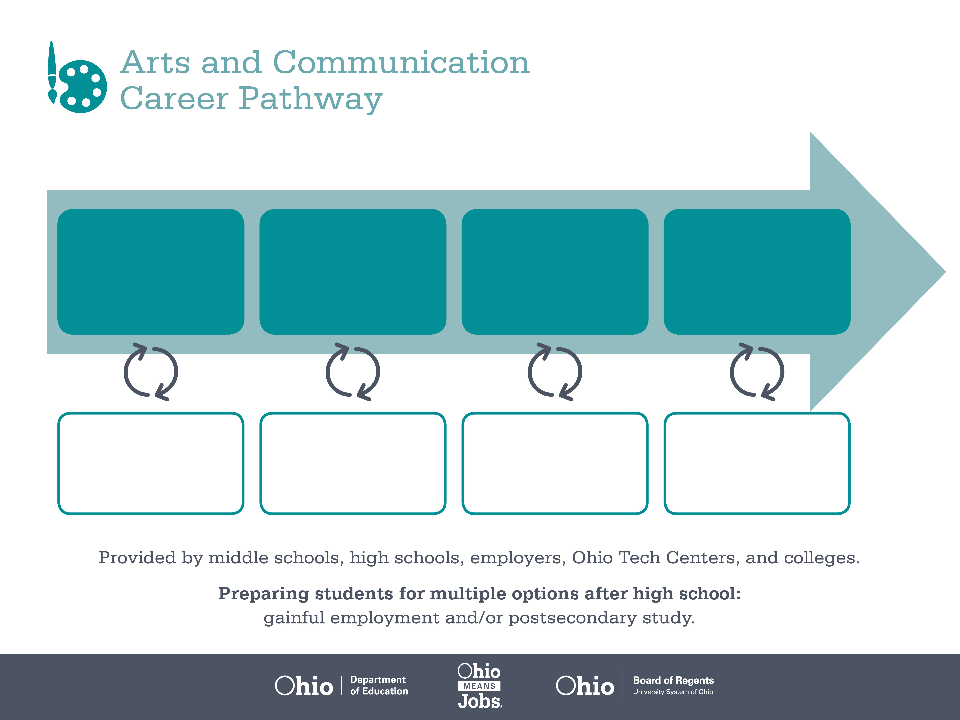
Certificate
Associate Degree,
Dance
Bachelor’s Degree,
Theatre Arts
Start Pre-Arts and Communication
As early as Grade 7
(based on readiness)
Dancer
Median Salary: $30,222
Job Growth (10 yr): 10%
Annual Openings: 20
Average Tuition (1 yr): $0 –$3,900/yr
Choreographer
Median Salary: $54,500
Job Growth (10 yr): 17.5%
Annual Openings: 23
Average Tuition (2 yrs): $3,900/yr
Musical Theatre Director
Median Salary: $55,140
Job Growth (10 yr): 6.3%
Annual Openings: 68
Average Tuition (4 yrs): $9,600/yr
Workplace Visits
Job Shadow
Internship
Work
Supervised Experience
---
Work
Supervised Experience
Internship
---
Work
Internship
---
Work
Ohio In-demand Occupations
Data reflects 2014 Ohio labor statistics and public institutions of higher education for 2013-2014. For specific tuition costs, visit ohiohighered.org.

Slide 2

Secondary Pathway: Performing Arts |  |  |  |  | Postsecondary Program: Dance
An Example of Courses with Secondary and Postsecondary Credits
Secondary | 7 8 | English I | Algebra I | Physical Science |  | Social Studies | Fine Arts | Arts & Communication Primer
 | 9 10 | English II | Geometry | Biology |  | World History | Health (.5) PE (.5) | Performing Arts Introduction | Dance I | World Languages
 | 11 | English III | Algebra II | Chemistry |  | U.S. History | Choreography | Dance II | World Languages
 | 12 | English IV | Trigonometry/ Calculus | Physics |  | U.S. Government | Business of Arts & Communication | Dance III
Postsecondary | Year 1 1st Semester | English Composition | College Algebra | Public Speaking |  | Introduction to Dance | Theatre I | Fundamentals of Music
 | Year 1 2nd Semester | Sociology | Chemistry | Introduction to Stagecraft |  | Dance Pedagogy | Script Analysis | Jazz and Hip Hop
 | Year 2 1st Semester | World Languages | Social Media Marketing | Performing Arts Business |  | Dance History | Modern Dance | Audition Techniques
 | Year 2 2nd Semester | World Languages | Musical Theatre | Theatre Management |  | Ballet | Choreography | Character Design
 |  | High School Career-Technical Education Program Courses
 |  | High School Courses for Postsecondary Credit (Including Apprenticeship Hours) and the Corresponding Postsecondary Courses
 |  | Required Courses
 |  | Recommended Electives
Visit education.ohio.gov/CareerConnections for reference information.
Course titles and sequences will vary between schools.
11/2014

