Slide 1
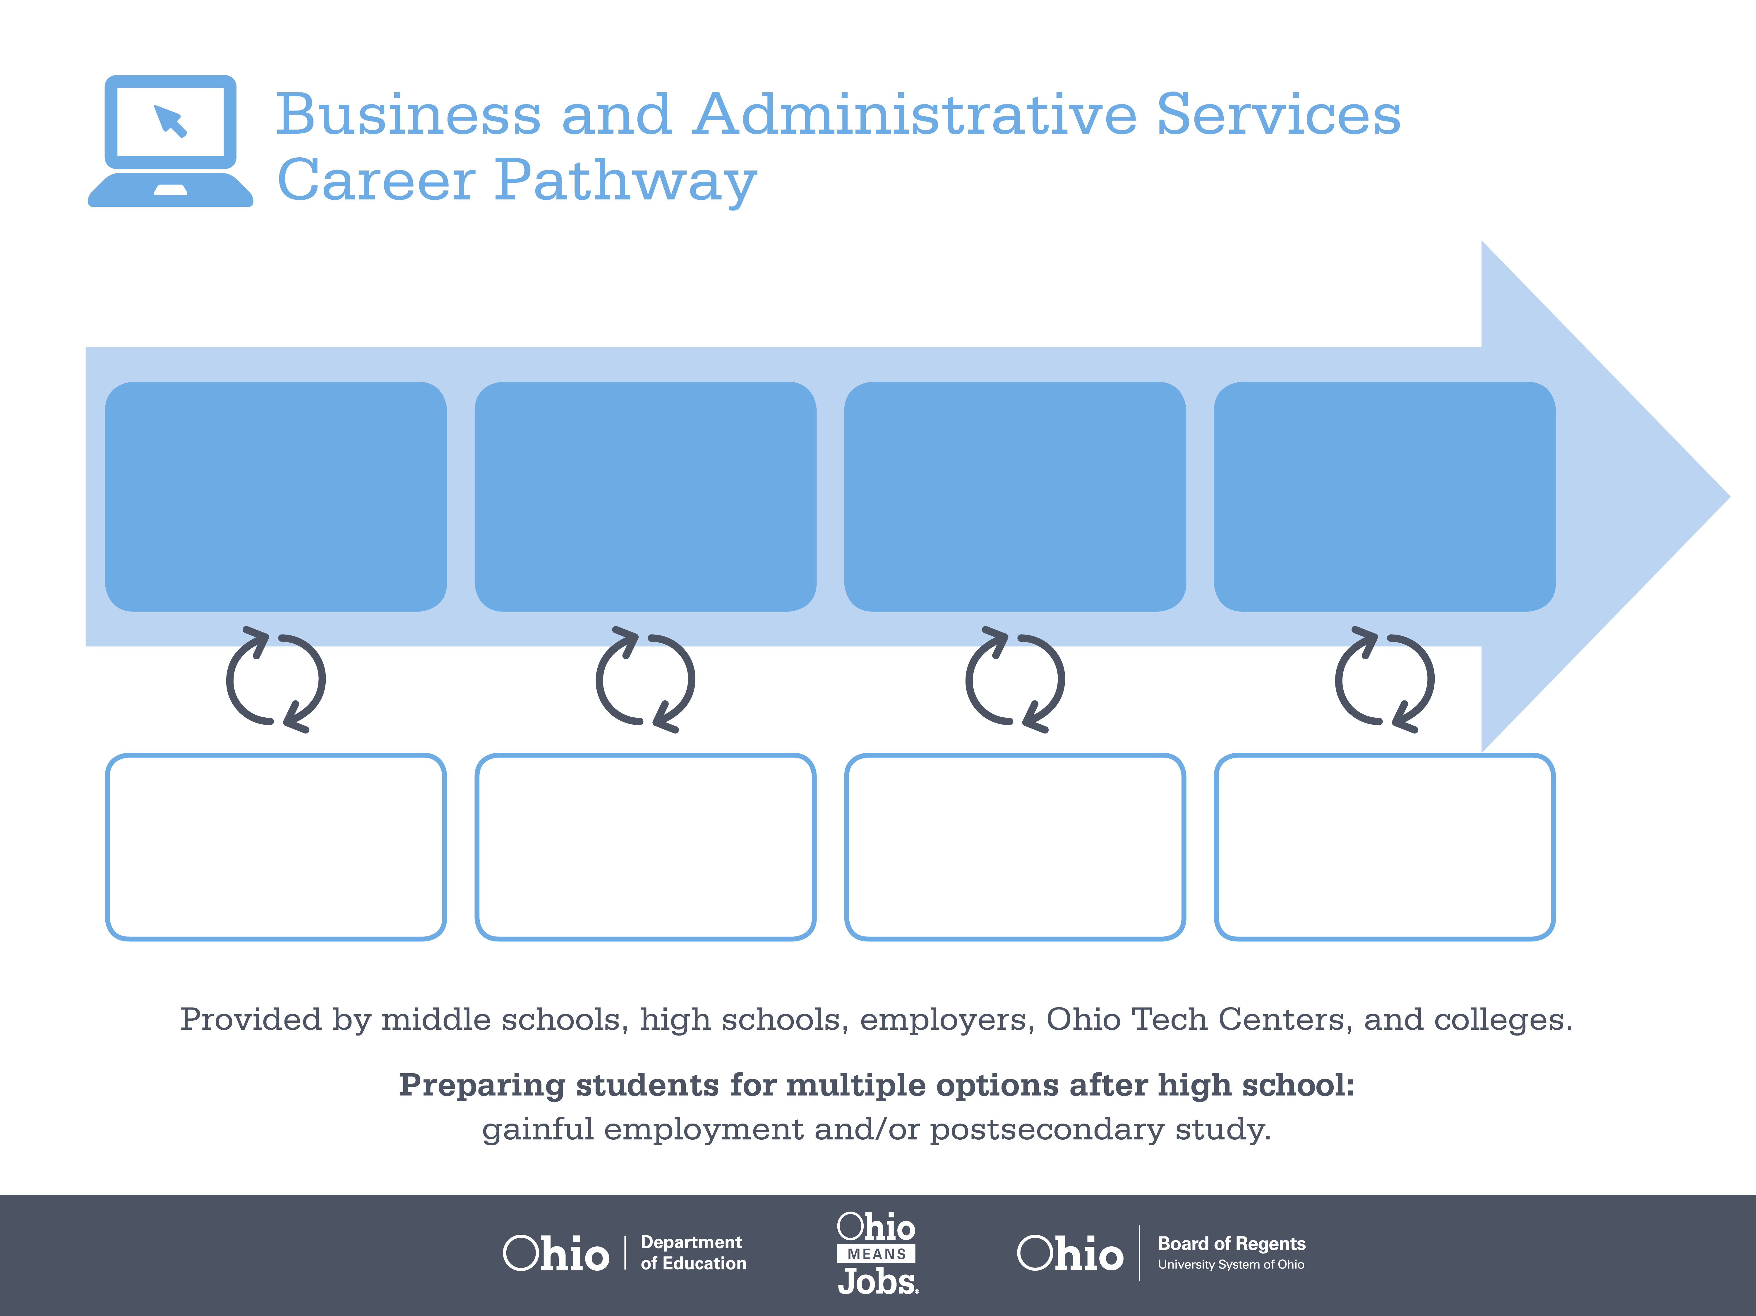
Certificate,
Administrative Professional
Professional Administrative
Certificate of Excellence
Bachelor’s Degree,
Operations Management
Start Pre-Business
As early as grade 7
(based on readiness)
Administrative Assistant
Median Salary: $31,210
Job Growth (10 yr): -0.4%
Annual Openings: 888
Average Tuition (1 yr): $0 –$3,900/yr
Executive Administrative Assistant
Median Salary: $43,500
Job Growth (10 yr): 7%
Annual Openings: 680
Average Tuition (2 yrs): $3,900/yr
Operations Director
Median Salary: $73,730
Job Growth (10 yr): 9.4%
Annual Openings: 323
Average Tuition (4 yrs): $9,600/yr
Workplace Visits
Job Shadow
Internship
Work
Supervised Experience
---
Work
Supervised Experience
Internship
---
Work
Internship
---
Work
Ohio In-demand Occupations
Data reflects 2014 Ohio labor statistics and public institutions of higher education for 2013-2014. For specific tuition costs, visit ohiohighered.org.

Slide 2

Secondary Pathway: Business and Administrative Services |  |  |  |  | Postsecondary Program: Business Management
An Example of Courses with Secondary and Postsecondary Credits
Secondary | 7 8 | English I | Algebra I | Physical Science |  | Social Studies | Fine Arts | Business Foundations | Fundamentals of Business & Admin.
 | 9 10 | English II | Geometry | Biology |  | World History | Health (.5) PE (.5) | Management Principles | World Languages
 | 11 | English III | Algebra II | Chemistry |  | U.S. History | Office Management | World Languages
 | 12 | English IV | Trigonometry/ Calculus | Physics |  | U.S. Government | Financial Accounting | Operations Management
Postsecondary | Year 1 1st Semester | English I | Business Math | Document Production |  | Beginning Spreadsheet | Office Procedures | Information Technology Basics
 | Year 1 2nd Semester | English II | Accounting Concepts | Document Production II |  | Intermediate Spreadsheet | Beginning Database | Presentation Graphics | Contemporary American Business | Social Science Elective
 | Year 2 1st Semester | Business Communication | Public Speaking | Employability Skills |  | Organizational Behavior | Intermediate Database | Principles of Management | Web Design
 | Year 2 2nd Semester | Interpersonal Communication | Human Resource Management | Office Simulation |  | HR Co-Op Experience | Business Management Elective
 |  | High School Career-Technical Education Program Courses
 |  | High School Courses for Postsecondary Credit (Including Apprenticeship Hours) and the Corresponding Postsecondary Courses
 |  | Required Courses
 |  | Recommended Electives
Visit education.ohio.gov/CareerConnections for reference information.
Course titles and sequences will vary between schools.
11/2014

