Slide 1
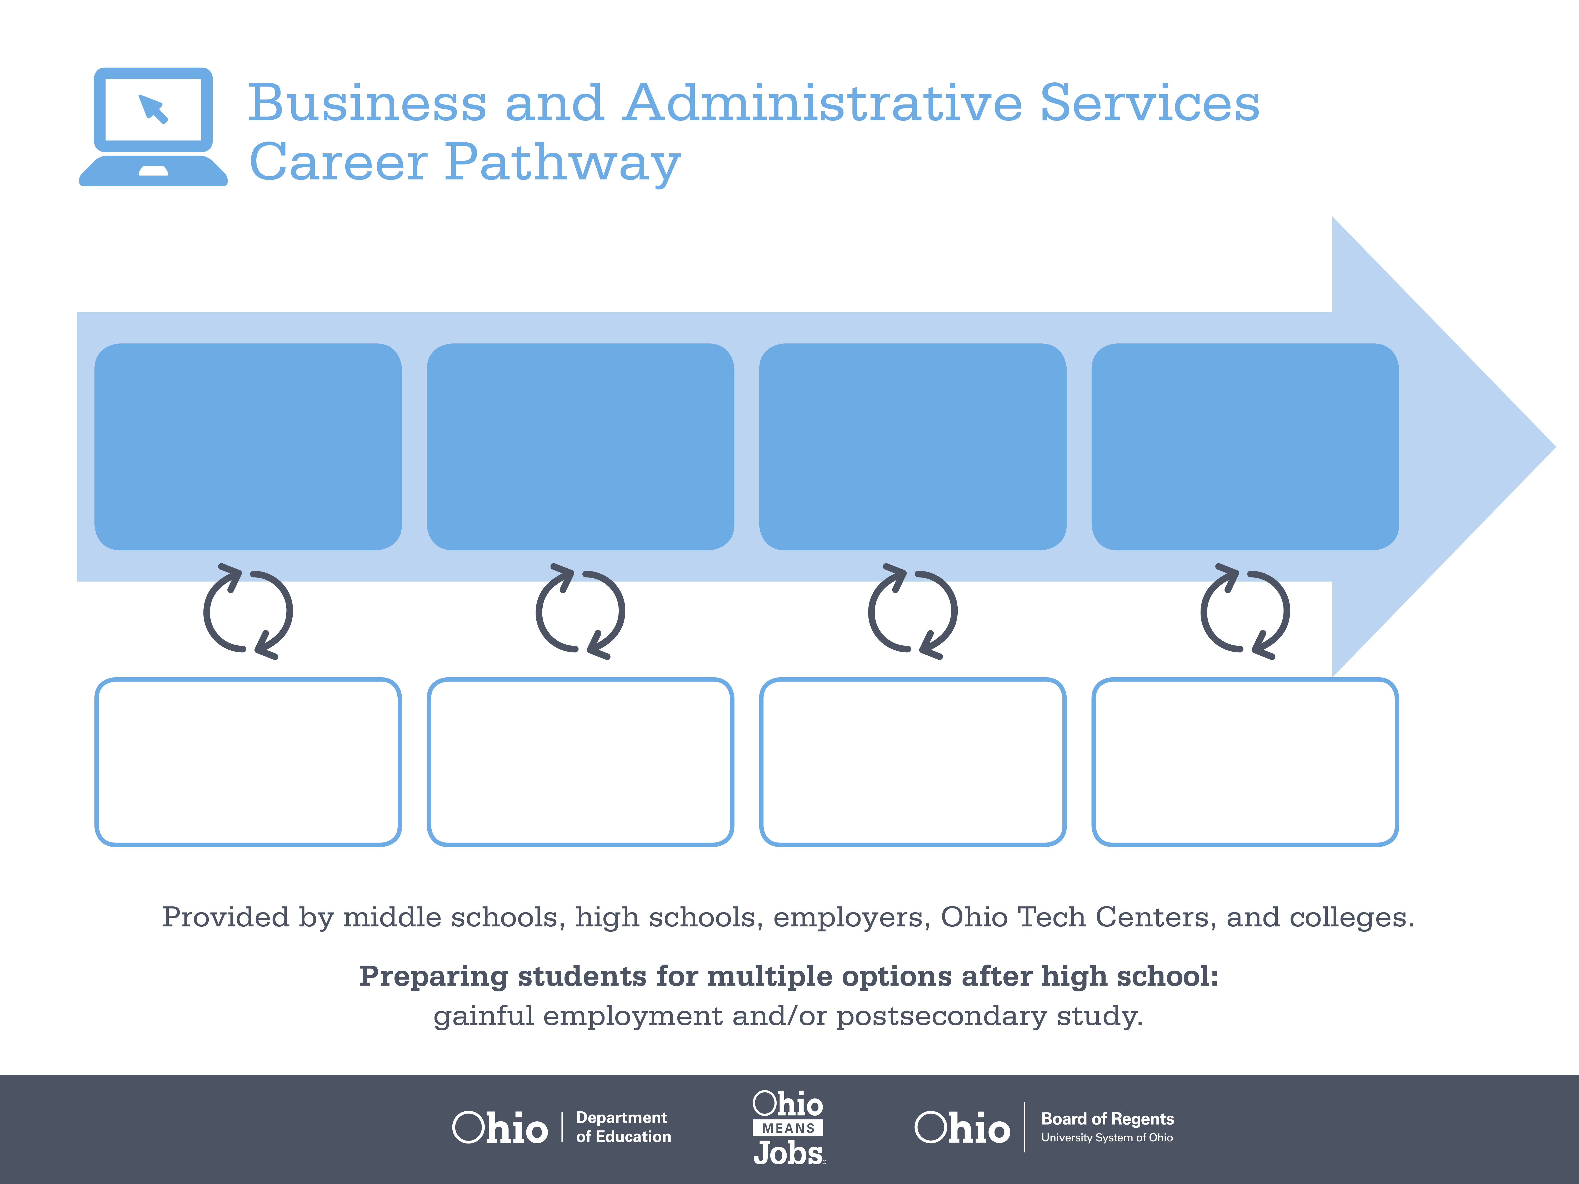
Certificate
Associate Degree,
Paralegal Studies
Doctoral Degree,
Law
Start Pre-Business
As early as grade 7
(based on readiness)
Legal Administrative Assistant
Median Salary: $37,310
Job Growth (10 yr): 4.4%
Annual Openings: 130
Average Tuition (1 yr): $0 –$3,900/yr
Paralegal
Median Salary: $42,010
Job Growth (10 yr): 18.4%
Annual Openings: 216
Average Tuition (2 yrs): $3,900/yr
Average Tuition (4 yrs): $9,600/yr
Lawyer
Median Salary: $94,460
Job Growth (10 yr): 7.9%
Annual Openings: 541
Average Tuition (3 yrs): $21,200/yr
Workplace Visits
Job Shadow
Internship
Work
Supervised Experience
---
Work
Supervised Experience
Internship
---
Work
Internship
---
Work
Ohio In-demand Occupations
Data reflects 2014 Ohio labor statistics and public institutions of higher education for 2013-2014. For specific tuition costs, visit ohiohighered.org.

Slide 2

Secondary Pathway: Business and Administrative Services |  |  |  |  | Postsecondary Program: Paralegal Studies
An Example of Courses with Secondary and Postsecondary Credits
Secondary | 7 8 | English I | Algebra I | Physical Science |  | Social Studies | Fine Arts | Business Foundations | Fundamentals of Business & Admin.
 | 9 10 | English II | Geometry | Biology |  | World History | Health (.5) PE (.5) | Management Principles | World Languages
 | 11 | English III | Algebra II | Chemistry |  | U.S. History | Office Management | Financial Accounting | World Languages
 | 12 | English IV | Trigonometry/ Calculus | Environmental Science |  | U.S. Government | Legal Office Management | Business Capstone
Postsecondary | Year 1 1st Semester | English | Algebra | College Seminar |  | Intro to Paralegal Studies/Ethics | Law Office Technology
 | Year 1 2nd Semester | English | Computer Applications | Legal Research & Writing |  | Torts & Contracts | Intro to Environmental Science | Intro to Sociology | Administrative Law | Business Organizations
 | Year 2 1st Semester | Communication | Advanced Legal Research | Civil Practice & Procedure |  | Technical Elective | Technical Elective
 | Year 2 2nd Semester | Psychology | Family Law | Legal Practicum |  | Humanities Elective | Technical Elective
 |  | High School Career-Technical Education Program Courses
 |  | High School Courses for Postsecondary Credit (Including Apprenticeship Hours) and the Corresponding Postsecondary Courses
 |  | Required Courses
 |  | Recommended Electives
Visit education.ohio.gov/CareerConnections for reference information.
Course titles and sequences will vary between schools.
11/2014

