Slide 1
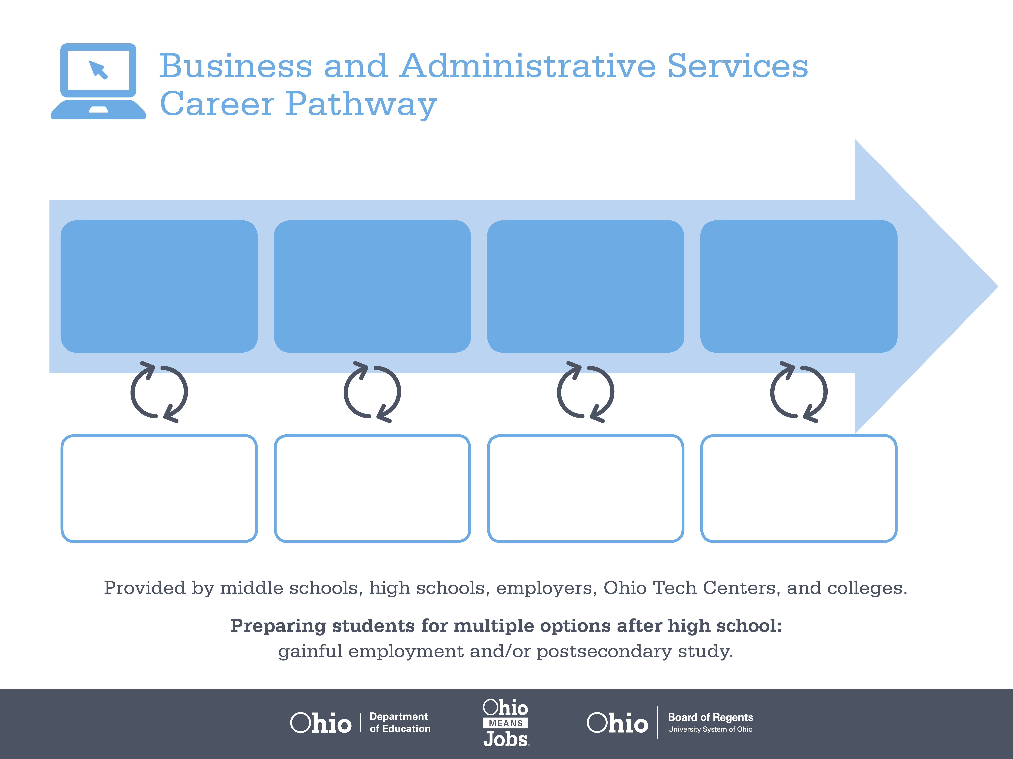
Certified Administrative
Manager
Associate Degree,
Office Specialist
Bachelor’s Degree,
Operations Management
Start Pre-Business
As early as grade 7
(based on readiness)
Office Clerk
Median Salary: $27,550
Job Growth (10 yr): 11.4%
Annual Openings: 3,294
Average Tuition (1 yr): $0 –$3,900/yr
Office Supervisor
Median Salary: $46,300
Job Growth (10 yr): 9.6%
Annual Openings: 1,662
Average Tuition (2 yrs): $3,900/yr
Operations Manager
Median Salary: $89,770
Job Growth (10 yr): -1.3%
Annual Openings: 829
Average Tuition (4 yrs): $9,600/yr
Workplace Visits
Job Shadow
Internship
Work
Supervised Experience
---
Work
Supervised Experience
Internship
---
Work
Internship
---
Work
Ohio In-demand Occupations
Data reflects 2014 Ohio labor statistics and public institutions of higher education for 2013-2014. For specific tuition costs, visit ohiohighered.org.

Slide 2

Secondary Pathway: Business and Administrative Services |  |  |  |  | Postsecondary Program: Business Management
An Example of Courses with Secondary and Postsecondary Credits
Secondary | 7 8 | English I | Algebra I | Physical Science |  | Social Studies | Fine Arts | Business Foundations | Fundamentals of Business & Admin.
 | 9 10 | English II | Geometry | Biology |  | World History | Health (.5) PE (.5) | Management Principles | World Languages
 | 11 | English III | Algebra II | Chemistry |  | U.S. History | Office Management | Financial Accounting | World Languages
 | 12 | English IV | Trigonometry/ Calculus | Physics |  | U.S. Government | Operations Management | Business Capstone
Postsecondary | Year 1 1st Semester | English I | Business Math | Intro to Financial Accounting |  | Foundations of Business | Micro-economics | Management Elective
 | Year 1 2nd Semester | English II | Computer Applications | Managerial Accounting |  | Marketing Principles | Arts & Humanities Elective
 | Year 2 1st Semester | Public Speaking | Statistics | International Business |  | Organizational Behavior | Business Law | Intro to Supervision
 | Year 2 2nd Semester | Business Capstone or Internship | Management Information Systems | Macro-economics |  | Business Communication | Natural Sciences Elective
 |  | High School Career-Technical Education Program Courses
 |  | High School Courses for Postsecondary Credit (Including Apprenticeship Hours) and the Corresponding Postsecondary Courses
 |  | Required Courses
 |  | Recommended Electives
Visit education.ohio.gov/CareerConnections for reference information.
Course titles and sequences will vary between schools.
11/2014

