Slide 1
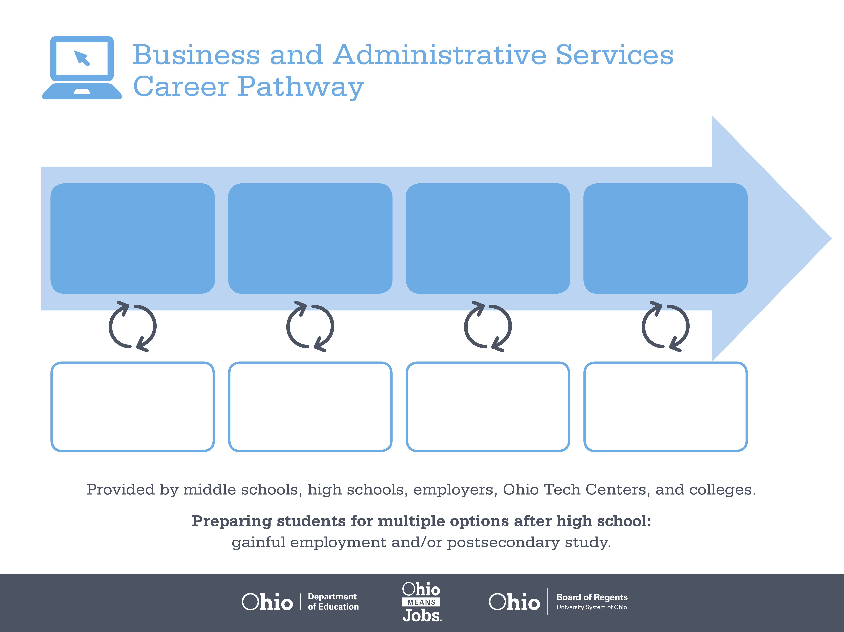
Certificate,
Medical Office
Associate Degree,
Health Information Technology
Bachelor’s Degree,
Health Care Administration
Start Pre-Business
As early as grade 7
(based on readiness)
Medical Secretary
Median Salary: $29,350
Job Growth (10 yr): 31.3%
Annual Openings: 1,602
Average Tuition (1 yr): $0 –$3,900/yr
Medical Records Technologist
Median Salary: $33,370
Job Growth (10 yr): 14.6%
Annual Openings: 246
Average Tuition (2 yrs): $3,900/yr
Health Administration Manager
Median Salary: $85,520
Job Growth (10 yr): 16%
Annual Openings: 555
Average Tuition (4 yrs): $9,600/yr
Workplace Visits
Job Shadow
Internship
Work
Supervised Experience
---
Work
Supervised Experience
Internship
---
Work
Internship
---
Work
Ohio In-demand Occupations
Data reflects 2014 Ohio labor statistics and public institutions of higher education for 2013-2014. For specific tuition costs, visit ohiohighered.org.

Slide 2

Secondary Pathway: Business and Administrative Services |  |  |  |  | Postsecondary Program: Medical Management
An Example of Courses with Secondary and Postsecondary Credits
Secondary | 7 8 | English I | Algebra I | Physical Science |  | Social Studies | Fine Arts | Business Foundations | Fundamentals of Business & Admin.
 | 9 10 | English II | Geometry | Biology |  | World History | Health (.5) PE (.5) | Management Principles | Medical Terminology | World Languages
 | 11 | English III | Algebra II | Chemistry |  | U.S. History | Office Management | Business Informatics | World Languages
 | 12 | English IV | Trigonometry/ Calculus | Physics |  | U.S. Government | Medical Office Management | Business Capstone
Postsecondary | Year 1 1st Semester | English | College Seminar | Office Procedures I |  | Word I | Excel I | PowerPoint I | Keyboarding & Document Formatting
 | Year 1 2nd Semester | Business Language | Introduction to Health Care | Office Procedures II |  | Word II | Advanced Document Formatting | PowerPoint II | Medical Terminology | Access I
 | Year 2 1st Semester | Business Math | Bookkeeping I | Advanced Medical Terminology |  | Excel II | Health Data Management | Office Integration
 | Year 2 2nd Semester | Business Capstone | Medical Reimburse-ment | Computer Transcription |  | Business Practicum | Natural Sciences Elective | Technical Elective
 |  | High School Career-Technical Education Program Courses
 |  | High School Courses for Postsecondary Credit (Including Apprenticeship Hours) and the Corresponding Postsecondary Courses
 |  | Required Courses
 |  | Recommended Electives
Visit education.ohio.gov/CareerConnections for reference information.
Course titles and sequences will vary between schools.
12/2014

