Slide 1
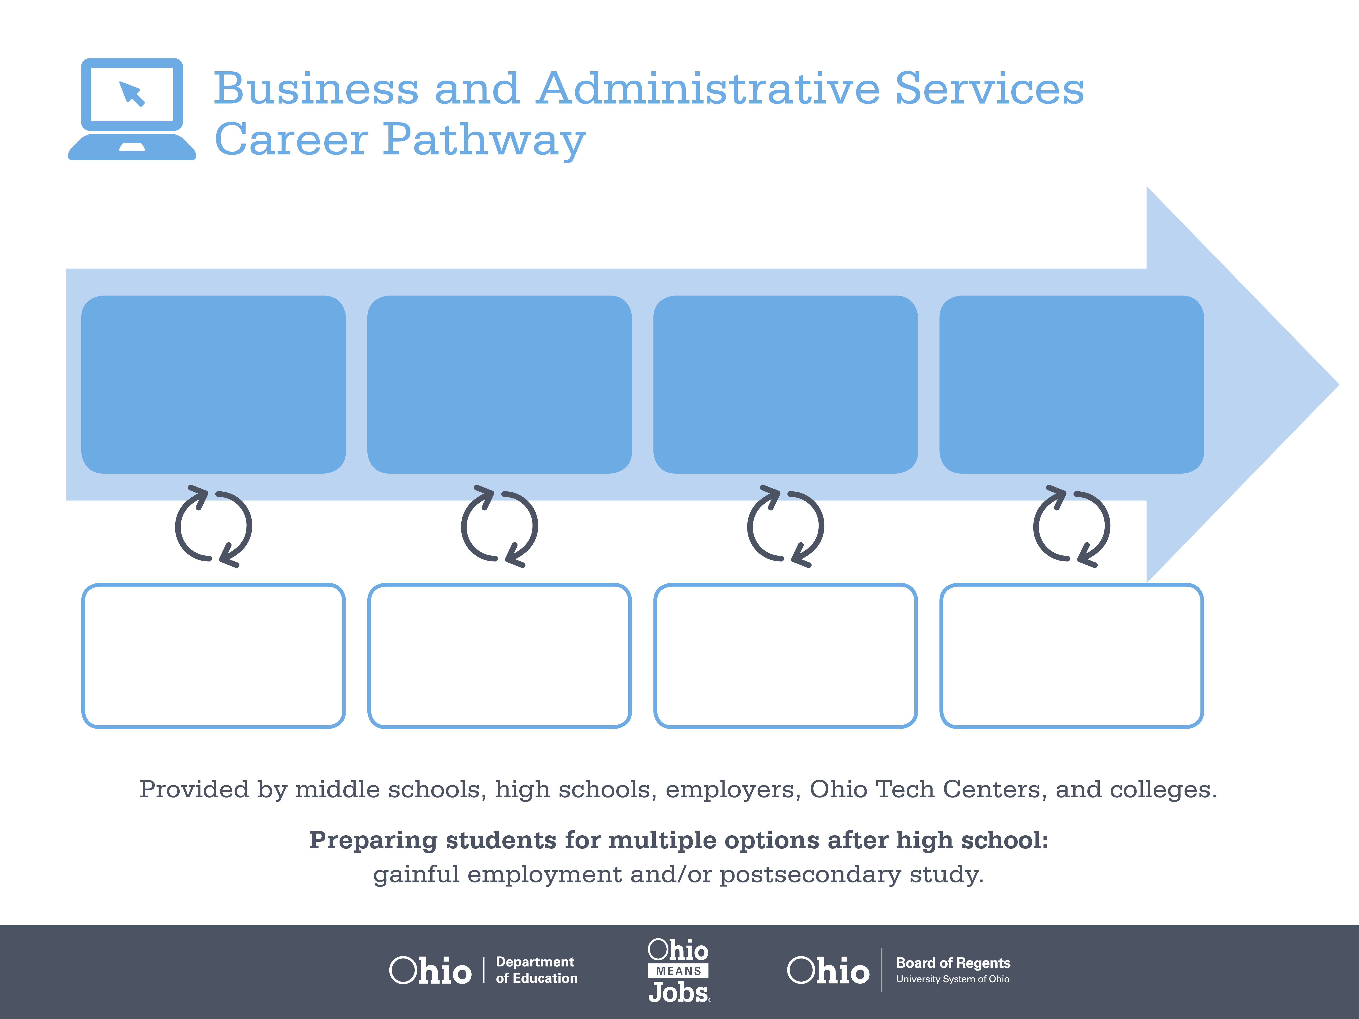
Certificate
Associate Degree,
Marketing Operations
Bachelor’s Degree,
Finance
Start Pre-Business
As early as grade 7
(based on readiness)
Billing Clerk
Median Salary: $32,260
Job Growth (10 yr): 16%
Annual Openings: 787
Average Tuition (1 yr): $0 –$3,900/yr
Purchasing Agent
Median Salary: $57,040
Job Growth (10 yr): 0.7%
Annual Openings: 334
Average Tuition (2 yrs): $3,900/yr
Purchasing Manager
Median Salary: $92,440
Job Growth (10 yr): 5.1%
Annual Openings: 90
Average Tuition (4 yrs): $9,600/yr
Workplace Visits
Job Shadow
Internship
Work
Supervised Experience
---
Work
Supervised Experience
Internship
---
Work
Internship
---
Work
Ohio In-demand Occupations
Data reflects 2014 Ohio labor statistics and public institutions of higher education for 2013-2014. For specific tuition costs, visit ohiohighered.org.

Slide 2

Secondary Pathway: Business and Administrative Services |  |  |  |  | Postsecondary Program: Marketing Operations
An Example of Courses with Secondary and Postsecondary Credits
Secondary | 7 8 | English I | Algebra I | Physical Science |  | Social Studies | Fine Arts | Business Foundations | Fundamentals of Business & Admin. Svcs.
 | 9 10 | English II | Geometry | Biology |  | World History | Health (.5) PE (.5) | Financial Accounting | Supply Chain Management | World Languages
 | 11 | English III | Algebra II | Chemistry |  | U.S. History | Managerial Accounting | World Languages
 | 12 | English IV | Trigonometry/ Calculus | Physics |  | U.S. Government | Logistics Management | Business Capstone
Postsecondary | Year 1 1st Semester | English | College Seminar | Financial Accounting |  | Software Applications | Personal Finance | Business Language
 | Year 1 2nd Semester | Business Applications | Investments | Statistics |  | Managerial Accounting | Management | Micro-economics | Natural/ Physical Science
 | Year 2 1st Semester | Macro-economics | Legal Environment of Business | Money & Banking |  | International Finance | Finance Elective | Arts & Humanities Elective
 | Year 2 2nd Semester | Marketing Principles | Finance Capstone | Finance Practicum |  | Finance Elective | Social/ Behavioral Science
 |  | High School Career-Technical Education Program Courses
 |  | High School Courses for Postsecondary Credit (Including Apprenticeship Hours) and the Corresponding Postsecondary Courses
 |  | Required Courses
 |  | Recommended Electives
Visit education.ohio.gov/CareerConnections for reference information.
Course titles and sequences will vary between schools.
11/2014

