Slide 1
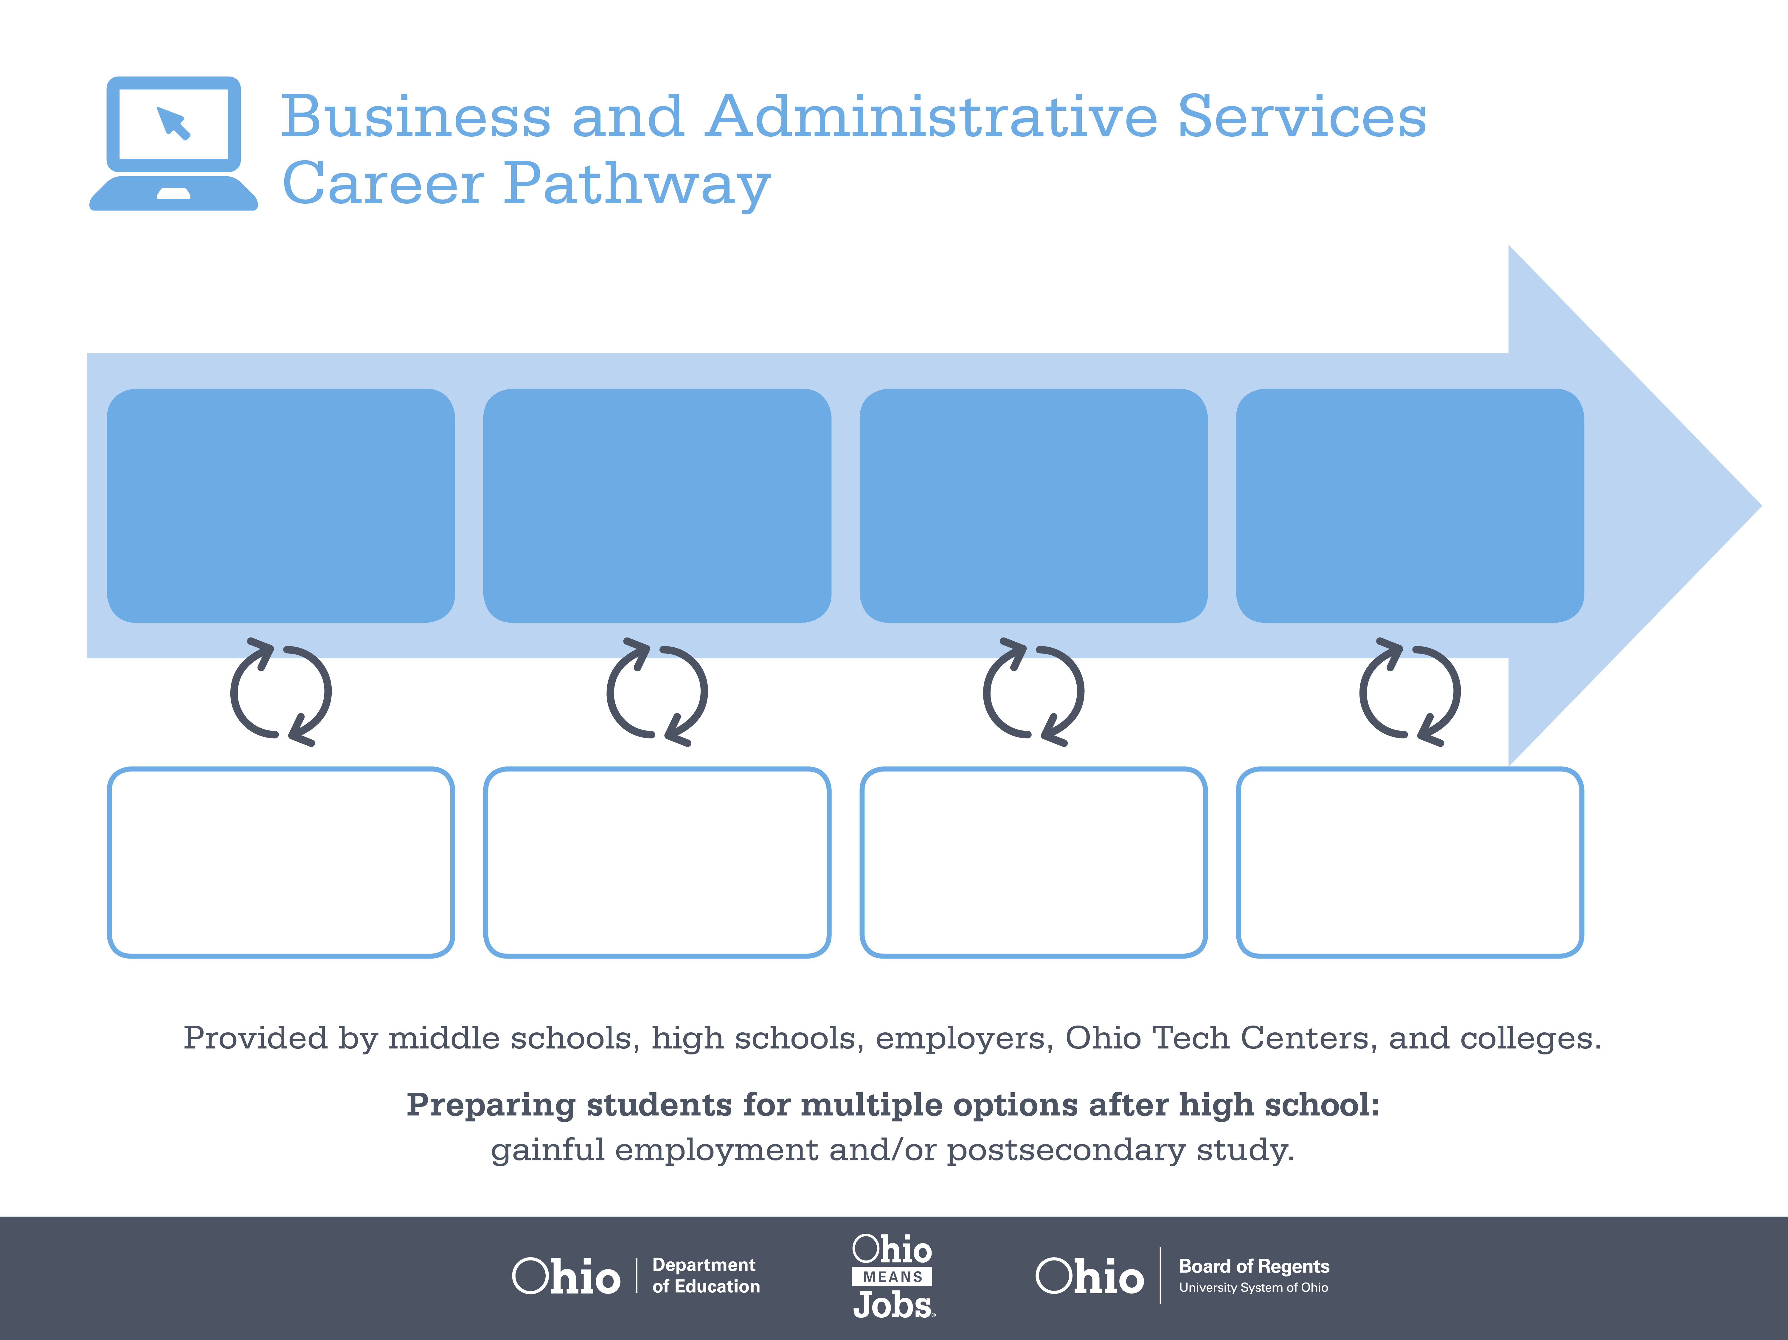
Certificate
Associate Degree,
Supply Chain Management
Bachelor’s Degree,
Operations Management
Start Pre-Business
As early as grade 7
(based on readiness)
Production Clerk
Median Salary: $38,710
Job Growth (10 yr): 8.5%
Annual Openings: 469
Average Tuition (1 yr): $0 –$3,900/yr
Logistician
Median Salary: $69,450
Job Growth (10 yr): 22.3%
Annual Openings: 216
Average Tuition (2 yrs): $3,900/yr
Transportation Manager
Median Salary: $77,660
Job Growth (10 yr): 9%
Annual Openings: 148
Average Tuition (4 yrs): $9,600/yr
Workplace Visits
Job Shadow
Internship
Work
Supervised Experience
---
Work
Supervised Experience
Internship
---
Work
Internship
---
Work
Ohio In-demand Occupations
Data reflects 2014 Ohio labor statistics and public institutions of higher education for 2013-2014. For specific tuition costs, visit ohiohighered.org.

Slide 2

Secondary Pathway: Business and Administrative Services |  |  |  |  | Postsecondary Program: Supply Chain Management
An Example of Courses with Secondary and Postsecondary Credits
Secondary | 7 8 | English I | Algebra I | Physical Science | Social Studies | Fine Arts | Business Foundations | Fundamentals of Business and Admin.
 | 9 10 | English II | Geometry | Biology | World History | Health (.5) PE (.5) | Management Principles | World Languages
 | 11 | English III | Algebra II | Chemistry | U.S. History | Supply Chain Management | Operations Management | World Languages
 | 12 | English IV | Trigonometry/ Calculus | Physics | U.S. Government | Logistics Management | Business Capstone
Postsecondary | Year 1 1st Semester | English | College Seminar | Financial Accounting | Supply Chain Management Principles | Micro-economics
 | Year 1 2nd Semester | Statistics | Transportation & Traffic Management | Strategic Procurement | IT in Logistics | Customer Service & Sales | Marketing Principles | International Management
 | Year 2 1st Semester | Managerial Accounting | Warehouse Management | Inventory Management | International Business | Import/ Export Regulations & Compliance | Humanities Elective
 | Year 2 2nd Semester | Performance Management | Project Management | SCM Seminar | SCM Practicum | Natural Science Elective
 |  | High School Career-Technical Education Program Courses
 |  | High School Courses for Postsecondary Credit (Including Apprenticeship Hours) and the Corresponding Postsecondary Courses
 |  | Required Courses
 |  | Recommended Electives
Visit education.ohio.gov/CareerConnections for reference information.
Course titles and sequences will vary between schools.
1/2015

