Slide 1
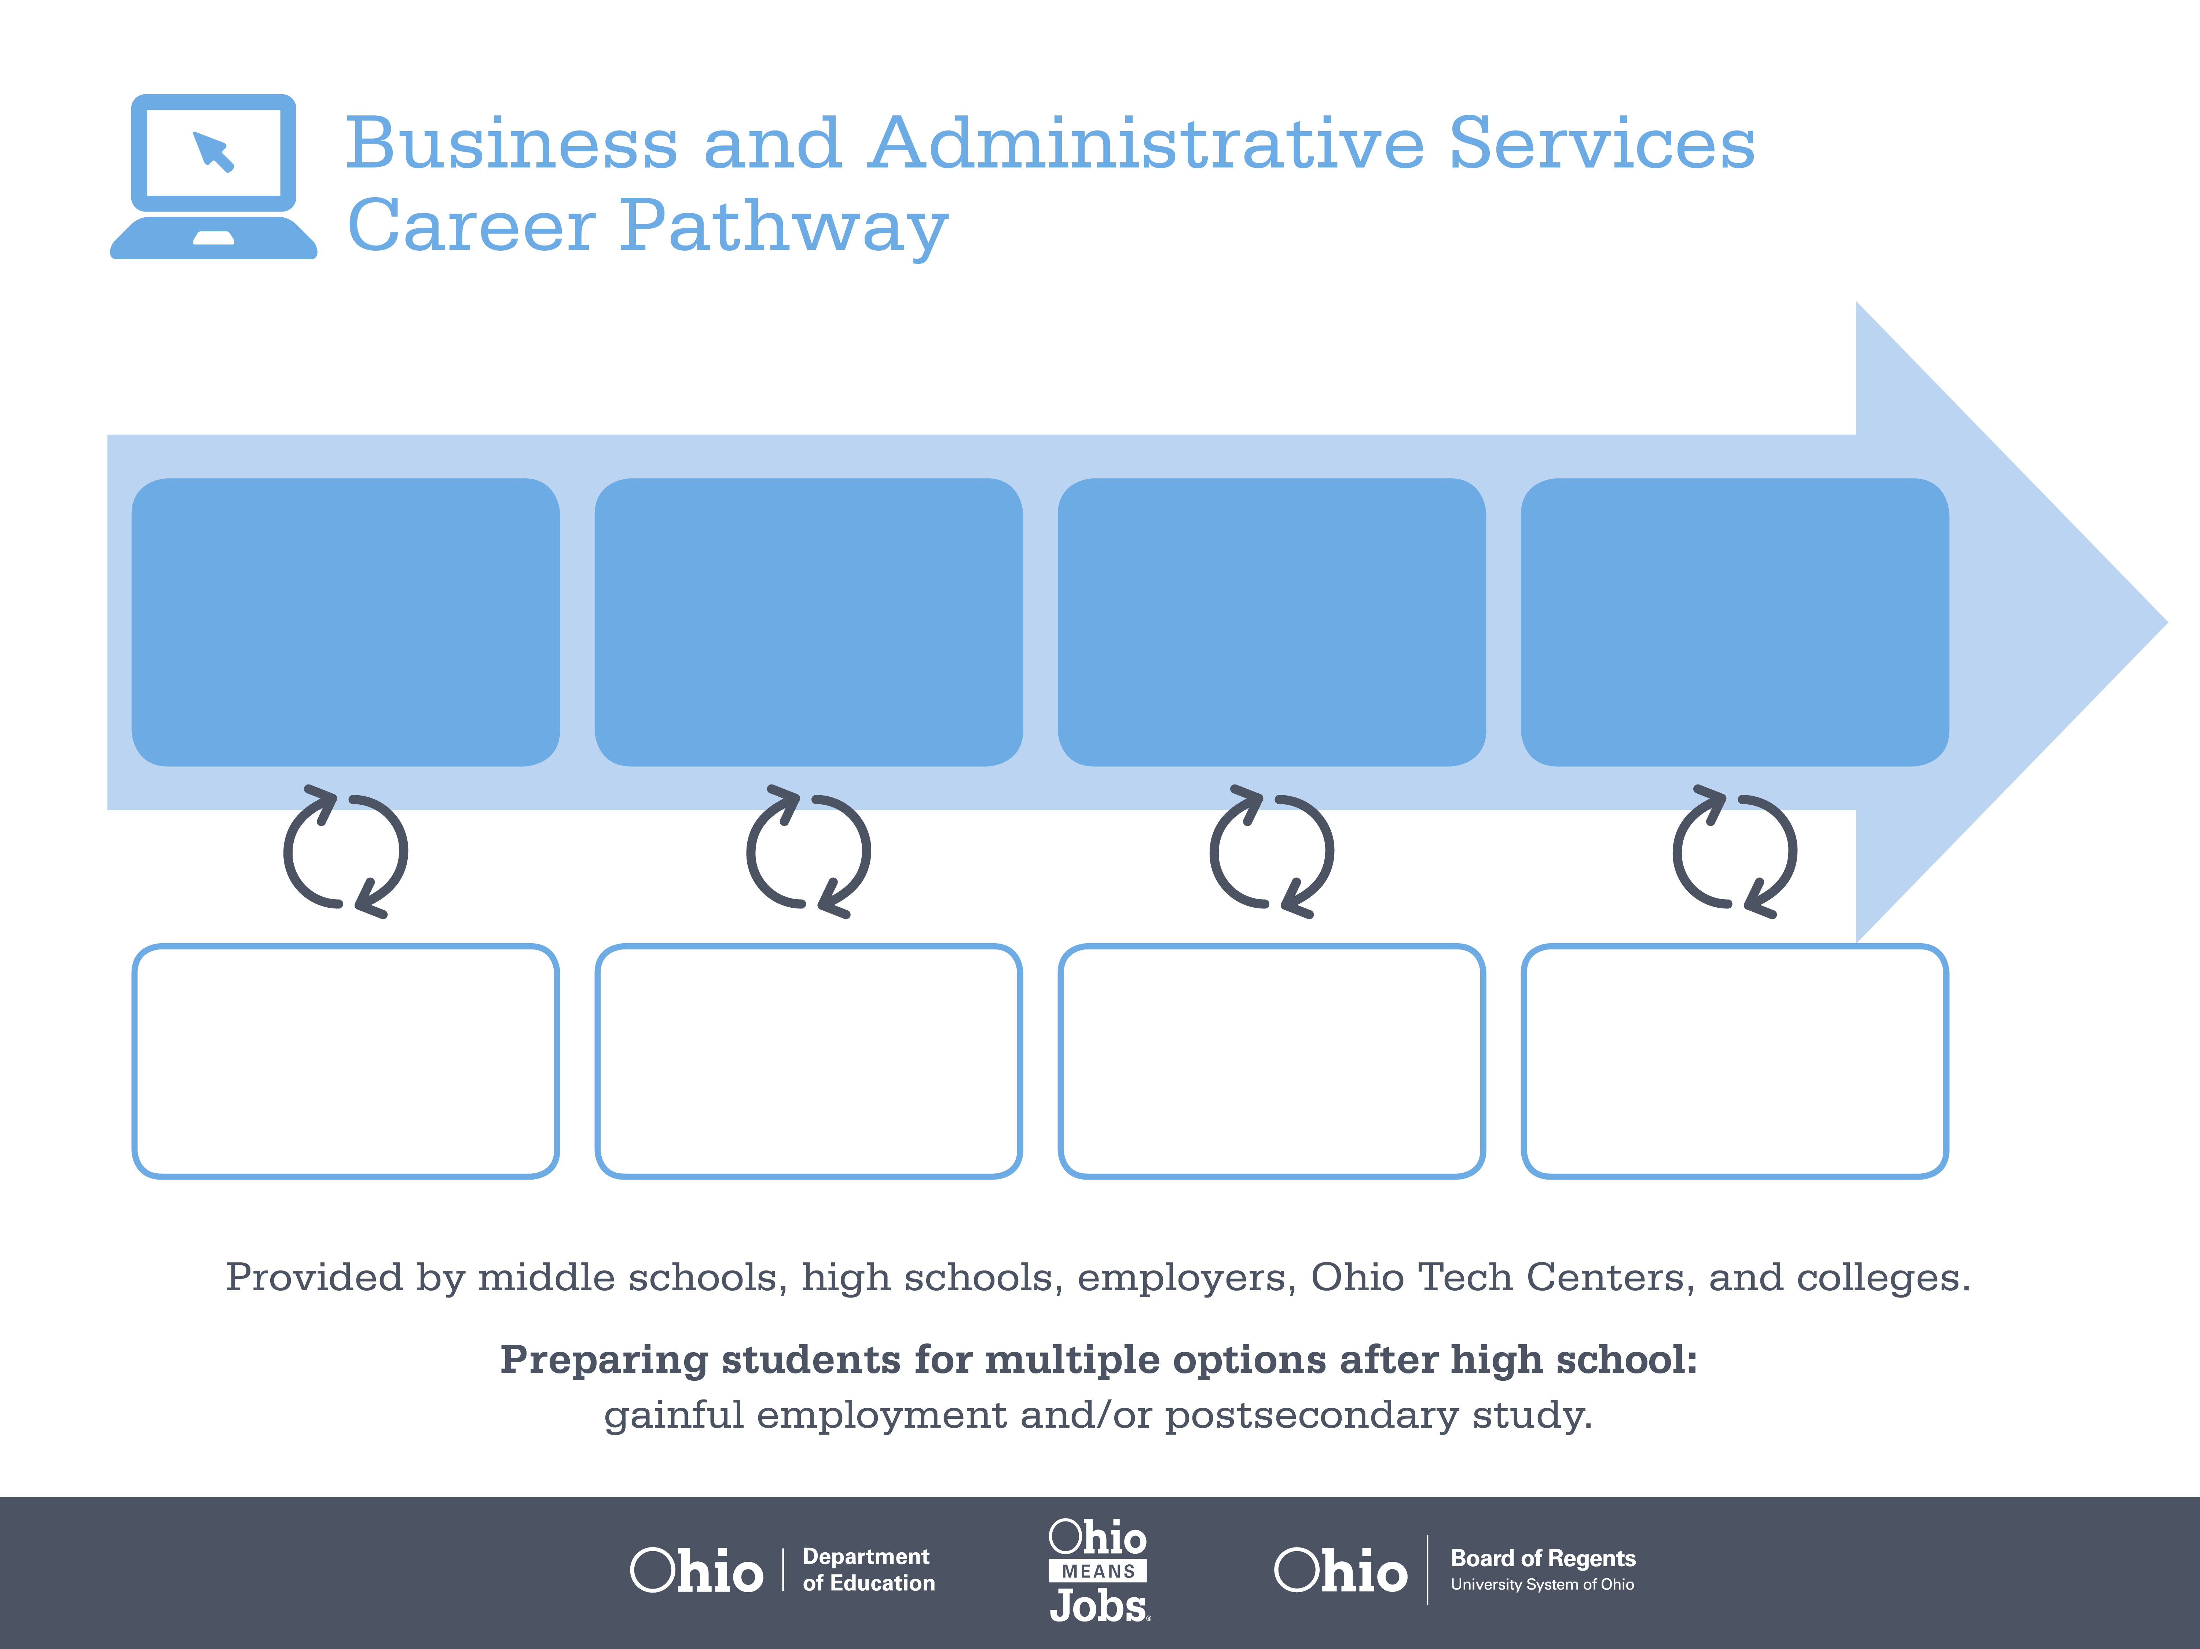
Certificate
Associate Degree,
Human Resources
Bachelor’s Degree,
Human Resources
Administration
Start Pre-Business
As early as grade 7
(based on readiness)
Office Assistant
Median Salary: $24,100
Job Growth (10 yr): 14.8%
Annual Openings: 1,272
Average Tuition (1 yr): $0 –$3,900/yr
Training Specialist
Median Salary: $54,100
Job Growth (10 yr): 21.8%
Annual Openings: 312
Average Tuition (2 yrs): $3,900/yr
Training Manager
Median Salary: $101,550
Job Growth (10 yr): 10%
Annual Openings: 23
Average Tuition (4 yrs): $9,600/yr
Workplace Visits
Job Shadow
Internship
Work
Supervised Experience
---
Work
Supervised Experience
Internship
---
Work
Internship
---
Work
Ohio In-demand Occupations
Data reflects 2014 Ohio labor statistics and public institutions of higher education for 2013-2014. For specific tuition costs, visit ohiohighered.org.

Slide 2

Secondary Pathway: Business and Administrative Services |  |  |  |  | Postsecondary Program: Human Resources
An Example of Courses with Secondary and Postsecondary Credits
Secondary | 7 8 | English I | Algebra I | Physical Science |  | Social Studies | Fine Arts | Business Foundations | Fundamentals of Business & Admin.
 | 9 10 | English II | Geometry | Biology |  | World History | Health (.5) PE (.5) | Management Principles | World Languages
 | 11 | English III | Algebra II | Chemistry |  | U.S. History | Managerial Accounting | Operations Management | World Languages
 | 12 | English IV | Trigonometry/ Calculus | Physics |  | U.S. Government | Human Resources Management | Business Capstone
Postsecondary | Year 1 1st Semester | English | Business Language | Business Applications |  | Human Resources Management | Computer Applications | Management
 | Year 1 2nd Semester | Statistics | Personnel Interviewing | Employee Training |  | Labor Relations | HR Policy & Procedure Writing | Legal Environment of Business | Benefits & Compensation
 | Year 2 1st Semester | Intercultural Communication | Micro-economics | HR Records Management |  | Workplace Safety | Staffing & the Law | Payroll
 | Year 2 2nd Semester | American Government | Administration of Human Resources | Voluntary Benefits |  | HRM Practicum | Natural Sciences Elective
 |  | High School Career-Technical Education Program Courses
 |  | High School Courses for Postsecondary Credit (Including Apprenticeship Hours) and the Corresponding Postsecondary Courses
 |  | Required Courses
 |  | Recommended Electives
Visit education.ohio.gov/CareerConnections for reference information.
Course titles and sequences will vary between schools.
6/2015

