Slide 1
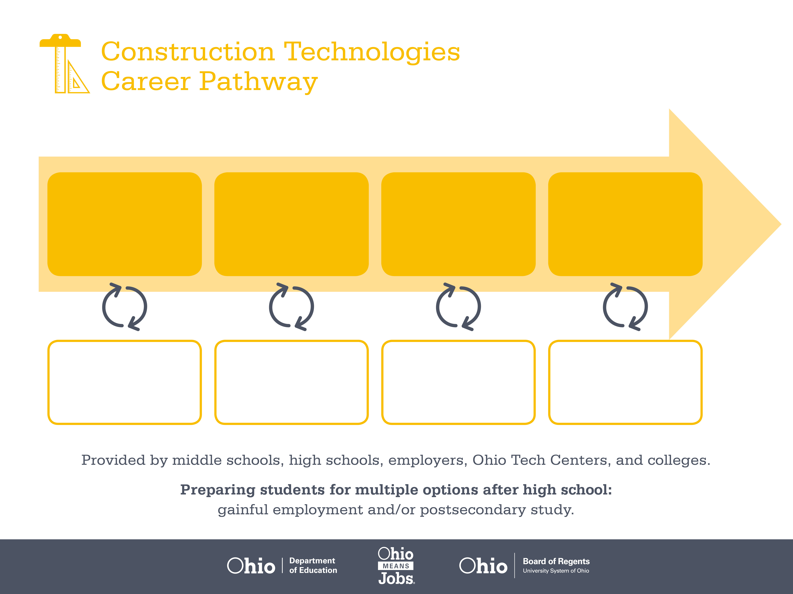
Apprenticeship
Associate Degree,
Skilled Trades
Bachelor’s Degree,
Operations Management
Start Pre-Construction
As early as grade 7
(based on readiness)
Electrician Apprentice
Median Salary: 26,410
Job Growth (10 yr): 14.3%
Annual Openings: 839
Average Tuition (1 yr): $0 –$3,900/yr
Professional Electrician
Median Salary: $44,330
Job Growth (10 yr): 14.3%
Annual Openings: 839
Average Tuition (2 yrs): $3,900/yr
Crew Leader
Median Salary: $57,500
Job Growth (10 yr): 14.8%
Annual Openings: 457
Average Tuition (4 yrs): $9,600/yr
Workplace Visits
Job Shadow
Internship
Work
Supervised Experience
Internship
---
Work
Supervised Experience
---
Work
Internship
---
Work
Ohio In-demand Occupations
Data reflects 2014 Ohio labor statistics and public institutions of higher education for 2013-2014. For specific tuition costs, visit ohiohighered.org.

Slide 2

Secondary Pathway: Mechanical, Electrical and Plumbing |  |  |  |  | Postsecondary Program: Electrical Trades
An Example of Courses with Secondary and Postsecondary Credits
Secondary | 7 8 | English I | Algebra I | Physical Science |  | Social Studies | Fine Arts | Core & Sustainable Construction
 | 9 10 | English II | Geometry | Biology |  | World History | Health (.5) PE (.5) | Mechanical, Electrical, & Plumbing Sys. | Construction Electrical Systems | World Languages
 | 11 | English III | Algebra II | Chemistry |  | U.S. History | Commercial & Industrial Systems | World Languages
 | 12 | English IV | Trigonometry/ Calculus | Environmental Science |  | U.S. Government | Alternative Power Generation | Construction Safety & Leadership
Postsecondary | Year 1 1st Semester | English Composition I | College Algebra | Industrial Computing |  | CAD | Industrial Electricity I
 | Year 1 2nd Semester | English Composition II | Trigonometry | Industrial Wiring |  | Hydraulics I | Industrial Electricity II | Environmental Science
 | Year 2 1st Semester | Interpersonal Communication | HVAC I | Industrial Electronics |  | Motors & Controls | Programmable Controller I
 | Year 2 2nd Semester | Psychology | Electrical Prints & Trouble-shooting | Instrumentation & Controls |  | Industrial Fluid Power II | Robotics | Hydraulics II
 |  | High School Career-Technical Education Program Courses
 |  | High School Courses for Postsecondary Credit (Including Apprenticeship Hours) and the Corresponding Postsecondary Courses
 |  | Required Courses
 |  | Recommended Electives
Visit education.ohio.gov/CareerConnections for reference information.
Course titles and sequences will vary between schools.
1/2016

