Slide 1
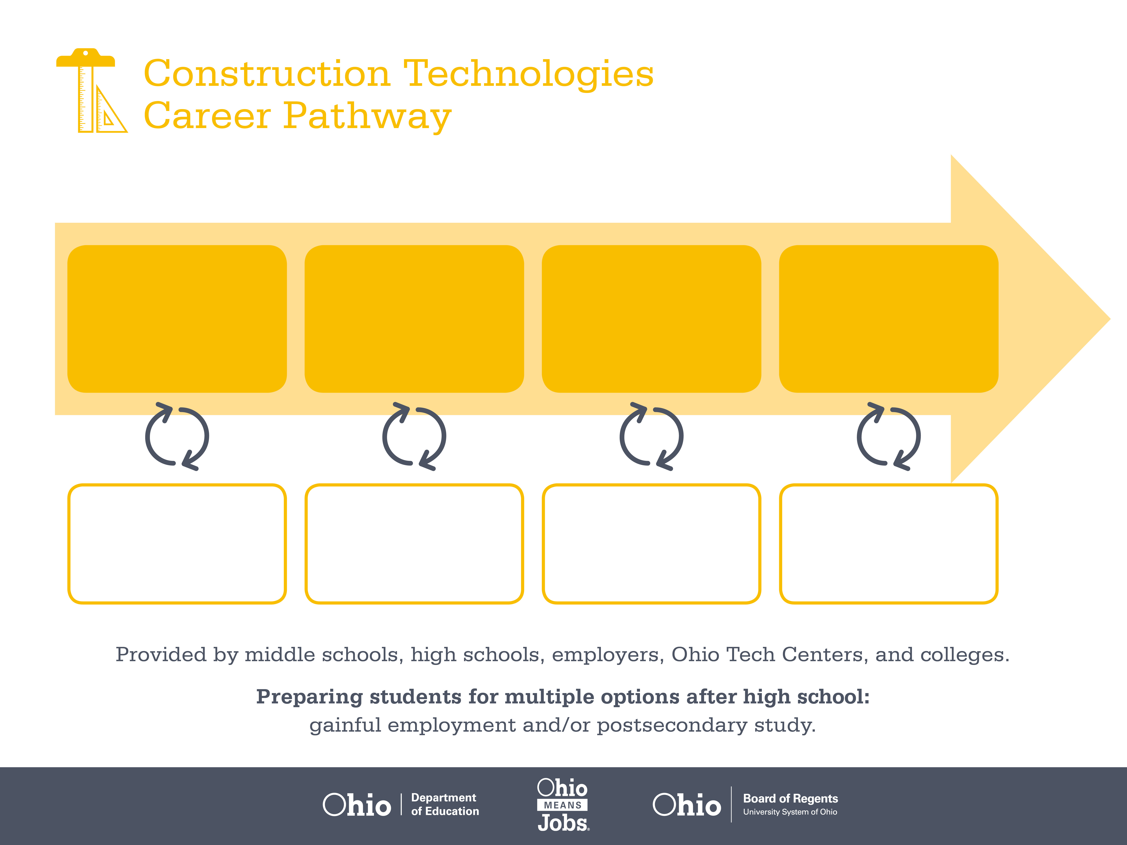
Certificate,
Construction Equipment
Operation
Certificate,
Heavy Equipment
Operation
Associate Degree,
Construction Management
Start Pre-Construction
As early as grade 7
(based on readiness)
Excavator
Median Salary: $36,900
Job Growth (10 yr): 006%
Annual Openings: 54
Average Tuition (1 yr): $0 –$3,900/yr
Operating Engineer
Median Salary: $44,430
Job Growth (10 yr): 12.1%
Annual Openings: 421
Average Tuition (1 yr): $0 –$3,900/yr
Project Supervisor
Median Salary: $57,500
Job Growth (10 yr): 14.8%
Annual Openings: 457
Average Tuition (2 yrs): $3,900/yr
Workplace Visits
Job Shadow
Internship
Work
Supervised Experience
---
Work
Supervised Experience
Internship
---
Work
Internship
---
Work
Ohio In-demand Occupations
Data reflects 2014 Ohio labor statistics and public institutions of higher education for 2013-2014. For specific tuition costs, visit ohiohighered.org.

Slide 2

Secondary Pathway: Strucural Systems |  |  |  |  | Postsecondary Program: Construction Management
An Example of Courses with Secondary and Postsecondary Credits
Secondary | 7 8 | English I | Algebra I | Physical Science |  | Social Studies | Fine Arts | Core & Sustainable Construction
 | 9 10 | English II | Geometry | Biology |  | World History | Health (.5) PE (.5) | Plan Reading | World Languages
 | 11 | English III | Algebra II | Chemistry |  | U.S. History | Construction Safety & Leadership | Construction Management | World Languages
 | 12 | English IV | Trigonometry/ Calculus | Environmental Science |  | U.S. Government | Heavy Equipment Operations | Construction Site Preparation
Postsecondary | Year 1 1st Semester | English | College Seminar | Construction Documents |  | Construction Methods | Construction Material Science | Construction Drawings
 | Year 1 2nd Semester | Business | Basic CAD | Quantity Survey |  | OSHA 30-hour Safety & Health | Basic Mechanical Drafting | Safety & Loss Prevention | Environmental Science
 | Year 2 1st Semester | Intermediate Algebra | Cost Control | Intro to Surveying |  | Estimating | Residential Computer Estimating | Company Management
 | Year 2 2nd Semester | Statistics | Project Management | Psychology |  | Business Management | Humanities Elective
 |  | High School Career-Technical Education Program Courses
 |  | High School Courses for Postsecondary Credit (Including Apprenticeship Hours) and the Corresponding Postsecondary Courses
 |  | Required Courses
 |  | Recommended Electives
Visit education.ohio.gov/CareerConnections for reference information.
Course titles and sequences will vary between schools.
1/2016

