Slide 1
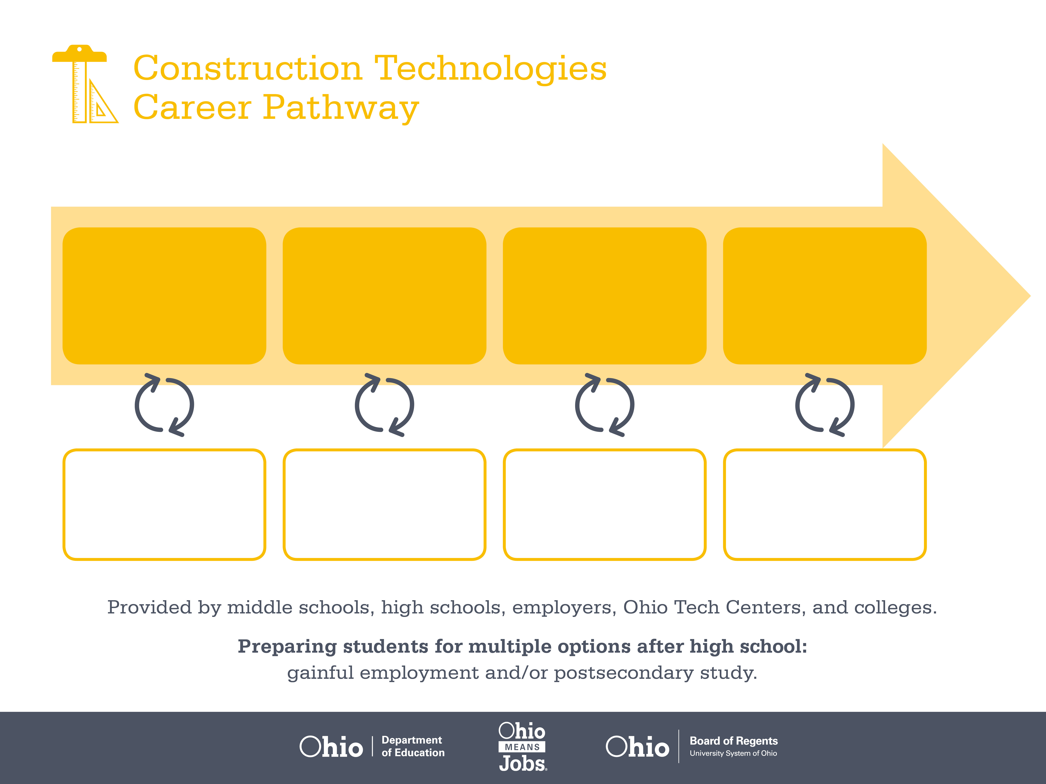
Apprenticeship
Associate Degree,
Skilled Trades
Bachelor’s Degree,
Operations Management
Start Pre-Construction
As early as grade 7
(based on readiness)
HVAC Apprentice
Median Salary: $27,810
Job Growth (10 yr): 28.9%
Annual Openings: 437
Average Tuition (1 yr): $0 –$3,900/yr
Professional HVAC Mechanic
Median Salary: $42,580
Job Growth (10 yr): 28.9%
Annual Openings: 437
Average Tuition (2 yrs): $3,900/yr
Site Superintendent
Median Salary: $89,770
Job Growth (10 yr): -1.3%
Annual Openings: 829
Average Tuition (4 yrs): $9,600/yr
Workplace Visits
Job Shadow
Internship
Work
Supervised Experience
Internship
---
Work
Supervised Experience
---
Work
Internship
---
Work
Ohio In-demand Occupations
Data reflects 2014 Ohio labor statistics and public institutions of higher education for 2013-2014. For specific tuition costs, visit ohiohighered.org.

Slide 2

Secondary Pathway: Mechanical, Electrical and Plumbing |  |  |  |  | Postsecondary Program: HVAC
An Example of Courses with Secondary and Postsecondary Credits
Secondary | 7 8 | English I | Algebra I | Physical Science |  | Social Studies | Fine Arts | Core & Sustainable Construction
 | 9 10 | English II | Geometry | Biology |  | World History | Health (.5) PE (.5) | Mechanical, Electrical, & Plumbing Sys. | Heating & Cooling Systems | World Languages
 | 11 | English III | Algebra II | Chemistry |  | U.S. History | HVAC Refrigeration | World Languages
 | 12 | English IV | Trigonometry/ Calculus | Environmental Science |  | U.S. Government | Sheet Metal | Construction Safety & Leadership
Postsecondary | Year 1 1st Semester | English | Technical Math | College Seminar |  | Electricity | Basic Refrigeration | Intro to Computers
 | Year 1 2nd Semester | Interpersonal Communication | Heating Systems I | Installation Fundamentals |  | Refrigeration Control Systems | Refrigeration Handling | Social Science Elective
 | Year 2 1st Semester | Business Law | Heating Systems II | CAD |  | Duct Layout & Prints | Basic Refrigeration II | Environmental Science
 | Year 2 2nd Semester | Capstone | Climate Control | HVAC Design |  | Workplace Safety | Humanities Elective
 |  | High School Career-Technical Education Program Courses
 |  | High School Courses for Postsecondary Credit (Including Apprenticeship Hours) and the Corresponding Postsecondary Courses
 |  | Required Courses
 |  | Recommended Electives
Visit education.ohio.gov/CareerConnections for reference information.
Course titles and sequences will vary between schools.
10/2014

