Slide 1
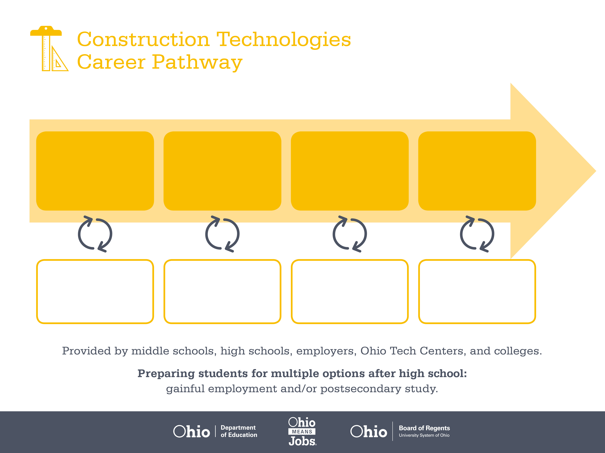
Certificate
Associate Degree,
Telecommunications
Bachelor’s Degree,
Network and Systems
Administration
Start Pre-Construction
As early as grade 7
(based on readiness)
Line Technician
Median Salary: $41,890
Job Growth (10 yr): 11.8%
Annual Openings: 119
Average Tuition (1 yr): $0 –$3,900/yr
Installation Technician
Median Salary: $50,160
Job Growth (10 yr): 10.4%
Annual Openings: 202
Average Tuition (2 yrs): $3,900/yr
Telecommunication Manager
Median Salary: $91,710
Job Growth (10 yr): 15.7%
Annual Openings: 313
Average Tuition (4 yrs): $9,600/yr
Workplace Visits
Job Shadow
Internship
Work
Supervised Experience
Internship
---
Work
Supervised Experience
---
Work
Internship
---
Work
Ohio In-demand Occupations
Data reflects 2014 Ohio labor statistics and public institutions of higher education for 2013-2014. For specific tuition costs, visit ohiohighered.org.

Slide 2

Secondary Pathway: Mechanical, Electrical and Plumbing |  |  |  |  | Postsecondary Program: Telecommunications
An Example of Courses with Secondary and Postsecondary Credits
Secondary | 7 8 | English I | Algebra I | Physical Science |  | Social Studies | Fine Arts | Core & Sustainable Construction
 | 9 10 | English II | Geometry | Biology |  | World History | Health (.5) PE (.5) | Mechanical, Electrical, & Plumbing Sys. | World Languages
 | 11 | English III | Algebra II | Chemistry |  | U.S. History | Tele-communication / Low Voltage | Construction Electrical Systems | World Languages
 | 12 | English IV | Trigonometry/ Calculus | Physics |  | U.S. Government | Alternative Power Generation | Powerline / High-Voltage Power
Postsecondary | Year 1 1st Semester | English Composition I | College Algebra | Circuit Analysis I |  | Digital Systems I | Networking Systems I
 | Year 1 2nd Semester | Psychology | Calculus | Circuit Analysis II |  | Tele-communication | Networking Systems II | Electronic Circuits
 | Year 2 1st Semester | Humanities Elective | Physics | Communication Trans Concepts |  | Data Communication | Fiber Optics
 | Year 2 2nd Semester | Capstone Project | Engineering Technology | Internship
 |  | High School Career-Technical Education Program Courses
 |  | High School Courses for Postsecondary Credit (Including Apprenticeship Hours) and the Corresponding Postsecondary Courses
 |  | Required Courses
 |  | Recommended Electives
Visit education.ohio.gov/CareerConnections for reference information.
Course titles and sequences will vary between schools.
6/2015

