Slide 1
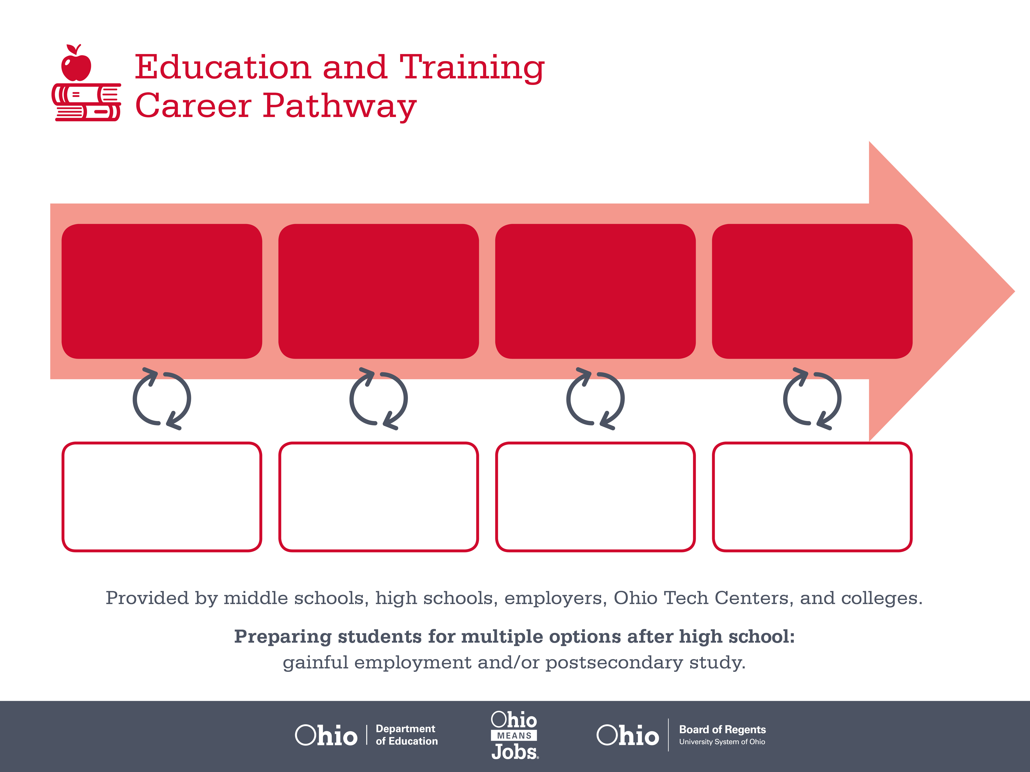
Associate Degree,
Teacher Assistant
Bachelor’s Degree,
Education
Master’s Degree,
Education
Start Pre-Education
As early as grade 7
(based on readiness)
Teacher Aide
Median Salary: $25,510
Job Growth (10 yr): 8.3%
Annual Openings: 1,301
Average Tuition (2 yrs): $3,900/yr
Elementary Special Education Teacher
Median Salary: $53,340
Job Growth (10 yr): 13.3%
Annual Openings: 319
Average Tuition (4 yrs): $9,600/yr
Elementary School Administrator
Median Salary: $82,690
Job Growth (10 yr): 2.1%
Annual Openings: 226
Average Tuition (2 yrs): $11,300/yr
Workplace Visits
Job Shadow
Internship
Work
Supervised Experience
---
Work
Supervised Experience
Internship
---
Work
Internship
---
Work
Ohio In-demand Occupations
Data reflects 2014 Ohio labor statistics and public institutions of higher education for 2013-2014. For specific tuition costs, visit ohiohighered.org.

Slide 2

Secondary Pathway: Teaching Professions |  |  |  | Postsecondary Program: Teacher Assistant
An Example of Courses with Secondary and Postsecondary Credits
Secondary | 7 8 | English I | Algebra I |  | Physical Science | Social Studies | Fine Arts | Introduction to Education & Training
 | 9 10 | English II | Geometry |  | Biology | World History | Health (.5) PE (.5) | World Languages
 | 11 | English III | Algebra II |  | Chemistry | U.S. History | Teaching Professions I | World Languages
 | 12 | English IV | Trigonometry/ Calculus |  | Physics | U.S. Government | Teaching Professions II
Postsecondary | Year 1 1st Semester | English Composition I | Intro to Education |  | Observing, Recording, Assessment | Childhood Guidance | Intro to Psychology | Early Education Seminar | Early Education Practicum
 | Year 1 2nd Semester | English Composition II | Biology |  | Child Development & Curriculum | Creative Curriculum | Language & Literacy Experiences | Human Development | Elementary Curriculum | Cognitive Curriculum
 | Year 2 1st Semester | Business Math | Educational Psychology |  | Children with Exceptionalities | Families, Communities, & Schools | Practicum I | Seminar I
 | Year 2 2nd Semester | History | Educational Technology |  | Health, Safety, & Nutrition | Administration & Staff Dynamics | Education Capstone | Practicum II | Seminar II
 |  | High School Career-Technical Education Program Courses
 |  | High School Courses for Postsecondary Credit (Including Apprenticeship Hours) and the Corresponding Postsecondary Courses
 |  | Required Courses
 |  | Recommended Electives
Visit education.ohio.gov/CareerConnections for reference information.
Course titles and sequences will vary between schools.
1/2016

