Slide 1
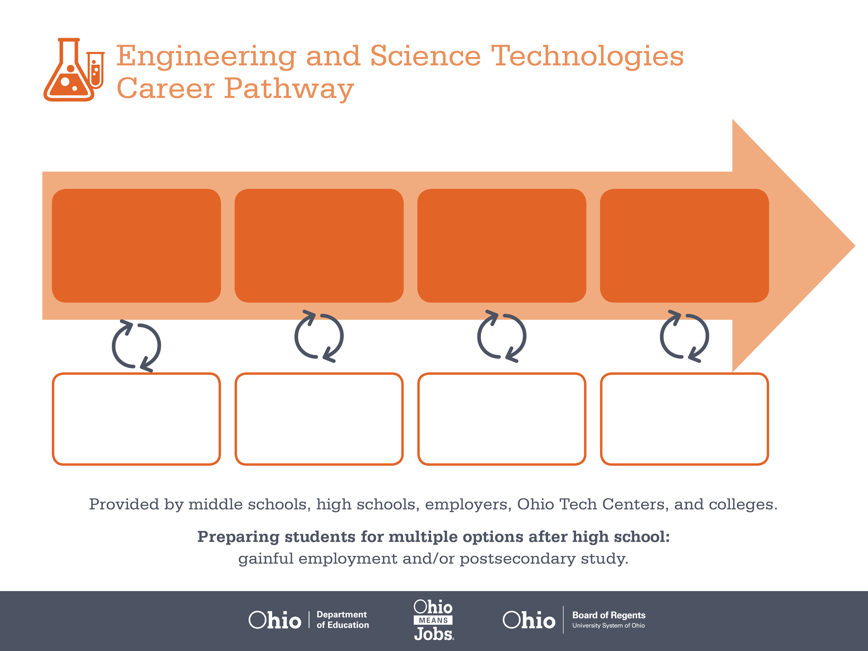
Certificate
Associate Degree,
Chemical Technology
Bachelor’s Degree,
Chemical Engineering
Start Pre-Engineering
As early as grade 7
(based on readiness)
Mix Machine Setter
Median Salary: $34,720
Job Growth (10 yr): -3.6%
Annual Openings: 272
Average Tuition (1 yr): $0 – $3,900/yr
Chemical System Operator
Median Salary: $46,680
Job Growth (10 yr): -6.9%
Annual Openings: 52
Average Tuition (2 yrs): $3,900/yr
Chemical Engineer
Median Salary: $85,560
Job Growth (10 yr): 8.7%
Annual Openings: 56
Average Tuition (4 yrs): $9,600/yr
Workplace Visits
Job Shadow
Internship
Work
Supervised Experience
---
Work
Supervised Experience
Internship
---
Work
Internship
---
Work
Ohio In-demand Occupations
Data reflects 2014 Ohio labor statistics and public institutions of higher education for 2013-2014. For specific tuition costs, visit ohiohighered.org.

Slide 2

Secondary Pathway: Engineering and Design |  |  |  |  | Postsecondary Program: Chemical Technology
An Example of Courses with Secondary and Postsecondary Credits
Secondary | 7 8 | English I | Algebra I | Physical Science |  | Social Studies | Fine Arts | Pre-Engineering Technologies
 | 9 10 | English II | Geometry | Biology |  | World History | Health (.5) PE (.5) | Manufacturing Operations | World Languages
 | 11 | English III | Algebra II | Chemistry |  | U.S. History | Computer Integrated Manufacturing | Engineering Principles | World Languages
 | 12 | English IV | Trigonometry/ Calculus | Physics |  | U.S. Government | Manufacturing Capstone
Postsecondary | Year 1 1st Semester | English Composition I | Calculus I | General Chemistry I |  | Chemistry Lab | Intro to Science Professions
 | Year 1 2nd Semester | Humanities Elective | Calculus II | General Chemistry II |  | Chemistry Lab II
 | Year 2 1st Semester | History Elective | Physics I | Organic Chemistry I |  | Organic Chem Lab I
 | Year 2 2nd Semester | English Composition II | Physics II | Organic Chemistry II |  | Organic Chem Lab II | Social Science Elective
 |  | High School Career-Technical Education Program Courses
 |  | High School Courses for Postsecondary Credit (Including Apprenticeship Hours) and the Corresponding Postsecondary Courses
 |  | Required Courses
 |  | Recommended Electives
Visit education.ohio.gov/CareerConnections for reference information.
Course titles and sequences will vary between schools.
1/2016

