Slide 1
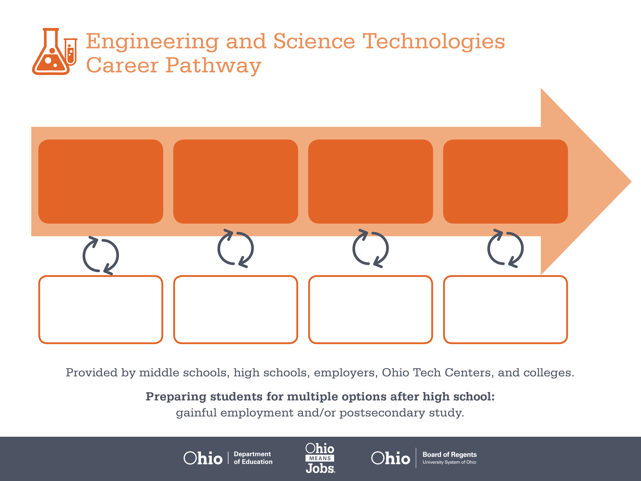
Certificate
Associate Degree,
Electrical Engineering
Technology
Bachelor’s Degree,
Electrical Engineering
Start Pre-Engineering
As early as grade 7
(based on readiness)
Production Worker
Median Salary: $23,720
Job Growth (10 yr): 7.4%
Annual Openings: 503
Average Tuition (1 yr): $0 –$3,900/yr
Electrical Engineering Technician
Median Salary: $54,540
Job Growth (10 yr): -0.2%
Annual Openings: 78
Average Tuition (2 yrs): $3,900/yr
Electrical Engineer
Median Salary: $76,980
Job Growth (10 yr): 5.2%
Annual Openings: 158
Average Tuition (4 yrs): $9,600/yr
Workplace Visits
Job Shadow
Internship
Work
Supervised Experience
---
Work
Supervised Experience
Internship
---
Work
Internship
---
Work
Ohio In-demand Occupations
Data reflects 2014 Ohio labor statistics and public institutions of higher education for 2013-2014. For specific tuition costs, visit ohiohighered.org.

Slide 2

Secondary Pathway: Engineering and Design |  |  |  |  | Postsecondary Program: Electrical Engineering Technology
An Example of Courses with Secondary and Postsecondary Credits
Secondary | 7 8 | English I | Algebra I | Physical Science |  | Social Studies | Fine Arts | Pre-Engineering Technologies
 | 9 10 | English II | Algebra II | Biology |  | World History | Health (.5) PE (.5) | Engineering Principles | DC & AC Electronic Circuits | World Languages
 | 11 | English III | Geometry | Chemistry |  | U.S. History | Analog-Based Electronic Circuits | Digital Electronics | World Languages
 | 12 | English IV | Trigonometry/ Calculus | Physics |  | U.S. Government | Robotics | Engineering Capstone
Postsecondary | Year 1 1st Semester | English Composition I | Computer Applications | Digital Systems |  | DC Electronic Systems | PC Tech Essentials
 | Year 1 2nd Semester | College Algebra | AC Electronic Systems | Switching & Amplifier Systems |  | AC Electronic Systems | Data Communications
 | Year 2 1st Semester | Physics I | Micro Economics | Data Acquisition Systems |  | Embedded Micro-controller Systems | Advanced Digital Systems
 | Year 2 2nd Semester | Physics II | Technical Writing | Small Group Communication |  | Capstone | Ethics
 |  | High School Career-Technical Education Program Courses
 |  | High School Courses for Postsecondary Credit (Including Apprenticeship Hours) and the Corresponding Postsecondary Courses
 |  | Required Courses
 |  | Recommended Electives
Visit education.ohio.gov/CareerConnections for reference information.
Course titles and sequences will vary between schools.
5/2015

