Slide 1
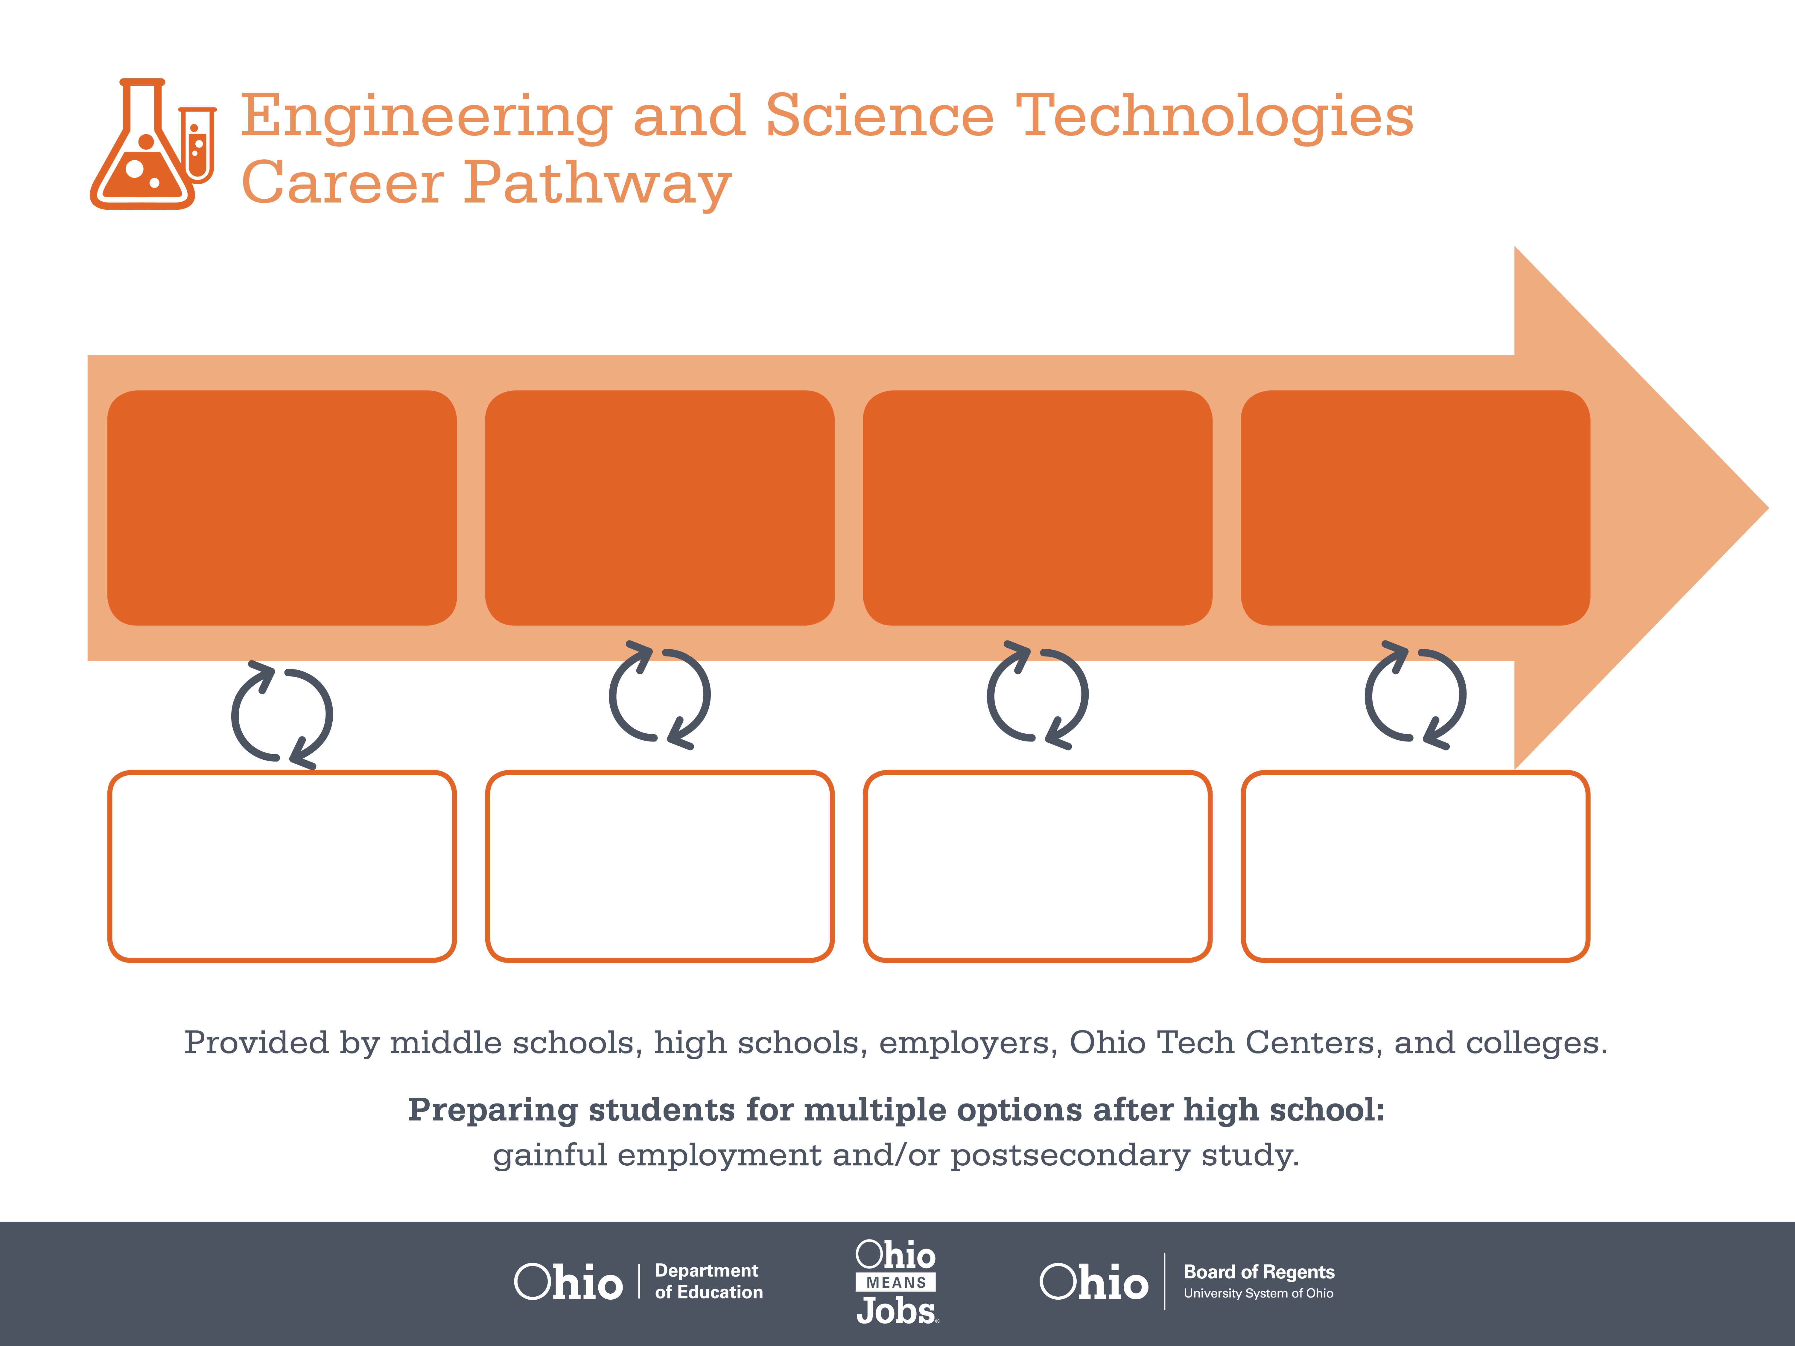
Certificate
Associate Degree,
Electromechanical Technology
Bachelor’s Degree,
Electronics Engineering
Start Pre-Engineering
As early as grade 7
(based on readiness)
Machine Assembler
Median Salary: $46,400
Job Growth (10 yr): 6.9%
Annual Openings: 76
Average Tuition (1 yr): $0 –$3,900/yr
Electromechanical Technician
Median Salary: $48,170
Job Growth (10 yr): -2.5%
Annual Openings: 8
Average Tuition (2 yrs): $3,900/yr
Electronics Engineer
Median Salary: $87,010
Job Growth (10 yr): 3.6%
Annual Openings: 124
Average Tuition (4 yrs): $9,600/yr
Workplace Visits
Job Shadow
Internship
Work
Supervised Experience
---
Work
Supervised Experience
Internship
---
Work
Internship
---
Work
Ohio In-demand Occupations
Data reflects 2014 Ohio labor statistics and public institutions of higher education for 2013-2014. For specific tuition costs, visit ohiohighered.org.

Slide 2

Secondary Pathway: Engineering and Design |  |  |  |  | Postsecondary Program: Electromechanical Technology
An Example of Courses with Secondary and Postsecondary Credits
Secondary | 7 8 | English I | Algebra I | Physical Science |  | Social Studies | Fine Arts | Pre-Engineering Technologies
 | 9 10 | English II | Algebra II | Biology |  | World History | Health (.5) PE (.5) | Engineering Principles | Engineering Design | World Languages
 | 11 | English III | Geometry | Chemistry |  | U.S. History | Analog Based Electronic Devices | DC & AC Electronic Circuits | World Languages
 | 12 | English IV | Trigonometry/ Calculus | Physics |  | U.S. Government | Robotics | Digital Electronics
Postsecondary | Year 1 1st Semester | Computer Applications | College Algebra | Intro to Engineering Technology |  | Engineering Design & Graphics | Electric Circuits | Basic Metrology
 | Year 1 2nd Semester | English Composition | Statistics | Physics |  | CAD I | Electronic Circuits | Fluid Power Transmission
 | Year 2 1st Semester | Interpersonal Communication | Energy, Power & Controls | Metallic Materials & Processes |  | Digital Electronic Systems | Ethics | Motors and Control Logic
 | Year 2 2nd Semester | Technical Writing | Electric Machinery & Controls | Electrical Measurement & Instruments |  | Lean Processing & Systems | Robotics | Micro Economics
 |  | High School Career-Technical Education Program Courses
 |  | High School Courses for Postsecondary Credit (Including Apprenticeship Hours) and the Corresponding Postsecondary Courses
 |  | Required Courses
 |  | Recommended Electives
Visit education.ohio.gov/CareerConnections for reference information.
Course titles and sequences will vary between schools.
6/2015

