Slide 1
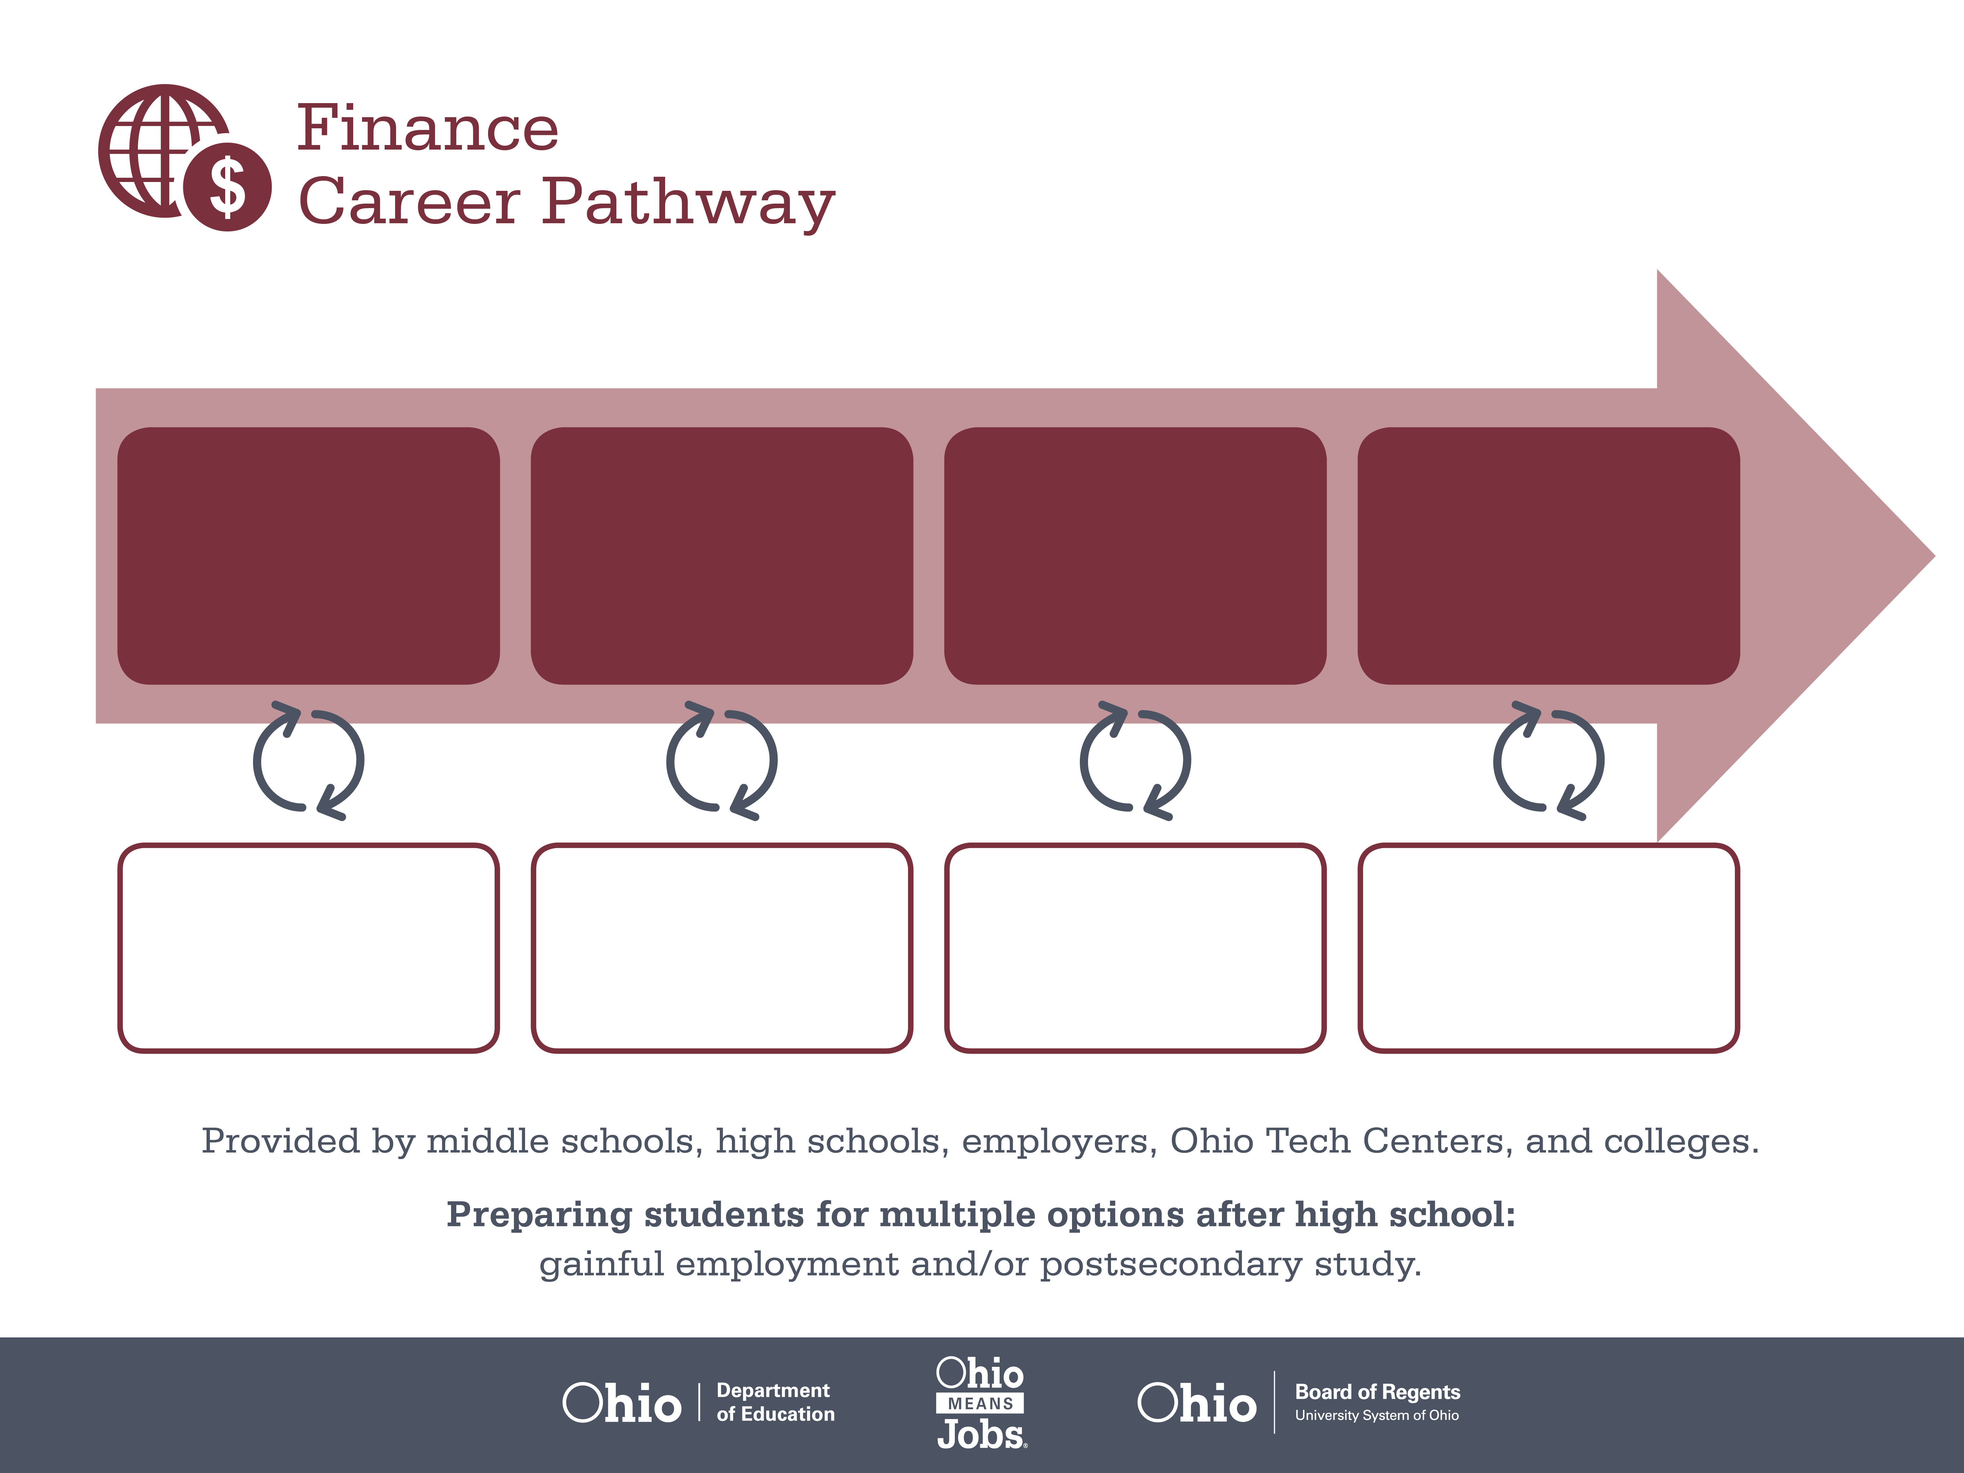
Certificate,
Accounting Technology
Associate Degree,
Accounting
Bachelor’s Degree,
Finance
Start Pre-Finance
As early as grade 7
(based on readiness)
Bookkeeper
Median Salary: $34,550
Job Growth (10 yr): 7.6%
Annual Openings: 1,294
Average Tuition (1 yr): $0 –$3,900/yr
Accountant
Median Salary: $59,610
Job Growth (10 yr): 10.7%
Annual Openings: 1,319
Average Tuition (2 yrs): $3,900/yr
Financial Examiner
Median Salary: $67,390
Job Growth (10 yr): 23.2%
Annual Openings: 42
Average Tuition (4 yrs): $9,600/yr
Workplace Visits
Job Shadow
Internship
Work
Supervised Experience
---
Work
Supervised Experience
Internship
---
Work
Internship
---
Work
Ohio In-demand Occupations
Data reflects 2014 Ohio labor statistics and public institutions of higher education for 2013-2014. For specific tuition costs, visit ohiohighered.org.

Slide 2

Secondary Pathway: Finance |  |  |  | Postsecondary Program: Accounting
An Example of Courses with Secondary and Postsecondary Credits
Secondary | 7 8 | English I | Algebra I |  | Physical Science | Social Studies | Fine Arts | Business Foundations
 | 9 10 | English II | Geometry |  | Biology | World History | Health (.5) PE (.5) | Finance Foundations | World Languages
 | 11 | English III | Algebra II |  | Chemistry | U.S. History | Financial Accounting | Corporate Finance | World Languages
 | 12 | English IV | Trigonometry/ Calculus |  | Physics | U.S. Government | Management Principles | Finance Capstone
Postsecondary | Year 1 1st Semester | English | Algebra |  | Financial Accounting | Software Applications | Micro-economics
 | Year 1 2nd Semester | Public Speaking | Business Statistics |  | Intro to Managerial Accounting | Macro-economics | Computer Accounting Systems
 | Year 2 1st Semester | Intermediate Accounting I | Cost Accounting |  | Federal Taxes | Intro to Business | Marketing Management | Natural/ Physical Science
 | Year 2 2nd Semester | Intermediate Accounting II | Managerial Accounting & Finance |  | Auditing | Business Law | Accounting Elective | Arts & Humanities Elective
 |  | High School Career-Technical Education Program Courses
 |  | High School Courses for Postsecondary Credit (Including Apprenticeship Hours) and the Corresponding Postsecondary Courses
 |  | Required Courses
 |  | Recommended Electives
Visit education.ohio.gov/CareerConnections for reference information.
Course titles and sequences will vary between schools.
1/2016

