Slide 1
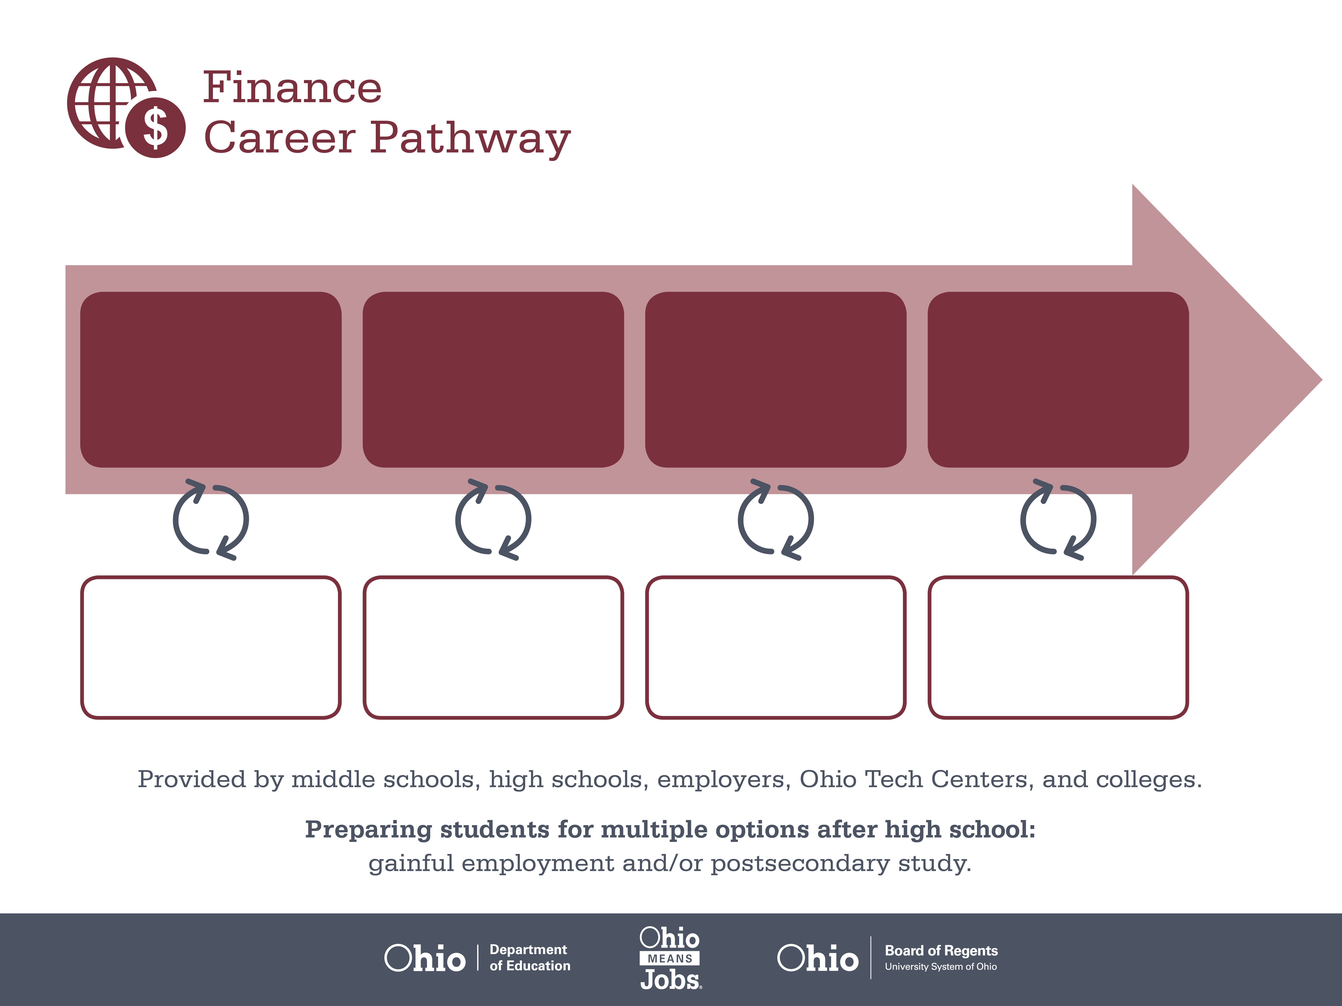
Certificate
Associate Degree,
Finance
Bachelor’s Degree,
Finance
Start Pre-Finance
As early as grade 7
(based on readiness)
Teller
Median Salary: $23,370
Job Growth (10 yr): 1.1%
Annual Openings: 952
Average Tuition (1 yr): $0 –$3,900/yr
Loan Officer
Median Salary: $54,760
Job Growth (10 yr): 13%
Annual Openings: 402
Average Tuition (2 yrs): $3,900/yr
Branch Manager
Median Salary: $97,670
Job Growth (10 yr): 2.7%
Annual Openings: 364
Average Tuition (4 yrs): $9,600/yr
Workplace Visits
Job Shadow
Internship
Work
Supervised Experience
---
Work
Supervised Experience
Internship
---
Work
Internship
---
Work
Ohio In-demand Occupations
Data reflects 2014 Ohio labor statistics and public institutions of higher education for 2013-2014. For specific tuition costs, visit ohiohighered.org.

Slide 2

Secondary Pathway: Finance |  |  |  | Postsecondary Program: Financial Services
An Example of Courses with Secondary and Postsecondary Credits
Secondary | 7 8 | English I | Algebra I |  | Physical Science | Social Studies | Fine Arts | Business Foundations
 | 9 10 | English II | Geometry |  | Biology | World History | Health (.5) PE (.5) | Finance Foundations | Management Principles | World Languages
 | 11 | English III | Algebra II |  | Chemistry | U.S. History | Financial Accounting | Fundamentals of Financial Services | World Languages
 | 12 | English IV | Trigonometry/ Calculus |  | Physics | U.S. Government | Financial Services Operations | Finance Capstone
Postsecondary | Year 1 1st Semester | English | College Seminar |  | Financial Accounting | Software Applications | Personal Finance | Business Language
 | Year 1 2nd Semester | Business Applications | Investments |  | Statistics | Managerial Accounting | Management | Micro-economics | Natural/ Physical Science
 | Year 2 1st Semester | Macro-economics | Legal Environment of Business |  | Money & Banking | International Finance | Finance Elective | Arts & Humanities Elective
 | Year 2 2nd Semester | Marketing Principles | Finance Capstone |  | Finance Practicum | Finance Elective | Social/ Behavioral Science
 |  | High School Career-Technical Education Program Courses
 |  | High School Courses for Postsecondary Credit (Including Apprenticeship Hours) and the Corresponding Postsecondary Courses
 |  | Required Courses
 |  | Recommended Electives
Visit education.ohio.gov/CareerConnections for reference information.
Course titles and sequences will vary between schools.
11/2014

