Slide 1
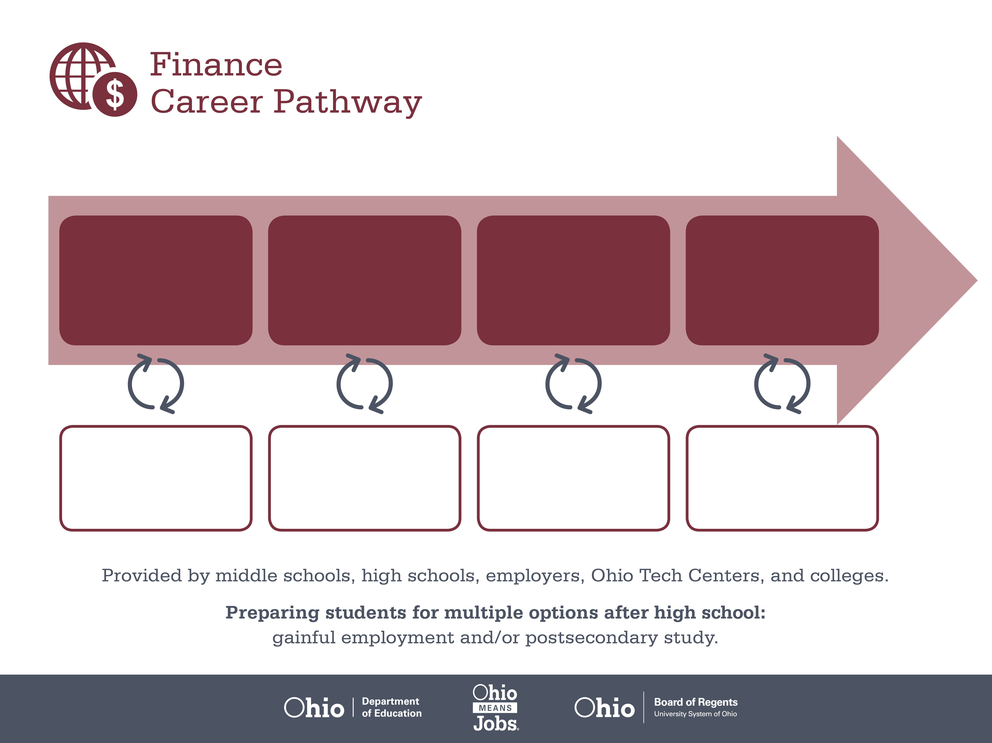
Certificate
Bachelor’s Degree,
Insurance
Master’s Degree,
Finance
Start Pre-Finance
As early as grade 7
(based on readiness)
Customer Service Agent
Median Salary: $30,520
Job Growth (10 yr): 8.7%
Annual Openings: 2,916
Average Tuition (1 yr): $0 –$3,900/yr
Insurance Underwriter
Median Salary: $58,860
Job Growth (10 yr): 4.4%
Annual Openings: 192
Average Tuition (4 yrs): $9,600/yr
Financial Analyst
Median Salary: $71,740
Job Growth (10 yr): 16.5%
Annual Openings: 240
Average Tuition (2 yrs): $11,300/yr
Workplace Visits
Job Shadow
Internship
Work
Supervised Experience
---
Work
Supervised Experience
Internship
--
Work
Internship
---
Work
Ohio In-demand Occupations
Data reflects 2014 Ohio labor statistics and public institutions of higher education for 2013-2014. For specific tuition costs, visit ohiohighered.org.

Slide 2

Secondary Pathway: Finance |  |  |  | Postsecondary Program: Insurance
An Example of Courses with Secondary and Postsecondary Credits
Secondary | 7 8 | English I | Algebra I |  | Physical Science | Social Studies | Fine Arts | Business Foundations
 | 9 10 | English II | Geometry |  | Biology | World History | Health (.5) PE (.5) | Finance Foundations | Fundamentals of Financial Services | World Languages
 | 11 | English III | Algebra II |  | Chemistry | U.S. History | Financial Accounting | Financial Services Operations | World Languages
 | 12 | English IV | Trigonometry/ Calculus |  | Physics | U.S. Government | Management Principles | Finance Capstone
Postsecondary | Year 1 1st Semester | English I | Insurance Principles |  | Claims Handling | Software Applications | Organizational Behavior
 | Year 1 2nd Semester | Principles of Management | Property Coverages |  | Loss Adjustment | Insurance Claims Software | Customer Service in Insurance
 | Year 2 1st Semester | English II | Business Math |  | Micro-economics | Marketing Management | Employability Skills
 | Year 2 2nd Semester | Negotiation Skills | Statistics |  | Financial Accounting | Legal Environment of Business | Business Policy
 |  | High School Career-Technical Education Program Courses
 |  | High School Courses for Postsecondary Credit (Including Apprenticeship Hours) and the Corresponding Postsecondary Courses
 |  | Required Courses
 |  | Recommended Electives
Visit education.ohio.gov/CareerConnections for reference information.
Course titles and sequences will vary between schools.
5/2015

