Slide 1
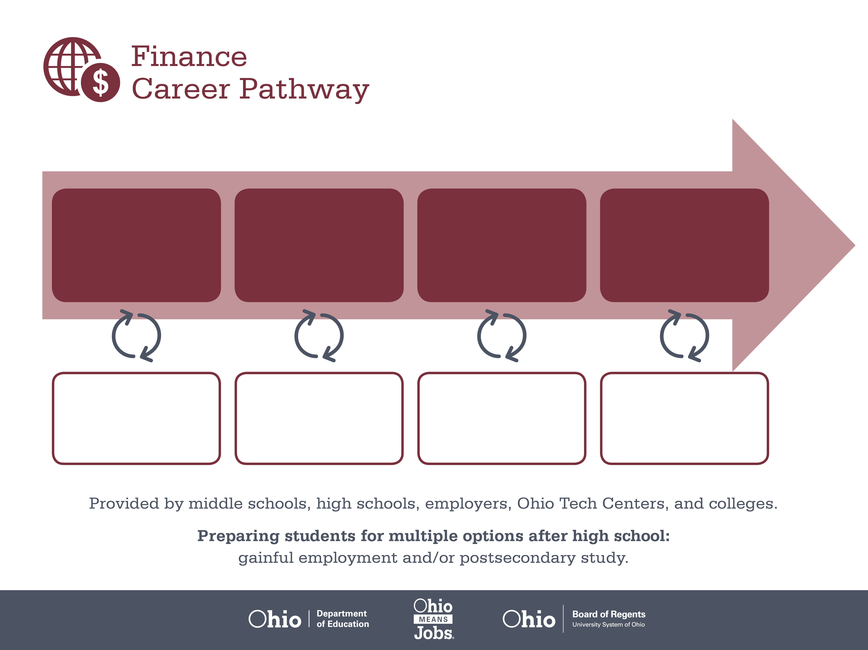
Associate Degree,
Financial Services
Bachelor’s Degree,
Finance
Master’s Degree,
Finance
Start Pre-Finance
As early as grade 7
(based on readiness)
Investment Sales Assistant
Median Salary: $30,520
Job Growth (10 yr): 8.7%
Annual Openings: 2,916
Average Tuition (2 yrs): $3,900/yr
Investment Sales Agent
Median Salary: $51,490
Job Growth (10 yr): 7.3%
Annual Openings: 401
Average Tuition (4 yrs): $9,600/yr
Financial Advisor
Median Salary: $64,840
Job Growth (10 yr): 22.1%
Annual Openings: 208
Average Tuition (2 yrs): $11,300/yr
Workplace Visits
Job Shadow
Internship
Work
Supervised Experience
---
Work
Supervised Experience
Internship
--
Work
Internship
---
Work
Ohio In-demand Occupations
Data reflects 2014 Ohio labor statistics and public institutions of higher education for 2013-2014. For specific tuition costs, visit ohiohighered.org.

Slide 2

Secondary Pathway: Finance |  |  |  | Postsecondary Program: Financial Services
An Example of Courses with Secondary and Postsecondary Credits
Secondary | 7 8 | English I | Algebra I |  | Physical Science | Social Studies | Fine Arts | Business Foundations
 | 9 10 | English II | Geometry |  | Biology | World History | Health (.5) PE (.5) | Finance Foundations | Fundamentals of Financial Services | World Languages
 | 11 | English III | Algebra II |  | Chemistry | U.S. History | Financial Accounting | Financial Services Operations | World Languages
 | 12 | English IV | Trigonometry/ Calculus |  | Physics | U.S. Government | Management Principles | Finance Capstone
Postsecondary | Year 1 1st Semester | English Composition I | Financial Accounting |  | Legal Environment of Business | Microcomputer Applications I | Macro-economics
 | Year 1 2nd Semester | English Composition II | Managerial Accounting |  | Principles of Banking | College Algebra | Micro-economics
 | Year 2 1st Semester | Sociology | Business Finance |  | Principles of Management | Science Elective
 | Year 2 2nd Semester | Business Communication | Principles of Insurance |  | Fundamentals of Investments | Principles of Marketing
 |  | High School Career-Technical Education Program Courses
 |  | High School Courses for Postsecondary Credit (Including Apprenticeship Hours) and the Corresponding Postsecondary Courses
 |  | Required Courses
 |  | Recommended Electives
Visit education.ohio.gov/CareerConnections for reference information.
Course titles and sequences will vary between schools.
6/2015

