Slide 1
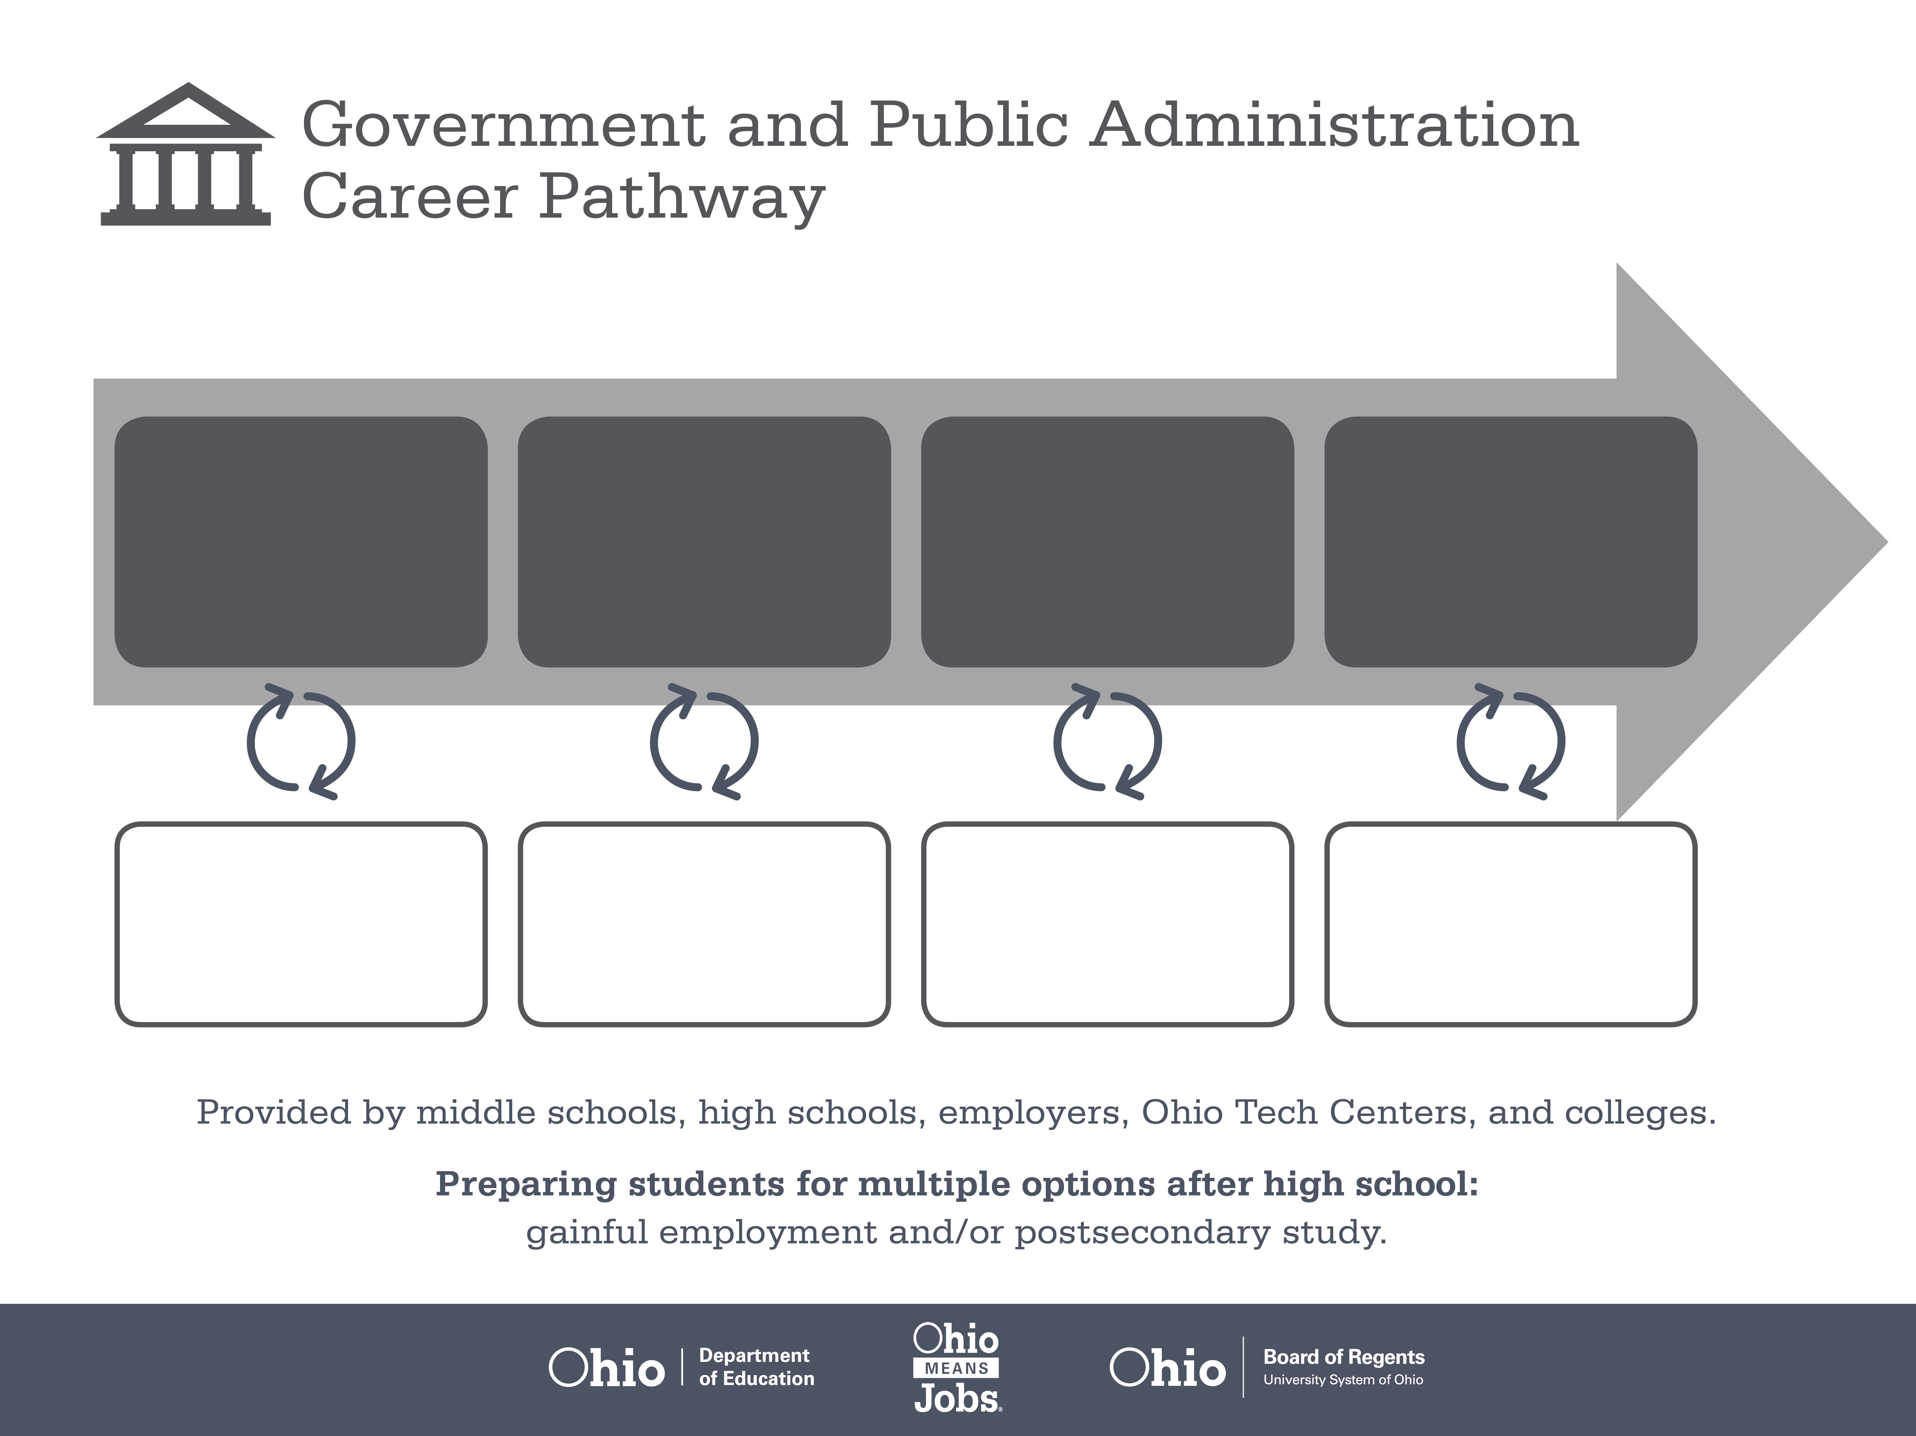
Certificate
Associate Degree,
Organizational Leadership
Bachelor’s Degree,
Public Affairs
Start Pre-Agriculture
As early as grade 7
(based on readiness)
Building Inspector
Median Salary: $48,190
Job Growth (10 yr): 8.9%
Annual Openings: 125
Average Tuition (1 yr): $0 – $3,900/yr
Government Property Inspector
Median Salary: $57,670
Job Growth (10 yr): 13.7%
Annual Openings: 159
Average Tuition (2 yr): $3,900/yr
Compliance Manager
Median Salary: $88,090
Job Growth (10 yr): 2.9%
Annual Openings: 537
Average Tuition (4 yr): $9,600/yr
Workplace Visits
Job Shadow
Internship
Work
Supervised Experience
---
Work
Supervised Experience
Internship
---
Work
Internship
---
Work
Ohio In-demand Occupations
Data reflects 2014 Ohio labor statistics and public institutions of higher education for 2013-2014. For specific tuition costs, visit ohiohighered.org.

Slide 2

Secondary Pathway: Government and Public Administration |  |  |  |  | Postsecondary Program: Organizational Leadership
An Example of Courses with Secondary and Postsecondary Credits
Secondary | 7 8 | English I | Algebra I | Physical Science |  | Social Studies | Fine Arts
 | 9 10 | English II | Geometry | Biology |  | World History | Health (.5) PE (.5) | Civics | World Languages
 | 11 | English III | Algebra II | Chemistry |  | U.S. History | Ethics | World Languages
 | 12 | English IV | Trigonometry/ Calculus | Physics |  | U.S. Government | Psychology | Intro to Public Affairs
Postsecondary | Year 1 1st Semester | English Composition | Accounting I | Business Law |  | Public Affairs | Business Ethics | Construction Documents
 | Year 1 2nd Semester | Communication | Accounting II | Macro-economics |  | Organizational Behavior | Leadership: Theory & Application | OSHA Safety & Health
 | Year 2 1st Semester | Calculus | Corporate Finance | Micro-economics |  | Non-Profit Management | Construction Drawings | Safety & Loss Prevention
 | Year 2 2nd Semester | Group Dynamics & Team Building | Contemporary Issues in Leadership | Statistics |  | Principles of Marketing | Construction Methods
 |  | High School Career-Technical Education Program Courses
 |  | High School Courses for Postsecondary Credit (Including Apprenticeship Hours) and the Corresponding Postsecondary Courses
 |  | Required Courses
 |  | Recommended Electives
Visit education.ohio.gov/CareerConnections for reference information.
Course titles and sequences will vary between schools.
11/2015

