Slide 1
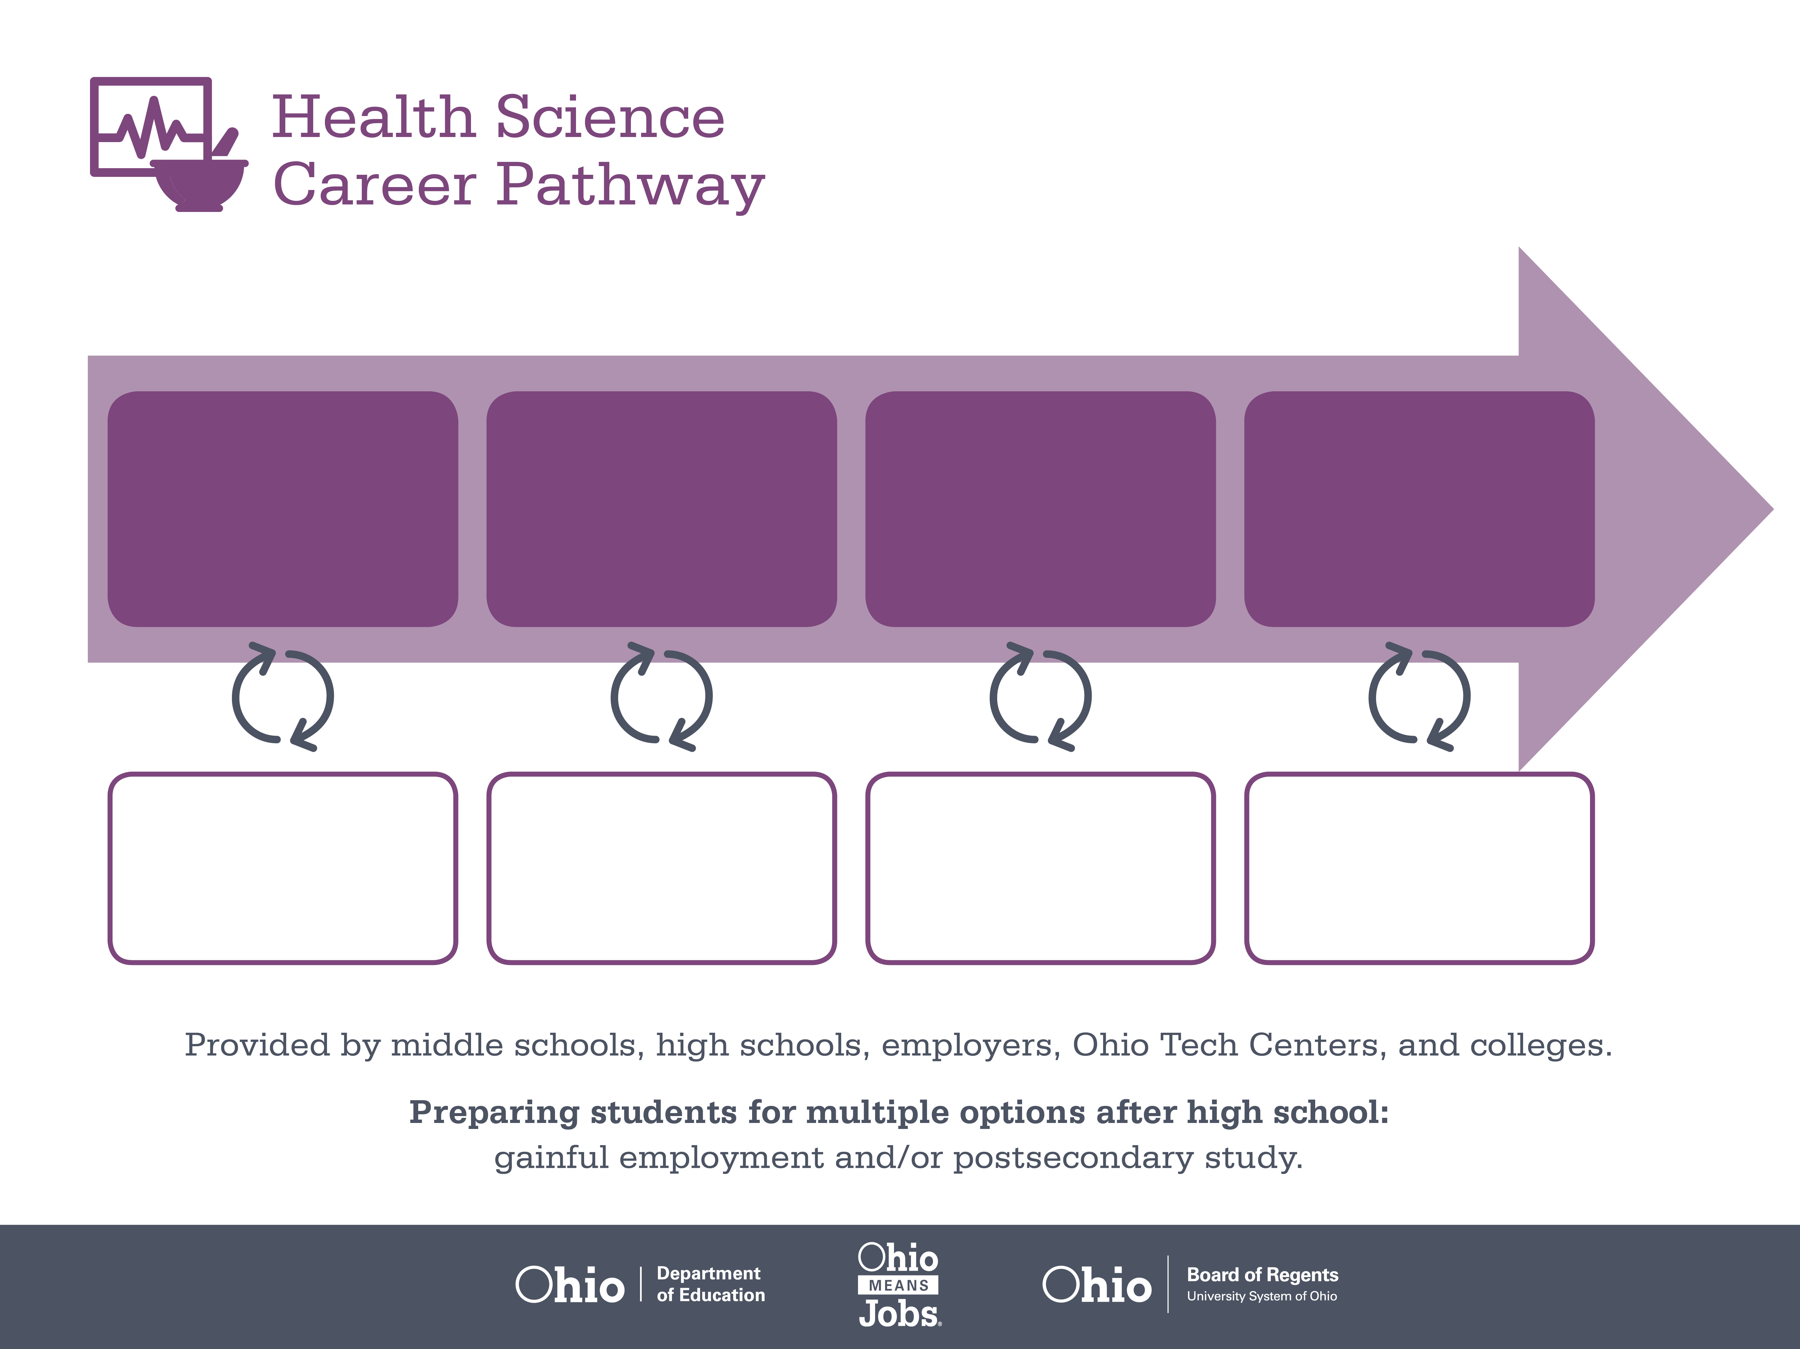
Certificate,
Phlebotomy Technician
Associate Degree,
Medical Lab Technician
Doctoral Degree,
Microbiology
Start Pre-Health
As early as grade 7
(based on readiness)
Phlebotomist
Median Salary: $28,200
Job Growth (10 yr): 12.6%
Annual Openings: 224
Average Tuition (1 yr): $0 –$3,900/yr
Medical Lab Technician
Median Salary: $39,410
Job Growth (10 yr): 10.2%
Annual Openings: 177
Average Tuition (2 yrs): $3,900/yr
Average Tuition (4 yrs): $9,600/yr
Medical Scientist
Median Salary: $57,760
Job Growth (10 yr): 31.1%
Annual Openings: 85
Average Tuition (4 yrs): $35,000/yr
Workplace Visits
Job Shadow
Internship
Work
Supervised Experience
---
Work
Supervised Experience
Internship
---
Work
Internship
---
Work
Ohio In-demand Occupations
Data reflects 2014 Ohio labor statistics and public institutions of higher education for 2013-2014. For specific tuition costs, visit ohiohighered.org.

Slide 2

Secondary Pathway: Medical Bioscience |  |  |  | Postsecondary Program: Medical Laboratory Technology
An Example of Courses with Secondary and Postsecondary Credits
Secondary | 7 8 | English I | Algebra I | Physical Science | Social Studies | Fine Arts | Health Science & Technology
 | 9 10 | English II | Geometry | Biology | World History | Health (.5) PE (.5) | Principles of Biomedical Technology | Biomedical Engineering | World Languages
 | 11 | English III | Algebra II | Chemistry | U.S. History | Medical Terminology | Biotechnology for Health & Disease | World Languages
 | 12 | English IV | Trigonometry/ Calculus | Anatomy & Physiology | U.S. Government | Biochemistry of Health | Genetics of Disease
Postsecondary | Year 1 1st Semester | English Composition I | College Algebra | Anatomy & Physiology I | Elementary Chemistry | Hematology & Coagulation | Medical Terminology
 | Year 1 2nd Semester | English Composition II | Microbiology | Anatomy & Physiology II | Organic Chemistry | Urinalysis | Body Fluids
 | Year 2 1st Semester | Interpersonal Communication | Clinical Microbiology | Electronic Health Records | Clinical Chemistry | Clinical Immunology | Blood Collection Techniques
 | Year 2 2nd Semester | Psychology | Immuno-hematology | Clinical Practicum | Medical Lab Tech Seminar
 |  | High School Career-Technical Education Program Courses
 |  | High School Courses for Postsecondary Credit (Including Apprenticeship Hours) and the Corresponding Postsecondary Courses
 |  | Required Courses
 |  | Recommended Electives
Visit education.ohio.gov/CareerConnections for reference information.
Course titles and sequences will vary between schools.
6/2015

