Slide 1
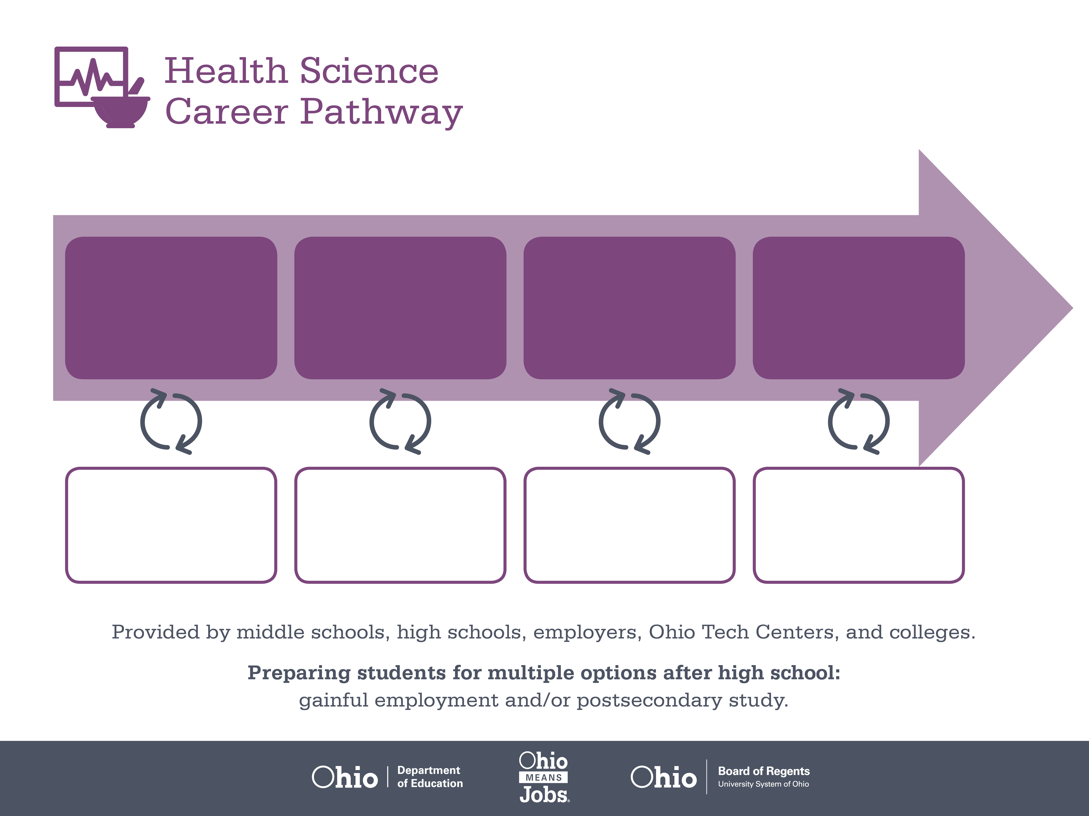
Certificate
Associate Degree,
Bioscience Technology
Master’s Degree,
Orthotics and Prosthetics
Start Pre-Health
As early as grade 7
(based on readiness)
Medical Appliance Tech
Median Salary: $31,800
Job Growth (10 yr): 2%
Annual Openings: 10
Average Tuition (1 yr): $0 –$3,900/yr
Biomedical Technician
Median Salary: $50,600
Job Growth (10 yr): 22%
Annual Openings: 100
Average Tuition (2 yrs): $3,900/yr
Average Tuition (4 yrs): $9,600/yr
Orthotist/Prosthetist
Median Salary: $65,210
Job Growth (10 yr): 2.9%
Annual Openings: 8
Average Tuition (2 yrs): $11,300/yr
Workplace Visits
Job Shadow
Internship
Work
Supervised Experience
---
Work
Supervised Experience
Internship
---
Work
Internship
---
Work
Ohio In-demand Occupations
Data reflects 2014 Ohio labor statistics and public institutions of higher education for 2013-2014. For specific tuition costs, visit ohiohighered.org.

Slide 2

Secondary Pathway: Medical Bioscience |  |  |  | Postsecondary Program: Bioscience Technology
An Example of Courses with Secondary and Postsecondary Credits
Secondary | 7 8 | English I | Algebra I | Physical Science | Social Studies | Fine Arts | Health Science & Technology
 | 9 10 | English II | Geometry | Biology | World History | Health (.5) PE (.5) | Principles of Biomedical Technology | World Languages
 | 11 | English III | Algebra II | Chemistry | U.S. History | Medical Terminology | Biomedical Engineering | World Languages
 | 12 | English IV | Trigonometry/ Calculus | Anatomy & Physiology | U.S. Government | Biochemistry of Health | Genetics of Disease
Postsecondary | Year 1 1st Semester | English Composition I | College Algebra | Biology I | Bioscience Lab Skills | Bio-manufacturing | Bio-informatics
 | Year 1 2nd Semester | English Composition II | Chemistry | Biology II | Bioscience Lab Methods | Psychology
 | Year 2 1st Semester | Public Speaking | Organic Chemistry | Molecular Genetics | Scientific Literacy | Protein Purification & Analysis
 | Year 2 2nd Semester | Ethics | Statistics | Human Genetics | Bioscience Capstone
 |  | High School Career-Technical Education Program Courses
 |  | High School Courses for Postsecondary Credit (Including Apprenticeship Hours) and the Corresponding Postsecondary Courses
 |  | Required Courses
 |  | Recommended Electives
Visit education.ohio.gov/CareerConnections for reference information.
Course titles and sequences will vary between schools.
6/2015

