Slide 1
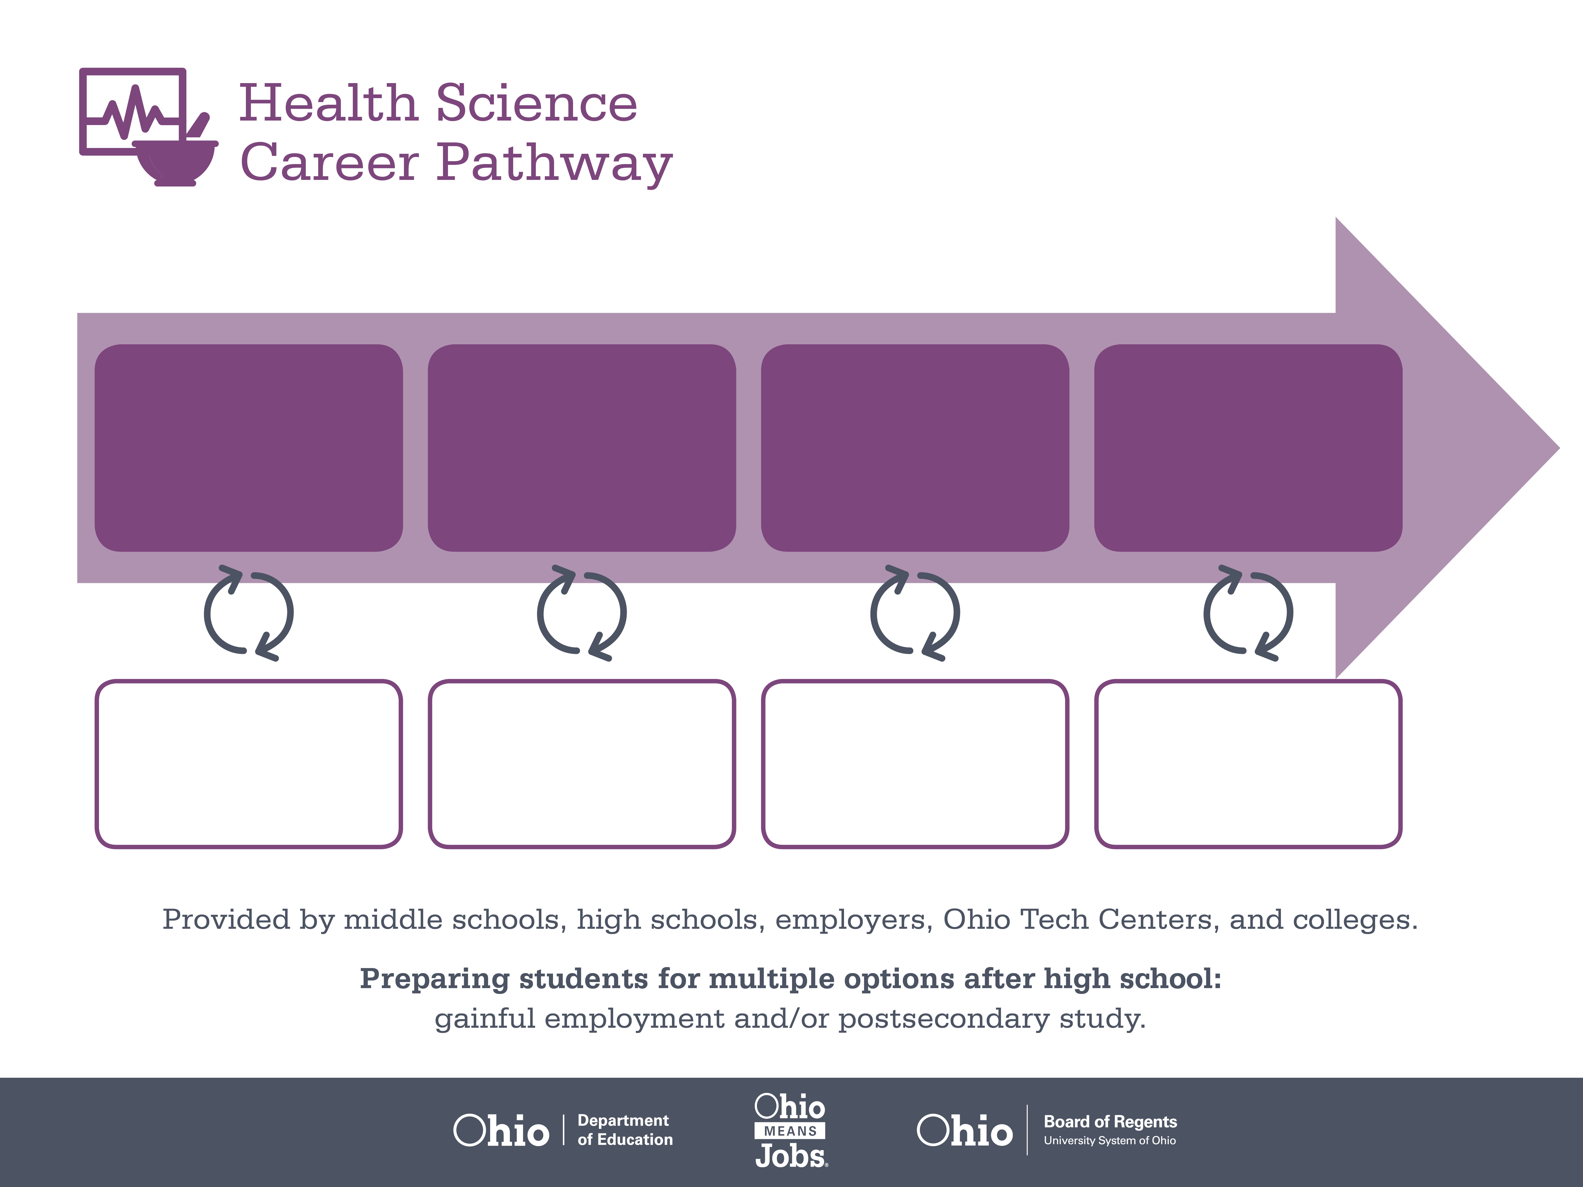
Certificate,
Pharmacy Technician
Bachelor’s Degree,
Chemistry
Doctoral Degree,
Pharmacy
Start Pre-Health
As early as grade 7
(based on readiness)
Pharmacy Technician
Median Salary: $26,740
Job Growth (10 yr): 19.5%
Annual Openings: 541
Average Tuition (1 yr): $0 –$3,900/yr
Chemist
Median Salary: $64,180
Job Growth (10 yr): 0.6%
Annual Openings: 102
Average Tuition (4 yrs): $9,600/yr
Pharmacist
Median Salary: $114,520
Job Growth (10 yr): 15.1%
Annual Openings: 478
Average Tuition (4 yrs): $31,500/yr
Workplace Visits
Job Shadow
Internship
Work
Supervised Experience
---
Work
Supervised Experience
Internship
---
Work
Internship
---
Work
Ohio In-demand Occupations
Data reflects 2014 Ohio labor statistics and public institutions of higher education for 2013-2014. For specific tuition costs, visit ohiohighered.org.

Slide 2

Secondary Pathway: Medical Bioscience |  |  |  | Postsecondary Program: Chemical Technology
An Example of Courses with Secondary and Postsecondary Credits
Secondary | 7 8 | English I | Algebra I | Physical Science | Social Studies | Fine Arts | Health Science & Technology
 | 9 10 | English II | Geometry | Biology | World History | Health (.5) PE (.5) | Principles of Biomedical Technology | Biomedical Engineering | World Languages
 | 11 | English III | Algebra II | Chemistry | U.S. History | Human Patho-physiology | World Languages
 | 12 | English IV | Trigonometry/ Calculus | Anatomy & Physiology | U.S. Government | Biochemistry of Health | Genetics of Disease
Postsecondary | Year 1 1st Semester | English Composition | Statistics I | Chemistry I | Chemical Technology I | Social Science Elective
 | Year 1 2nd Semester | Statistics II | Calculus I | Chemistry II | Chemical Technology II | Bio-Organic Chemistry | Chemical Technology Co-Op I
 | Year 2 1st Semester | Composition II | Public Speaking | Calculus II | Analytical Chemistry | Biology I
 | Year 2 2nd Semester | Capstone | Social Science Elective | Calculus III | Instrumental Analysis | Biology II | Chemical Technology Co-Op II
 |  | High School Career-Technical Education Program Courses
 |  | High School Courses for Postsecondary Credit (Including Apprenticeship Hours) and the Corresponding Postsecondary Courses
 |  | Required Courses
 |  | Recommended Electives
Visit education.ohio.gov/CareerConnections for reference information.
Course titles and sequences will vary between schools.
11/2014

