Slide 1
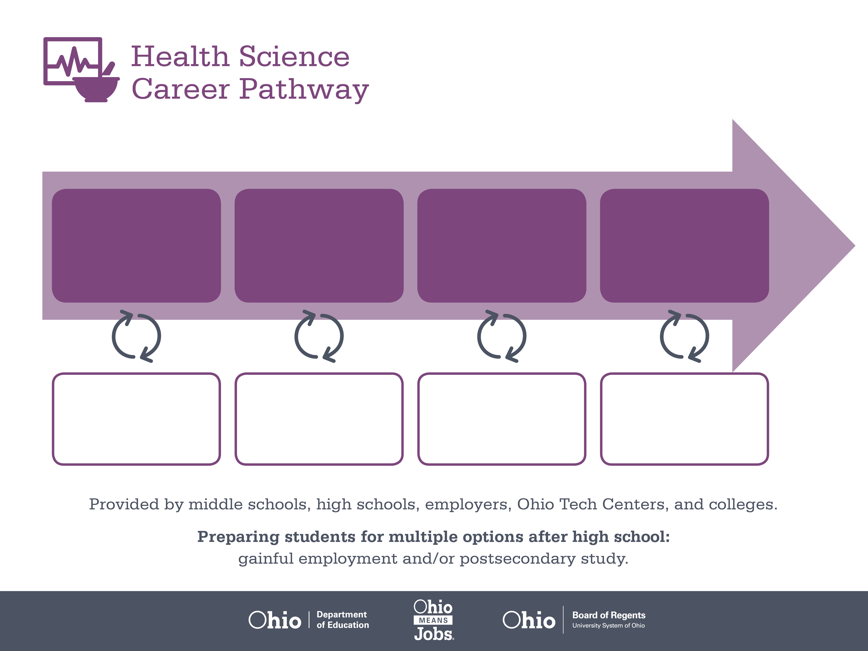
Certificate
Associate or Bachelor’s
Degree,
Radiologic Technology
Doctoral Degree,
Medicine
Start Pre-Health
As early as grade 7
(based on readiness)
Radiology Technician
Median Salary: $37,420
Job Growth (10 yr): 18.5%
Annual Openings: 264
Average Tuition (1 yr): $0 –$3,900/yr
Radiographer
Median Salary: $51,230
Job Growth (10 yr): 23.7%
Annual Openings: 399
Average Tuition (2 yrs): $3,900/yr
Average Tuition (4 yrs): $9,600/yr
Radiologist
Median Salary: $206,190
Job Growth (10 yr): 15.8%
Annual Openings: 571
Average Tuition (4 yrs): $35,000/yr
Workplace Visits
Job Shadow
Internship
Work
Supervised Experience
---
Work
Supervised Experience
Internship
---
Work
Internship
---
Work
Ohio In-demand Occupations
Data reflects 2014 Ohio labor statistics and public institutions of higher education for 2013-2014. For specific tuition costs, visit ohiohighered.org.

Slide 2

Secondary Pathway: Allied Health and Nursing |  |  |  | Postsecondary Program: Radiology
An Example of Courses with Secondary and Postsecondary Credits
Secondary | 7 8 | English I | Algebra I | Physical Science | Social Studies | Fine Arts | Health Science & Technology
 | 9 10 | English II | Geometry | Biology | World History | Health (.5) PE (.5) | Principles of Allied Health | World Languages
 | 11 | English III | Algebra II | Chemistry | U.S. History | Medical Terminology | Human Patho-physiology | World Languages
 | 12 | English IV | Trigonometry/ Calculus | Anatomy & Physiology | U.S. Government | Clinical Laboratory Techniques | Patient Centered Care & Diagnostics
Postsecondary | Year 1 1st Semester | English Composition I | Human Anatomy & Physiology I | Medical Terminology | Imaging Science I | Radiologic Procedures I | Clinical Practicum
 | Year 1 2nd Semester | English Composition II | Algebra | Human Anatomy & Physiology II | Imaging Science II | Radiologic Procedures II | Clinical Practicum
 | Year 2 1st Semester | Speech | Legal Aspects of Healthcare | Imaging Science III | Radiologic Procedures III | Clinical Practicum
 | Year 2 2nd Semester | Humanities Elective | Sociology | Imaging Science IV | Radiologic Procedures IV | Clinical Practicum
 |  | High School Career-Technical Education Program Courses
 |  | High School Courses for Postsecondary Credit (Including Apprenticeship Hours) and the Corresponding Postsecondary Courses
 |  | Required Courses
 |  | Recommended Electives
Visit education.ohio.gov/CareerConnections for reference information.
Course titles and sequences will vary between schools.
6/2015

