Slide 1
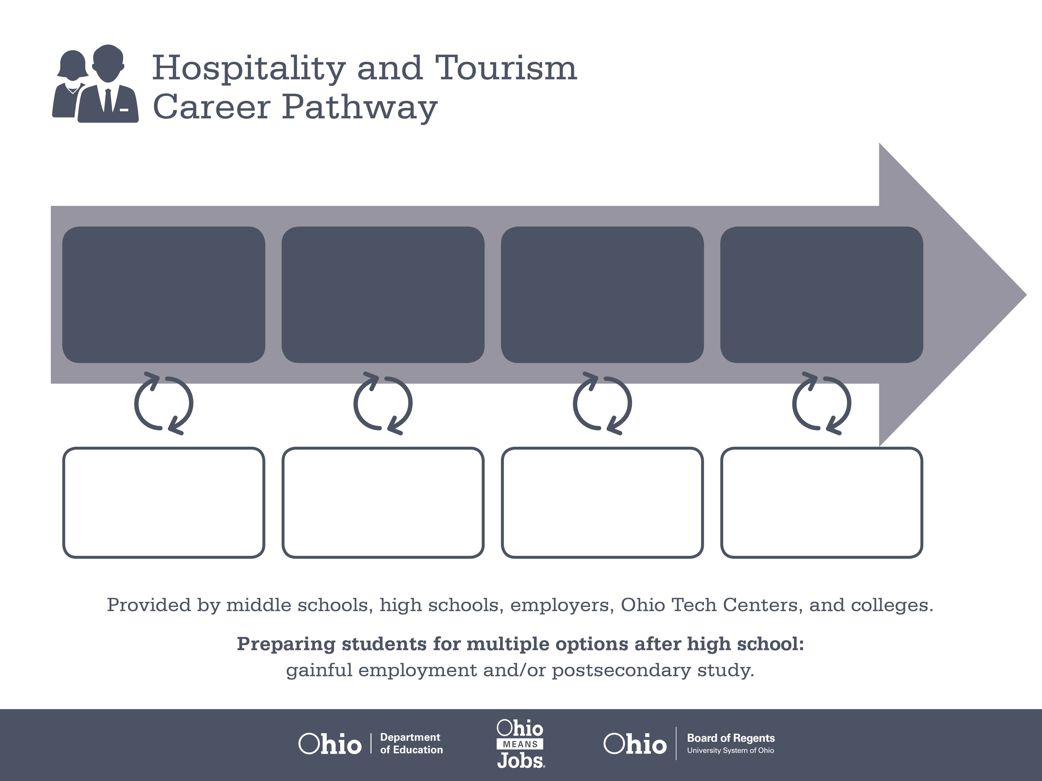
Certificate,
ServSafe
Associate Degree,
Restaurant Management
Associate Degree,
Culinary Arts
Start Pre-Hospitality
As early as grade 7
(based on readiness)
Food Preparation Worker
Median Salary: $20,945
Job Growth (10 yr): 6.1%
Annual Openings: 1,031
Average Tuition (1 yr): $0 –$3,900/yr
Restaurant Supervisor
Median Salary: $28,290
Job Growth (10 yr): 13%
Annual Openings: 1,332
Average Tuition (2 yrs): $3,900/yr
Chef
Median Salary: $39,950
Job Growth (10 yr): -1.9%
Annual Openings: 48
Average Tuition (2 yrs): $3,900/yr
Workplace Visits
Job Shadow
Internship
Work
Supervised Experience
---
Work
Supervised Experience
Internship
---
Work
Internship
---
Work
Ohio In-demand Occupations
Data reflects 2014 Ohio labor statistics and public institutions of higher education for 2013-2014. For specific tuition costs, visit ohiohighered.org.

Slide 2

Secondary Pathway: Culinary Arts and Food Service Operations |  |  |  |  | Postsecondary Program: Culinary Arts
An Example of Courses with Secondary and Postsecondary Credits
Secondary | 7 8 | English I | Algebra I | Physical Science |  | Social Studies | Fine Arts
 | 9 10 | English II | Geometry | Biology |  | World History | Health (.5) PE (.5) | Introduction to Hospitality & Tourism | World Languages
 | 11 | English III | Algebra II | Chemistry |  | U.S. History | Intro to Hospitality/ ServSafe | Nutrition & Wellness | World Languages
 | 12 | English IV | Trigonometry/ Calculus | Physics |  | U.S. Government | Quantity Food Preparation | Hospitality Capstone
Postsecondary | Year 1 1st Semester | English I | Basic Nutrition | Dining Room & Beverage Management |  | Mixology | College Seminar
 | Year 1 2nd Semester | English II | College Math | Computer Applications |  | American Regional Cuisine | Menu Development | Risk Mgmt. in Hospitality Industry | Hospitality Elective
 | Year 2 1st Semester | Business Communication | Career & Professional Development | Healthy Cooking Techniques |  | Essentials of Supervision | Garde Manger | International Cuisine | Arts & Humanities Elective
 | Year 2 2nd Semester | Social Diversity | Purchasing & Cost Controls | Hospitality Facilities Design |  | Catering & Banquet Operations | Hospitality Elective | Culinary Arts Co-Op
 |  | High School Career-Technical Education Program Courses
 |  | High School Courses for Postsecondary Credit (Including Apprenticeship Hours) and the Corresponding Postsecondary Courses
 |  | Required Courses
 |  | Recommended Electives
Visit education.ohio.gov/CareerConnections for reference information.
Course titles and sequences will vary between schools.
11/2014

