Slide 1
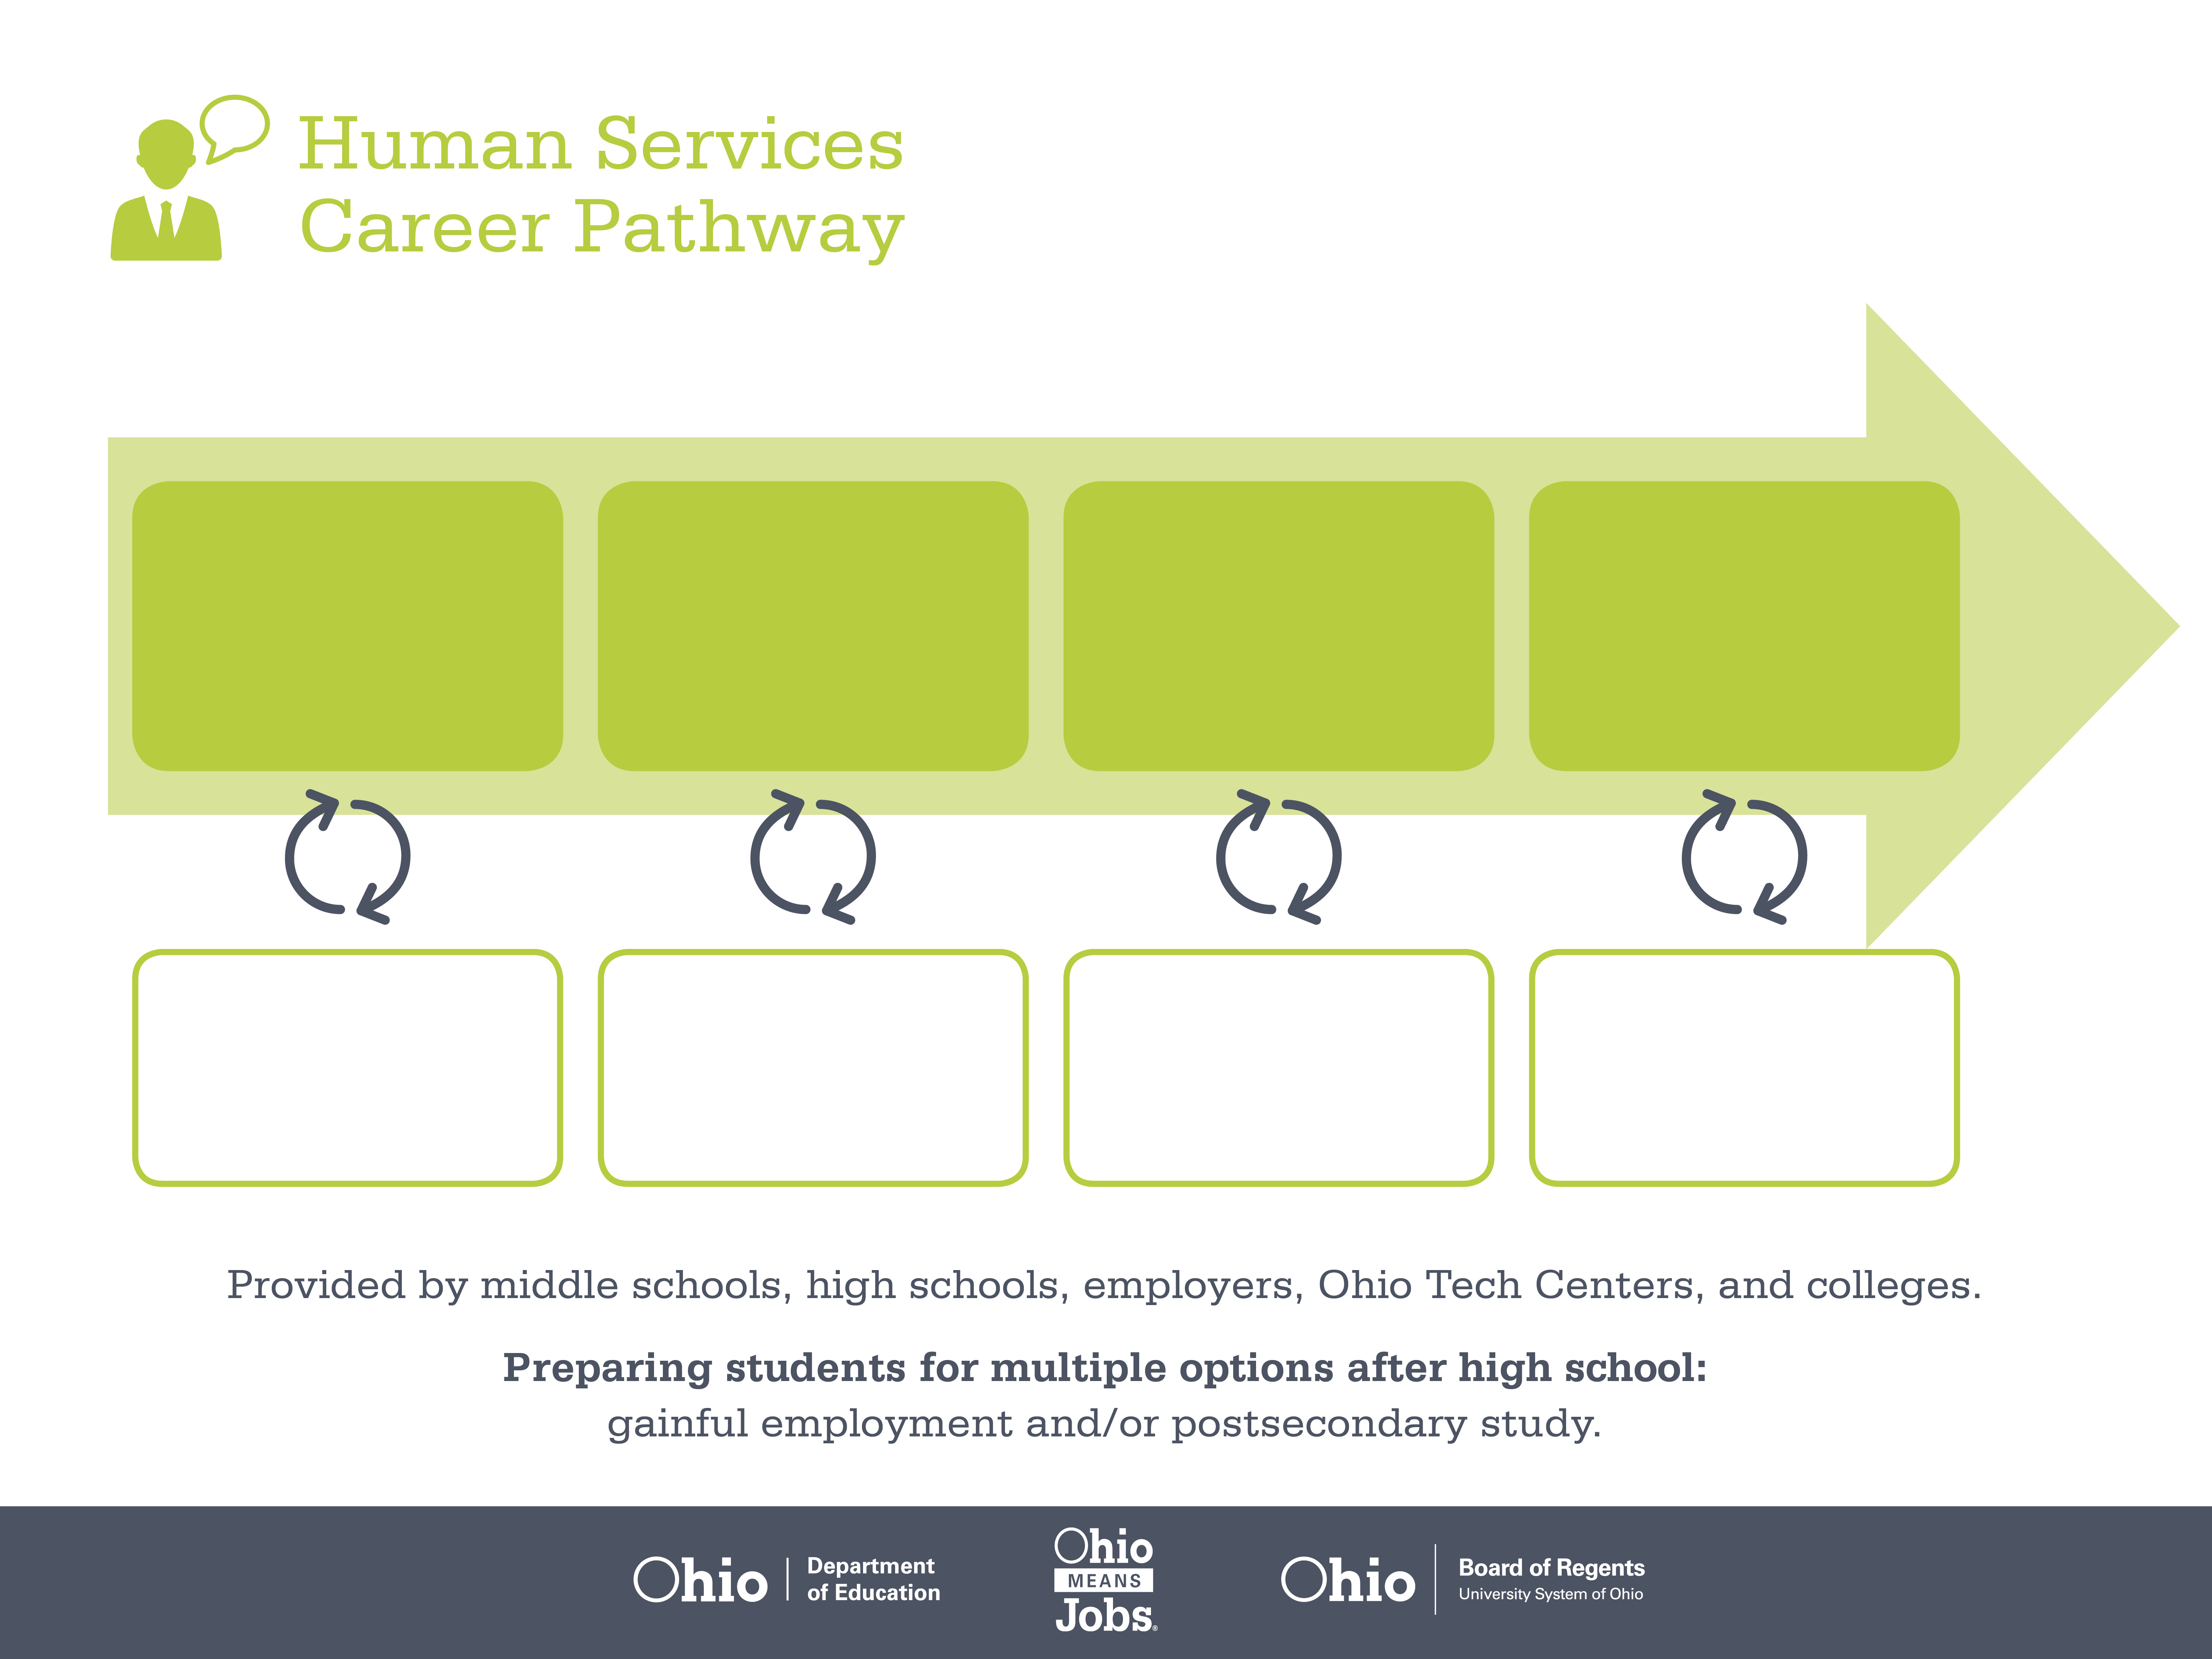
Certificate
Bachelor’s Degree,
Social Work
Master’s Degree,
Mental Health
Counseling
Start Pre-Human Services
As early as grade 7
(based on readiness)
Social Services Assistant
Median Salary: $27,450
Job Growth (10 yr): 15.7%
Annual Openings: 456
Average Tuition (1 yr): $0 –$3,900/yr
Mental Health Social Worker
Median Salary: $35,630
Job Growth (10 yr): 23.2%
Annual Openings: 326
Average Tuition (4 yrs): $9,600/yr
Mental Health Counselor
Median Salary: $42,690
Job Growth (10 yr): 28.7%
Annual Openings: 199
Average Tuition (2 yrs): $11,300/yr
Workplace Visits
Job Shadow
Internship
Work
Supervised Experience
---
Work
Supervised Experience
Internship
---
Work
Internship
---
Work
Ohio In-demand Occupations
Data reflects 2014 Ohio labor statistics and public institutions of higher education for 2013-2014. For specific tuition costs, visit ohiohighered.org.

Slide 2

Secondary Pathway: Human Services |  |  |  |  | Postsecondary Program: Human and Social Services
An Example of Courses with Secondary and Postsecondary Credits
Secondary | 7 8 | English I | Algebra I | Physical Science |  | Social Studies | Fine Arts | Introduction to Human Services
 | 9 10 | English II | Geometry | Biology |  | World History | Health (.5) PE (.5) | Health Science & Technology | World Languages
 | 11 | English III | Algebra II | Chemistry |  | U.S. History | Psychology | Nutrition & Wellness | World Languages
 | 12 | English IV | Trigonometry/ Calculus | Anatomy & Physiology |  | U.S. Government | Medical Terminology | Mental Health
Postsecondary | Year 1 1st Semester | English Composition I | Principles of Social Work | Psychology I |  | Chemical Dependency I | Direct Practice Skills
 | Year 1 2nd Semester | English Composition II | Sociology | Developmental Psychology |  | Case Management | Group Practice Skills | Social Welfare and Policy
 | Year 2 1st Semester | Fundamentals of Communication | College Algebra | Family Systems |  | Introduction to Ethics | Human Services Practicum I
 | Year 2 2nd Semester | Abnormal Psychology | Anatomy & Physiology | Chemical Dependency II |  | Human Services Practicum II | Human Services Capstone
 |  | High School Career-Technical Education Program Courses
 |  | High School Courses for Postsecondary Credit (Including Apprenticeship Hours) and the Corresponding Postsecondary Courses
 |  | Required Courses
 |  | Recommended Electives
Visit education.ohio.gov/CareerConnections for reference information.
Course titles and sequences will vary between schools.
4/2015

