Slide 1
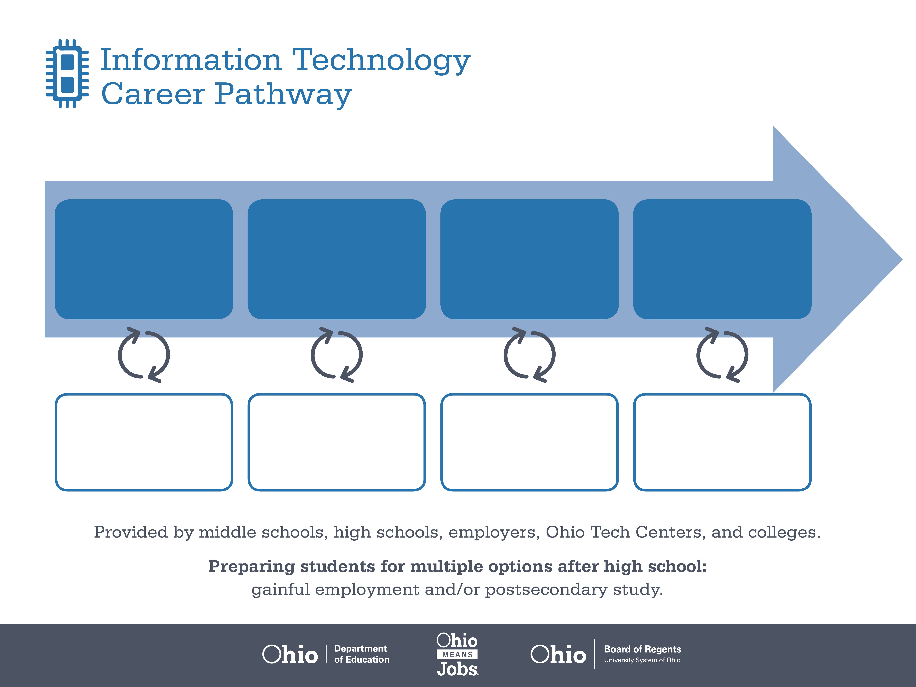
Certificate
Associate Degree,
Systems Analysis
Bachelor’s Degree,
IT Project Management
Start Pre-IT
As early as grade 7
(based on readiness)
Web Developer
Median Salary: $54,230
Job Growth (10 yr): 15.7%
Annual Openings: 313
Average Tuition (1 yr): $0 –$3,900/yr
Computer Systems Analyst
Median Salary: $76,210
Job Growth (10 yr): 21.5%
Annual Openings: 1,035
Average Tuition (2 yrs): $3,900/yr
IT Project Manager
Median Salary: $80,030
Job Growth (10 yr): 1.7%
Annual Openings: 186
Average Tuition (4 yrs): $9,600/yr
Workplace Visits
Job Shadow
Internship
Work
Supervised Experience
---
Work
Supervised Experience
Internship
---
Work
Internship
---
Work
Ohio In-demand Occupations
Data reflects 2014 Ohio labor statistics and public institutions of higher education for 2013-2014. For specific tuition costs, visit ohiohighered.org.

Slide 2

Secondary Pathway: Interactive Media |  |  |  | Postsecondary Program: Interactive Media
An Example of Courses with Secondary and Postsecondary Credits
Secondary | 7 8 | English I | Algebra I |  | Physical Science | Social Studies | Fine Arts | Information Technology | Web Design
 | 9 10 | English II | Geometry |  | Biology | World History | Health (.5) PE (.5) | Design Techniques | Interactive Application Development | World Languages
 | 11 | English III | Algebra II |  | Chemistry | U.S. History | 3D Techniques | World Languages
 | 12 | English IV | Trigonometry/ Calculus |  | Physics | U.S. Government | Video & Sound | IT Capstone
Postsecondary | Year 1 1st Semester | English | College Seminar |  | Biology | Principles of Interactive Design | Video and Sound Basics | Intro to Computer Design | HTML
 | Year 1 2nd Semester | Visual Communication | Storyboarding |  | Audio Production I | Branding | CSS | Media Graphics & Optimization | Intro to Humanities
 | Year 2 1st Semester | Flash I and II | Intro to Sociology |  | Audio Production II | JavaScript Fundamentals | Content Management & Integration | Statistics
 | Year 2 2nd Semester | Advanced Flash III | Interactive Portfolio |  | Web Design Creation | Interactive Media Practicum | Creation-Encore
 |  | High School Career-Technical Education Program Courses
 |  | High School Courses for Postsecondary Credit (Including Apprenticeship Hours) and the Corresponding Postsecondary Courses
 |  | Required Courses
 |  | Recommended Electives
Visit education.ohio.gov/CareerConnections for reference information.
Course titles and sequences will vary between schools.
07/2015

