Slide 1
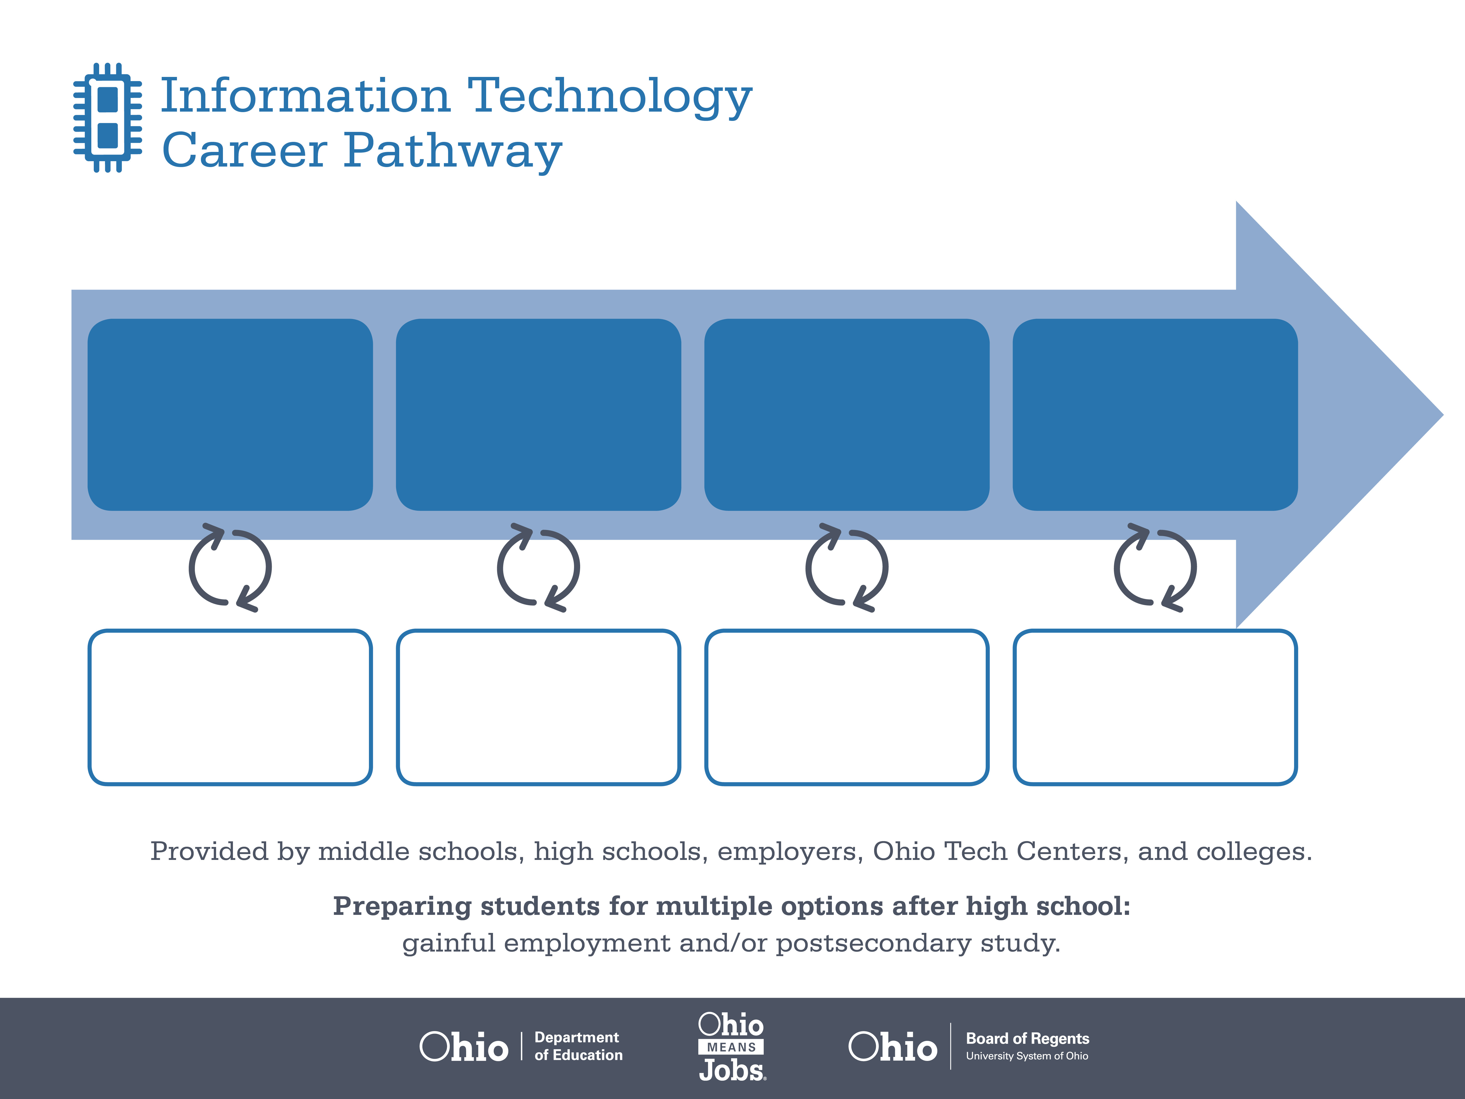
Certificate
Bachelor’s Degree,
Computer Science
Master’s Degree,
Computer Engineering
Start Pre-IT
As early as grade 7
(based on readiness)
Computer Programmer
Median Salary: $66,510
Job Growth (10 yr): 4.8%
Annual Openings: 280
Average Tuition (1 yr): $0 –$3,900/yr
Software Developer, Applications
Median Salary: $80,010
Job Growth (10 yr): 24.6%
Annual Openings: 768
Average Tuition (2 yrs): $3,900/yr
Software Developer, Systems Software
Median Salary: $82,140
Job Growth (10 yr): 28.8%
Annual Openings: 246
Average Tuition (4 yrs): $9,600/yr
Workplace Visits
Job Shadow
Internship
Work
Supervised Experience
---
Work
Supervised Experience
Internship
---
Work
Internship
---
Work
Ohio In-demand Occupations
Data reflects 2014 Ohio labor statistics and public institutions of higher education for 2013-2014. For specific tuition costs, visit ohiohighered.org.

Slide 2

Secondary Pathway: Programming and Software Development |  |  |  |  | Postsecondary Program: Programming and Software Development
An Example of Courses with Secondary and Postsecondary Credits
Secondary | 7 8 | English I | Algebra I | Physical Science |  | Social Studies | Fine Arts | Information Technology | Programming
 | 9 10 | English II | Geometry | Biology |  | World History | Health (.5) PE (.5) | Object Oriented Programming | Visual Programming | World Languages
 | 11 | English III | Algebra II | Chemistry |  | U.S. History | Systems Analysis & Design | World Languages
 | 12 | English IV | Trigonometry/ Calculus | Physics |  | U.S. Government | Database Applications Development
Postsecondary | Year 1 1st Semester | English | College Seminar | Intro to Business |  | Computer Applications | Computer Programming | Operating Systems & Security
 | Year 1 2nd Semester | Technical Writing | Math for Information Technology | Internet Programming I |  | Database | Advanced C++
 | Year 2 1st Semester | College Algebra | Visual Basic I | Internet Programming II |  | Systems Analysis & Design | Natural Science Elective
 | Year 2 2nd Semester | Communication | Visual Basic II | Java Programming |  | Arts & Humanities Elective | Social Science Elective | IT Capstone
 |  | High School Career-Technical Education Program Courses
 |  | High School Courses for Postsecondary Credit (Including Apprenticeship Hours) and the Corresponding Postsecondary Courses
 |  | Required Courses
 |  | Recommended Electives
Visit education.ohio.gov/CareerConnections for reference information.
Course titles and sequences will vary between schools.
11/2014

