Slide 1
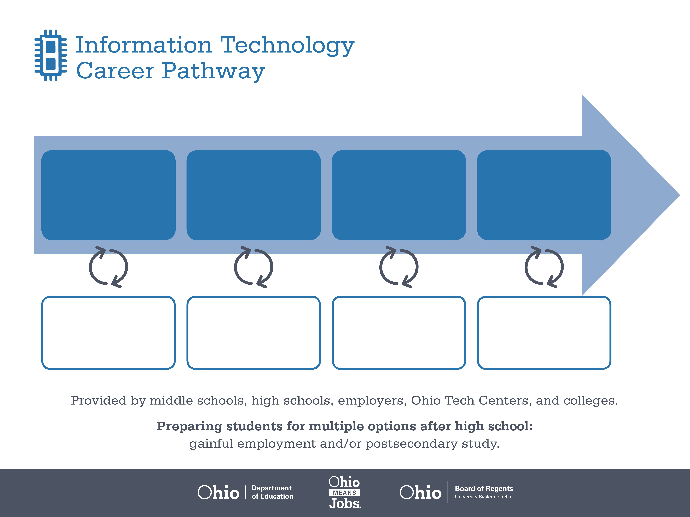
Certificate,
IC3, CompTIA A+
Bachelor’s Degree,
IT Project Management
Master’s Degree,
Management
Information Systems
Start Pre-IT
As early as grade 7
(based on readiness)
Computer User Support Specialist
Median Salary: $42,750
Job Growth (10 yr): 13.4%
Annual Openings: 949
Average Tuition (1 yr): $0 –$3,900/yr
IT Project Manager
Median Salary: $80,030
Job Growth (10 yr): 1.7%
Annual Openings: 186
Average Tuition (4 yrs): $9,600/yr
Information Systems Manager
Median Salary: $109,560
Job Growth (10 yr): 14.6%
Annual Openings: 323
Average Tuition (4 yrs): $11,300/yr
Workplace Visits
Job Shadow
Internship
Work
Supervised Experience
---
Work
Supervised Experience
Internship
---
Work
Internship
---
Work
Ohio In-demand Occupations
Data reflects 2014 Ohio labor statistics and public institutions of higher education for 2013-2014. For specific tuition costs, visit ohiohighered.org.

Slide 2

Secondary Pathway: Information Services and Support |  |  |  |  | Postsecondary Program: Computer Science
An Example of Courses with Secondary and Postsecondary Credits
Secondary | 7 8 | English I | Algebra I | Physical Science |  | Social Studies | Fine Arts | Information Technology | Networking
 | 9 10 | English II | Geometry | Biology |  | World History | Health (.5) PE (.5) | Network Operating Systems | Network Management | World Languages
 | 11 | English III | Algebra II | Chemistry |  | U.S. History | Network Security | World Languages
 | 12 | English IV | Trigonometry/ Calculus | Physics |  | U.S. Government | Routing & Switching
Postsecondary | Year 1 1st Semester | English | College Algebra | College Seminar |  | Computer Applications | Programming Logic | Humanities Elective
 | Year 1 2nd Semester | Business Communication | Operating Systems | Networking Concepts |  | Object Oriented Analysis | Visual Basic I | HTML | Systems Analysis
 | Year 2 1st Semester | Financial Accounting | Micro-economics | Project Management |  | Technical Elective | Natural Science Elective
 | Year 2 2nd Semester | Marketing Principles | Database Systems Programming | IT in Logistics |  | Computer Science Seminar | Computer Science Practicum | Technical Elective
 |  | High School Career-Technical Education Program Courses
 |  | High School Courses for Postsecondary Credit (Including Apprenticeship Hours) and the Corresponding Postsecondary Courses
 |  | Required Courses
 |  | Recommended Electives
Visit education.ohio.gov/CareerConnections for reference information.
Course titles and sequences will vary between schools.
11/2014

